Slide 1
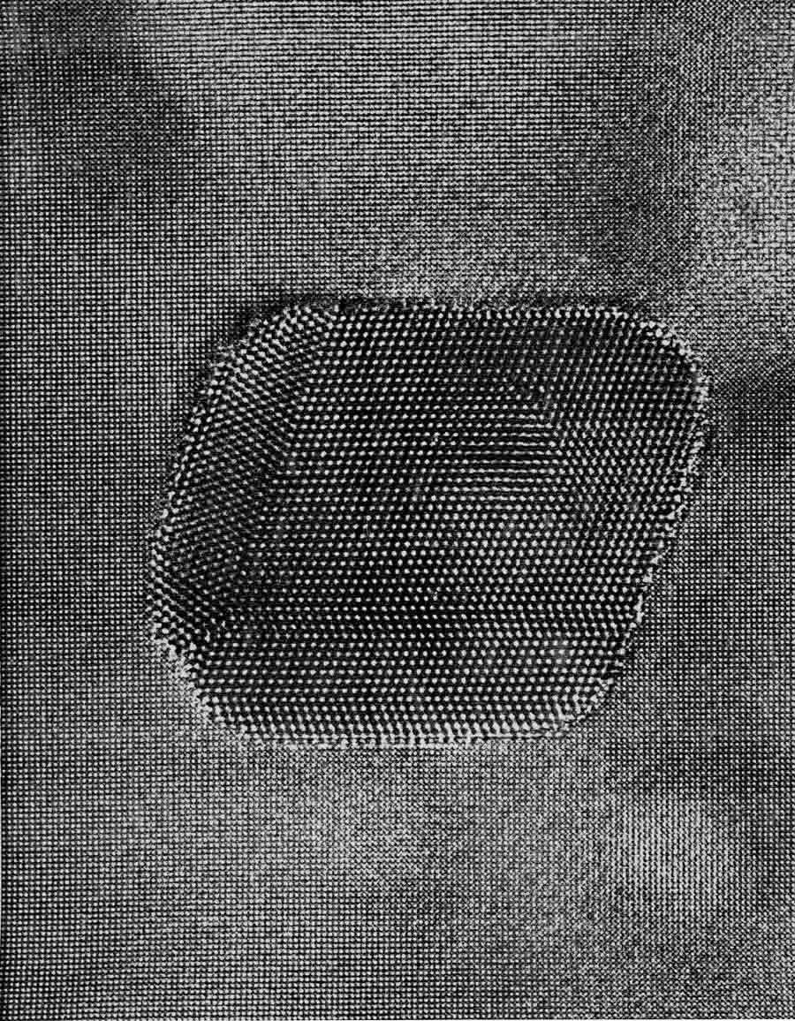
TEM, HREM & Thoughts
Image Curtesy Staf Van Tenderloo

Slide 2
Why HREM
In order to…
  Make your boss/advisor happy
  Obtain a pretty picture for publication
  Obtain local structural information
  Obtain precise structural information atomic column by atomic column
  Obtain some new science (and not reinvent)
  Follow the science, not the electron

Slide 3
Two fundamental modes
Low Resolution interpretation
Local periodicities
Defects such as twins etc
High Resolution interpretation
Local positions at defects etc with 0.1 Angstrom accuracy or better

Slide 4
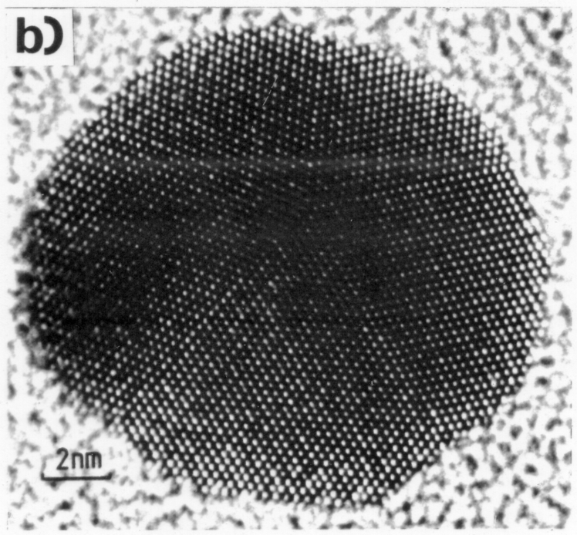
Examples
MTP (1983)
SrTiO₃ (001) (2015)
1nm
TiO₂ DL

Slide 5
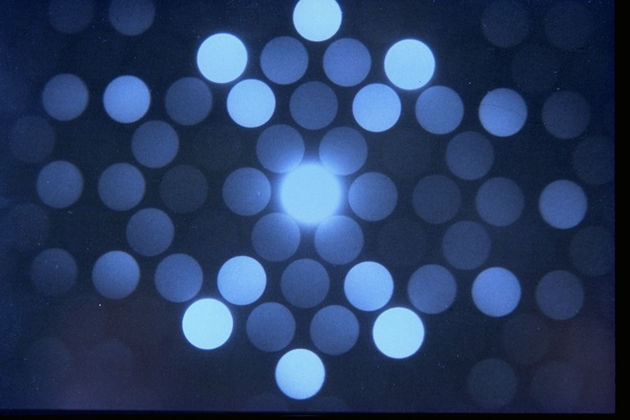

Slide 6
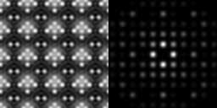
All Data

Slide 7
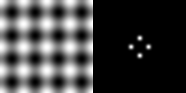
Low Resolution …

Slide 8

Higher resolution …

Slide 9

Higher resolution …

Slide 10

Higher resolution …

Slide 11
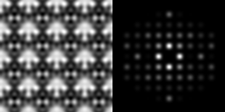
Higher resolution …

Slide 12
All Data

Slide 13
But…
Classic resolution limit is approximately the radiation wavelength
Electron wavelength is ~ 0.025 Angstroms
Best resolution to date is ~ 0.5 Angstroms, 20 time wavelength
Lens Aberrations

Slide 14
Aberrations
Microscopes without correctors have lenses about as good as a milk bottle
  Distortions
  Some spacings show but should not
  Some spacings should show but do not
  Information is often not where it should be

Slide 15

Defocus
Sample
Gaussian
focus
Focal Plane
$$∆z$$
Obj.
lens
Different distances = different phase

Slide 16
Spherical Aberration Cs
Sample
Gaussian
focus
Focal Plane
Obj.
lens
least
confusion

Slide 17
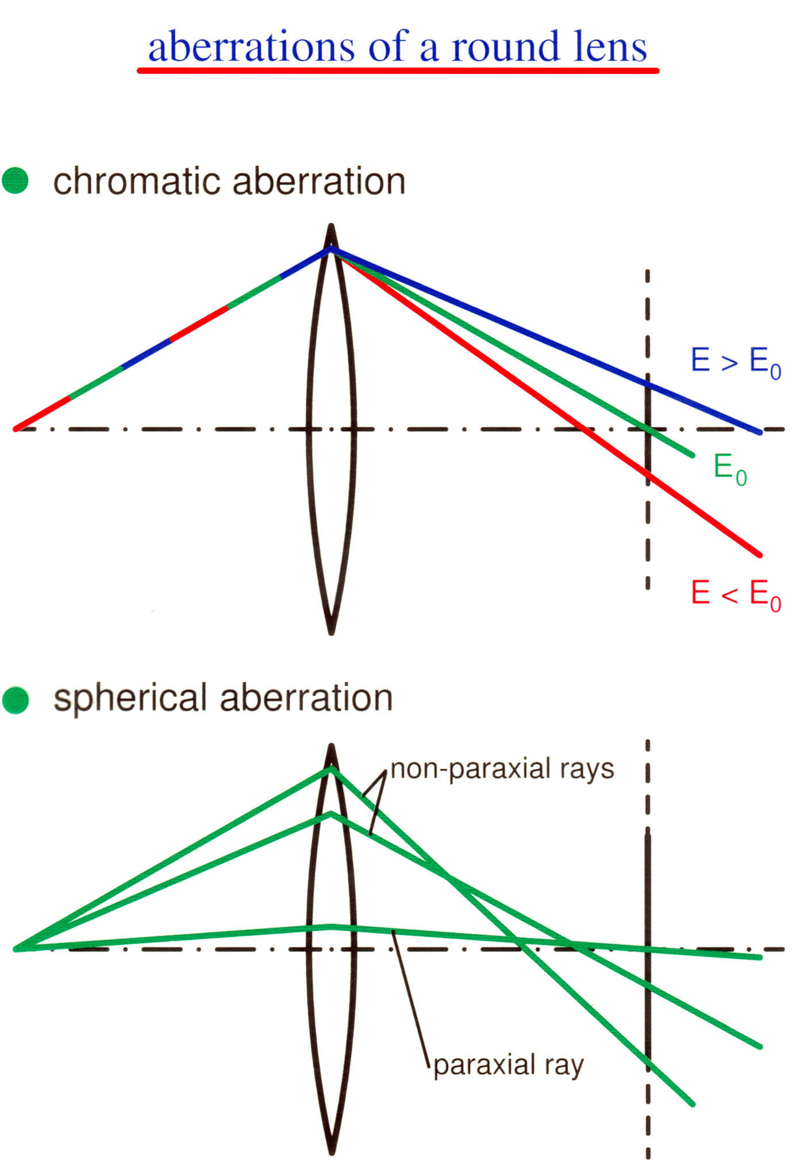
Chromatic Aberration
Disc of Least Confusion
Focal length of lens is dependent upon wavelength

Slide 18
Aberrations
Aberrations are a phase-shift in reciprocal space
Multiply by exp(-iχ(u))
Can expand as a Taylor series
χ(u) = A + Bu + Cu² + D|u.a|² + …
A,B don’t matter, C is defocus, D is astigmatism, Cs has u⁴
Image
Plane
χ(u)
Phase distance from surface of constant phase
u
Optic axis

Slide 19
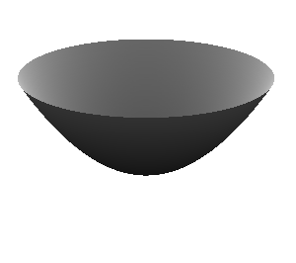
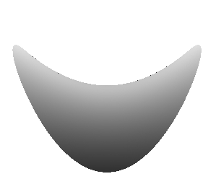
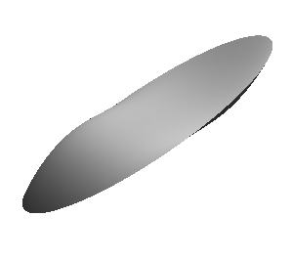
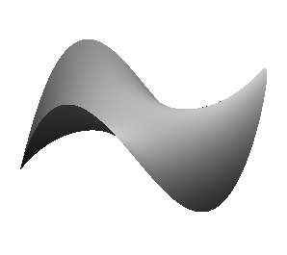
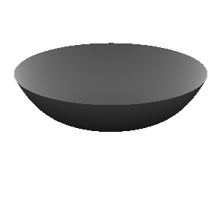
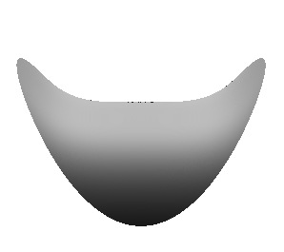
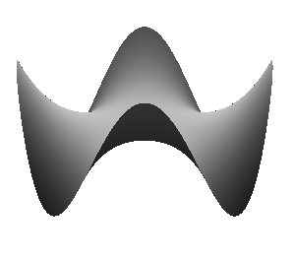
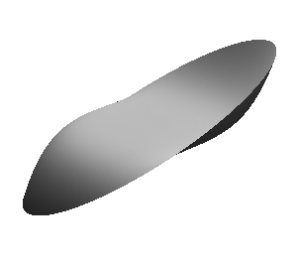
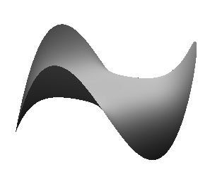
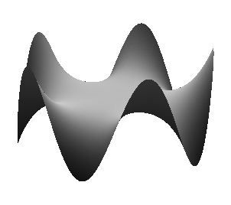
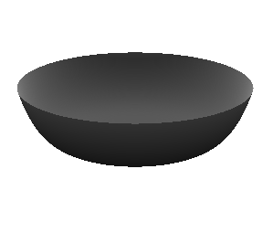
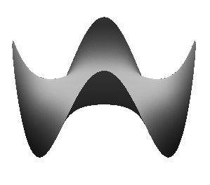
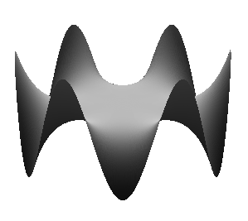
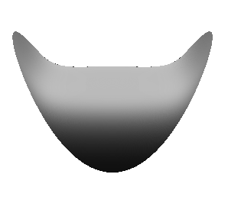

Aberrations
C_{1,0}
C_{1,2}
Surfaces of constant phase
C_{2,1}
C_{2,3}
C_{3,0}
C_{3,2}
C_{3,4}
C_{4,1}
C_{4,3}
C_{4,5}
C_{5,0}
C_{5,2}
C_{5,4}
C_{5,6}

Slide 20
More complete formalism
. If ψ(r) is the wave exiting the specimen, the imaging
process is
Fourier Phase Fourier
Transform Change Transform
ψ(r) --------------> Ψ(u) -----------> Ψ'(u) --------------> ψ'(r) -
Incoherent
Intensity Average
---------> |ψ'(r)|2 ---------> I(r), Final Image.

Slide 21
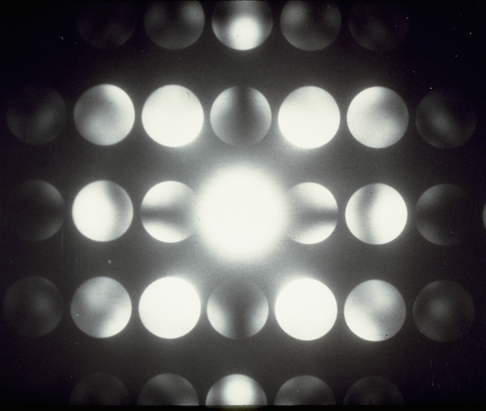
Linear & Non-Linear

Slide 22
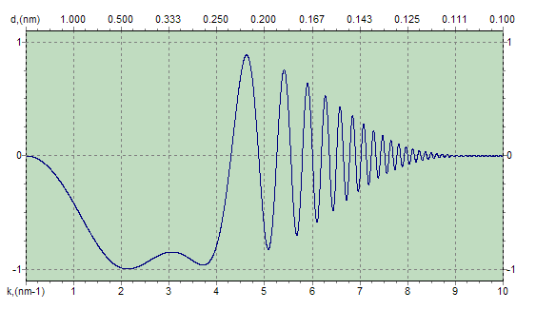
Linear Contrast Model
Linear: Thin sample
I(r) = ∫ cos(2πv.r) E(v,0)sin(χ(v)) dv
Non-linear: General solution
I(r) = ∫ exp(2πiv.r) P(v)dv
P(v) = <∫ Ψ*(u-v) Ψ(u) exp(-i χ(u) + i χ(u-v))du>
= ∫ Ψ*(u-v) Ψ(u) exp(-i χ(u) + i χ(u-v))E(u,u-v)du
E(u,u-v) = exp(-|∇χ(u)-∇χ(u-v)|2/4α)exp(-π2λ2(u2-|u-v|2)2/4ß)
Involves both a statistical average “<..>” and an Envelope Term,
typically a first-order approximation.

Slide 23
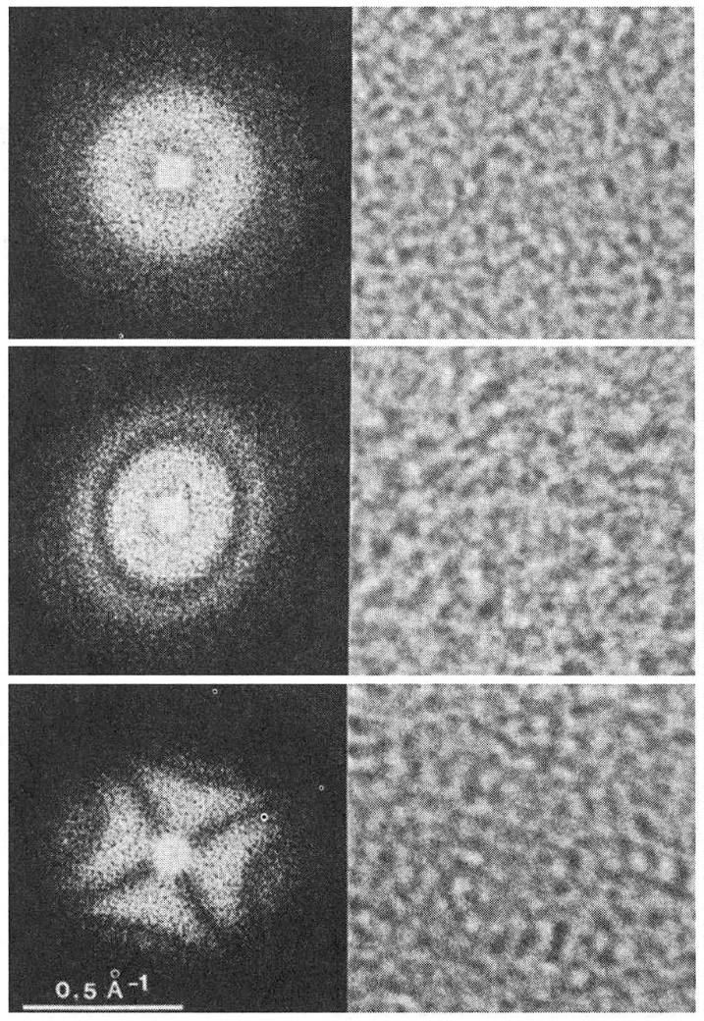
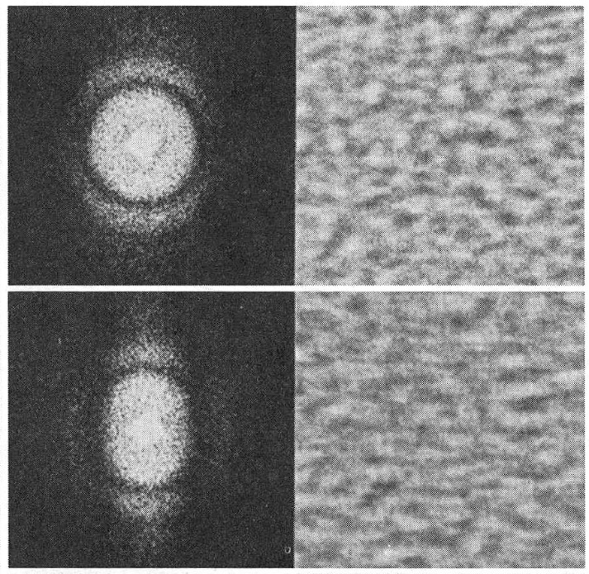
Astigmatism & Drift
Drift
Well aligned
Misaligned

Slide 24
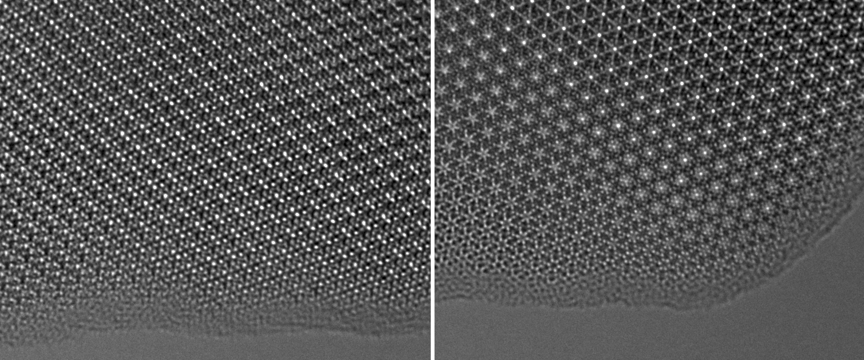
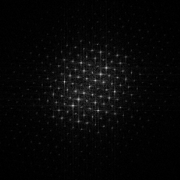
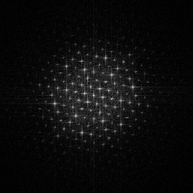
Effect of slight
beam tilt

Slide 25
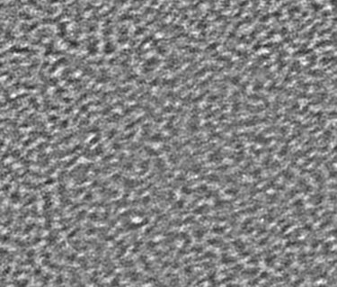
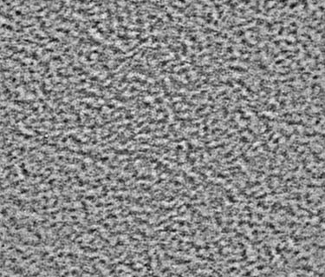
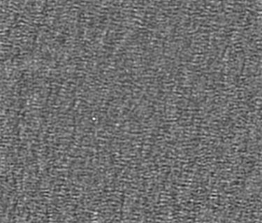
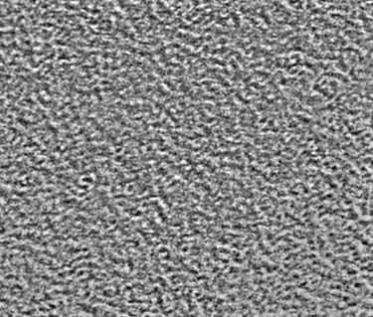
Coma-Free Alignment
Before
After
+α
+α
-α
-α

Slide 26
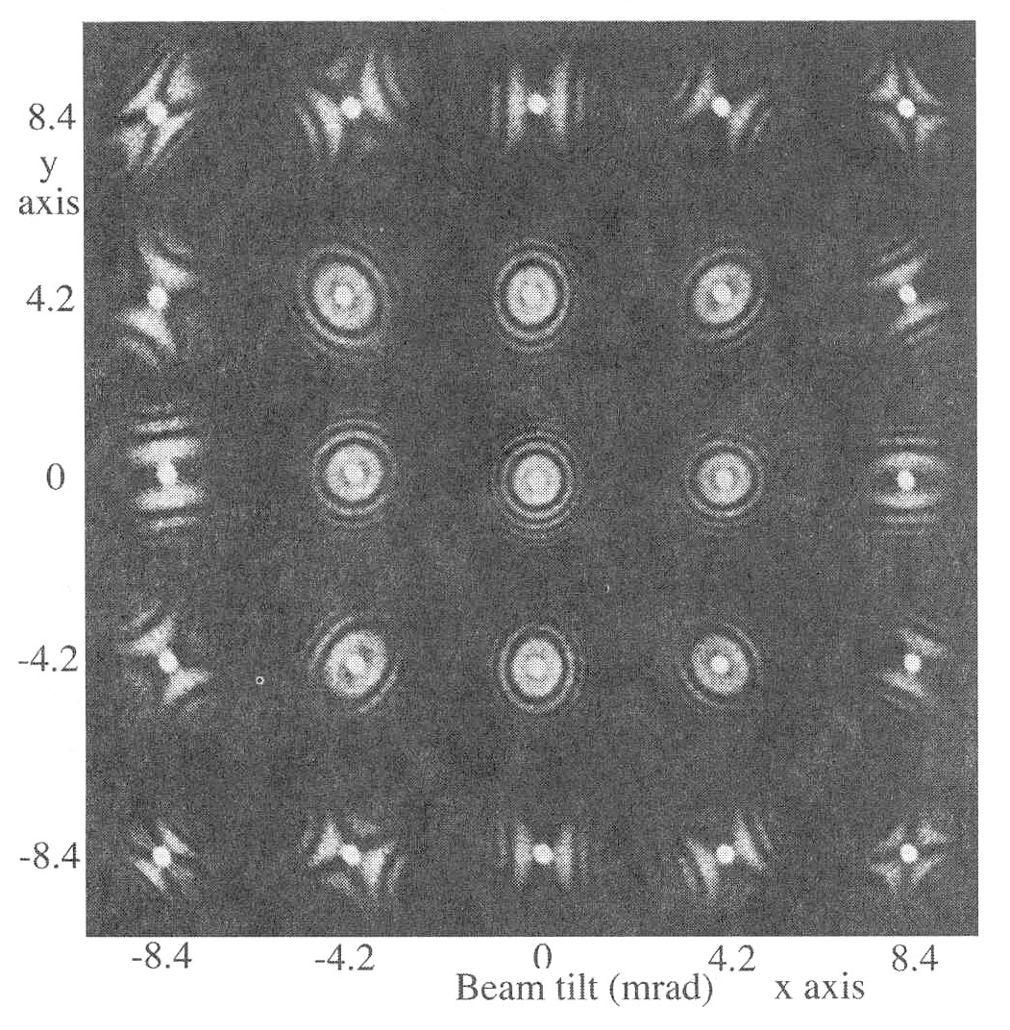
Beam Tilt
Diffractograms
(FFT patterns of amorphous regions)
Similar to the effect of astigmatism
Astigmatism correction may be required after the alignment of beam tilt.

Slide 27


Translation
Sample
Gaussian
focus
Focal Plane
Obj.
lens
least
confusion

Slide 28
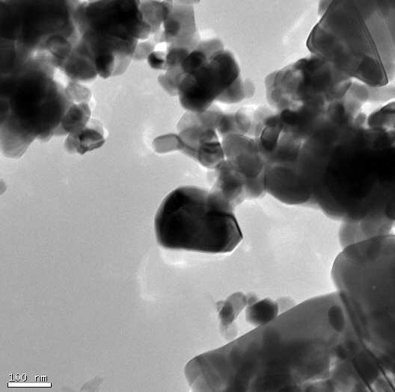
Ghost Image
C

Slide 29
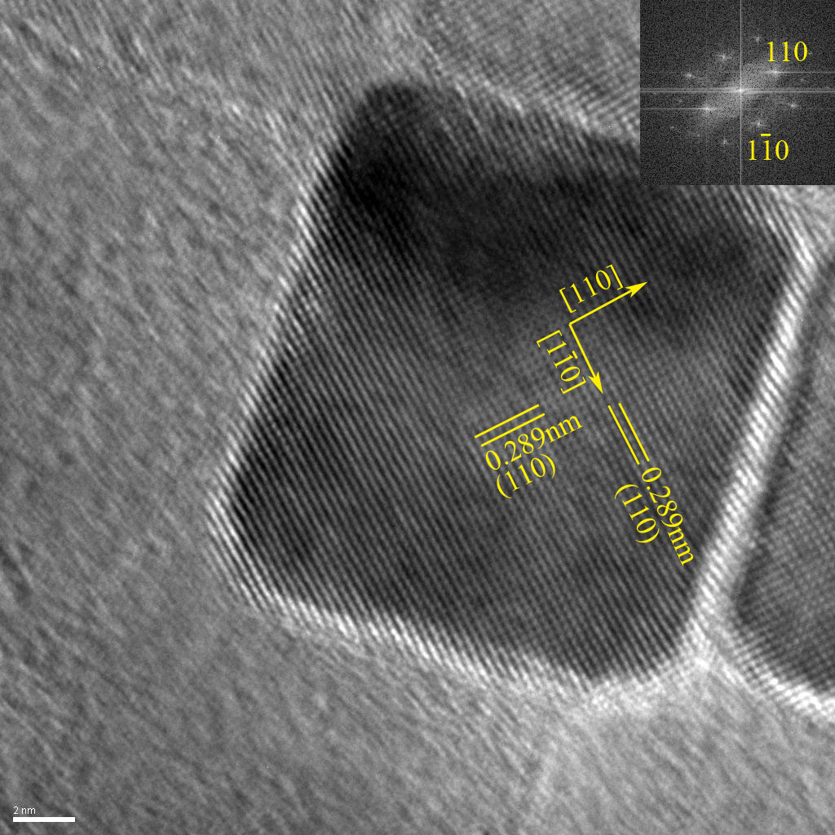

Slide 30
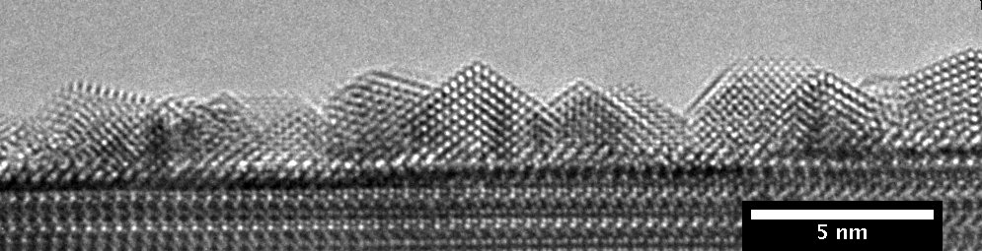
Au@NdScO₃
Unfriendly sample – large differences in depth of nanoparticles leads to different contrast

Slide 31
Direct Interpretation
Image Curtesy Van Tenderloo

Slide 32
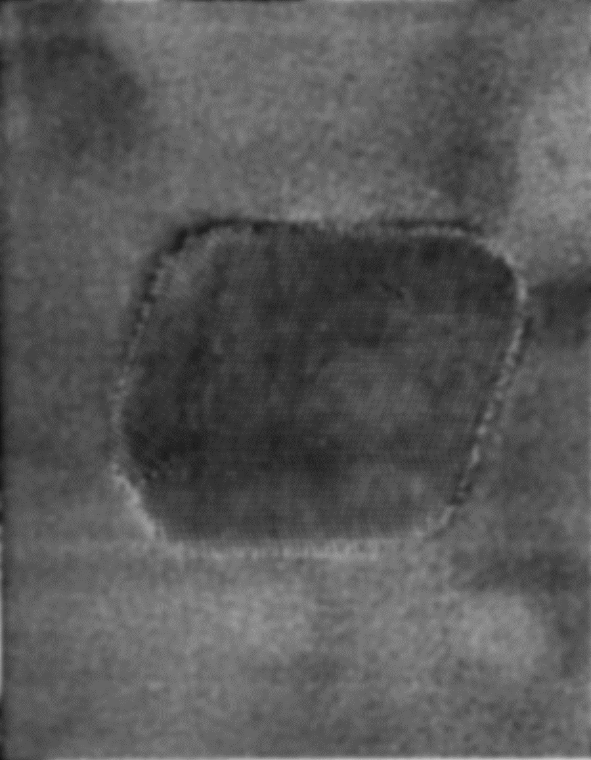
Direct Interpretation
Strain Contrast!
Image Curtesy Van Tenderloo

Slide 33
Caveats
Linear imaging is an approximation that is a guide only.
Kinematical is an approximation that is rarely good enough
Pseudo-Linear Imaging
Pseudo-Kinematical
Rigor Please!

Slide 34
Examples

Slide 35
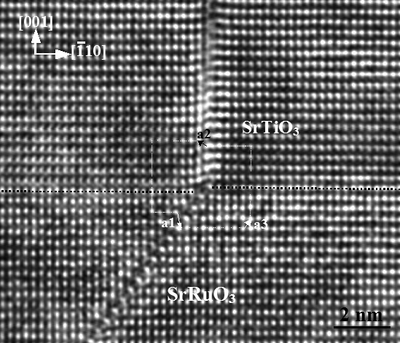
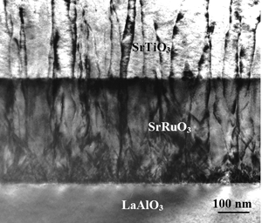
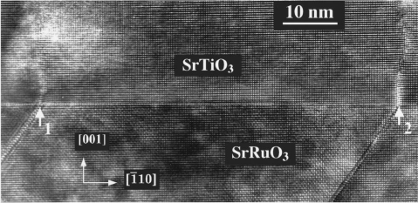
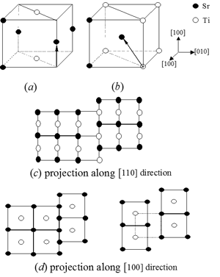
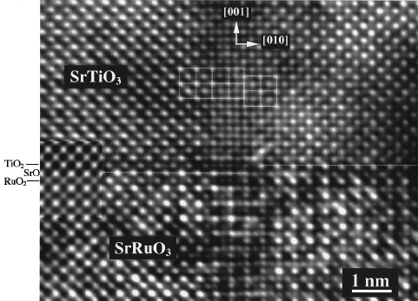
Interfaces
Columnar grain boundaries in SrTiO3 film are associated with {111} planar defects in the SrRuO₃ layer. Two atomic structural models of the antiphase boundaries in the (-110) plane, with a crystallographic shear vector R=a/2[001] (a) and R=a/2[-1-11] (b).
a/3[-112] → a/6[-221] + a/2[001]

Slide 36
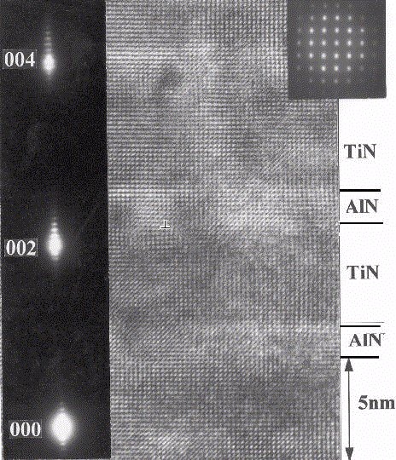

Slide 37
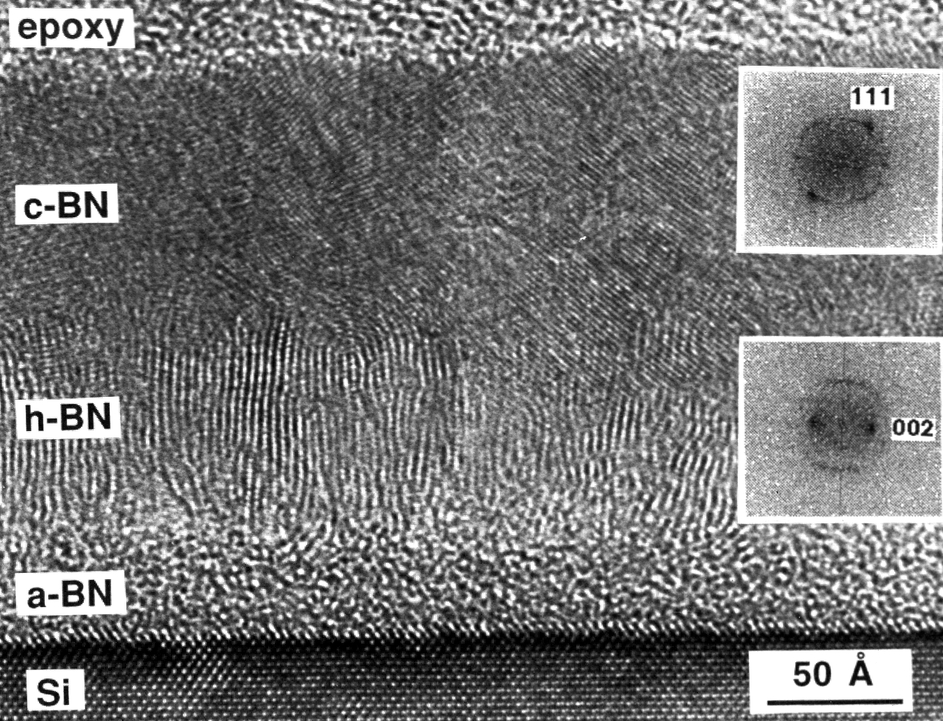

Slide 38
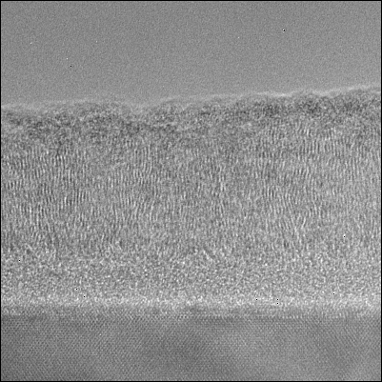
h-BN
a-BN
Si
30 Å

Slide 39
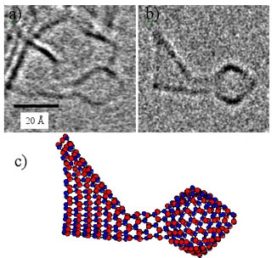

Slide 40
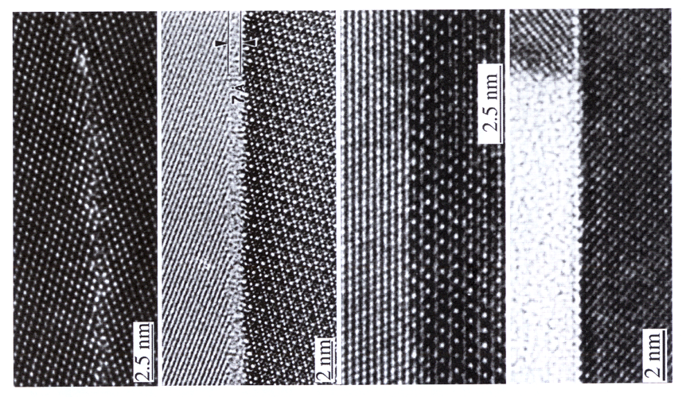

Slide 41
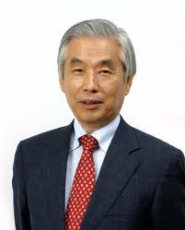
Structural Fluctuations (Iijima)
P. M. Ajayan, L. D. Marks,. 24-6, 229 (1990)

Slide 42
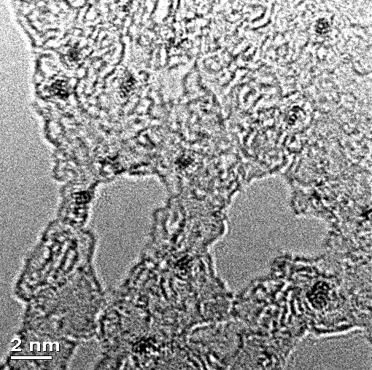
High-Resolution TEM: <1 nm
Uniformity in size (<1nm) and spatial distribution
High crystallinity evident from visible lattice fringes inside particles
Lattice spacing = 2.39 ± 0.07(Å)
Icosahedral shape based on trace analysis of particle edge
HREM image of Au₁₃(PPh₃)₄(SC12)₄
Huiping Xu, Ray Twesten

Slide 43
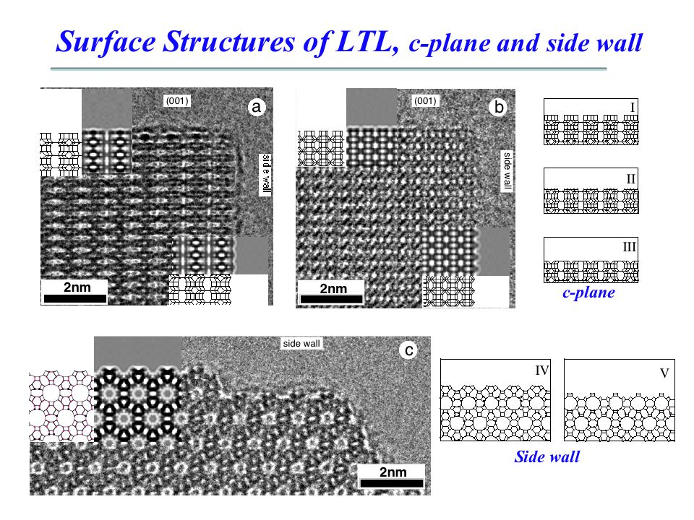

Slide 44





Nanoparticle surfaces?
PRL 111, 156101 (2013)
Oleic Acid Acetic Acid
1nm
1nm

Slide 45



SrTiO₃ (001) surface
[100]
[110]
Around 20 nm size
Surface is flat in projection
[001]
1nm
thickness increase
y
[110]
[110]
x

Slide 46


Profile Imaging: Fit Bulk
Area 2
Area 1
ACAT at ANL Bulk Fit

Slide 47



Different Surfaces
MacTempas
DFT positions (PBEsol) used in multislice
Can use DFT potentials as well

Slide 48
Nanoparticle surfaces
PRL 111, 156101 (2013)
Oleic Acid Acetic Acid
1nm
1nm
SrO surface
TiO₂ DL

Slide 49

Nanoparticle surfaces?
PRL 111, 156101 (2013)
To Bulk
1nm
SrO surface
Precision good enough – functional matters!

Slide 50

Microscopy Big Bang
Photon
Scanned photon
Electron
Scanned electron
Aberration –corrected electron
Other
Curtesy A. Howie

Slide 51

Spatial Resolution

Slide 52






TEAM Project: R. Erni, et al., Phys Rev Lett, 102 (2009) 96101
43 meV 40kV & 0.12nm
(Bell, 2010)
3 meV
(Krivenak, 2021)
Atomic imaging and EELS, R. Keile, UIC
The Big Bang
0.2nm SEM of a surface, J Ciston
3D atomic tomography of a dislocation C-C. Chen et al
Combined effect of light & H₂O, P. Crozier

Slide 53

Resolution Limiting Factors.
Incoherent Aberrations
( Source Size, Energy Spread,
HT stability, lens stability
Chromatic Aberration ).
Coherent Aberrations
(Objective lens
Spherical Aberration)
Detectors
(Phosphor coupled CCD)
(Monochromation,
Novel Sources, improved stabilities, C_{c} correction)
(Spherical Aberration Correctors)
(Direct Electron Detectors)

Slide 54
Aberrations
C_{1,0}
C_{1,2}
C_{2,1}
C_{2,3}
C_{3,0}
C_{3,2}
C_{3,4}
C_{4,1}
C_{4,3}
C_{4,5}
C_{5,0}
C_{5,2}
C_{5,4}
C_{5,6}

Slide 55
Basic concept
One cannot correct with a spherical lens, i.e. one with only even u terms
One can, however, generate –ve 4th order terms by breaking symmetry
  Use hexapoles, which introduce terms with 3-fold symmetry
  Octapoles, 4-fold symmetry
  Arrange to cancel out most of the 3-fold or 4-fold aberrations

Slide 56

Multipole Lenses

Slide 57
Correction of Spherical Aberration.
Image plane
Image plane
Object
plane
Objective
lens
Corrector
Need to have non-spherical elements

Slide 58
Practical Approach
Convert beam from radially symmetric to ellipsoidal (one direction), compensate C_{s} for this direction, switch by 90 degrees (or 60) and repeat

Slide 59


Corrector Optics.
Dr Peter Hartel, CEOS

Slide 60
Chromatic Aberration
Hexapole Wien corrector: Balance Lorentz (magnetic) and Electrostatic Force for some energy
Electrons of lower (higher) energy have a net deflection

Slide 61


Two early aberration correctors
Quadrupole-octupole corrector (~1975)
(grandfather to Nion’s corrector)
Sextupole - round lens - sextupole corr. (~1980)
(grandfather to CEOS’s corrector)
Neither corrector ever worked properly, most likely because parasitic aberrations were neither quantified nor accurately compensated.

Slide 62

Aberrations
Corrects all aberrations up to C5,0;
first strong aberrations are 7th order ones
corrected
(or minimized)
aberrations
C_{1,0}
C_{1,2}
C_{2,1}
C_{2,3}
C_{3,0}
C_{3,2}
C_{3,4}
C_{4,1}
C_{4,3}
C_{4,5}
C_{5,0}
C_{5,2}
C_{5,4}
C_{5,6}

Slide 63


Instrumentation – Mark 1 (JEOL 2200FS).

Slide 64


Instrumentation – Version 2 (JEOL 2200 MCO).

Slide 65
System Overview.
HT tank
P.S
CESCOR
CESCOR
EOS
Linux
CESCOR
CETCOR
LAN
CETCOR
P.S
CETCOR
FIBER
OPTIC
Video
flat cable
(LENS DEF)
CCD
Cross cable
ARC NET
VME
GATAN camera PS
Hamamatsu
Control
FIBER OPTIC
HUB
TEM PC
JEOL TEMCON
TEM Server
JEOL Ext
Screen Monitor
LAN
CAMERA PC
CEOS Viewer
Gatan
JEOL Ext
Microscope handler
LAN
STEM PC
JEOL ASID
EDS PC
LAN
LAN
IEEE 1394
DigiScan
IEEE1394
LAN

Slide 66



DP12
QP
HP
HP 1
HP 2
DP11
TL22
IShift
DP21
Objective
Dshift
QP
TL21
DP22
TL11
TL12
DPHP1
DPHP2
ADL
2nd Order correction (off, on axis)
- Anisotropic coma
Cs correction
Image and diffraction plane
alignment
Hexapole centering
Image shift
B2 correction,
Beam centering
B2 correction,
Beam centering
A1, A2 correction
Diffraction shift
A1 diffraction plane correction

Slide 67

NU ARM

Slide 68

Sawada, H. et al. Experimental
evaluation of a spherical aberration corrected TEM and STEM, Journal of
Electron Microscopy, 2005, 52, 2, 120,

Slide 69

C_{s} correction

Slide 70

TEM of Graphene at 80 kV

Slide 71






Aberration Correction in JEM-2200FS
Ronchigram
Simulated probe
HAADF-STEM image
Si(110)
Hexapole off
Conventional
Ip = 10 pA
0.16 nm(HM)
0.76 nm(TM)
11 mrad
1 nm
Hexapole on
Cs-corrected
Ip = 50 pA
0.12 nm(HM)
0.35 nm(TM)
25 mrad
34 mrad
1 nm

Slide 72








Si(112) 78 pm dumbbell image
FFT
Intensity profile
444(78pm)
624(72pm)
Histogram
713(70pm)
804(60pm)
Intensity profile from FFT spot

Slide 73

30 kV
Experimental and calculated Cc/Cs-corrected 30-kV HRTEM images of graphene (A) and MoS2 (B). The diffractograms (A1 and B1) of the experimental raw images of graphene (A2) and MoS2 (B2) in bright-atom contrast (field of view 40×40 nm2) indicate the achieved resolution. The magnified images (A3 and B3) directly allow for identifying the atomic structure. The averaged experimental images (A4 and B4) show a strong signal-to-noise improvement and are in good agreement with the simulated images (A5 and B5) as visible in the corresponding line profiles (A6 and B6). The scale bars in A5 and B5 correspond to 0.5 nm.
Chromatic Aberration Correction for Atomic Resolution TEM Imaging from 20 to 80 kV
Linck et al, Phys. Rev. Lett. 117, 076101, 2016

Slide 74
Beware!
All you get with advanced instruments is easier/quicker alignment and better signal/images
Many people sell the advantages of their instrument/technique (42, Douglas Adams)
It is easier for a novice to get a “good” image, but that does not make it correct or representative
There is no “dynamical diffraction” corrector
Nothing will correct for a bad sample
Nothing will correct for a bad interpretation

