Slide 1
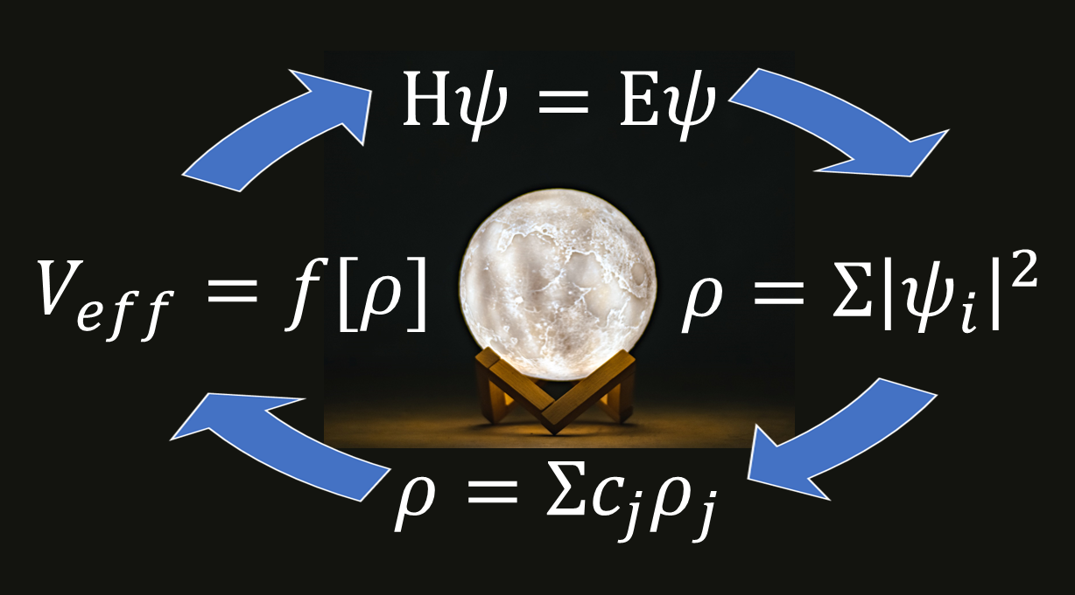
Predictive DFT Mixing: Successes and Opportunities
Laurie Marks
Department of Materials Sci & Eng
Northwestern University

Slide 2
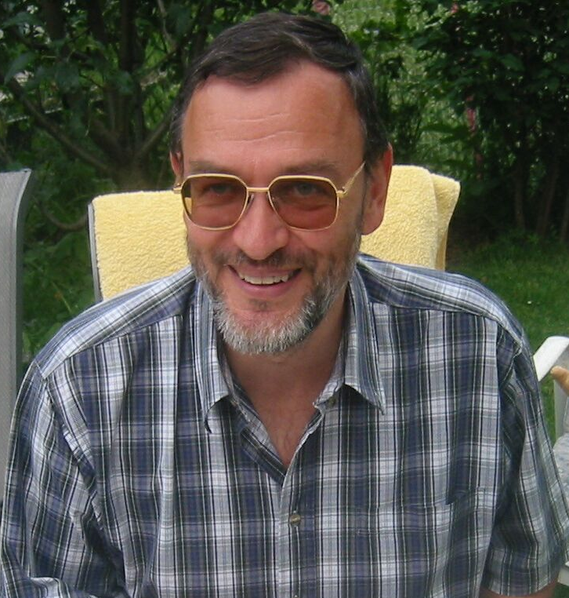
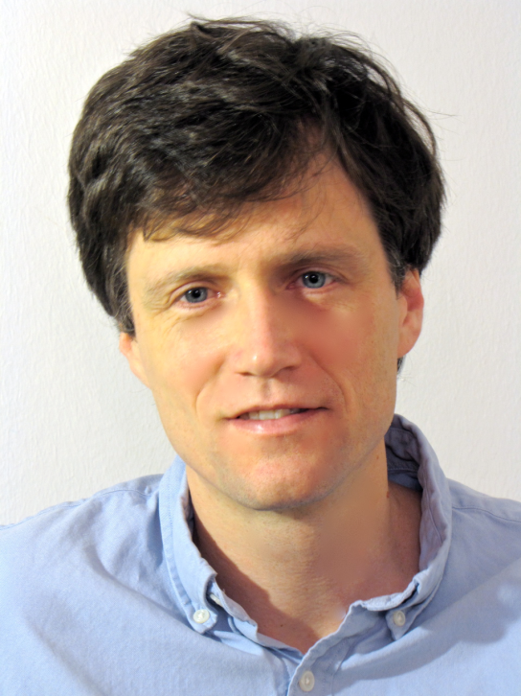
Acknowledgements
Peter Blaha Russel Luke TU Wien U. Göttingen

Slide 3
Caveat 1
I have a British sense of humor
I am not a mathematician, and do not publish in SIAM
I can code adequately (Dunning-Kruger)
I am 67% experimental, 33% theory
I do physics/chemistry/materials science and have been called many things (some nice)

Slide 4
Caveat 2
History according to DFT & Math are (very) different
We tried to marry these, see Marks & Luke arXiv:0801.3098v1 2008
Referee thought it was too math “chatty”, so we had to condense it

Slide 5
Context
Wien2k, standard benchmark for DFT
Algorithms I will talk about are in code used by > 3,000 groups around the world
Calculations that range from seconds to weeks on > 128 cores
>20,000 calculations, used in > 1,000 refereed papers
Copied to three other codes

Slide 6
Overview
What is (and is not) DFT
What is needed for the mixer (fixed-point solver)
How this has been approached (physics and pragmatism). Much that goes further than math literature (sorry).
Predictive approach
Since I come from a different community, my approach is different

Slide 7
What is DFT?
Density Functional Theory
Solve the quantum mechanics for tens to thousands of atoms
Fundamental to many areas of current chemistry, materials science and physics
One of the major killer of electrons on supercomputers

Slide 8
Fixed Point cycle
Functional derivative of Energy
Start with ρ(r)
Mix F(ρ(r)) & ρ(r)
Calculate Veff (r) =f[ρ(r)]
SCF cycle
Solves a variational energy by a fixed-point method, implicit minimization

Slide 9
General Structure
Density contains 10³ to 10⁶ components
No gradients plausible
Fortunately the eigenvectors/values are much, much smaller (10-1000)
Often converges in 20-40 iterations
Iff well posed, the stationary point is a variational minimum of the energy, so has good properties

Slide 10
But..
The term “DFT” is a misnomer
Saying “I used DFT” is like saying that I solved a math problem
There are hundreds of flavors of differing complexity, different models for the potential
For some problems particular models are not variational minima

Slide 11
Jacob’s Ladder
Accuracy
Complexity
Numerics
Stability
Conditioning
Speed
J. P. Perdew et al., J Chem Phys 123, 062201 (2005)

Slide 12
Balance issues
Not a simple grid with terms of equal importance
Relative importance varies with problem
Can have mixed variables (in Wien2k only)
Densities, gradients & atomic positions
Constraints (Lagrangian additions to fixed point)

Slide 13
Aside: general case in Wien2k
There is no need to limit to just a fixed point
$$R_{k}(ρ_{k})={F(ρ}_{k})−ρ_{k}$$
Generalization
$$R_{k}(ρ_{k},g_{k})={(F(ρ}_{k})−ρ_{k},r_{k})$$
Positions $r_{k}$, pseudo-gradient $g_{k}$ converges to a true gradient of the energy at the solution.
Proposed in 1983 bv Bendt & Zunger, failed then and with DIIS (Kresse, priv comm)

Slide 14
Math issues
There are cases with multiple fixed points
There are cases where there is no downhill route from certain densities to the solution
At the solution properties are good – unpredictable otherwise
Radius of convergence etc. changes with problem, details unclear
Global minimum with atoms as well

Slide 15
Numerical issues
Algorithms involve numerical integrations/differentiations – stability and conditioning errors
Some codes are more equal than others, e.g. break symmetry boundary conditions
Variables often effectively single-precision
Not a well researched topic (most codes have been written by physicists/chemists)

Slide 16
Transparency issues
All approaches require an inverse – how is rarely mentioned (and regularization)
Codes can have rubber bands to hold them together (Wien2k did 15 years ago)
They are not always written to be transparent
Can have undisclosed variables (sometime not deliberate)

Slide 17
Physics issues
The fundamental character can change discontinuously, to illustrate
Problem starts as steam
Then condenses into water
Ends as ice
There might be a storm/lightning in the mix
This cannot be ignored in the math or algorithm.

Slide 18
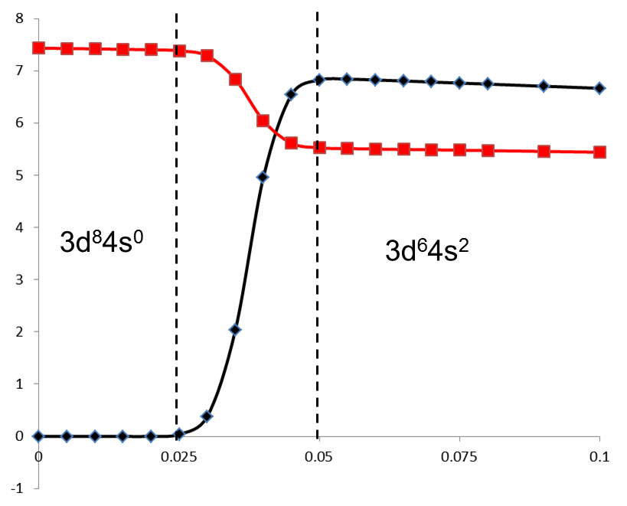
Phase Transitions: Can change discontinuously
Electronic configuration of F(ρ) in the second step as a function of the size of the first Pratt step for an Fe atom, with the 4s occupancy within the muffin-tins in black (x10) and the 3d in red

Slide 19
Analogy: water running downhill
Start with ρ(r)
Mix F(ρ(r)) & ρ(r)
Calculate Geff (r) =f[ρ(r)]
SCF cycle
Solves a variational energy by a fixed-point method, implicit minimization

Slide 20
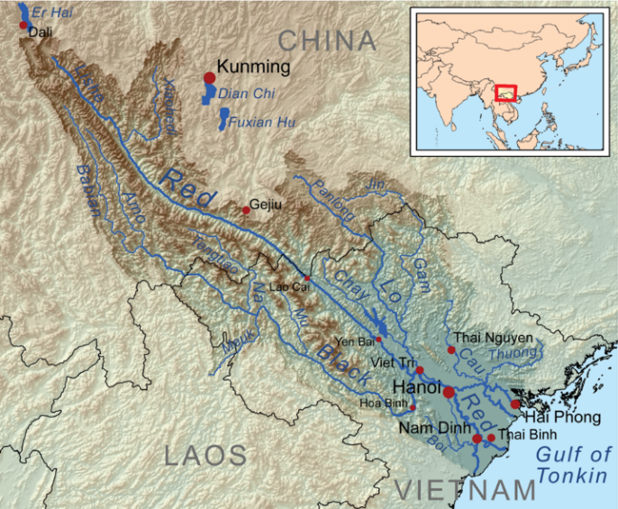
Flowing downhill can be simple
Red River

Slide 21
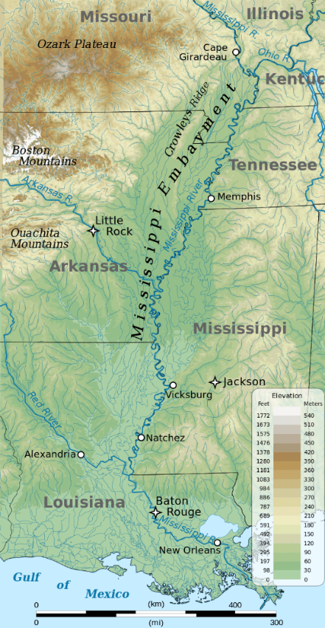
Not so simple
Mississippi
Many wiggles, but no hard walls

Slide 22
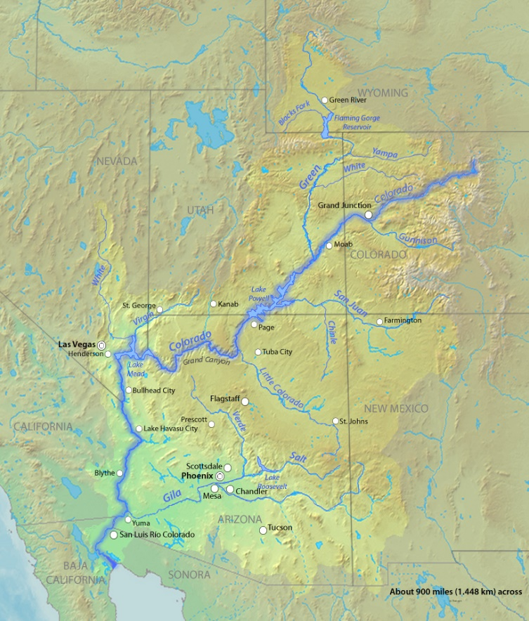
Problem Changes
Starts in the mountains
Lake Powell
Grand Canyon
Down to sea…not!

Slide 23
What is needed
Fixed-point algorithm that can solve for all reasonable problems. (Really dumb ones are impossible.)
No user adjustable parameters
Solves for all different flavors from 10 to 10³ atoms, good to bad conditioning, stiff to soft, all levels of Jacob’s ladder
Works for users who know little

Slide 24
Caveat
One of the most common questions on DFT lists is:
“My calculation won’t converge, please help”

Slide 25
How to solve?
Simple approach:
General approach:
Using available information
to find solutions

Slide 26
Historical perspective
New point ${F(ρ}_{k})$
Define a residue $R_{k}={F(ρ}_{k})−ρ_{k}$
Simplest is linear
$$ρ_{k+1}=ρ_{k}+{αR}_{k}$$
Slow, and what is $α$ ? (user choice)
Pratt method often works if the user chooses right

Slide 27
More history
Initially people tried the “standard” Broyden method (1965) – it did not work
Sequential Broyden, fair (Srivastava, 1984)
Better, multisecant (Johnson 1988)
$$ρ_{k+1}={{ρ_{k}+Σ α}_{j}R}_{j}$$
The coefficients from L2 (LS) solution.
Some LS are more equal than others. Different regularization & conditioning

Slide 28
General form
$s_{i}=ρ_{i}−ρ_{k} ; y_{i}=R_{i}−R_{k}$
$R= R_{k}+B_{k} s_{k+1}+s_{k+1} C_{k} s_{k+1}+…$
Form a matrix for s & y values
The key question is how to construct the solution, for which there are more than a few issues.
Marks & Luke, 2008

Slide 29
General form
Predicted step
$${p_{k}= B_{k}^{−1}R_{k}=H_{k} R}_{k}$$
Unpredicted step, greed $α_{k}$
$$u_{k}=R_{k}−{B_{k}p}_{k}$$
General form
$$ρ_{k+1}=ρ_{k}+α_{k}u_{k}+β_{k}p_{k}$$

Slide 30
General form
Predicted step
$${p_{k}= B_{k}^{−1}R_{k}=H_{k} R}_{k}$$
Unpredicted step, greed $α_{k}$
$$u_{k}=R_{k}−{B_{k}p}_{k}$$
General form
$$ρ_{k+1}=ρ_{k}+α_{k}u_{k}+β_{k}p_{k}$$

Slide 31
Issue 1: Unpredicted step
No information available
Must be controlled
If too large, simplex gradients are unreliable
Implicit trust, i.e. increase if improving “enough”
It is hard to know what enough is

Slide 32
General form
Predicted step
$${p_{k}= B_{k}^{−1}R_{k}=H_{k} R}_{k}$$
Unpredicted step, greed $α_{k}$
$$u_{k}=R_{k}−{B_{k}p}_{k}$$
General form
$$ρ_{k+1}=ρ_{k}+α_{k}u_{k}+β_{k}p_{k}$$

Slide 33
General form
Expand using prior histories (Secant)
$H_{k}=S_{k} {(T_{k}^{T}Y_{k})}^{−1} T_{k }^{T}$ $B_{k}=Y_{k} {(T_{k}^{T}S_{k})}^{−1} T_{k }^{T}$
$T_{k}=\left(1−λ\right)S_{k}+{λY}_{k}$
$λ=0$ is conventional Broyden (soft)
$λ=1≅$ DIIS, Anderson, MSEC (stiff)
Regularized pseudo-inverse (SVD), (Max Sing)*10⁻⁴
Marks 2013

Slide 34
Issue 2: Scaling
How to treat the previous steps?
Sequential (Broyden) or multisecant (DIIS, Simplex)?
As is, with different magnitudes?
All my tests support a simplex gradient
Broyden DIIS Simplex

Slide 35
Issue 3: what form?
$H_{k}=S_{k} {(T_{k}^{T}Y_{k})}^{−1} T_{k }^{T}$
$T_{k}=\left(1−λ\right)S_{k}+{λY}_{k}$
$λ=0$ is conventional “Good” Broyden, most greedy, may diverge, soft case
$λ=1≅$ DIIS, Anderson, “Bad” Broyden, least greedy, may stagnate (different scalings…), stiff case
8-16 memories (not critical)

Slide 36
What is a greedy algorithm?
A greedy algorithm takes decisions on the basis of information at hand without worrying about the consequences. In many cases “greed is good”, but not always.
Example: make 41c with 25c, 10c, 4c coins
Optimum solution: 25+4x4
Greedy solution: start with 41c, use largest reduction
25c Remainder 16
10c Remainder 6
4c Remainder 2

Slide 37
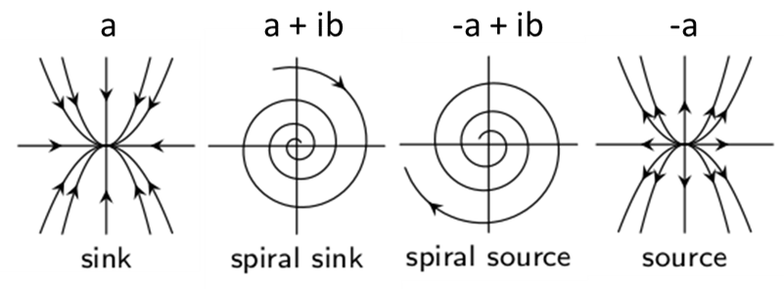
Ansatz: inspired by optimization
$T_{k}=\left(1−λ\right)S_{k}+{λY}_{k}$
Search up for largest $λ$ where ${ T}_{k}^{T}Y_{k}$does not have source eigenvalues
Stable Unstable

Slide 38
Issue 4: Predicted
$R= R_{k}+B_{k} s_{k+1}+s_{k+1} C_{k} s_{k+1}+…$
What about the higher-order term?
The linear model (predicted step is only valid for small enough steps)
What is small enough – needs a trust region
Surprisingly I don’t think any code except Wien2k has trust regions for DFT
Tensor method (untested)

Slide 39
Algorithms Work
Versions, in use ~1 year before paper
2008 DOI:10.1103/PhysRevB.78.075114 controlled unpredicted step – no more user input. Generalization of multisecant methods
2013 DOI:10.1021/ct4001685 implemented the general form, which is needed to avoid stagnation. (Solves simultaneously for atomic positions & density, global minimum.)

Slide 40
Not enough
Problems:
It is hard (to impossible) to know when a step is “good enough” or “bad enough” to adjust trust regions as residue is not always well scaled
Sometimes can stagnate
Sometimes can start badly
Can still diverge

Slide 41
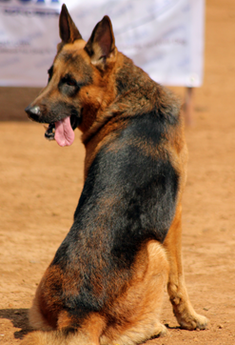
Predictive mixing (2021)
Use best values for the last step
DOI: 10.1021/acs.jctc.1c00630

Slide 42
Reminder: general form
Predicted step & residue
$${p_{k}= B_{k}^{−1}R_{k}=H_{k} R}_{k}$$
$${{R_{k}^{P}=B}_{k}p}_{k}$$
Unpredicted step, residue greed $α_{k}$
$u_{k}=R_{k}−{B_{k}p}_{k}=R_{k}^{U}$
General form
$$ρ_{k+1}=ρ_{k}+α_{k}u_{k}+β_{k}p_{k}$$

Slide 43
What we should have use
Predicted step, find $β′$ that minimizes
${||R_{k−1}^{P}−β′ B}_{k}p_{k−1}||$ then $β_{k}=(β_{k−1}+β′)/2$
Unpredicted step find $α′$ that minimizes
$${||R_{k−1}^{U}−α′ B}_{k}u_{k−1}|| \text{then} α_{k}=(α_{k−1}+α′)/2$$
For trust radius, use
$${||R_{k−1}−t′ B}_{k}s_{k}|| \text{then} t_{k}=(t_{k−1}+t′)/2$$
General form, bounded by size
$$ρ_{k+1}=ρ_{k}+α_{k}u_{k}+β_{k}p_{k}$$

Slide 44
Standard additions
For a really bad step, recalculate along direction and discard new point (don’t contaminate simplex gradients)
If a little bad, add to matrices & recalculate
SVD inversion with regularization
Start conservative
No user parameters except a couple that they think work but don’t (they will fiddle)

Slide 45
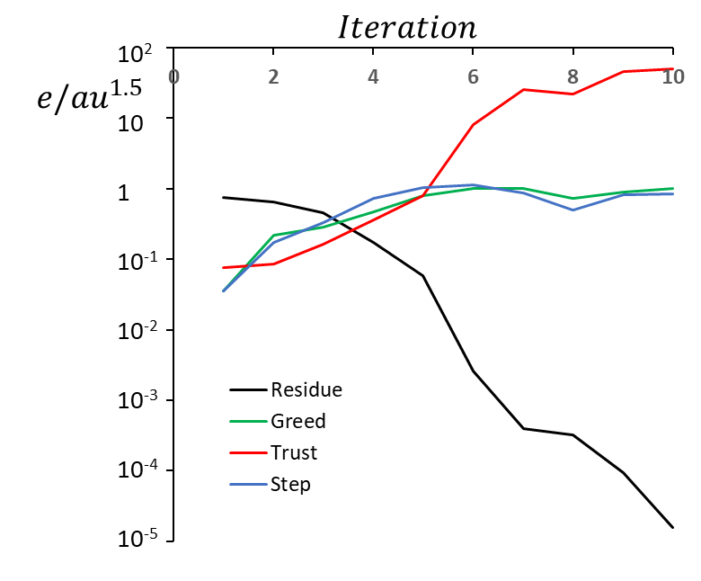
Does it work?
Simple case, bulk MgO
Greed/Trust start low, then rapidly increase

Slide 46
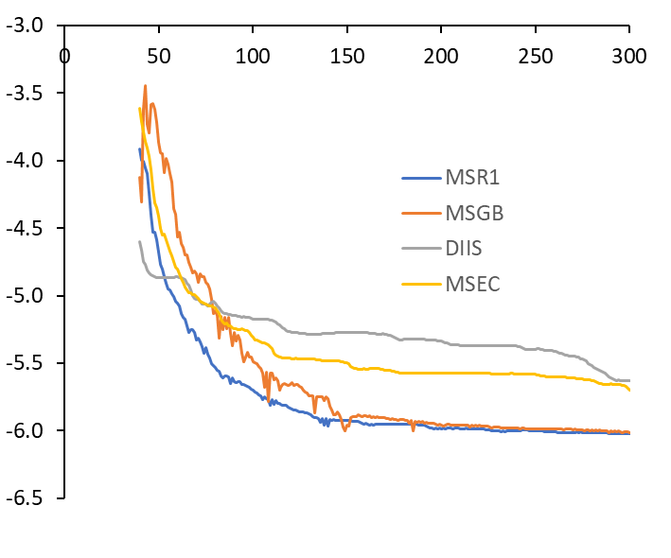
More complex: atoms+density
$$Iteration$$
MSR1: Predictive
MSEC: λ=0
MSGB: λ=1
DIIS: λ=0, different scaling
$$eV/atom$$
DIIS/MSEC don’t converge
MSGB is noisy (too greedy)

Slide 47
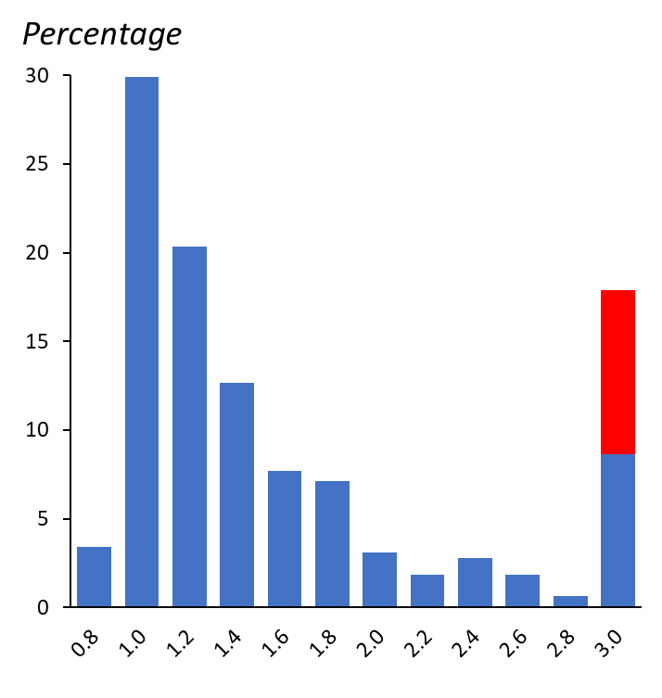
Statistics
Ration of iterations to converge of predictive approach versus “best” (by search) of greed for 36 cases (blue), and 4 which never converged in red

Slide 48
Current status
A detailed search can often find parameters as good – at the cost of doing 10 times or more as many calculations
It (and earlier versions) have survived the acid test – novice users
Follows the math
No rubber bands

Slide 49
Known unknowns
What is the right way to choose
$$T_{k}=\left(1−λ\right)S_{k}+{λY}_{k}$$
L2, L1, Kullback-Leibler or other metrics?
Tensor methods?
Predictive approach in other DFT codes?
Can it be used for other acceleration tools?
Adaptive windowing in anger?
Are their Wolfe conditions?

Slide 50
Unknown Unknowns

Slide 51
Next step?
Openmix project
Generate a code that can be used for all DFT variants, needs some interface for different codes
…extend to others….?
Let me know if you are interested
I can test other algorithms in Wien2k, or collaborate (I have licence)

Slide 52
Questions ?
It is through science that we prove, but through intuition that we discover. Jules H. Poincaré
Marks, L.D. and D.R. Luke, Robust mixing for ab initio quantum mechanical calculations. Physical Review B, 2008. 78(7): p. 075114-12 http://doi.org/10.1103/PhysRevB.78.075114.
Marks, L.D., Fixed-Point Optimization of Atoms and Density in DFT. J Chem Theory Comput, 2013. 9(6): p. 2786-800 http://doi.org/10.1021/ct4001685.
Marks, L.D., Predictive Mixing for Density Functional Theory (and Other Fixed-Point Problems). J Chem Theory Comput, 2021. 17(9): p. 5715-5732 http://doi.org/10.1021/acs.jctc.1c00630.
Blaha, P., et al., WIEN2k: An APW+lo program for calculating the properties of solids. The Journal of Chemical Physics, 2020. 152(7): p. 074101 http://doi.org/10.1063/1.5143061

