Slide 1
Dynamical Diffraction
Doing it right
Known, but often ignored
Always used in calculations

Slide 2
Basics
So far:
  Kinematical (single scattering) model
  Ewald sphere (energy conservation, elastic)
  Simple solutions for diffracted beams, fudge for transmitted
Results:
  Qualitatively correct (thickness fringers, bend contours, strain)
  Quantitatively incorrect
  Incorrect inferences for inelastic

Slide 3
Notes on History
De Broglie proposed all matter could be written as waves in 1925
Schrödinger expanded to “undulatory mechanics” in 1926
Electron diffraction was demonstrated in 1927-28
Explained (non-relativistically) using dynamical theory by Bethe in 1928.

Slide 4
Dynamical Diffraction
Fully account for scattering from diffracted beams back to transmitted (and others)
Well understood, but only one useful simplification (two-beam), where result is
Numerical solutions in other cases easy, but it is important to understand why the have their form

Slide 5
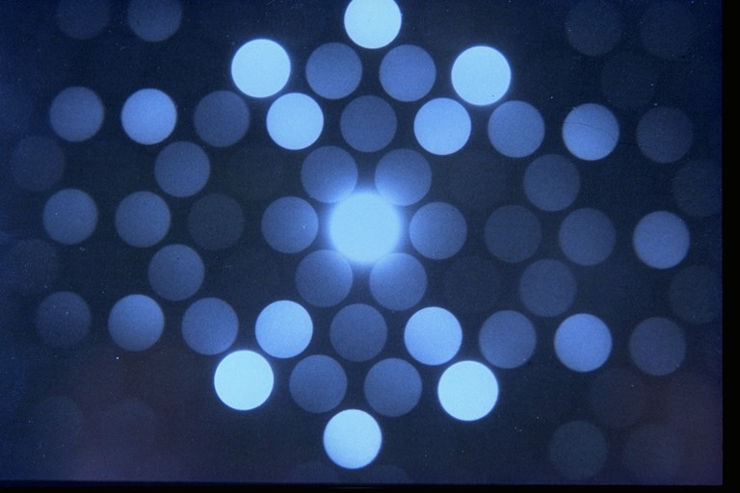
Kinematical
Dynamical

Slide 6
Math (in notes)

Slide 9
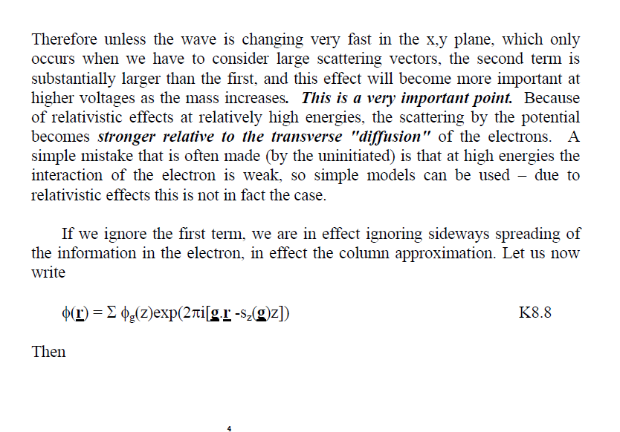

Slide 10
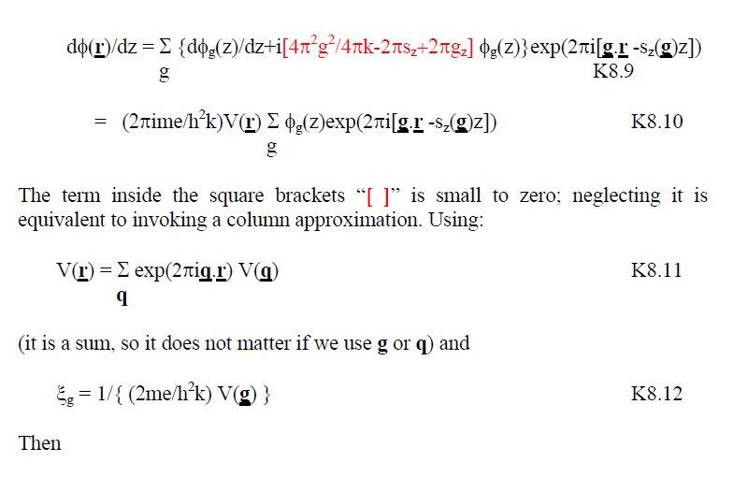

Slide 11
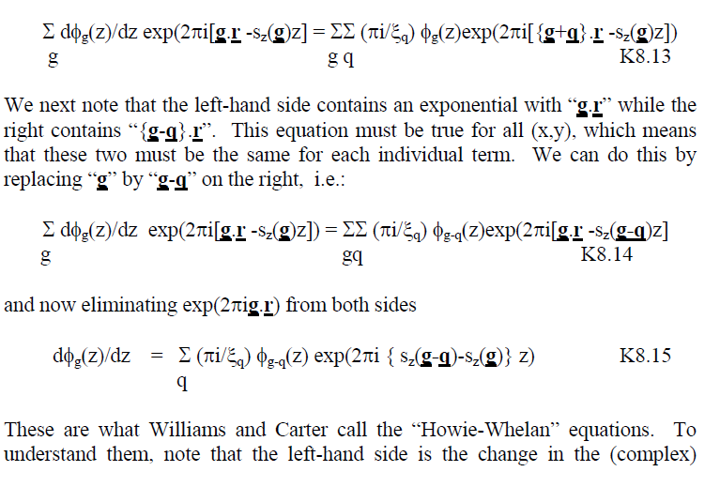

Slide 12
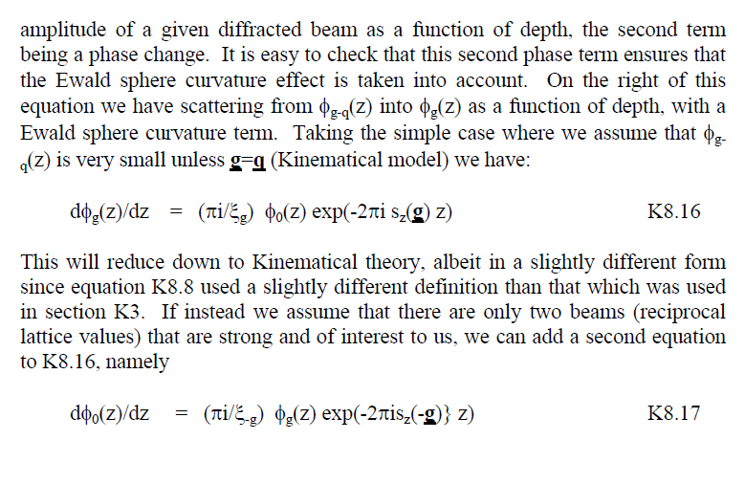

Slide 13
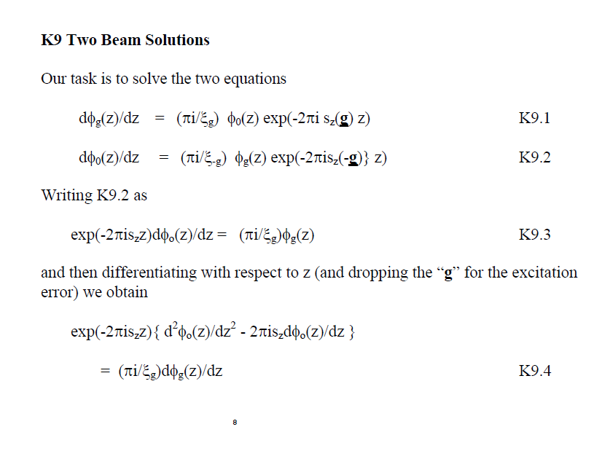
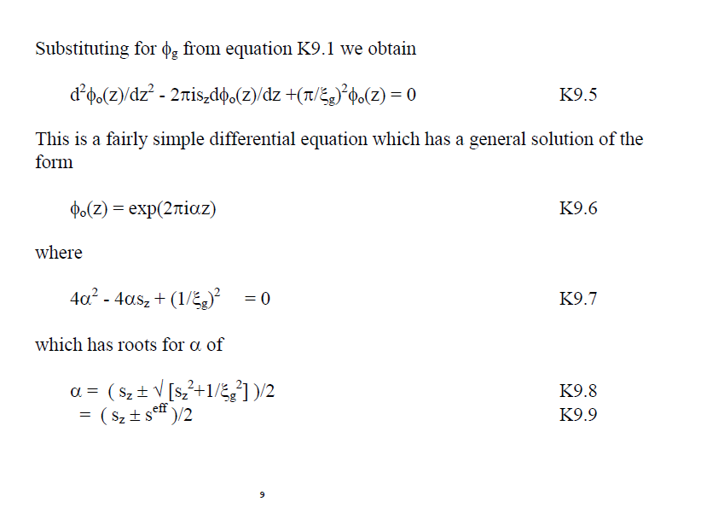

Slide 15
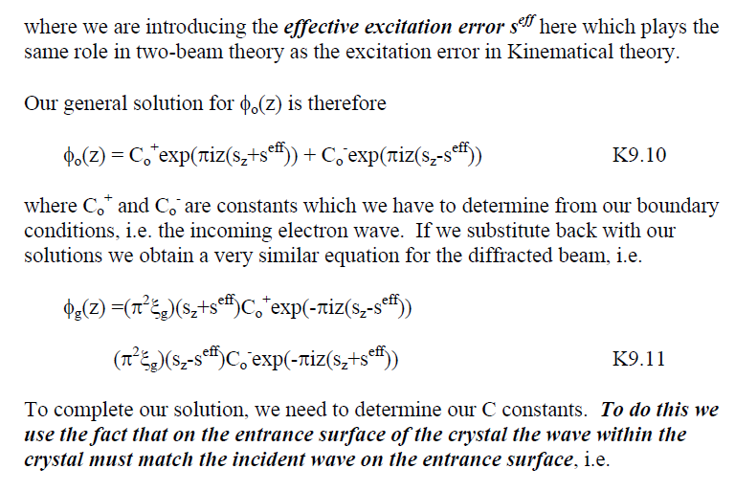

Slide 16
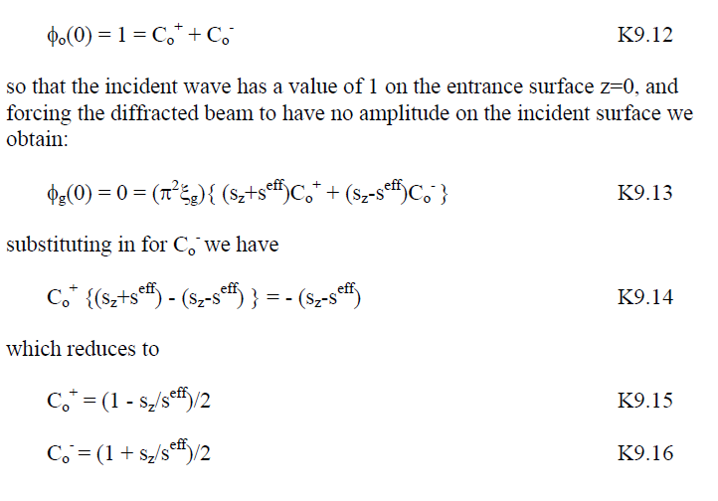

Slide 17
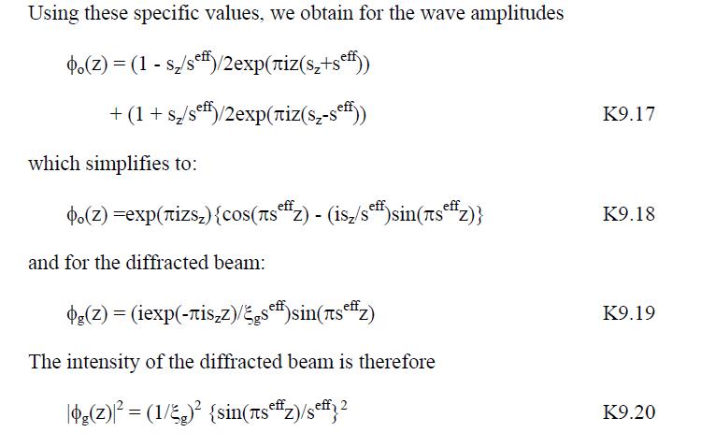
s_{z}^{eff} = (s_{z}²+ 1/ε_{g}²)^{1/2}

Slide 18
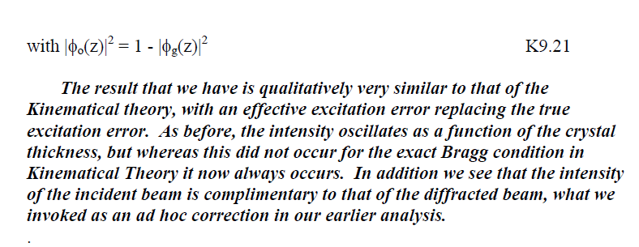

Slide 19
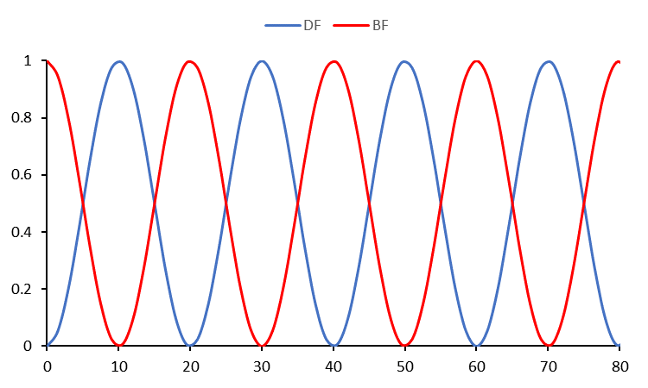
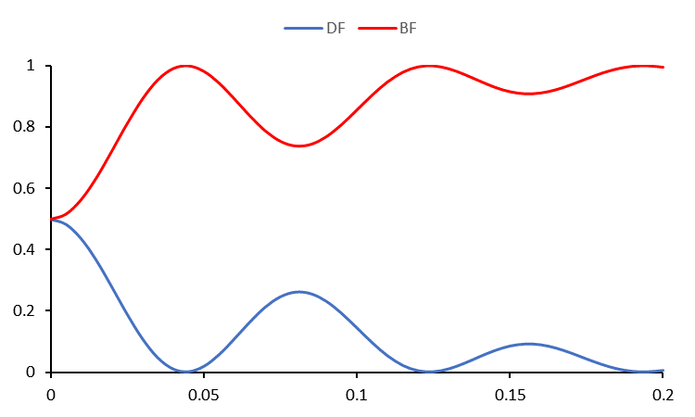
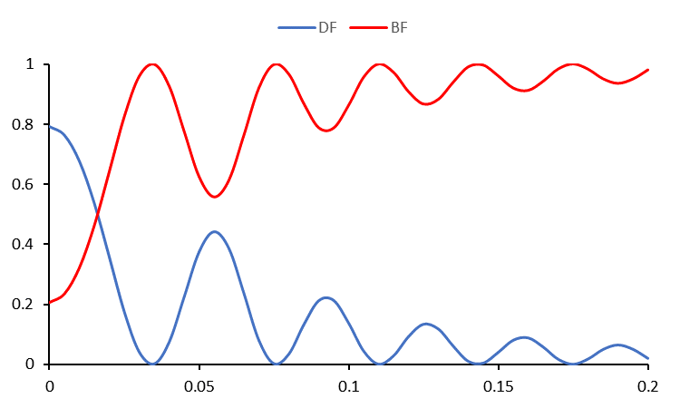
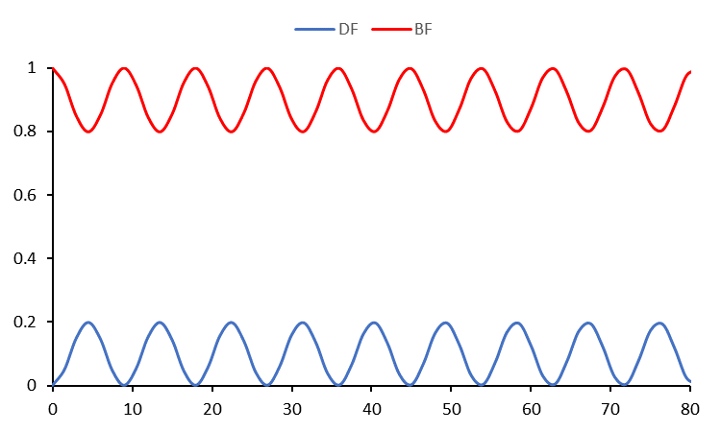
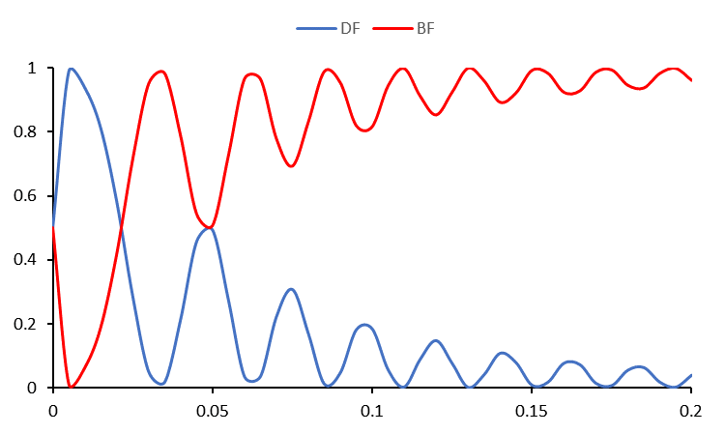
2-Beam solutions
Thickness fringes for zero and larger s_{z}
Bend contours

Slide 20

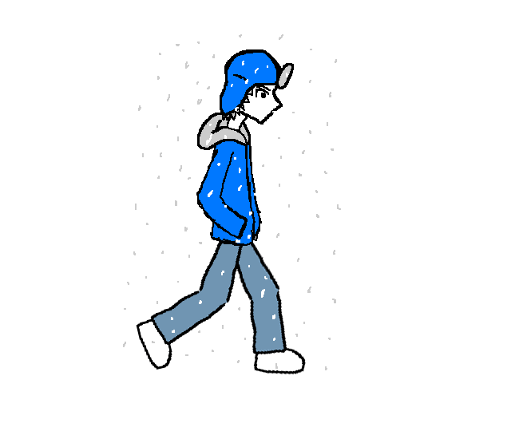


Life is eigenvalues/vectors
Going from Evanston to watch a Bears game (we can always hope)
Individuals or collective – different eigenvectors of the trip
Walk to Car
Walk to Seats
Drive Down LSD
Watch the Game

Slide 21
An aside
Everything is an “***on”
  Phonons, electrons, magnons…
They are called “quasiparticles”, effectively independent solutions (eigenfunctions) in quantum mechanics.
The plane waves in kinematical are not “**ons”, as they are changing.

Slide 23
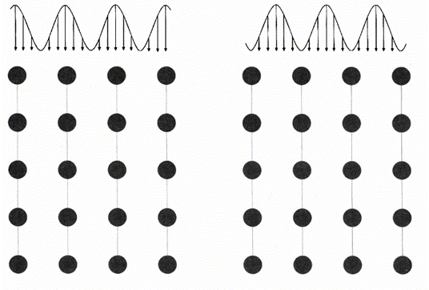
Key point: look at the +/- cases:
b(k⁺,r) = 2Co exp(2πiγ⁺z)exp(πi[2k⁺+g] .r)cos(πg.r)
|b(k⁺,r)|² ∼ cos(πg.r)² |b(k⁻,r)|² ∼ sin(πg.r)²
Damped Strongly Damped Weakly

Slide 24
Top-Bottom Effect
e⁻
Defect scatters Bloch waves (inclined)
+/-
Type of Bloch Wave
Type before defect
+ Strongly Adsorbed
+ → ++/-+
- → --/+-
-
+ Damped
+-/--
-
-+/--
--
+-/--
Image

Slide 25
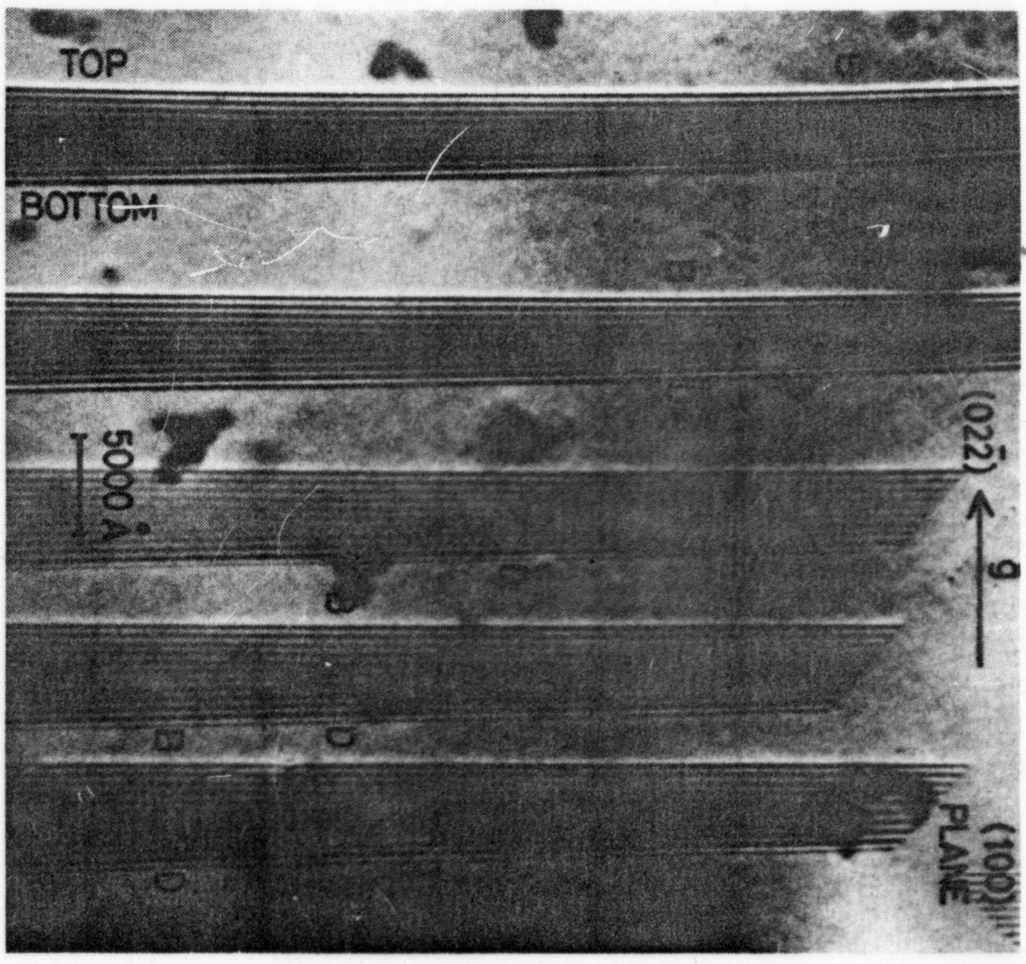

Slide 26
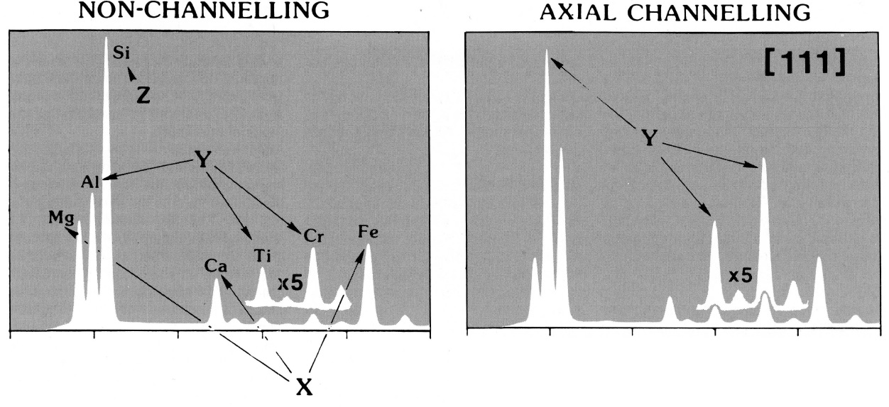
ALCHEMI
Atom Location by Channeling Enhanced Microanalysis
Cherns, Howie and Jacobs, 28a, Naturforschung, 1973

Slide 27
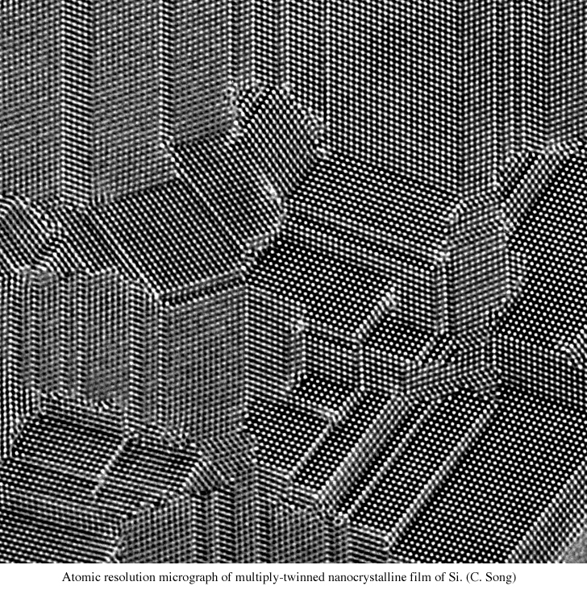

Slide 28
Au [110] – Vacuum wave
Courtesy C. Kisielowski, J.R. Jinschek (NCEM, Berkeley)

Slide 29
But…column approximation?
w
t, 20nm
w = 2tθ. Take θ=10 mRad, t=20nm, w=4 Angstroms

Slide 30
Basis Sets
Plane waves
  Solutions in vacuum
  Used in kinematical theory
Bloch waves
  Used in 2-beam theory (and beyond)
  Combinations of plane waves
Tight-binding model
  Uses atom-like orbitals (similar to chemistry, MO)

Slide 31
Basis Sets Continued
What to use?
No simple answer
The one which gives the simplest explanation with the least complications (KISS = Occam’s Razor) is normally best
Often this changes depending upon the type of problem/property of interest…

Slide 32
Channeling: Real-Space model
Electron channeling approximation*:
  1) Ignore all but ZOLZ interactions (high energy)
  2) Assume sample orientation so that one has well separated atomic columns along z (in initial expansion only)
  3) Use atomic-column based tight-binding model
* Fujimoto, phys. stat. sol. (1978) + many others
Van Dyck and Op de Beeck, Ultramicroscopy (1996)

Slide 33
Channeling Concept
~0
For many zone axes, in projection atoms are well separated
Potential large near columns
Small between columns
V(r) Atoms
r

Slide 34
Consider an isolated column: I
e⁻
d
Average potential

Slide 36
Final form, almost
Spreading of information
Diffraction

Slide 37
Look for a solution of form
This leads to

Slide 38
Consider an isolated column: II
Problem reduces to 2-D Schrödinger's Eqn
Solutions have form:
“Transverse Energy”
2D orbitals

Slide 39



Character of States
2D analogues of 3D atomic orbitals
1s 2p 3d

Slide 40
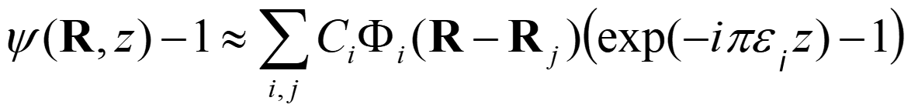
Dynamical Solutions: many columns
General solution
On a zone (symmetry), s-type orbitals dominate
Not so simple if the zone axis is complicated – not a solved problem

Slide 41
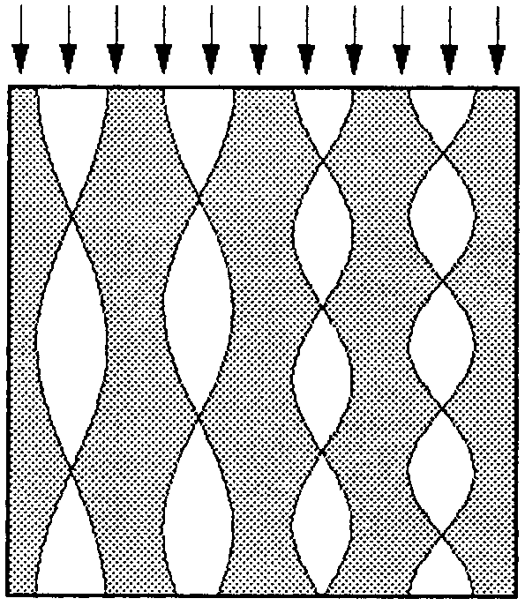
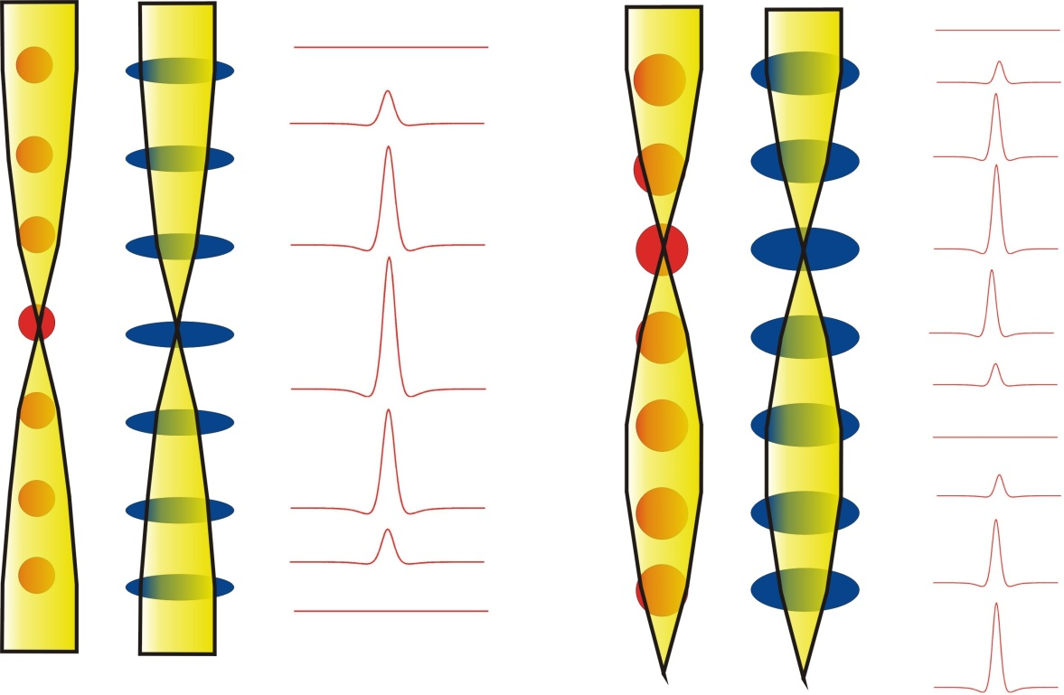
light atoms
heavy atoms
light atoms
heavy atoms
Curtesy D. Van Dyck

Slide 42
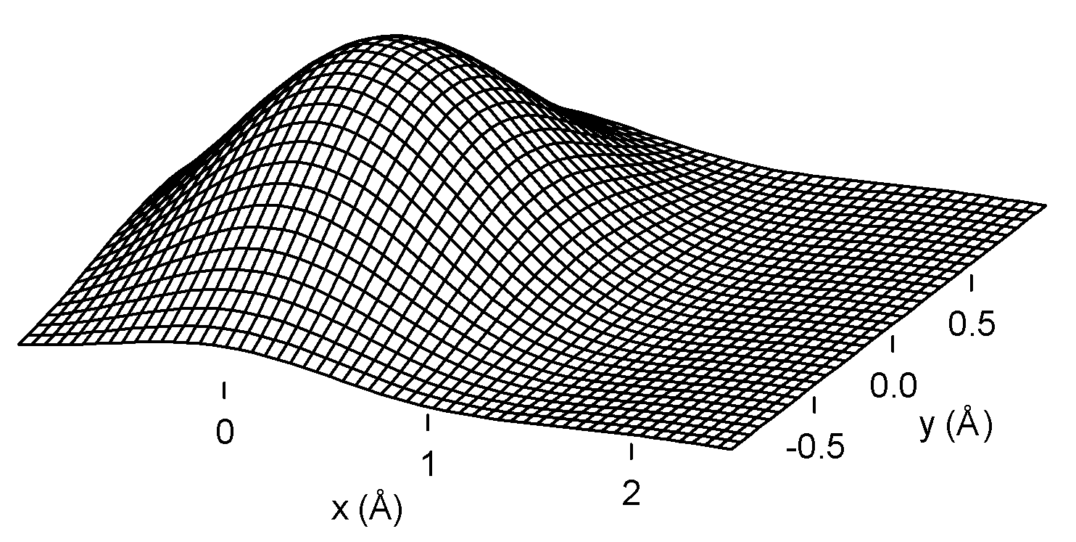
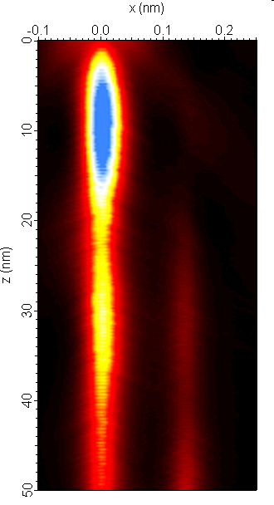
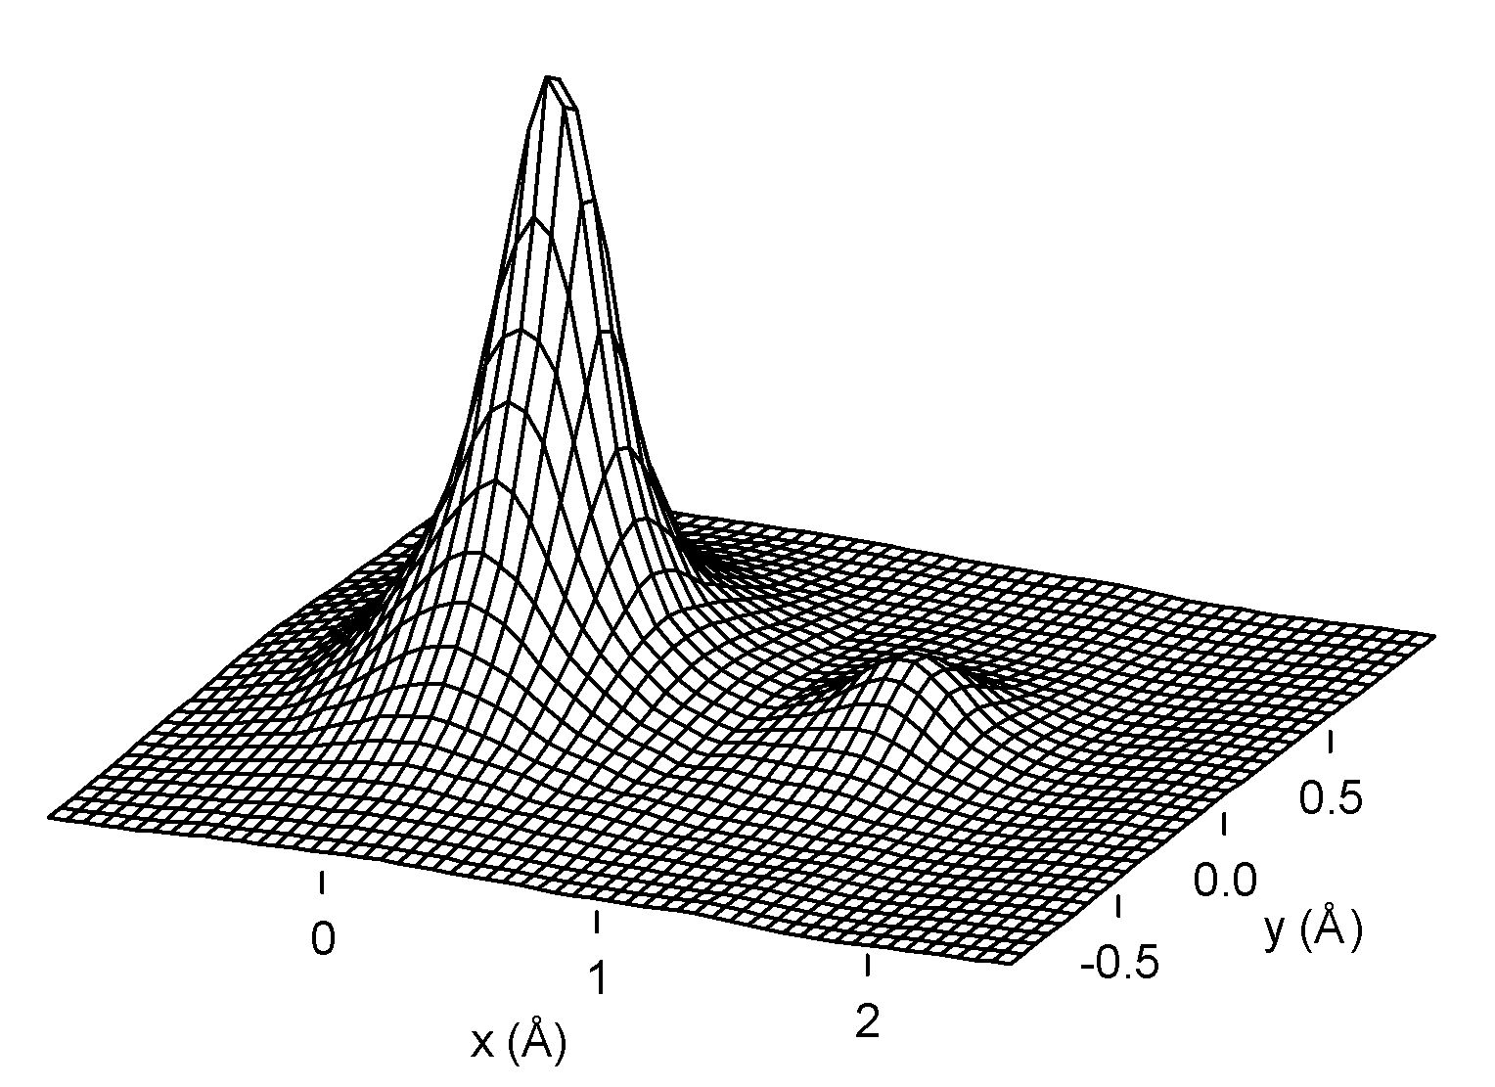
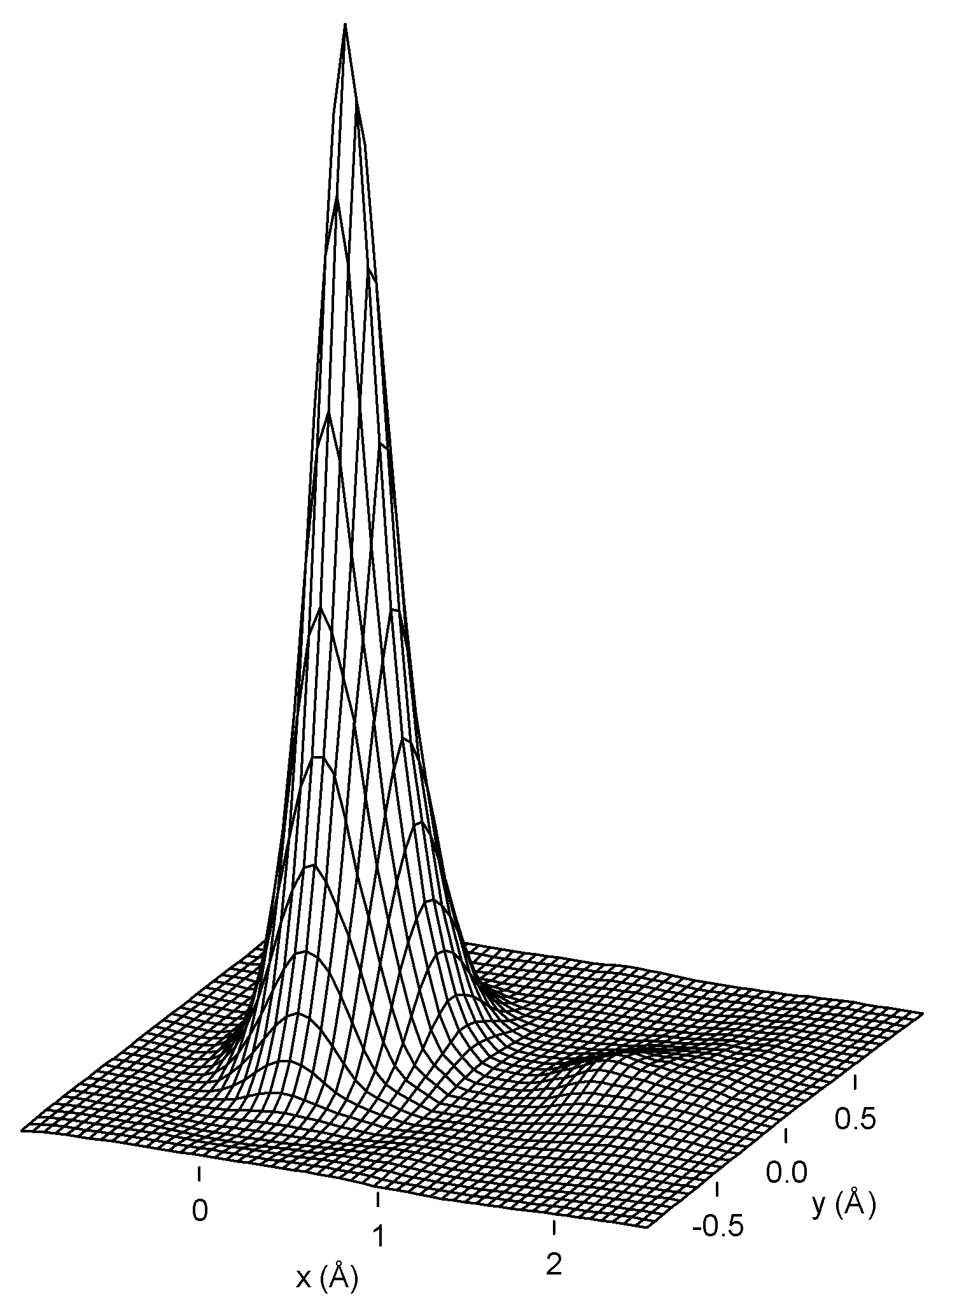
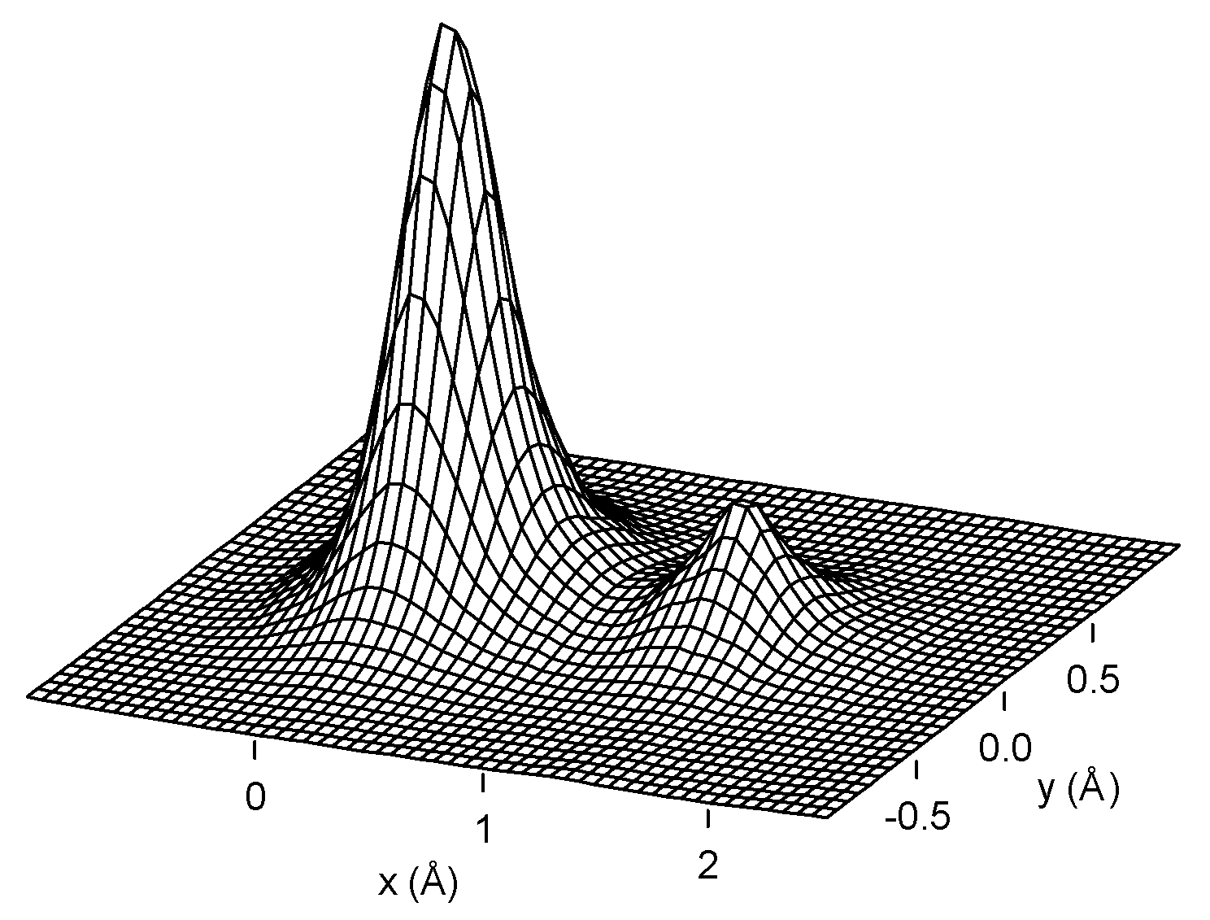
Probe Channeling
z=0 nm
z=23.5 nm
z=10 nm
z=33.0 nm

Slide 43
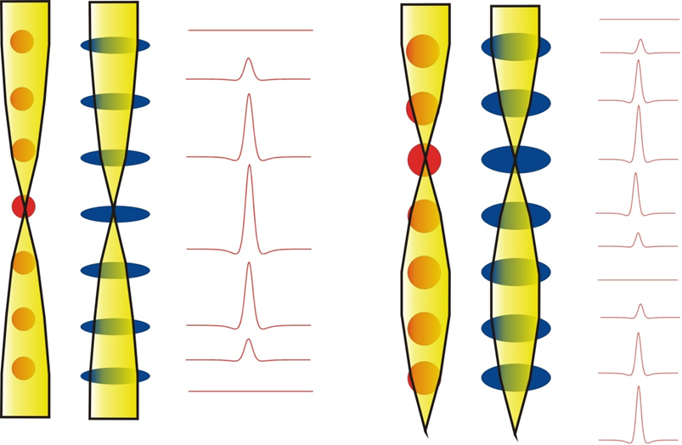
Heavy atoms first, then light

Slide 44
Depth dependence by atom type
O
Al
Ga
|1-ψ(r)| at atom
0
200
400
600
800
1000
Thickness [Å]

Slide 45
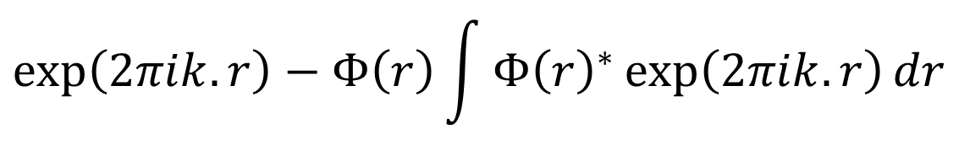


OPW
Suppose we have some atomic-like state,
and also add a plane-wave like term
The two must be orthogonal – a plane wave is not
Instead use
This is small when is large, misses the core
$$Φ(r)$$
$$\exp\left(2πik.r\right)−Φ\left(r\right)\int{{Φ\left(r\right)}^{∗}\exp\left(2πik.r\right)dr }$$
$$Φ(r)$$

Slide 46
So what does this gain us?
First core state (1s) cancels most of potential (OPW)
Only need to consider a few states, unlike classic Bloch-wave methods
N.B. Tight-binding
Effective (pseudo) potential
1s state
Potential

Slide 47
A Quick Comparison
Bloch Wave
  Different States
  Oscillate with Depth
Interference
  Thickness Fringes,etc
Tight Binding
  Atomic States
  Oscillate with Depth
Interference
  Atomic contrast
Note: ignore overlap of states

Slide 48
Channeling Concept
Lowest Transverse Energy states (1s) dominate
Can ignore (to 2nd order) delocalized states
2s
1s
V(r) E_{n}

Slide 49
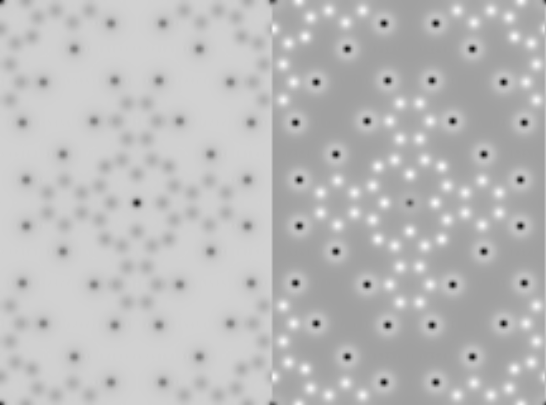
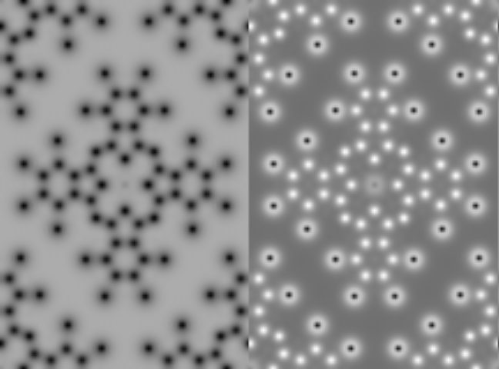
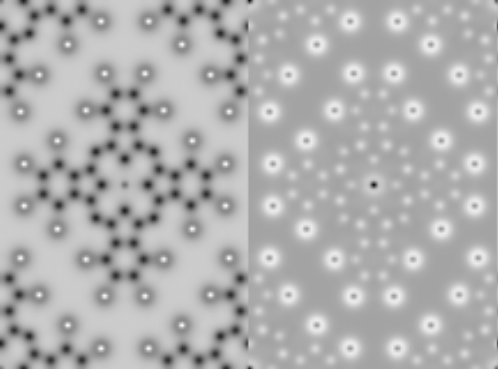
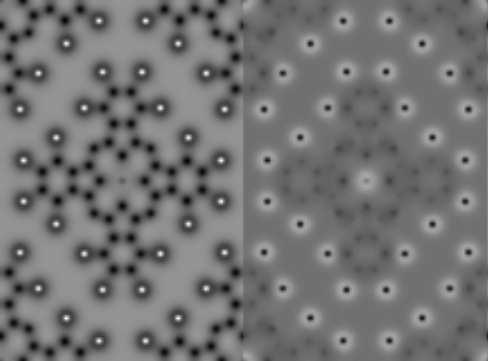
Full wave
Br
Br
4nm
11nm
Cu
Real Imaginary
19nm
26nm

Slide 50
Full wave
Br
4nm
4nm
Cu
Real Imaginary
19nm

Slide 51
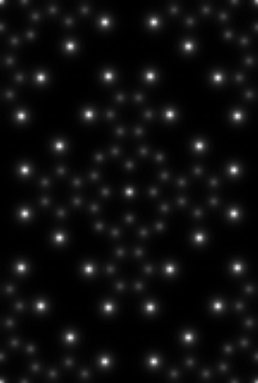
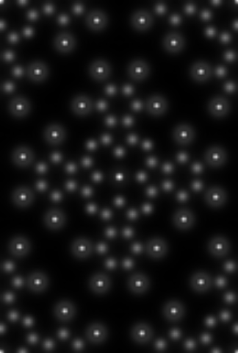
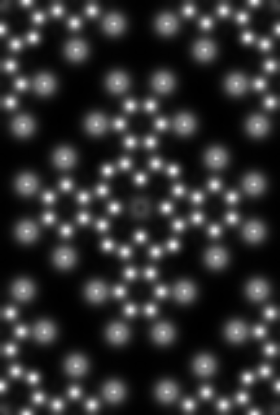
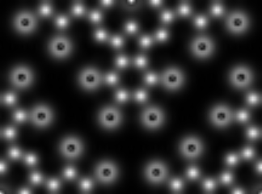
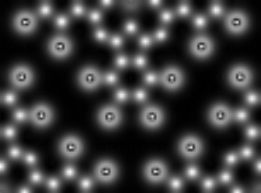
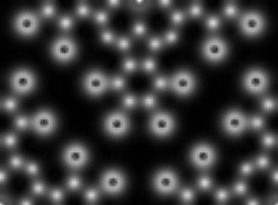
|1-ψ(r)|
Br
.4nm
4nm
11nm
19nm
26nm
34nm
Carbon is more important than Bromine for ~ 10nm

Slide 52
Sinkler Plots: Quasi-Kinematical
ψ(r)-1 has atom-like peaks with species-dependent oscillation
ψ(r)-1, 25 Å
ψ(r)-1, 125 Å
Imaginary
Real
Note: if the points lay on a straight line the result is pseudo-kinematical, i.e. it walks and talks like kinematical even though it is not

Slide 53
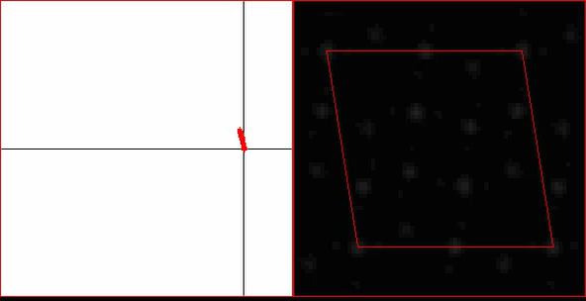
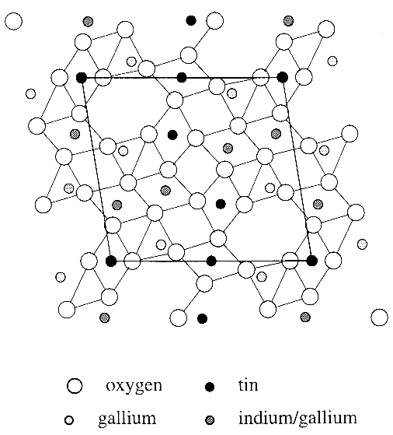
Thickness Movie
Oxygen 1s States
Metal 1s States

Slide 54
Bloch-wave formulation (dynamical theory)
Schroedinger equation
Wave function of the incident electron:
Ψ(r) = Σ_{j} ε^{(j)} b^{(j)}(r)
Bloch state (eigen state):
b^{(j)}(r) = Σ_{g}C_{g} ^{(j)}exp[2πi(k^{(j)}+g)·r]
Electron density distribution of the Bloch state: |b^{(j)}(r)|²
Excitation of the Bloch states: ε^{(j)}

Slide 55
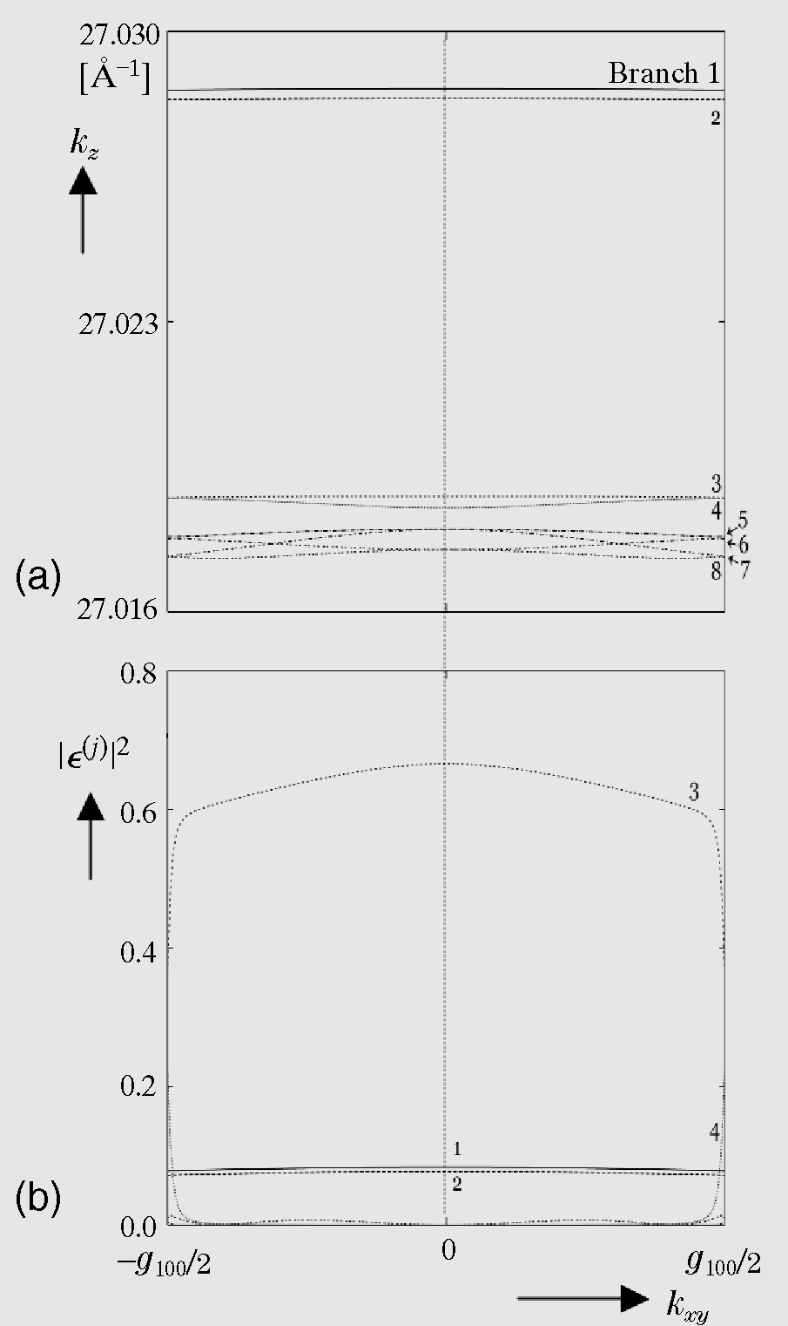
100kV
Dispersion surface and Excitations of
Bloch states
SrTiO₃ [001]
Dispersion
surface
k_{z}
Branches with lower potential energy
➔Higher kinetic energy (k)
Excitations of
the branches
|ε^{(j)}|²
(Energy conservation)
Curtesy of K. Tsuda

Slide 56
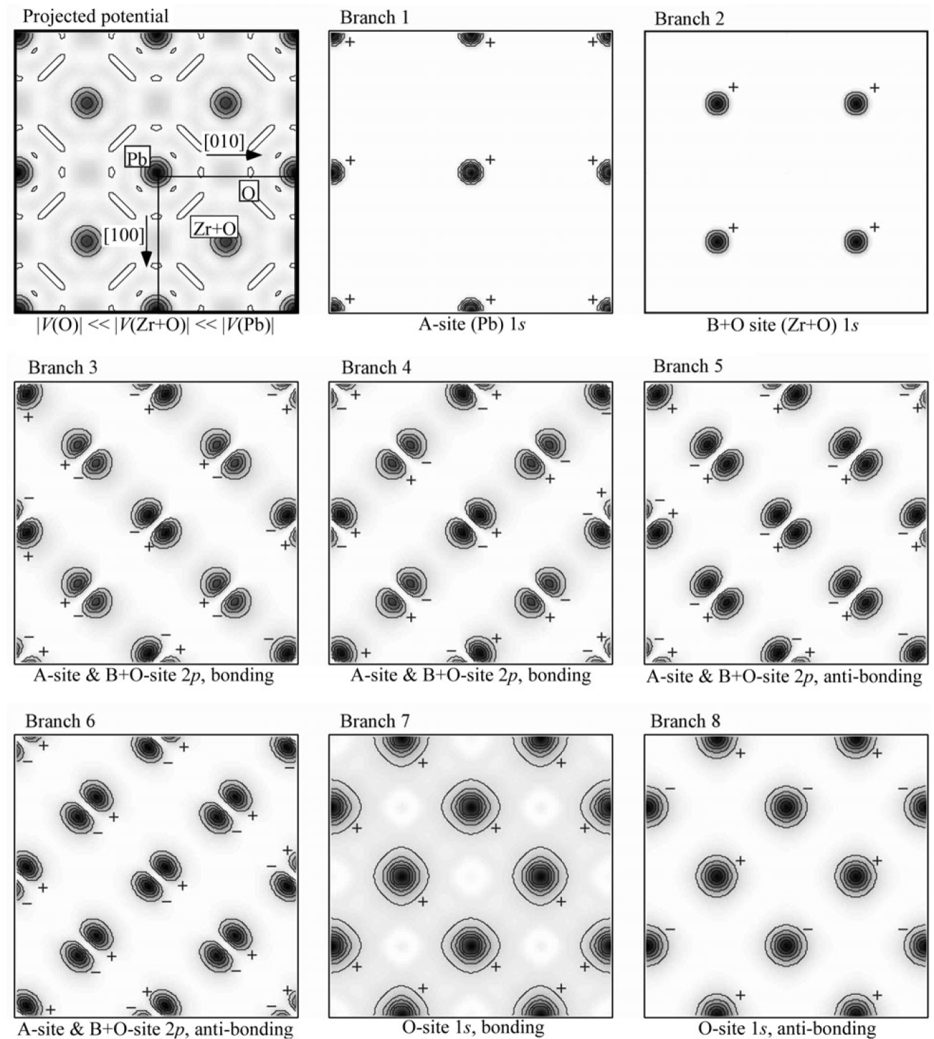
100kV
PbZrO₃ [001]
Bloch-state
simulations
⇒
⇒
⇒
⇒ : well-excited
at ZA

Slide 57
Caveats
In a thick crystal, must include all states
Higher E_{n} states not so “atomic”
Overlap of states on different columns can be important
Tilt off zone axis → excites more p, d states
Strain=tilt, hence may destroy simple picture

Slide 58
Relevance 1: HREM
For a thin sample the 1s states dominate – simple
The scattering is pseudo-kinematical, easy to interpret
In thicker samples (> 20nm) not quite so simple

Slide 59
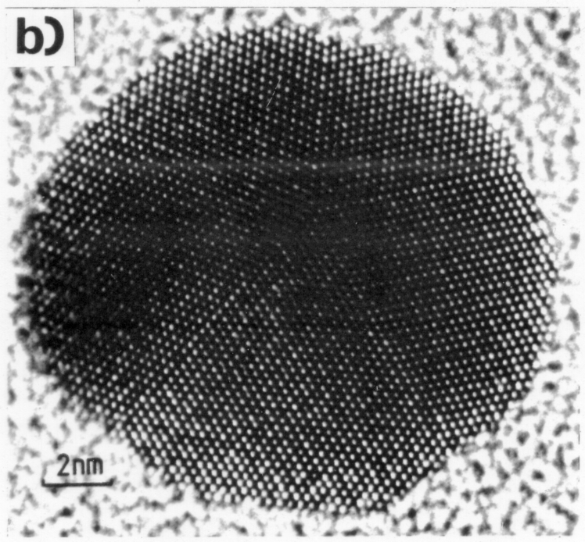
Examples
MTP (1983)
SrTiO₃ (001) (2015)
1nm
TiO₂ DL

Slide 60
Au [110] – Vacuum wave
Courtesy C. Kisielowski, J.R. Jinschek (NCEM, Berkeley)

Slide 61
Relevance 2: ADF
The closer the electron comes to the nucleus, the higher the probability of high-angle scattering (elastic or inelastic)
1s states dominate the high-angle scattering

Slide 62
Probe Channeling
z=0 nm
z=23.5 nm
z=10 nm
z=33.0 nm

Slide 63
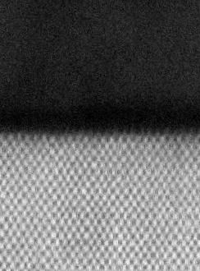
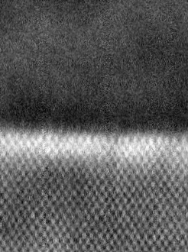
Strain Contrast at Si/SiO₂ Interfaces
(JEOL 2010F, 200 kV, C_{s}=1mm)
ADF Inner angle:
50 mrad
25 mrad
a-Si
SiO₂
c-Si
Strain Fields cause dechanneling (and scattering to small angles)
Z. Yu, D. A. Muller, and J. Silcox, J. Appl. Phys. 95, 3362 (2004).
David Muller 2001

Slide 64
When Does the Simple Picture Work?
Simple incoherent, Z^{1.7} theory works well:
  for an amorphous specimen
  for randomly-oriented polycrystalline specimens
  (mostly) for single crystals tilted between major zone axes
It doesn’t work for single crystals oriented on a zone axes – i.e. when you get atomic-place resolution.

