Slide 1
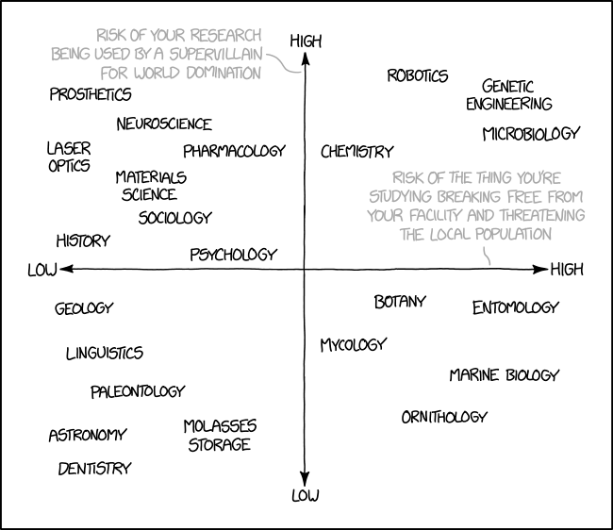
Notes:
As we saw in Section 13.11, the column approxima- tion is equivalent to assuming that the crystal can be divided into narrow columns. We then calculate the amplitudes of the beams in any such column as if the whole crystal consisted of an infinite number of identical columns. The approximation is valid when we don’t need to see image detail below 2–3 nm. The actual diameter of the column depends on the diffracting conditions. We can include the effect of distortions due to strains from lattice defects by imagining that the column consists of slabs of perfect crystal, each displaced by an amount R(z) (like a mini-SF that’s different on every plane). Remem- ber that z is actually measured along the column.

Slide 2
Sample Preparation
MSE 460
Winter 2022
1/13/22

Slide 3
Why is Sample Preparation Important?
Specimens need to have several properties:
  Electron transparent (thinner is better!)
  Flat
  Electrically conductive
  Representative of true nature of material
Choose a technique that fits your experiment to make it easier
Sample prep can make alignment easier
(e.g. amorphous area, specimen orientation)
Notes:
Samples intended for electron microscope analysis are often electrically non-conductive. Bombarding these samples with electrons would lead to overcharges that inhibit image formation and may even disintegrate the sample. This is why a conductive coating is applied to those samples. Carbon is a compromise because it is not as conductive as the common sputter coatings

Slide 4
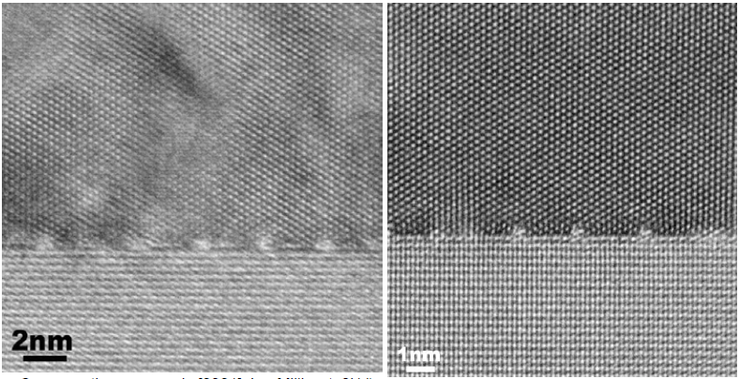
Sample Thickness
Notes:
Thicker sample scatters more!!!!!

Slide 5
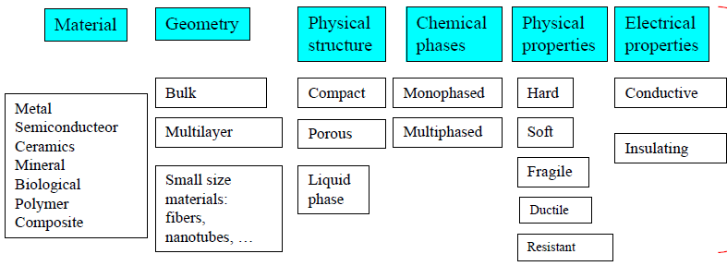
Factors to Consider
What information are you looking for?
  Morphology
  Composition
  Defects
  Atomic structure

Slide 6
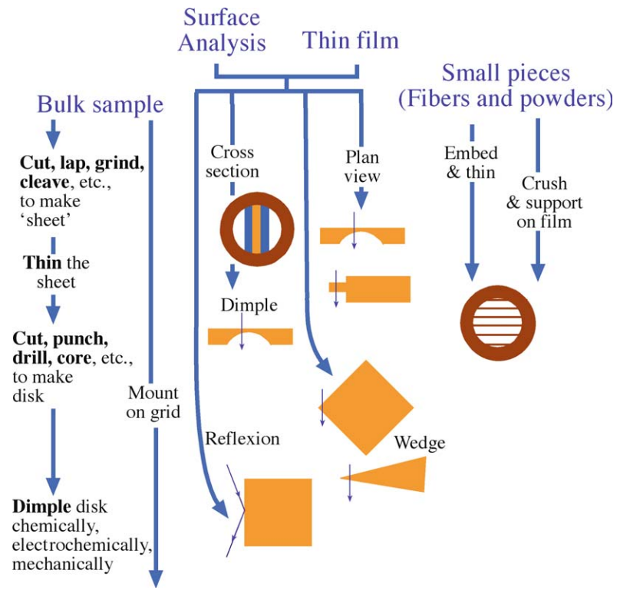
Techniques (not exhaustive)
Mechanical:
polishing, cleavage, crushing, ultramicrotomy
Mechanical + ionic:
grinding, dimpling, ion milling
Ionic:
focused ion beam (FIB)
Chemical:
electro-polishing
Physical:
thin film deposition
Brains:
have the sample make itself
Notes:
Ultramcrotomy (cutting extremely thin layers of biological samples)

Slide 7
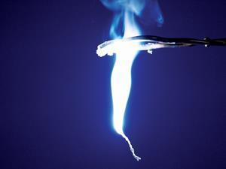
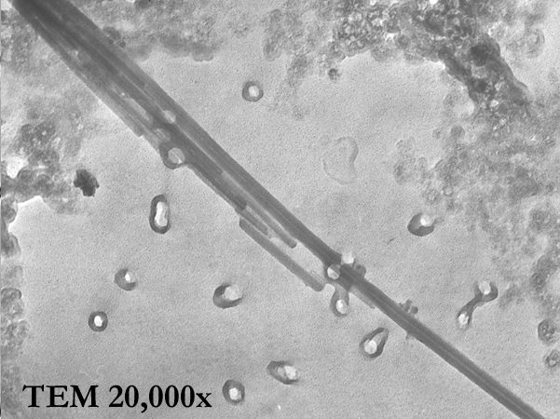
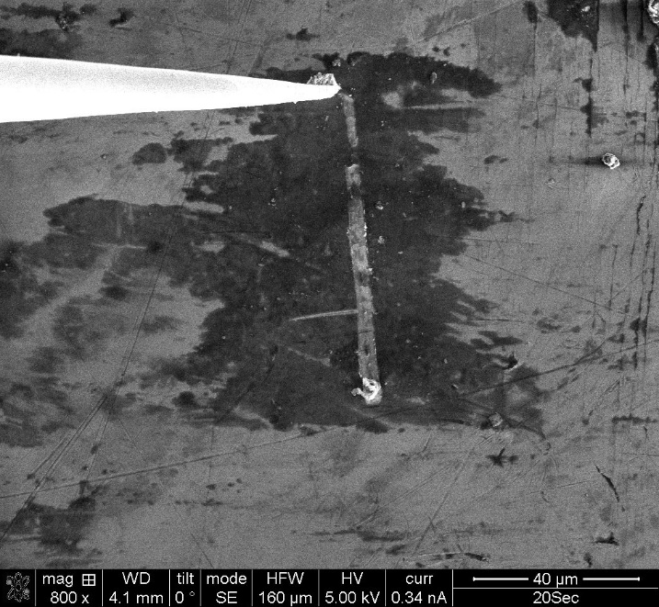
“Brains” Methods
MgO smoke particles
Asbestos concentrations
Scrape relevant material off (tribolayer)
Notes:
1. Burn Mg, hold grid above
2. Asbestos standard test – wave grid in air certain # of times (commercially) and measure density of fibers on grid
3. Graphitic layer (fib liftout manipulator used to scrape off material and put on grid)

Slide 8
Powder Methods
Dip TEM grid into powder
Drop cast from a solution or suspension (e.g. nanoparticles)
Crush a brittle sample and disperse in a solution for drop casting
  Be careful!
  Won’t work for metals
  May cause deformation (e.g. fracture)
Disadvantages:
  Can’t control orientation of sample
If you can avoid something, then avoid it.

Slide 9

Drop Casting
Add very little amount of powder to a solvent (e.g. ethanol, isopropanol, etc.)
Sonicate until well dispersed
Drop cast onto a TEM grid over a Kimwipe (to surface tension of the solvent)

Slide 10
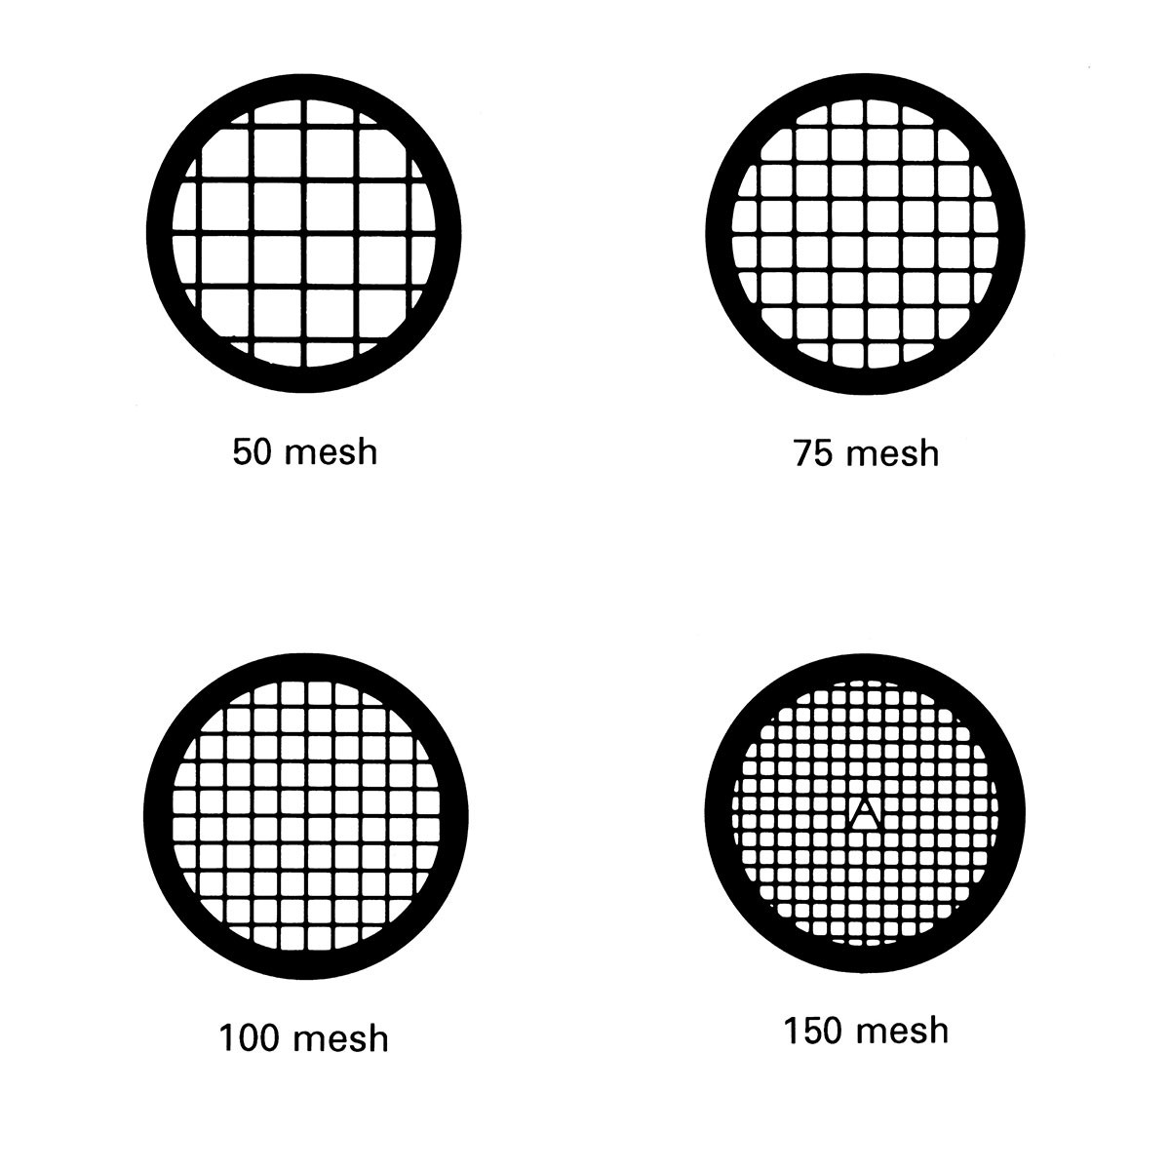
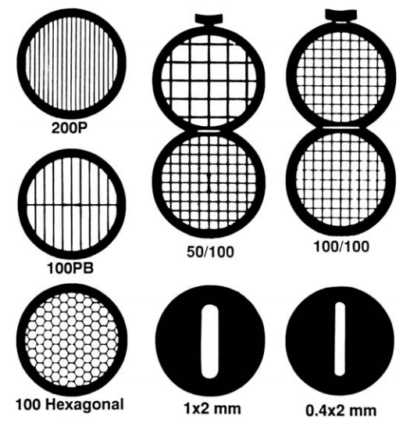
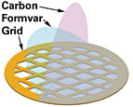
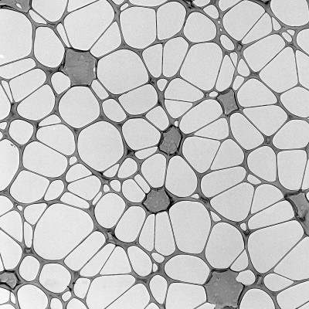
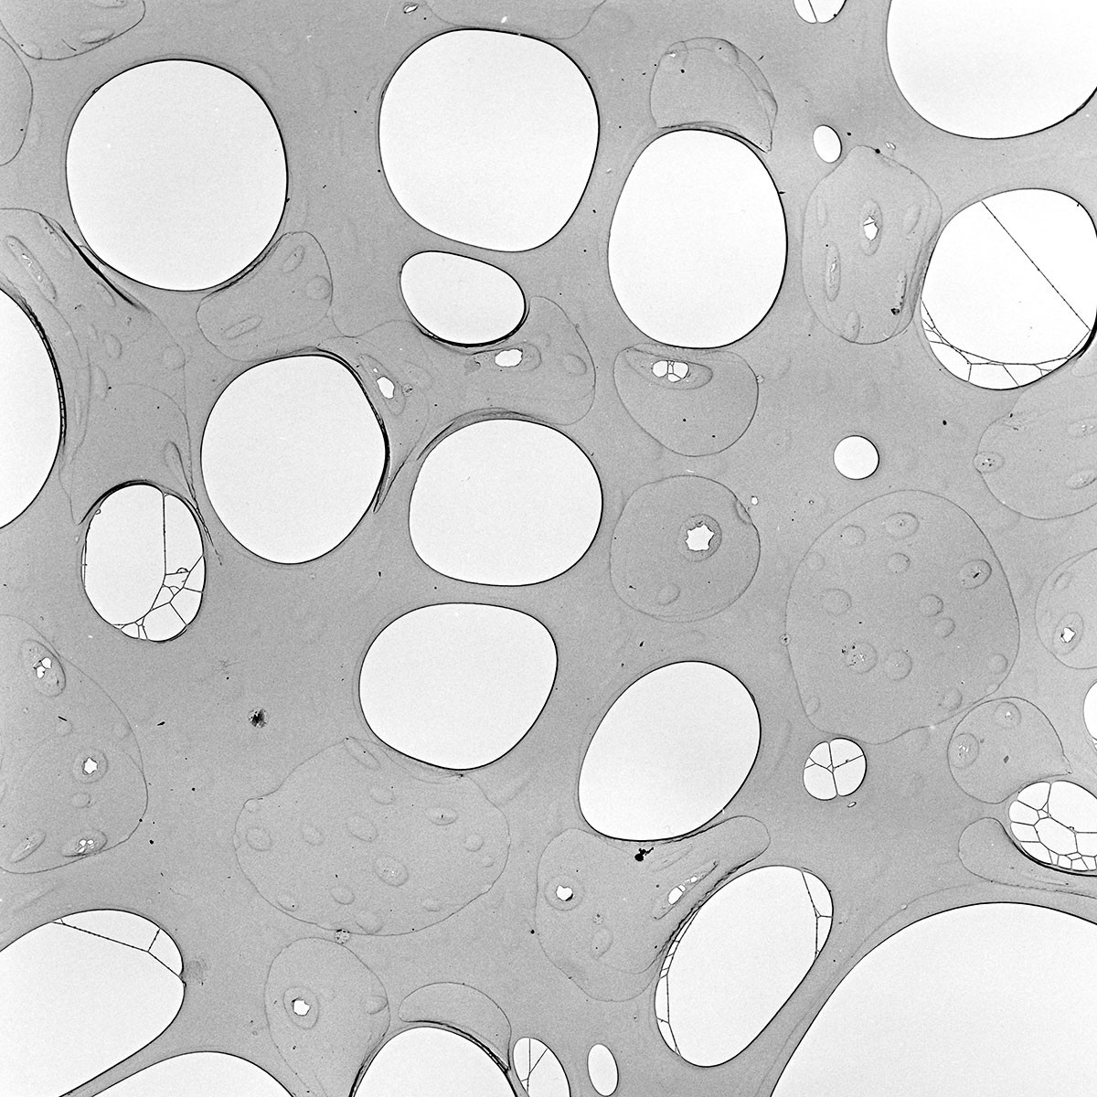

TEM Grids
Many different grid types
and shapes
Film materials
  Carbon – conductive, transparent
  Formvar – adds support, but decreases
  resolution (interferes with signal)
  Silicon nitride – stable at high temperatures
Film shapes
  Film
  Lacey carbon
  Holey carbon

Slide 11
Bulk Materials
 | Electropolishing | Ion milling | Focused Ion Beam
Metal and alloys | Yes | Yes | Yes
Ceramics | No | Yes | Yes
Polymer | No | Yes | Yes
Solid thin film | Not common | Yes | Yes

Slide 12
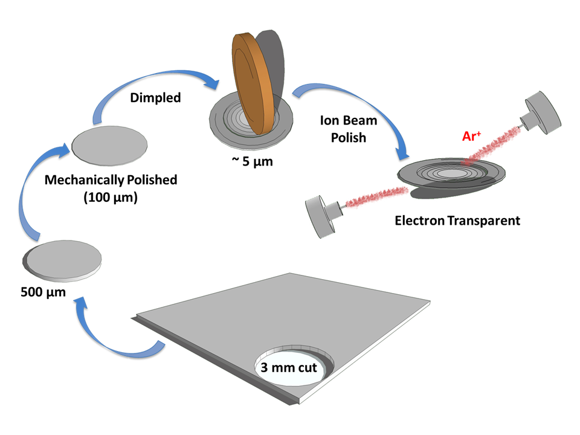
Ion Milling Procedures
Notes:
Rotary punch (SiC slurry)

Slide 13
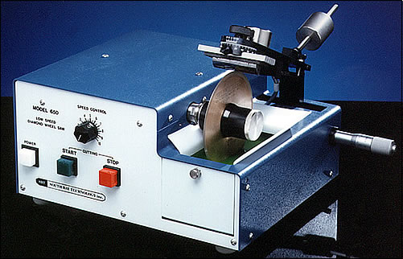
Cutting
~500 μm
Low Speed Diamond Wheel Saw
Alternatively, grow or buy a thin sample
Notes:
Cutting. Use a precision saw with a piece of abrasive wheel to cut the bulk sample into thin slices. The slice thickness can be controlled by the saw. If it is too thin, the slice may break or get distorted; while if too thick, more materials are consumed and it will take much effort to thin it in the following procedures. Normally 0.7 mm is an optimal thickness. Cutting fluids should be used to prevent the specimen from heating and lubricate the cutting tool, and cutting dressing should be used to remove fragments on the saw surface every few minutes. This cutting process is normally done in few minutes, and the operator should stay onsite until it is completed.

Slide 14
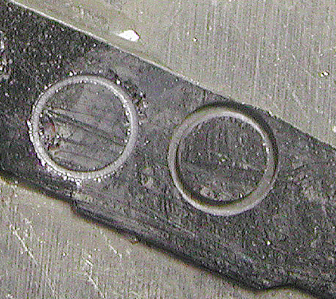
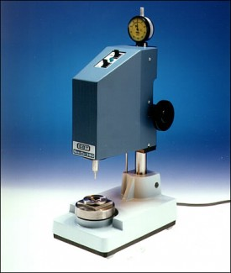
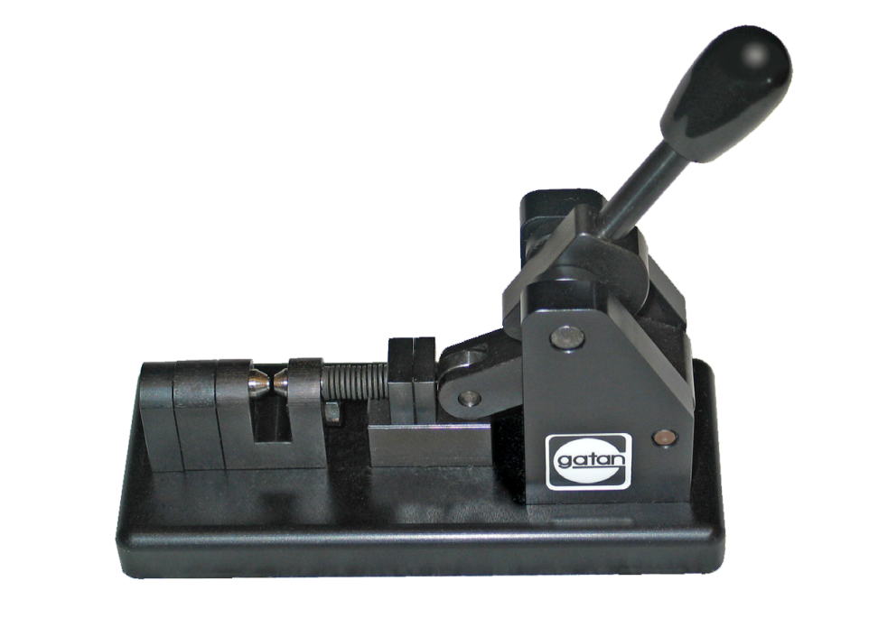
Disk Cutting
Starting about 500 μm in thickness
Cut into 3 mm disks using disc punch or ultrasonic cutter
Disk punch (ductile)
Ultrasonic disk cutter (brittle)
Notes:
Drilling to small disks, with diameter about 3 mm or little smaller, using an ultrasonic disk cutter (Fig. 2.4c). If the sample is ductile, like metals, use a sample puncher to get thin disks.
NUANCE sample prep facility in EPIC has I believe two different instruments that can achieve this.

Slide 15
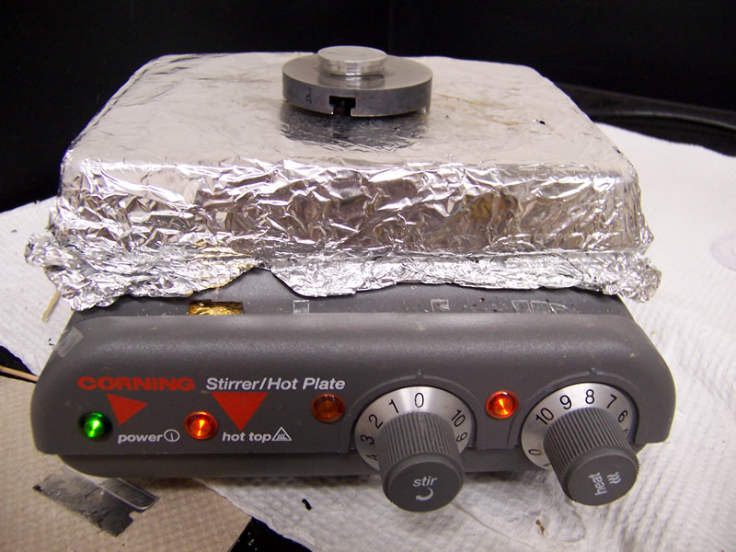
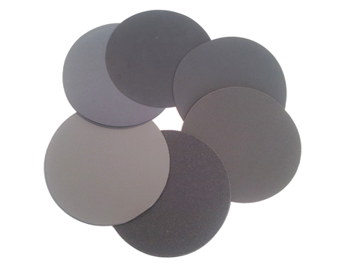
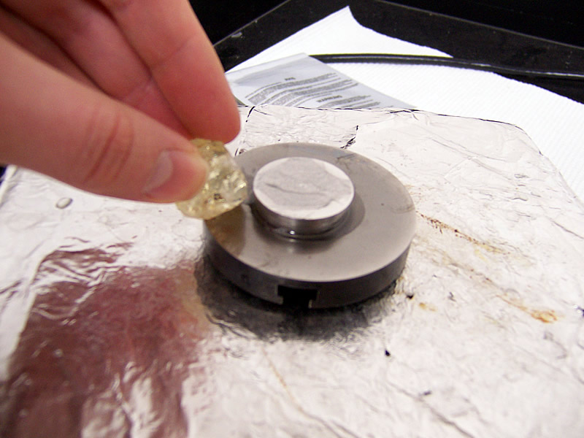
Mechanical Pre-Thinning
Grind with SiC sandpaper
Polish with Al₂O₃ or diamond suspension
Thin until ~70-100 μm
Sample holder
crystal bond wax
Notes:
Grinding and polishing. In order to handle easily, the thin slice is bonded to a sample holder, such as a big Al stub, using crystal bond wax. (it melts between 120 and 150 ° C upon heating, so that it can bond the sample when it cools down). The wax dissolves in acetone solvent. Precaution should be taken during grinding to avoid the sample being worn away or peeled off from the bond. Grind the sample from coarse grits gradually to fine grits, then polish it. Both sides should be polished, and the backside that is not used for dimpling should be well polished. After polishing, the specimen thickness is expected thinner than 100 μm, and normally 60 μm is achievable.

Slide 16
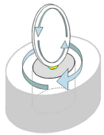
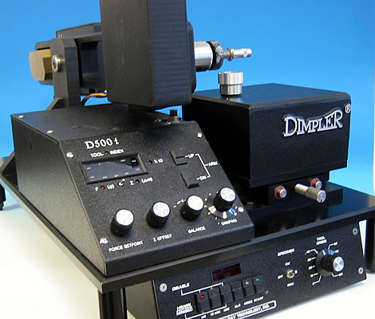
Dimpling
Dimple wheel
Dimple down to ~10-20 μm
Less time for ion-milling
Large thin area for TEM
Grinding slurry
Specimen
Sample Profile
10-20 μm
10-20 μm
Notes:
Dimpling. Mount a piece of disk on a dimpler holder using crystal bond, and dimple its top surface to get a depression (Fig. 2.4d). To obtain a good TEM sample, this process is very critical, since it is a mechanical process to remove the material without artifacts on the final sample. The remaining thickness should be as thin as possible while not penetrated at this stage. If it is too thick, it will take long time for ion milling, which may enhance ion milling artifacts. Slightly further dimpling to thin the thickness, if possible, will significantly reduce the following ion milling time, while precautions should be taken to avoid holes or breakage of the specimen. Generally after the dimpling process, the remaining sample thickness should reach 10– 20 μm. In addition, dimpling can be used to roughly select the perforation location.
To become electron-transparent and be able to get good images in the TEM, it needs to be even thinner than that, on the order of 10s of nm. That’s basically impossible to do precisely with mechanical polishing tools, so next…

Slide 17
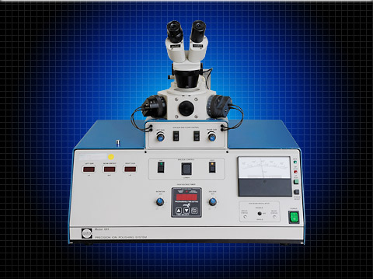
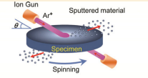
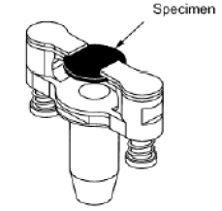
Ion Milling
Ion Gun
Ar⁺
Sputtered material
Spinning
Precision Ion Polishing System
(PIPS)
Ar⁺
0-10 kV
6º – 12º
Notes:
Ar implantation
a high-energy ion gun is used to bombard the top surface of the sample. The high energy ions interact with the loosely bounded surface atoms in the top amorphous layer of the sample under investigation and remove them to reveal an atomic level clean surface. Several parameters such as the ion energy, angle of beam incidence are adjusted throughout the process to optimize the sample preparation time and the quality of the surface.
The flower-petal fringes we saw in lab are due to the buckling of the sample
You need to watch closely at the end—keep going until you’ve punched a hole through the sample

Slide 18
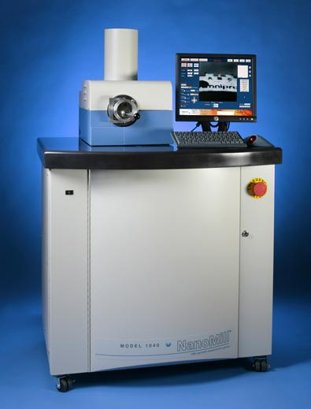
Remove Amorphous Layer
NanoMill® TEM specimen preparation system
Ultra-low energy ion source
Concentrated ion beam
Removes amorphous and implanted layers
Ideal for post-focused ion beam processing and milling of conventionally prepared specimens
Liquid nitrogen-cooled specimen stage
Fischione’s Model 1040
Notes:
The NanoMill system features gaseous ion source technology that results in ion energies as low as 50 eV and a beam size as small as 1 µm. It allows specimens to be prepared without amorphization, implantation, or redeposition. The ion beam can be targeted to a specific area of interest. A secondary electron detector is used to image the ion-induced secondary electrons that are generated from the targeted area of the specimen.
-.5 – 2 KeV

Slide 19
Grinding + Ion Milling
Pros:
  Thin area for HREM
  Most versatile thinning process, excellent for metal/oxide
Cons:
  Mechanical deformation
  Amorphous layer
  Radiation damage (and implantation)

Slide 20
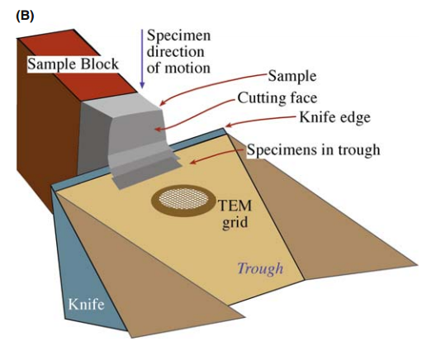
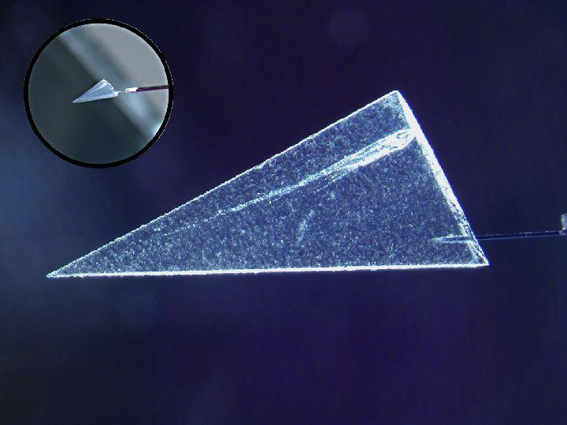
Ultramicrotome
Often used for sectioning biological samples or polymers (soft materials)
Good for embedded samples
Pros:
  Leaves chemistry unchanged
  Very thin samples
Cons:
  Fractures or deforms samples
https://stardust.jpl.nasa.gov/news/status/2006_aaas.html
Notes:
Quick and easy!
When sectioning with an ultramicrotome, the sample is inserted into an arm, mounted on special bearings, which performs a motorized vertical cutting movement. After the section has been cut and the specimen arm retracted, an extremely precise electromechanical feed moves the sample slightly forward by a set distance corresponding to the desired section thickness.
The sectioning is performed by a vertical movement of the specimen over the extremely sharp blade of a fixed glass or diamond knife.
Removing the sections directly from the knife blade is difficult, because they are so thin. They are, therefore, collected from the surface of the water bath (or with the help of a micromanipulator for the case of cryo-sectioning) after the sectioning procedure.
Any further preparation can then be done that may be needed before examination with electron microscopy (EM).
Biocryo facility has one?

Slide 21
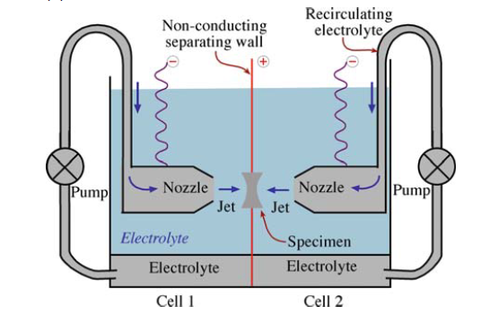
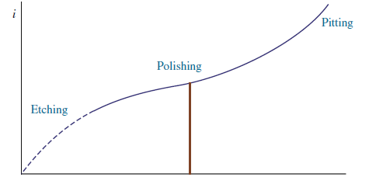
Twin-Jet Electropolishing
Electrolyte
Temperature
Jet speed
Voltage/current
Inspection
Current
Schematic of a twin-jet electropolishing apparatus. The positively charged specimen is held in a Teflon holder between the jets.
Voltage
Electropolishing curve showing the increase in current between the anode and the cathode as the applied voltage is increased.
Notes:
Quicker and requires less monitoring than PIPS, but only works for conductive samples
Electrochemical etching
Corrosive electrolyte vapor thins the sample; a lead sheet can be placed around the motor to shieled it from radiation if you have a radioactive sample (original use)
The electrolyte is pumped from the tank into the thinning cell and jets by an impeller pump driven by a 12v dc motor. A stainless steel plate fitted to the base of the motor protects it from the corrosive electrolyte vapour. The pump motor cover is easily removed so that lead sheet may be placed around the motor to shield it from radiation, if required. The photo-cell detector and light source plug into sockets at the ends of their respective leads. They are protected from corrosive electrolytes and ionising radiation by screw-on stainless steel housings that push-fit into the thinning cell. Perforation can be determined by eye when the photo-cell detector is removed from the cell. This is necessary if composite specimens of 1mm discs pressed into 3mm discs are to be thinned because perforations occurring at the interface must be ignored. Such composites can substantially reduce the amount of radioactivity and magnetism because only the 1mm disc is the radioactive or magnetic specimen. Thinning from one side only is achieved by placing a thin piece of glass over the disc. The glass is held in position during electropolishing by the screw-in portion of the disc holder.
NUANCE/EPIC sample prep facility has a struers twin-jet electropolisher

Slide 22
Twin-Jet Electropolishing
Pros
  No mechanical damage
  Free of surface roughness
  Free of strain hardening
Cons
  Preferential etching of multiphase material
  For conductive materials
  May change surface chemistry

Slide 23
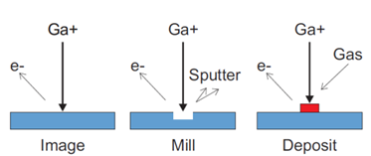
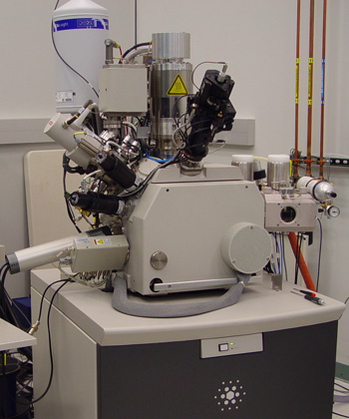
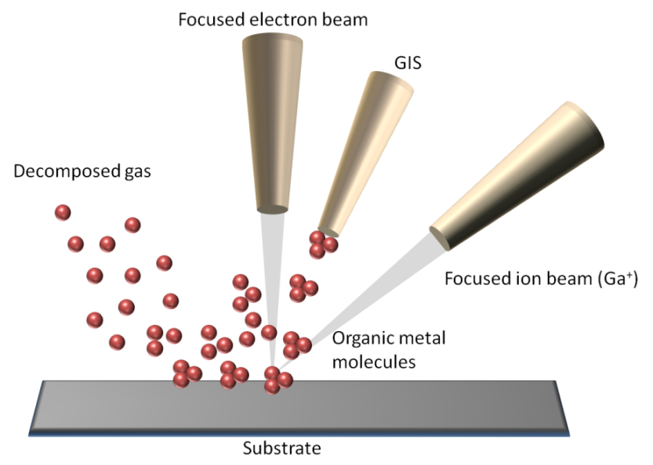
Focused Ion Beam
Notes:
Ga is a heavier ion, cuts more aggressively than ion milling
The high-energy Ga+ ion beams used in focused ion beam systems form defected, amorphous and/or implanted layer in the specimen. FIB, in general, produces TEM samples which are less suitable for high performance analytical (S)TEM (HRTEM, HRSTEM, high spatial resolution EELS and EDX) investigations. The low-energy Ar+ ion milling is ideal for the final stage of specimen preparation in order to decrease the defected layer.
FEB is just like an SEM, for viewing…
GIS gas injection system (puts down precursor)
Electron gun (for viewing), ion gun, deposition gas delivery
Beam of ions hits sample and causes local sputtering, removing material in a controlled way
A special deposition gas may also be introduced which will decompose on the surface resulting in site-specific, very precise deposition. You can also sometimes do gas-assisted etching in a similar way
the gallium (Ga+) primary ion beam hits the sample surface and sputters a small amount of material, which leaves the surface as either secondary ions (i+ or i−) or neutral atoms (n⁰). The primary beam also produces secondary electrons (e⁻). As the primary beam rasters on the sample surface, the signal from the sputtered ions or secondary electrons is collected to form an image.
At low primary beam currents, very little material is sputtered and modern FIB systems can easily achieve 5 nm imaging resolution (imaging resolution with Ga ions is limited to ~5 nm by sputtering^{[2][3]} and detector efficiency). At higher primary currents, a great deal of material can be removed by sputtering, allowing precision milling of the specimen down to a sub micrometer or even a nano scale.
If the sample is non-conductive, a low energy electron flood gun can be used to provide charge neutralization. In this manner, by imaging with positive secondary ions using the positive primary ion beam, even highly insulating samples may be imaged and milled without a conducting surface coating, as would be required in an SEM.

Slide 24
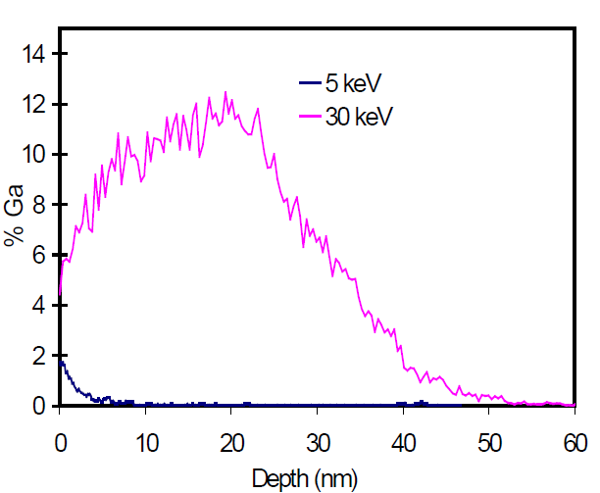
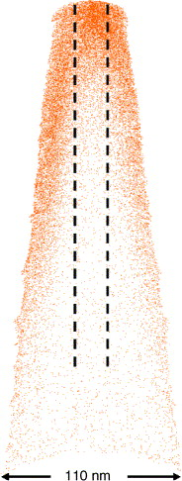
Ga⁺ Implantation
Ga⁺
Atomic-map of a Si specimen sharpened in a FIB with 30 keV Ga ions
Ga⁺ implantation profile in Si for 30 keV and 5 keV accelerating energies.
Thompson K, Lawrence D, Larson D J, et al. Ultramicroscopy 107 (2007) 131-139
Notes:
May adjust chemistry of your sample, as Ga+ will be implanted up to 50 nm deep (at 30 keV)

Slide 25
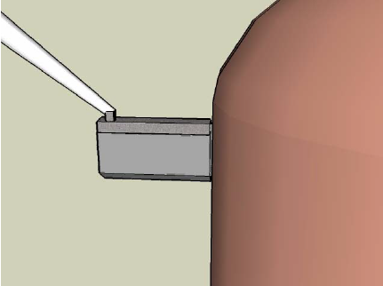
TEM Sample Prep with FIB
Pt Deposition
Bulk-Out
U-Cut
Lift Out
Mounting
Thinning
Cleaning

Slide 26
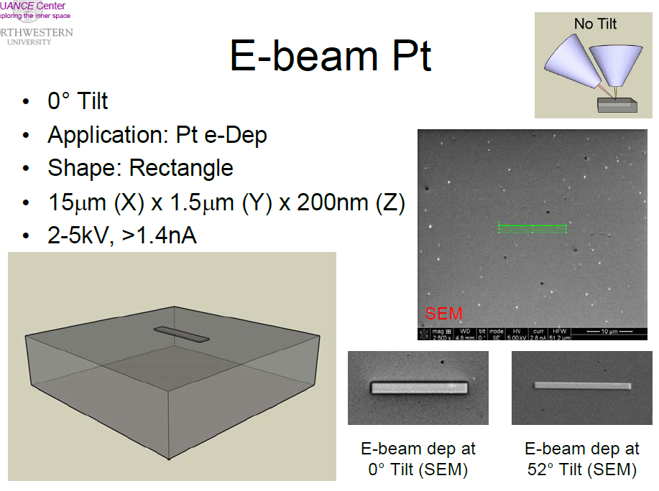
Notes:
Pt protects the sample from the cutout process
First protective layer (not as severe Ga implantation)
“optional”
No tilt means the electron beam is there to do the work

Slide 27
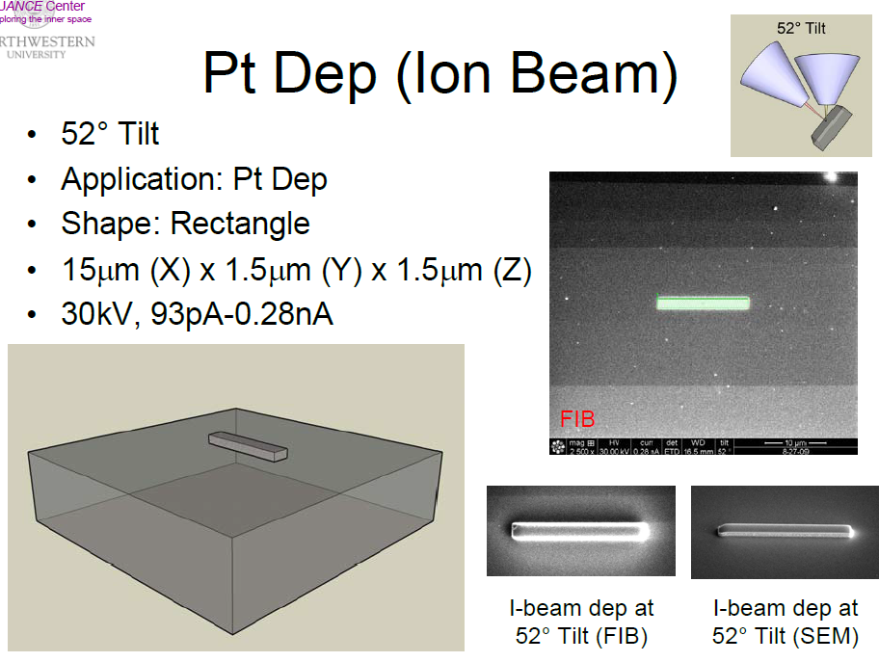
Notes:
52deg. Tilt says ion beam is doing the work, instead of electron beam

Slide 28
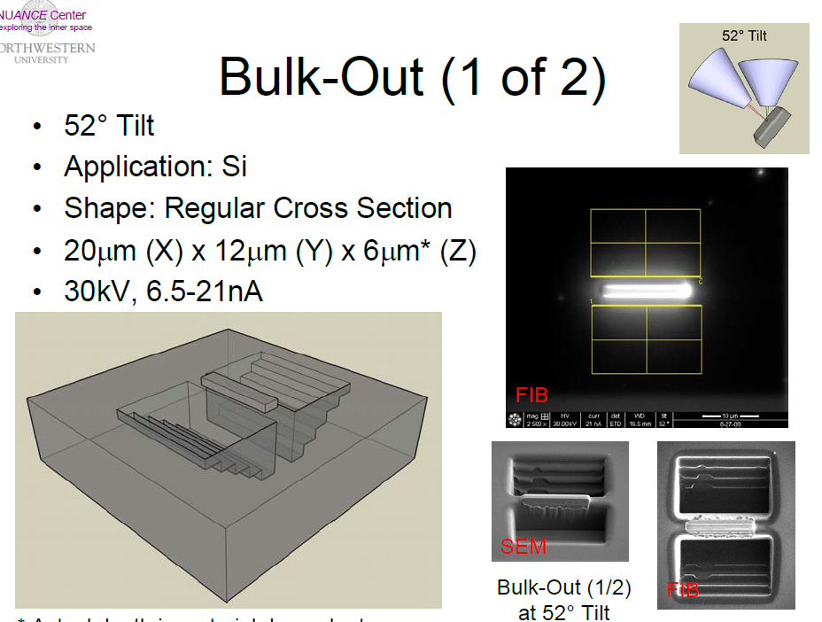
Notes:
These grooves are a result of the default “regular cross section” program, which just cuts away the material in the most efficient way.

Slide 29
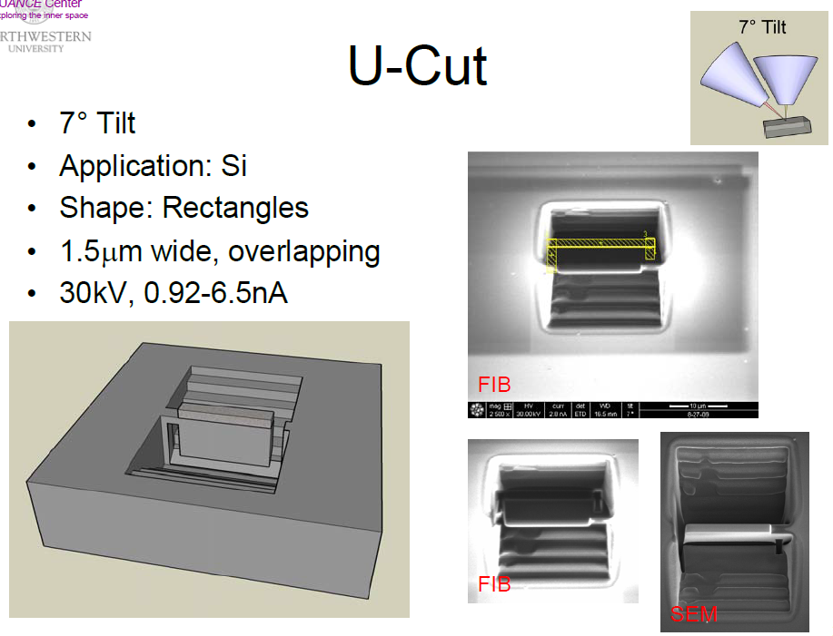

Slide 30
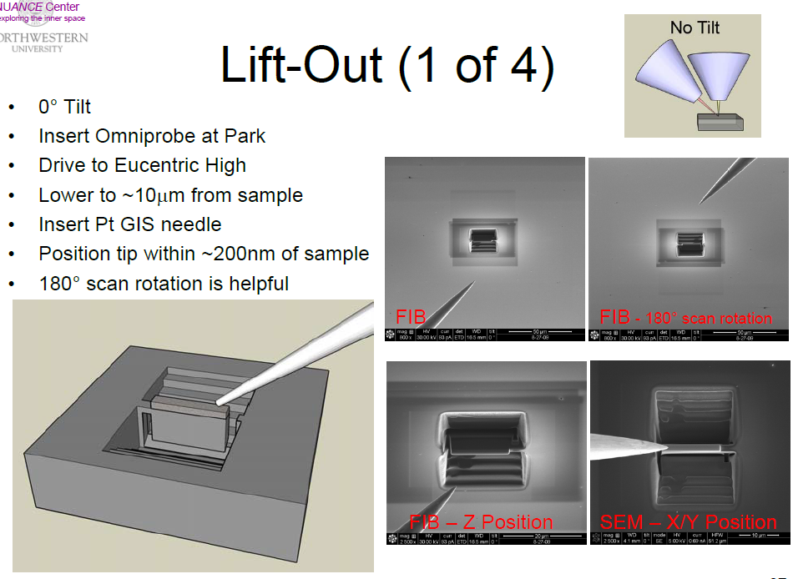

Slide 31
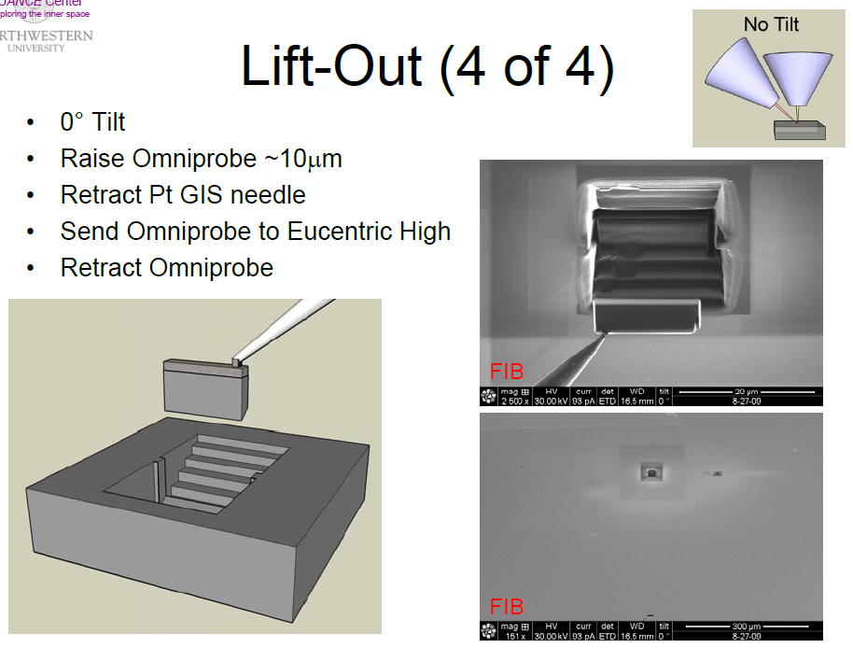

Slide 32
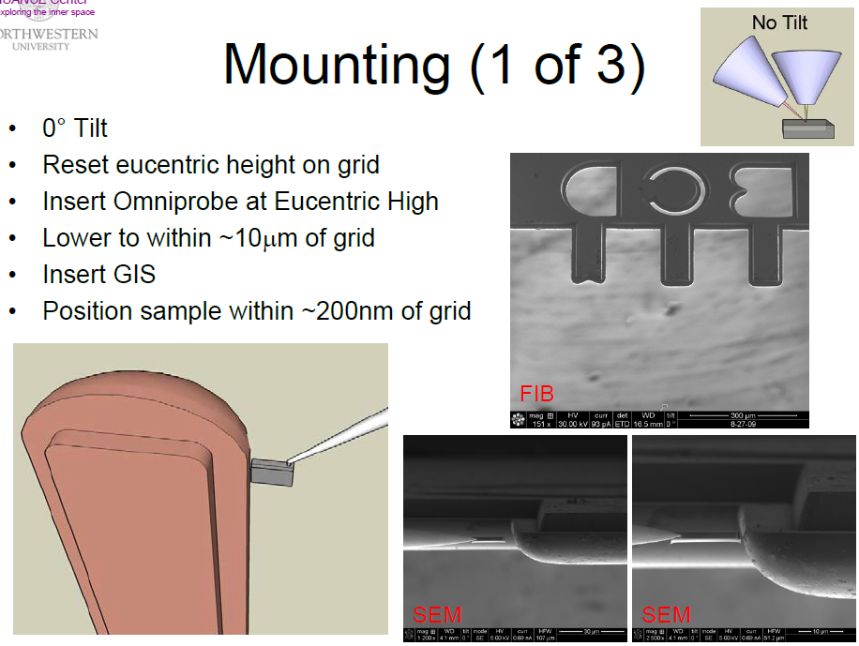

Slide 33
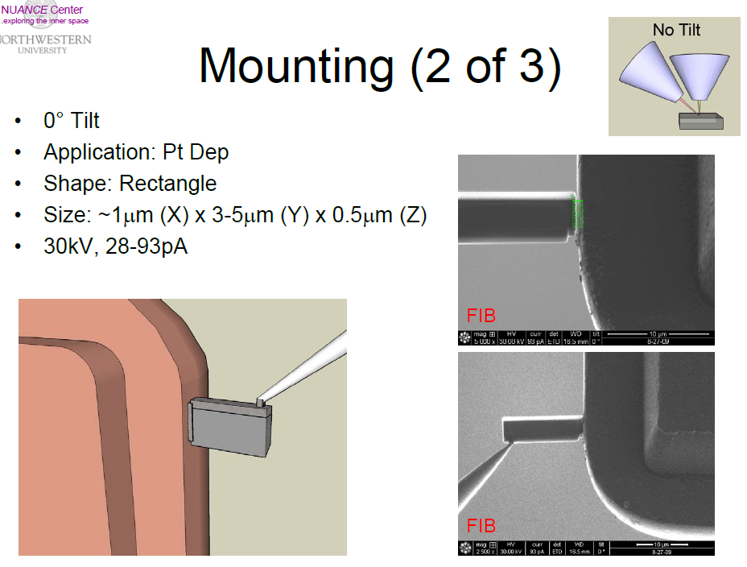

Slide 34
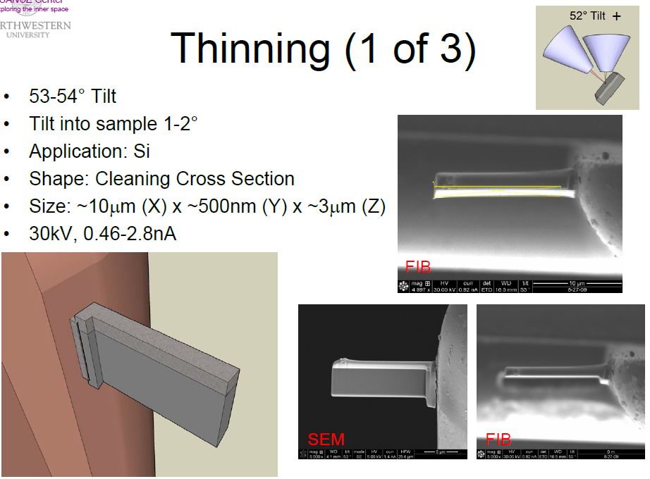

Slide 35
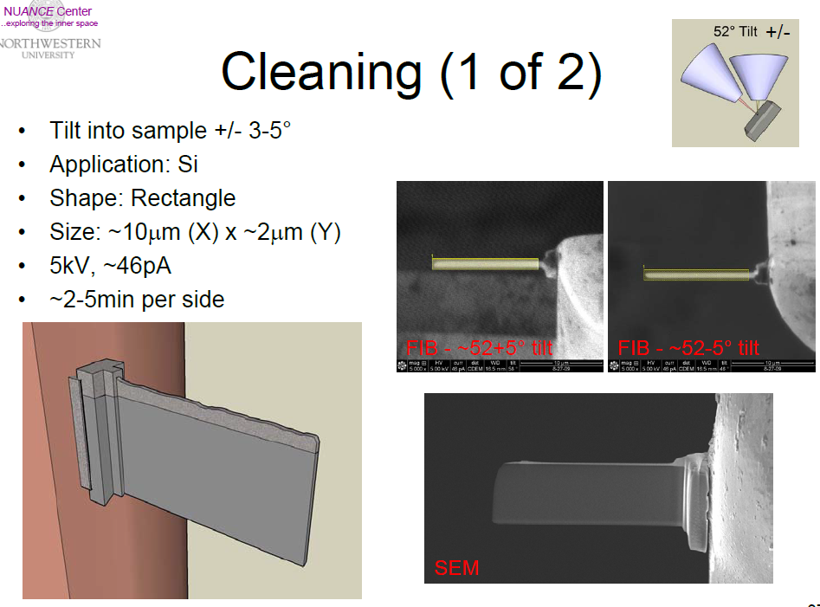
Notes:
Further ion milling (but still using Ga instead of Ar)

Slide 36
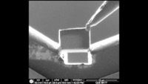
FIB Lift-Out Process
https://www.youtube.com/watch?v=vNOpzDViAhE
Notes:
Entire process is 4-5 hours! And the success rate has a steep learning curve

Slide 37
Site-Specific TEM Specimen
SEM plane view
SEM cross section
Grain A
GB
Grain B
Grain B
Grain A

Slide 38
Sample Prep Artifacts (1)
Variable thickness VS uniform thickness
  Difficult to image and understand
  Limited area for EELS and chemical analysis
  May not see low density features (defects, precipitates)
  Poor statistics
Surface films
  Contamination (Left over residue from sample prep method)
  Surface oxides
  Irregular topography
  Contamination buildup
  Amorphization

Slide 39
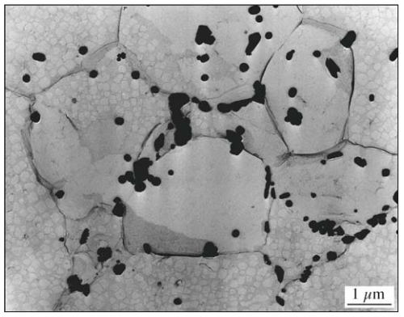
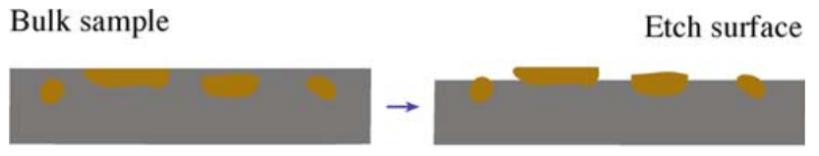
Sample Prep Artifacts (2)
Differential thinning
  Different phases or orientations thin at different rates
  Grain or phase boundary grooving
Selectivity
  Not representative of full sample
  If you crush a sample, you lose
  microstructure information
  Debonded regions that fall off
“False” defects
  High defect density obscures microstructure
  Deformation caused defects
  Heating changes defects

Slide 40
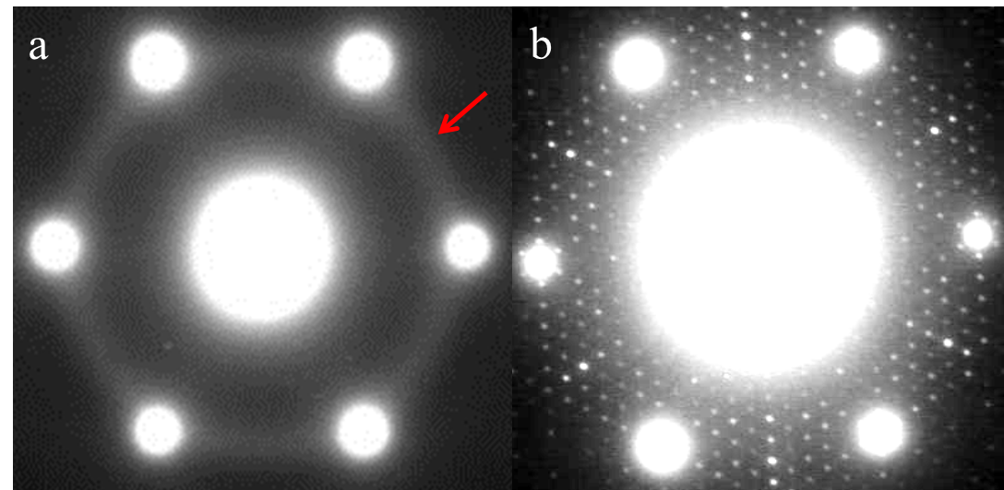
Sample prep can affect experimental data
Notes:
STO
Post-PIPS (amorphous ring)
Heated
Surface reconstruction (smaller spots)

Slide 41
Case Studies: Sample Prep & General Electron Microscopy Techniques

Slide 42
Case Study I
You find an unlabeled single crystal sample in your lab. You believe it is some type of ceramic. Using electron microscopy, how would you determine what the sample is?
How would you determine its orientation?
Notes:
Orientation: ion beam milling for electron diffraction
What it is: crush that up into a powder! XRD is so much cheaper and quicker than TEM/ED for a first pass

Slide 43
Case Study II
A colleague comes to you with a sample. They claim they grew SrTiO₃ nanoparticles doped with 0.3 wt% La. How would you prepare a sample? What techniques would you use to characterize the nanoparticles?
Notes:
Drop cast (NPs)
EELS/EDS would make a quick check, but try ICP for higher res of small weight percents
Always make sure someone gave you what they think they did
To characterize NPs, could try a number of things but SE imaging in S-TEM (higher res than SEM) is a good place to start (size, shape, etc.)

Slide 44
Case Study III
Manufacturers often apply a coating to drill bits to increase their strength. You are contacted by a company interested in making a new coating, but they want to see what other manufacturers are using first. How would you prepare a sample to determine what the coating is?
Notes:
Scrape!
If you can’t, cut off a cross-section for SEM/STEM-EDS

Slide 45
Case Study IV
Your customer has several alloyed samples of different compositions and is interested in their corrosion resistance, especially what is happening at grain boundaries. For instance, what is the grain boundary orientation and composition? How would you prepare samples and characterize the grain boundaries?
Notes:
Unfortunately, for that much detail of a single grain boundary: FIB
For general composition and density of GB’s, regular ion milling would be ok

Slide 46
Case Study V
Your collaborator has grown a superlattice structure of m x (LaMnO₃)/n x (SrTiO₃) layers (m = n = 2). You are tasked with characterizing the quality of the growth (i.e. sharp interfaces, defect free, stoichiometry). How would you prepare a sample and what techniques would you use?
Notes:
Ion beam, regular cut/polish
To see sharpness of interfaces and defects, you’d probably want HRTEM
Stoichiometry would be EDS, probably
To see layers/interfaces, LMO is much heavier than STO, so HR-HAADF would be a good one!

Slide 47

Case Study V
A. B. Shah Adv. Mater. 22 (2010) 1156-1160.
Notes:
Std oxide cutting & PIPs, etc.

Slide 48


