Slide 1
The Phase Problem for Electrons
L. D. Marks
Northwestern University
Electron Crystallography is the branch of science that uses electron scattering and imaging to study the structure of matter

Slide 2
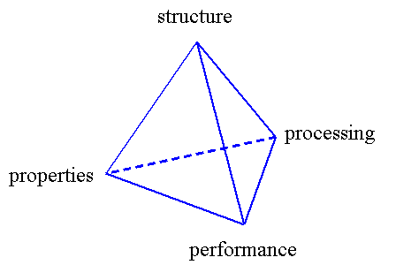
What is the science?

Slide 3
Why determine the structure?
To finish my PhD
To get/keep my job
Because structure coupled with other science really matters – but only when coupled
Follow the science, not the electron

Slide 4
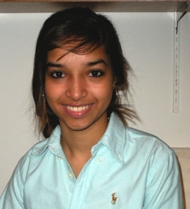
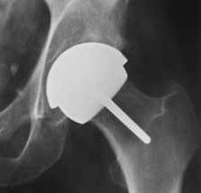
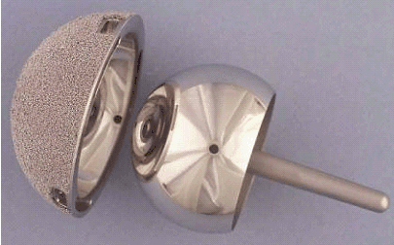
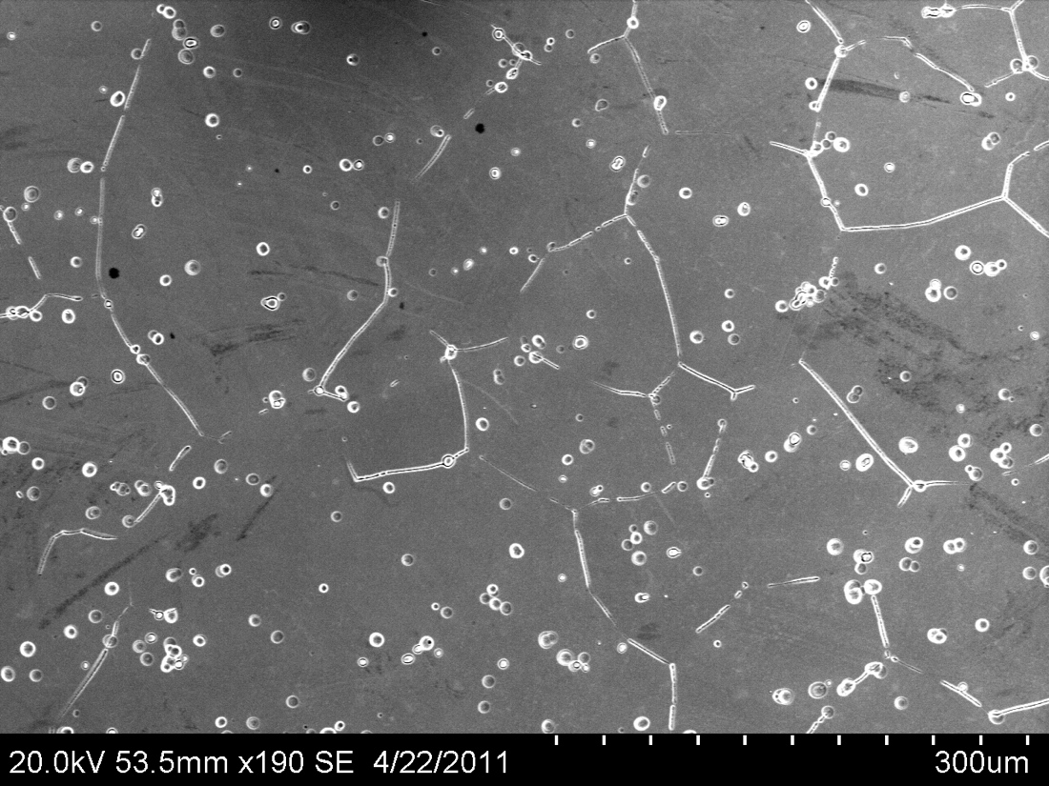

Metal-on-Metal
Hip Replacements
Alloys show differential corrossion in Bovine Calf Serum, attack at some grain boundaries and matrix carbides
SEM Image
Pooja Panigrahi, undergraduate thesis, 2011
4

Slide 5
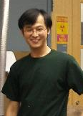
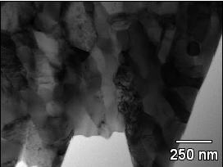
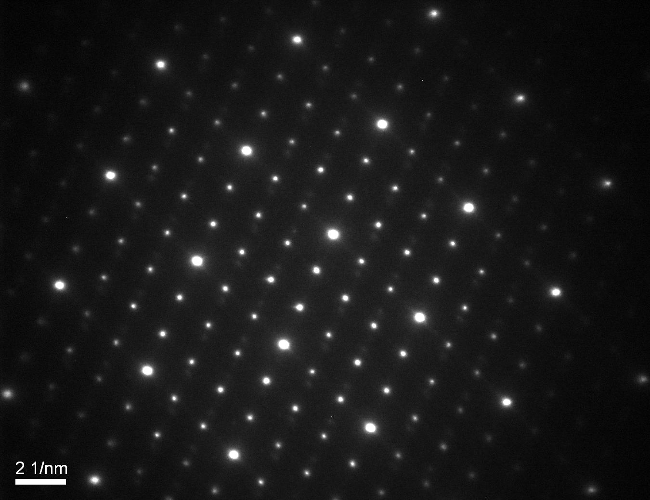
Carbides
ZA [011]
54.7
-200
-600
-1-11
333
What are the carbides (currently unclear)? Do different carbides corrode differently in humans?
Yifeng Liao et al, submitted

Slide 6
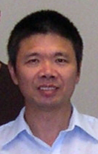
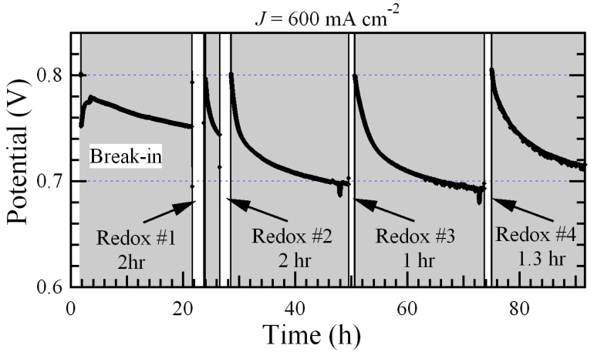
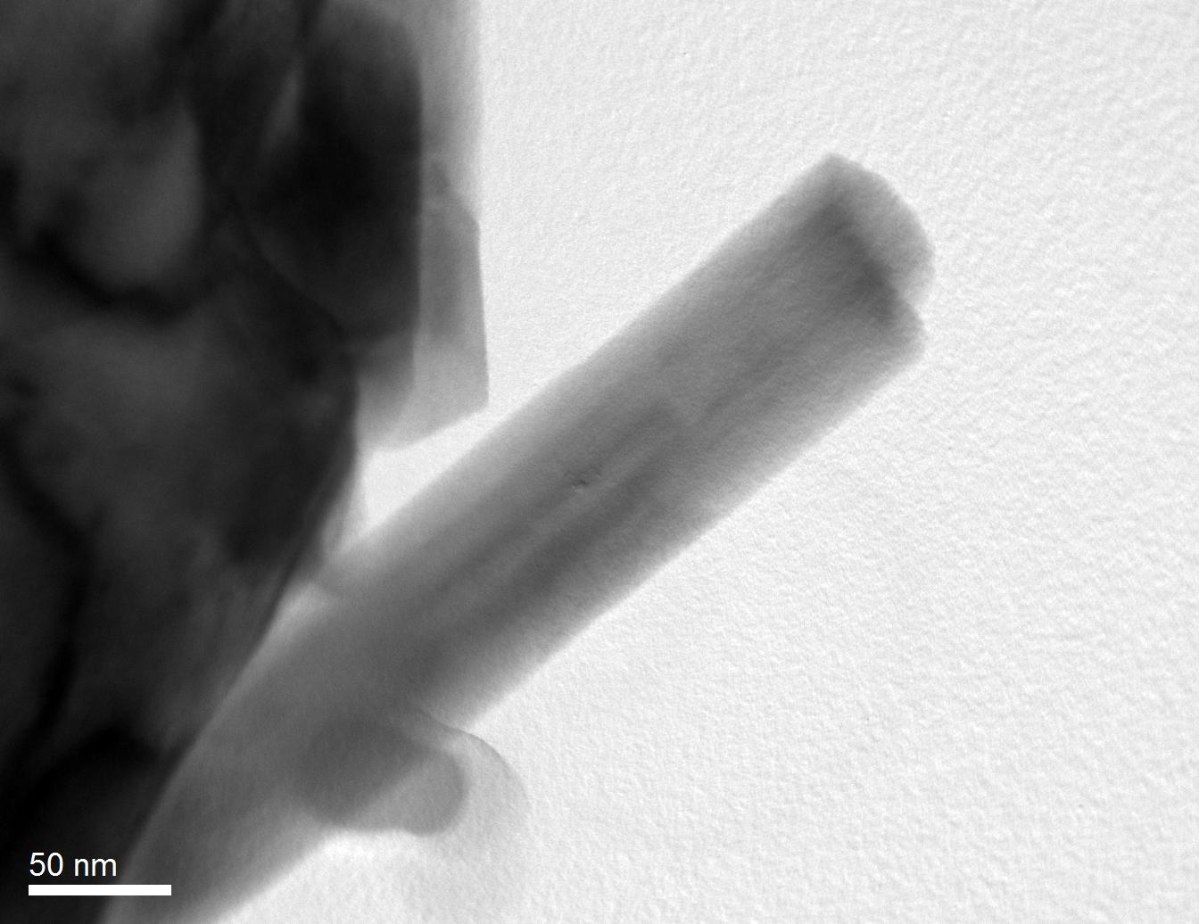
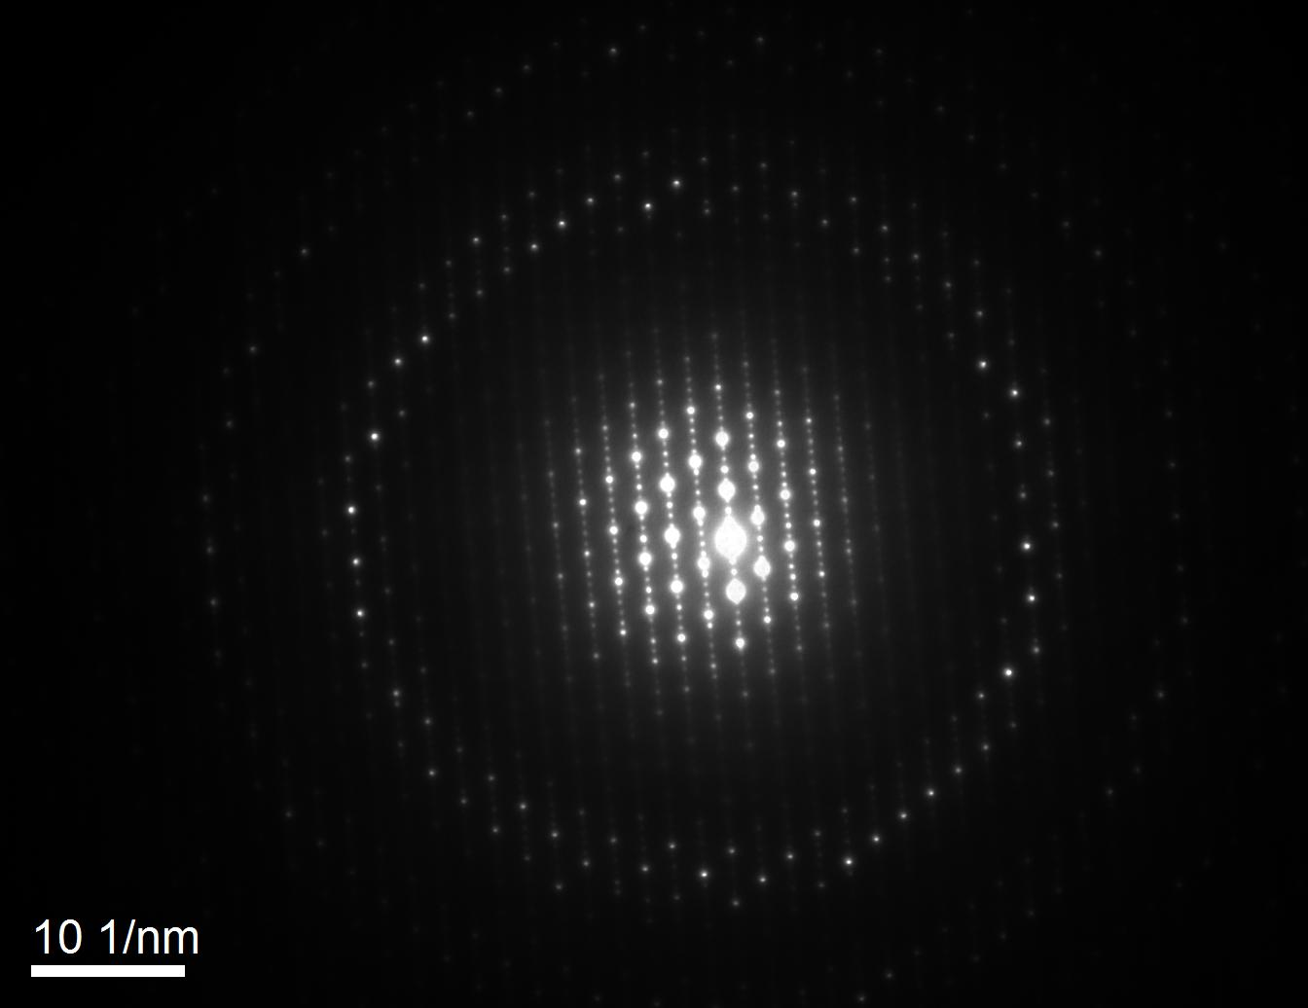

Solid Oxide
Fuel Cells
Pd nanoparticles formed in-situ have much better performance
La_{0.84}Sr_{0.16}Cr_{0.45}Pd_{3.61}O_{x}
Pd ~ 71%
Yougui Liao et al, submitted

Slide 7


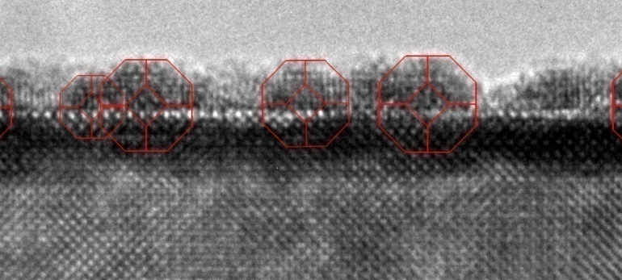
Thermodynamic Shape Control
Pt
SrTiO₃
More reactive (propane oxidation)
SrTiO₃ (001) surface dictates epitaxy →nanoparticles → catalysis
Substrate
Enterkin, J. A et al, Nano Lett. 11, 993 (2011); ACS Catalysis, 1 (6), 629, 2011
7

Slide 8
How to solve a structure?
Guess, then refine
  Will always give something, but if the guess is wrong GIGO
Use Patterson function
  Difficult for complicated structures (more to come)
Use DFT¹
  If the original guess is wrong, GIGO
  Functionals are inaccurate for most oxides (energies wrong)
Get an image
  STM is hard to interpret
  HREM, can be ambiguous (more to come)
Get a Diffraction Pattern
  Incomplete information (more to come)
¹For later today

Slide 9
Four basic elements are required to solve a recovery problem
1. A data formation model
  Imaging/Diffraction/Measurement
2. A priori information
The presence of atoms or similar
3. A recovery criterion:
  A numerical test of Goodness-of-Fit
4. A solution method.
  Mathematical details
Patrick Combettes, (1996). Adv. Imag. Elec. Phys. 95, 155

Slide 10
Four basic elements are required to solve a recovery problem
1. A data formation model
  Imaging/Diffraction/Measurement
  Kinematical Theory/Linear Imaging
  Single Weak Scattering + Ewald Sphere
  Qualitatively correct; Quantitatively inaccurate
  Bragg’s Law
  Single Scattering + Zero Excitation Error
  Worse than Kinematical Theory (it is different)
  Dynamical Theory/Non-Linear Imaging
  Quantitatively correct, to the accuracy of the electrostatic potential (exact in principle)
Warning: Errors in the model introduce systematic errors in the recovery which of course can lead to GIGO

Slide 11
Patterson Function I
(FT of Diffraction Pattern)
ρ(x, y, z)
(u v w)
(u v w)
y
x
v
u

Slide 12
Patterson Function II
Solids normally contain well-separated atoms, and majority of scattering is near the core -- peaked
Patterson map will contain points corresponding to vectors between atoms in the real cell
Real Cell
Patterson Cell
y
v
u
x

Slide 13
Patterson Function
Real Cell
Patterson Cell
1) Patterson is symmetric about origin (centrosymmetry)
2) Can see pattern of real cell in Patterson cell repeated N times
3) Contains N(N-1) peaks (not counting origin) → gets complicated!

Slide 14
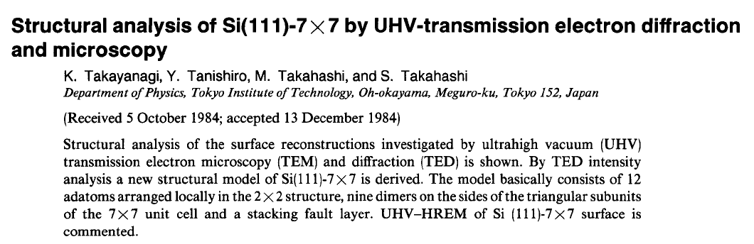
Patterson Function
J Vac Sci Technol A3, 1502 (1986) > 1800 Citations

Slide 15
Diffraction Phase Problem
Surface ρ(r)
FFT
F(h) = |F(h)|exp[2πiΦ(h)]
Measured diffraction intensities
|F(h)| = [I(h)]^{1/2}
Unmeasured
An equal opportunity problem – true for x-ray and electron diffraction

Slide 16
Basics
We know the amplitudes
We want to find the phases
Problem is insolvable without additional information – constraints
Use an iterative approach

Slide 17
The Phase Problem
We have an exit wave from the sample
  ψ(r) wave in real space = a(r)exp(-iφ(r))
  Ψ(u) = ∫exp(-2πiu.r)ψ(r)dr = A(u)exp(-iφ(u))
Observables
  I(r) = <|ψ(r)|²> = <a(r)²> Real Space Image
  I(u) = <|Ψ(u)|²> = <A(u)²> Diffraction Pattern
Note: “<>” is average over incoherent aberrations and other statistical terms

Slide 18


Phase: Apples & Oranges
FT A_{a} exp(-i φ_{a})
FT A_{o} exp(-i φ_{o})
+
{
Oranle ?
Appge ?
A_{o} exp(-i φ_{a}) IFT
Phase of Apple + Amplitude of Orange = ?

Slide 19

Phase of Apple = Apple
FT⁻¹ {A_{o} exp(-i φ_{a}) }
Apple
Phase is more important than amplitude

Slide 20
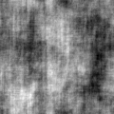
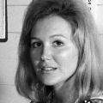

The importance of phase information
Correct Modulus Random Phases
Correct Phase Random Modulus
Suzy

Slide 21





Role of error in phases (degrees)
0 10 20
30 40 50
We would like to find the phases exactly, but we don’t have to

Slide 22
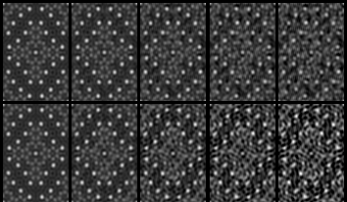
Phase and Modulus Errors
0 10° 20° 30° 40°
Phase Error
Modulus Error
Modulus Correct
Phase Correct
R 0 26% 52% 78% 104%
We only need approximately correct phases We can tolerate modulus errors

Slide 23
How do we overcome this
Recover phase information from a series of images at different defocus.
  Classic inversion problem which can be ill-conditioned
Recover phase information for special cases where solution is exact (in principle)
Recover approximate phase information using constraints (direct methods)

Slide 24
Inversion
I(r) ~ ∫Ψ(u)T(u)exp(2πiu.r)du + noise
write A(u)=Ψ(u)T(u)
The optimal filter (L2) F(u) to apply is given by (Wiener, 1940)
F(u) = T*(u)/{|T(u)|²+n(u)²/S(u)²}
n(u) = spectral distribution of noise
S(u) = estimate of signal

Slide 25

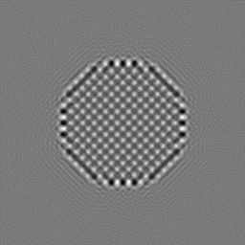

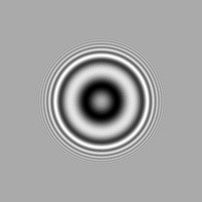
Wiener Filtering
Aberrated Image
Original Test Object
Linear CTF (close to correct)
Wiener Filtered
Simple Example

Slide 26
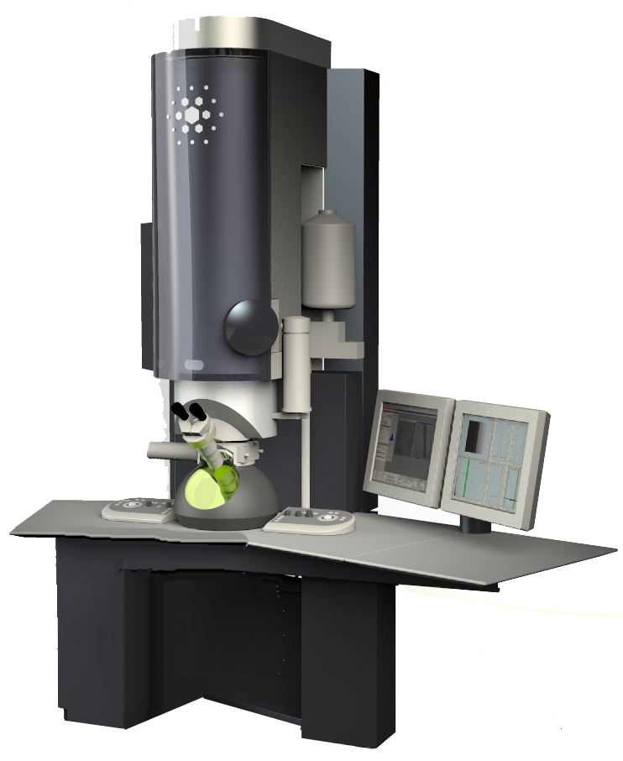
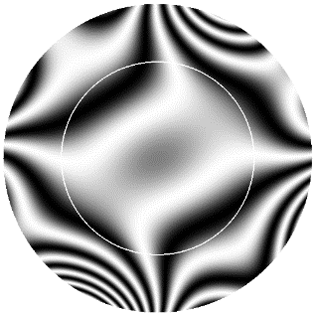
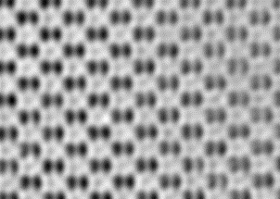
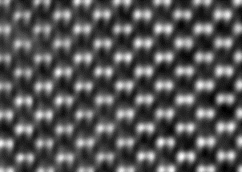

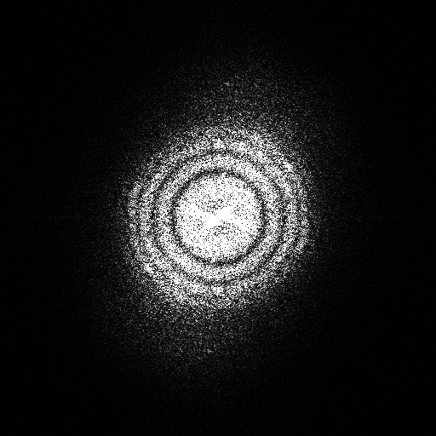
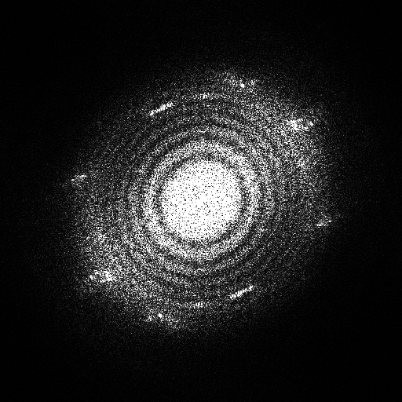
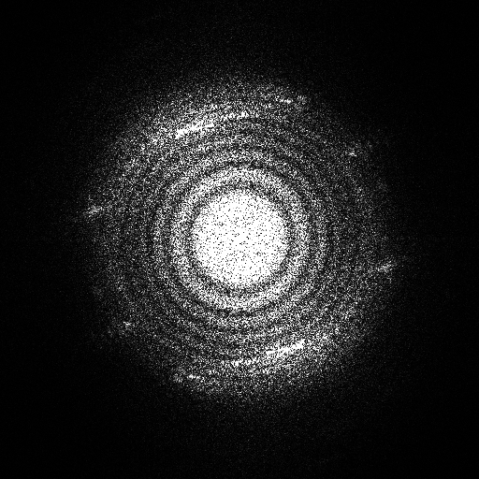
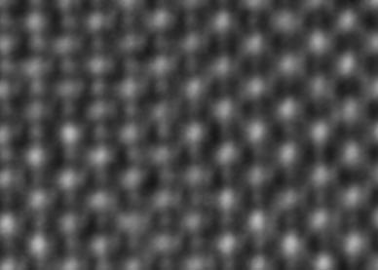
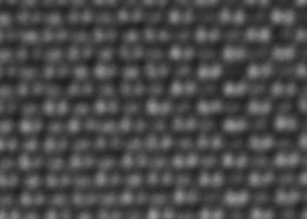
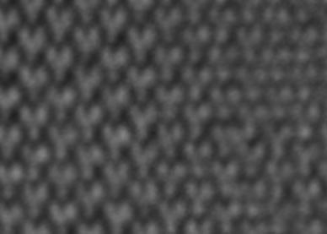
Aberration control & reconstruction of electron wave function
Aberration Function χ(g)
Wave Function Ψ(r)
hardware
feedback
ATLAS
TrueImage
illumination tilt series
through-focus series
software correction of residual aberrations
Curtesy Rafal Dunin-Borkowski
FZ Jülich
Notes:
26

Slide 27
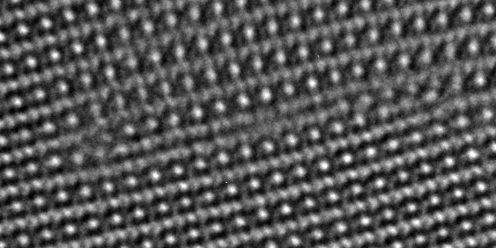
ATLAS & TrueImage:: Stacking Faults in SrTiO₃ (110)
Z_{opt} micrograph
Titan 80-300
deficiencies:
shaded columns
inf. signal-to-noise ratio
spurious contrast peaks
Ti
O
[001]
1.38 Å
-
[110]
J. Barthel, PhD Thesis (2007)
Curtesy Rafal Dunin-Borkowski
Notes:
27

Slide 28
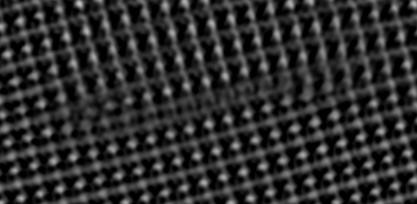
ATLAS & TrueImage:: Stacking Faults in SrTiO₃ (110)
uncorrected phase image
Titan 80-300
deficiencies:
shaded columns
Ti
O
[001]
1.38 Å
-
[110]
J. Barthel, PhD Thesis (2007)
Curtesy Rafal Dunin-Borkowski
Notes:
28

Slide 29

ATLAS & TrueImage:: Stacking Faults in SrTiO₃ (110)
corrected phase image
Titan 80-300
deficiencies:
none
Ti
O
[001]
1.38 Å
-
[110]
J. Barthel, PhD Thesis (2007)
Curtesy Rafal Dunin-Borkowski
Notes:
29

Slide 30
Exact Cases
Suppose we have N pixels, and N/2 are known to be zero (compact support)
Wave is described by N/2 moduli, N/2 phases (for a real wave) in reciprocal space
Unkowns – N ; measurements N/2 ; contraints N/2
Problem is in principle fully solveable
(It can be shown to be unique in 2 or more dimensions, based upon the fundamental theorem of algebra)

Slide 31
Example: Diffractive Imaging
= ?
|ϕ(x,y)|=?
+
|ϕ(x,y)|=1
True diffraction pattern for small particle model
(Non-Convex Constraint)
Convex Support
Constraint

Slide 32
Example: Diffractive imaging
Constraint: part of real-space x is zero
(Convex constraint)
Iteration
  x = 0, part of map
  |X| = |X_{observed}|
Iterate

Slide 33

Phase Recovery
True real space exit wave for small particle model
Reconstructed exit wave after 3000 iterations

Slide 34
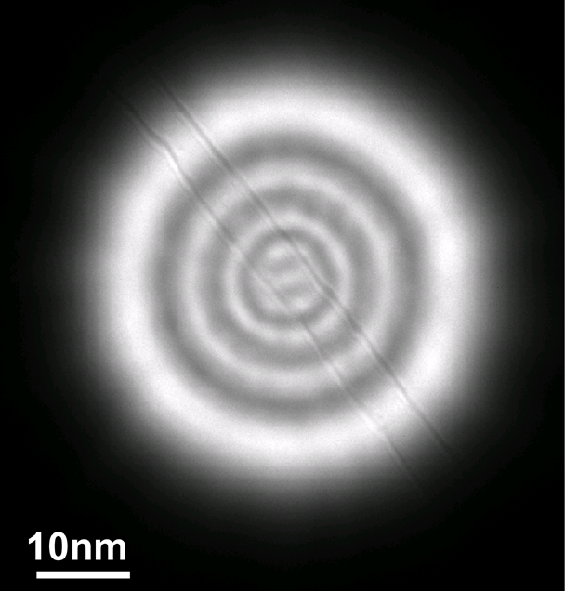
Electron Nanoprobe formation
Condenser Lens III
Lower Objective
Specimen
Back Focal Plane
10 μm aperture -> 50 nm beam
M = 1/200
JM Zuo et al, Science 300, 1419 (2003)

Slide 35
Coherence length > 15 nm
Convergence angle <0.2 mrad

Slide 36
Direct Methods vs.
Indirect Methods
Indirect Methods:
“Trial and Error”
Direct Methods:
Using available information
to find solutions

Slide 37
Implementation
Infinite Number of Possible
Arrangements of
Atoms
Direct Methods
Finite
R, χ², structure, DFT and chemistry

Slide 38
Caveat: Not Physics
This is probability, not an exact “answer”
All one can say is that the “correct” answer will be among those that are found

Slide 39
What do D.M. give us
With the moon in the right quarter -- real space potential/charge density
In other cases:
  Atom positions may be wrong (0.1-0.2 Å)
  Peak Heights may be wrong
  Too many (or too few) atoms visible
But... this is often (not always) enough to complete the structure
Chris Gimore

Slide 40
Additional Information Available
Physical nature of experiment
  Limited beam or object size
Physical nature of scattering
  Atomic scattering
Symmetry (sometimes) + unit cell
Statistics & Probability
  Minimum Information/Bias = Maximum Entropy

Slide 41
Basic Ideas
There are certain relationships which range from exact to probably correct.
Simple case, Unitary Sayre Equation, 1 type
Divide by N, #atoms & f(k), atomic scattering factors
Constraint
Sayre, D. Acta Cryst. 5, 60, 1952

Slide 42
Real/Reciprocal Space
U(r) ≈ U(r)²
18
U(r)
U(r)²
-2
1
1
-
Reinforces strong (atom-like) features

Slide 43
Σ₂ Triplet
For reflections h-k, k and h:
φ(h) ≈ φ(k) + φ(h-k)
W. Cochran (1955). Acta. Cryst. 8 473-8.
k
h
1
h-k
= known structure amplitude and phase
= known structure amplitude and unknown phase

Slide 44
Cochran Distribution (Σ₂): I
Definition:
Consider the product
If the atoms are randomly distributed,
(exponential terms average to zero if m ≠ l)

Slide 45
Cochran Distribution: II
Consider next
Average is zero
NU
(
k
−
h
)
U
(
h
)
−
U
(
k
)
2
Known
=
|U(k)|
2
+
N
2
2
|U(k-h)U(h)|²
)|
(
)
-
2
N|U(k)U(k-
h)U(h)|
cos
φ
(
k
)
−
φ
(
k
−
h
)
−
φ
(
h
)
Known Average must be 2nπ

Slide 46
Cochran Distribution: III
We have a distribution of values. The Central Limit theorem: all distributions tend towards Gaussian. Hence a probability:
P(U(k) - NU(k-h)U(h))
~ Cexp(-|U(k) - NU(k-h)U(h)|²)
~ Cexp(2|U(k)U(k-h)U(h)|cos[φ(k)- φ(k-h)- φ(h)])
Compare to exp(-x²/2σ²)
  σ² = 1/4|U(k)U(k-h)U(h)|

Slide 47
Form of Distribution
Probability
Strong Beams
~ 1/2√|U(k)U(k-h)U(h)|
Weak Beams
[φ(k)- φ(k-h)- φ(h)]
Note: this is more statistics than the presence of atoms

Slide 48
Σ₂ Triplet
For reflections h-k, k and h:
φ(h) ≈ φ(k) + φ(h-k)
W. Cochran (1955). Acta. Cryst. 8 473-8.
k
h
1
h-k
= known structure amplitude and phase
= known structure amplitude and unknown phase

Slide 49

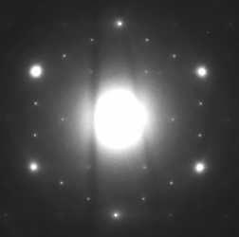
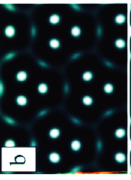
Example: Si(111) √3x√3 Au
3φ ~ 360n degrees
φ=0,120 or 240
φ=0 has only 1 atom
120 or 240 have 3
φ
φ
(1,0)
(220)
φ
Other information3 Au
Only one strong reflection
L. D. Marks, et al, Surf. Rev. Lett. 4, 1 (1997).

Slide 50
Inequalities
|Σ a_{i}b_{i}|² < Σ |a_{i}|² Σ |b_{i}|² (Triangle Inequality)
a_{i} = 1/sqrt(N)cos(2πkr_{i}) ; b_{i} = 1/sqrt(N)
Σ a_{i}b_{i} = U(k)
Σ |b_{i}|² = Σ 1/N = 1 for N atoms
Σ |a_{i}|² = 1/N Σ cos(2πkr_{i})²
= 1/2N Σ (1+cos(2π[2k]r_{i}) )
= ½ + U(2k)
Hence U²(k) < ½ +U(2k)/2
If U(k) is large – can set U(2k)

Slide 51
Quartets
Phase relationships involving 4 terms for weak reflections
  Positive and Negative
  Very useful for x-ray diffraction
  Rarely useful with TEM; dynamical effects can make weak reflections stronger than they should be

Slide 52
More subtle statistics
Better statistics (Information Theory)
Entropy of a distribution is more fundamental (as is Kullback-Liebler or relative entropy)
Most probable distribution maximizes entropy
S = - ∫ u(r) ln u(r) dr

Slide 53
Last step - Refinement
Fit atom positions via:
  R_{n} = Σ |I_{calc}-I_{expt}|^{n}/ ΣI_{expt}^{n} (or F_{calc}, F_{expt})
  χ^{n} = Σ |I_{calc}-I_{expt}|^{n}/σ^{n}
  n=1 for Robust Estimation
Should use dynamical I_{calc} for electrons
R₁ < 0.01 for most x-ray structures, < 0.1 currently for TED.
R₁~0.5 for random variables

Slide 54
Crystallographic Direct Methods Structure Triangle
Data
Ideal World
Direct Methods Map or Image
Trial
Structure
True
Structure
Structure Completion (non-trivial)

Slide 55
Gerchberg-Saxton Algorithm
Optik 35, 237 (1972) Citations > 1500
Paper was rediscovered by Crystallographers in 1990’s

Slide 56
Algorithm Overview (Gerschberg-Saxton)
Fourier Transform
Impose real space
constraints (S₁)
Atoms
Impose Fourier space
constraints (S₂)
Intensities
Inverse
Fourier Transform
Recovery
Criterion
Observed Intensities
(assigned phases)
(Global Search)
NO
YES
Feasible Solution

Slide 57
More: 1970’s Mathematics
C -- Some constraints (e.g. atomicity, probabilities of triplets)
F -- Some function (e.g. a FOM)
Minimize, e.g. Lagrangian
I = F + λ C

Slide 58
1990’s Mathematics
We have constraints (e.g. atomicity, amplitudes)
  Treat as sets
We are looking for the solution as intersection of several constraint sets
Positivity
Amplitudes
Atoms
Acta Cryst A55, 601 (1999)

Slide 59
The $64,000 question
A set is convex if any point between two members is also a member
  If all the sets are convex, problem has one solution
  If they are not, there may be more than one local minimum
Amplitude measurements
do not form a convex set
But…there still may only
be one solution.
Unsolved mathematical problem
|F(k)|=const
Α
•
•
B
C
•
×

Slide 60
Multiple non-convex constraints
Consider the two sets “N” and “U”
N
N
U
U
Overall Convex
Overall Non-Convex

Slide 61
Crystallographic methodology
N
Overall Unique
Addition of additional convex constraints tends to give a unique solution
Structure Completion: add additional constraints as the phases become known
Overall Non-Convex
U

Slide 62
Orthogonal Projections
Im
New Value
Im
Estimate
Known
0,0
Re
0,0
Re
|U(k)|
|U(k)|
Project: closest point in set
Modulus Only Part of U(k) known

Slide 63
Successive Projections
Iterate between projections
Other variants possible (see Combettes, Advances in Imaging and Electron Physics 95, 155-270, 1996)
Set of all U(k)
Set of |U_{obs}(k)|exp(iφ(k))
Start
Set of U(k) that satisfy
some constraints

Slide 64
Over-relaxed Projections
Iterate between projections
Overshoot (deliberately)
Converges faster
Sometimes better solutions
Set of all U(k)
Set of |U_{obs}(k)|exp(iφ(k))
Start
Set of U(k) that satisfies
atomistic constraints

Slide 65
Classic Direct Methods
Consider as an iteration
U_{n}(k) u_{n}(r)
Constraint Constraint
U’(k) u_{n}²(k)
Note the similarities
  Tangent Formula ≡ Orthogonal Projection
  Real space operator, effectively an eigenfunction (fixed point) method

Slide 66
Multiply-Connected Feasible Set
{S₁: | F {x}|=|X_{e}|}
Three shaded regions common to both sets, 3 unique solutions
Probability
Contours
Set with some probability

Slide 67
Typical results
Δφ = phase error
Σ|U(k)|{1-cos(Δφ)}
Σ|U(k)|
Incorrect
Correct

Slide 68
Types of Constraints
Convex – highly convergent
  Multiple convex constraints are unique
Non-convex – weakly convergent
  Multiple non-convex constraints may not be unique

Slide 69
More Constraints
Convex
Non-Convex
Positivity (weak) | Presence of Atoms
Atoms at given positions | Bond Lengths
Least bias (MaxEnt) | Interference A(k)=| B(k)+Known(k)|²
Intensities & errors ≡ χ² | Anti-bumping
Statistics (e.g. Σ₂) | Bond angles
Support for gradient
Symmetry

Slide 70
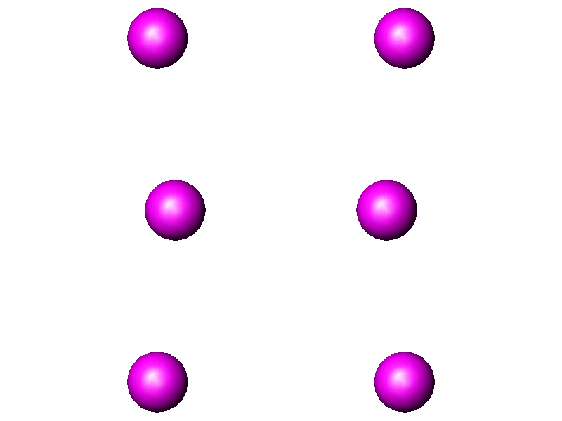
Atomistic Constraints
ρ(r) known (convex if position is known)
Bonding – another atom
Bumping ρ(r)=0

Slide 71
Example I: Difference Map
We know all the moduli, |F(k)|
We know part of the structure,
  F_{a}(k) = |F_{a}(k)|exp(iφ_{a}(k))
Project onto known moduli
  D(k) = exp(iφ_{a}(k)){|F(k)_{obs}|-|F_{a}(k)|}
  Conventional Fourier Difference Map
Other methods (SIM wts) equivalent to further projections.
D
F_{a}

Slide 72
Operators as projections
Some operator O, apply to some current estimate (x in real space, X in reciprocal space)
Define a set for the cases where
<O(x)-x> < some number
New estimate obtained by the iteration
x_{n+1} = O(x_{n})
N.B., there are some important formal mathematical issues…..

Slide 73
Example II: Sayre Equation
Use O(x) ≡ αx² ; α = scaling term
Couple with known moduli as second set
Iteration
  x_{n+1} = O(x_{n})= α x_{n}²
  |X_{n+1}| = |X_{observed}|
This is the Sayre equation (and tangent formula)
Iterate

Slide 74
Example III: Structure Completion
Explanation (pseudo-mathematical) of why structure completion strategies can solve, uniquely, problems when the initial maps are not so good

Slide 75
Structure Completion
Consider the two non-convex sets “N” and “U”
N
Add a third set “O”
Addition of additional constraints tends to give a unique solution
Structure Completion: add additional constraints as the atoms become known
Overall Non-Convex
U
Solution
Overall Convex

Slide 76
IV Convex Set for unmeasured |U(h,k,l)|
Phase of U(h,k,l) can be estimated from other reflections
Set of U(h,k,l) with a given phase is convex
Hence |U(h,k,l)| is well
specified and can be
(approximately) recovered
Remember, phase is more
important than amplitude
•
Β
C
•
Α
•
φ

Slide 77
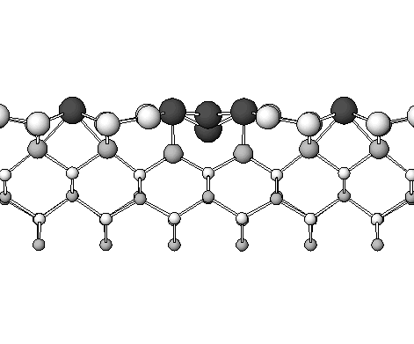
Support Constraint
Displacements decay as (α+z)exp(-qz) into bulk¹
Real space constraint
  ρ(z)=ρ(z)w(z) w(z)=1, -L<z<L =0, otherwise
Convex constraint
Has well documented properties
ρ(z)=0
ρ(z)≠0
ρ(z)=0
PRB 60, 2771 (1999)
¹Biharmonic expansion of strain field, SS 294, 324 (1993)

Slide 78
Unmeasured Reflections

Slide 79
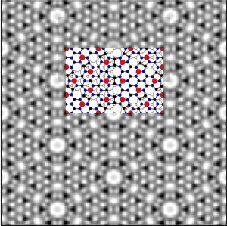

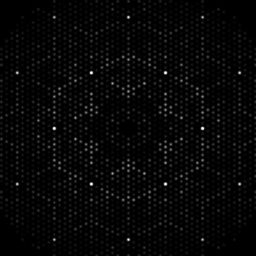
Restoration and Extension
+DP
0.3nm Image
0.05nm Image

Slide 80
Example V: Diffractive Imaging
= ?
|ϕ(x,y)|=?
+
|ϕ(x,y)|=1
True diffraction pattern for small particle model
(Non-Convex Constraint)
Convex Support
Constraint

Slide 81
Example V: Diffractive imaging
Constraint: part of real-space x is zero
Convex constraint
Iteration
  x = 0, part of map
  |X| = |X_{observed}|
Iterate

Slide 82
The Algorithm
G’_{n}
Inverse Fourier Transform
f_{n}
Calculate real-space constrained image C_{n}
Calculate amplitudes and phases; replace with experimental amplitudes
C_{n}
g_{n}
Apply Equation
Forward Fourier Transform
Charge flipping
G_{n}
g_{n+1}
(Wu and Spence)
The flow chart of hybrid input and output algorithm for iterative phase retrieval (after Millane and Stroud, 1997).

Slide 83
Convergence and the Missing Central Beam
HIO-W
ER-W
ER-Error Reduction
HIO-Hybrid Input Output
W-Whole Pattern
HIO
Missing central beam from IP saturation
Use low mag. TEM image
Reconstruction start with the whole pattern
Finish with as recorded diffraction pattern
ER
ER
HIO
HIO
ER
HIO
ER
HIO

Slide 84
Phase Recovery for a Small Particle
True real space exit wave for small particle model
Reconstructed exit wave after 3000 iterations

Slide 85
Electron Nanoprobe formation
Condenser Lens III
Lower Objective
Specimen
Back Focal Plane
10 μm aperture -> 50 nm beam
M = 1/200

Slide 86
Coherence length > 15 nm
Convergence angle <0.2 mrad

Slide 87
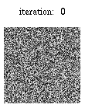

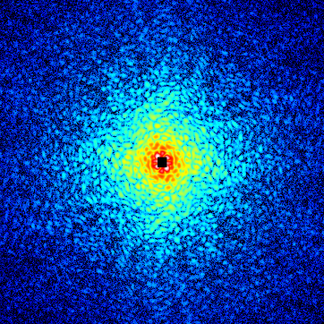
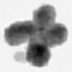
Coherent X-ray Diffraction
Differential Cross Section
Coherent Diffraction Pattern
Structure Factor
ρ (r) : Electron Density Distribution
Phase Retrieval
Sample Image
Reconstruction
without the aid of Lenses
Fourier Transform
Sample
Coherent X-rays
BL29XUL, SPring-8
Unstained Human Chromosome
Y. Nishino, Y. Takahashi, N. Imamoto, T. Ishikawa, and K. Maeshima, submitted (2008).

Slide 88
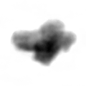
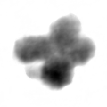
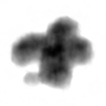
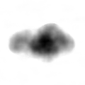
From 2D to 3D
Coherent diffraction measurement at 38 incident angles
from -70º to 70º at 2.5º intervals at the minimum
-60º
-30º
30º
60º
exposure time at each incident angle: 2700 s
normalize the diffraction data by using
the total number of electrons in the ２D reconstruction
use interpolation to obtain diffraction intensity in each voxel
image reconstruction using 3D Fourier transformation
J. Miao, T. Ishikawa, B. Johnson, E.H. Anderson,
B. Lai & K.O. Hodgson, PRL 89, 088303 (2002)

Slide 89
Reconstructed Si structure
reconstructed wave field
Multi-slice simulated
wave fields
SAND pattern
amplitude
phase
direct spot
4nm
6nm
8nm
amp
phase
200 spot
0.136 nm
・ Intensity ratio of 200 and the direct spots → thickness : 4 ～ 8 nm
amplitude
・ Dumbbell structure with the separation of 0.136 nm is resolved clearly
→ We succeeded in reconstructing dumbbell structure in silicon
phase
・ Lattice fringes can be seen, but dumbbell structure is not reconstructed
Nano structures can be reconstructed with atomic resolution
by electron diffractive imaging using SAND

Slide 90
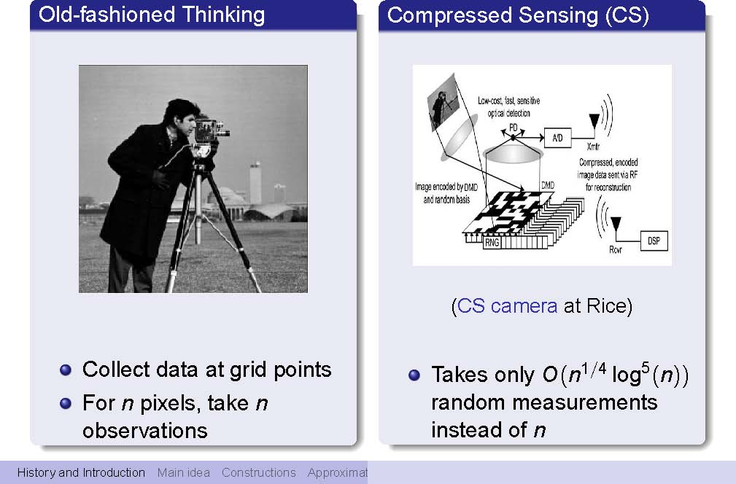
Compressive Sensing
From: An Introduction to Compressive Sensing, Olga V. Holtz, http://www.eecs.berkeley.edu/~oholtz/Talks/CS.pdf

Slide 91
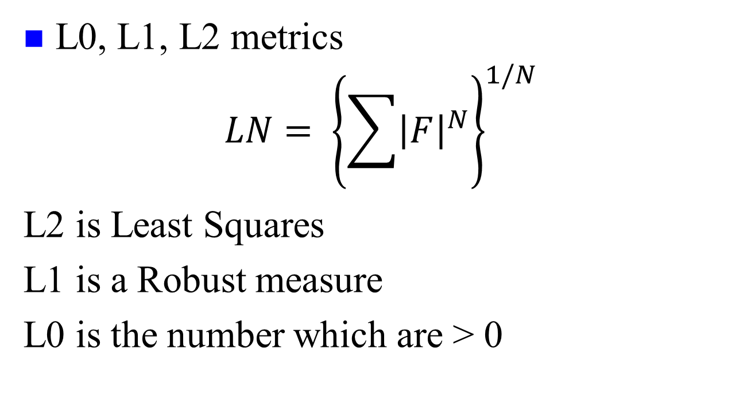
Some notation
L0, L1, L2 metrics
$$LN= {\left\{\sum{{\left|F\right|}^{N}}\right\}}^{1/N}$$
L2 is Least Squares
L1 is a Robust measure
L0 is the number which are > 0

Slide 92
Robust Statistics & Metrics
L2 is commonly used, but can weight outliers too much. L1 is one version of a Robust Metric
From Numerical Recipes in Fortran 77: The Art of Scientific Computing (ISBN 0-521-43064-x)

Slide 93
L0 minimization
From: An Introduction to Compressive Sensing, Olga V. Holtz, http://www.eecs.berkeley.edu/~oholtz/Talks/CS.pdf

Slide 94
L1 minimization
From: An Introduction to Compressive Sensing, Olga V. Holtz, http://www.eecs.berkeley.edu/~oholtz/Talks/CS.pdf

Slide 95
L1 solves the L0 problem sometimes
From: An Introduction to Compressive Sensing, Olga V. Holtz, http://www.eecs.berkeley.edu/~oholtz/Talks/CS.pdf

Slide 96
Application for structures
Charge Flipping (Acta Cryst. A 60, 134–141, 2004)
Iterative hard thresholding for compressed sensing (Appl. Comput. Harmon. Anal. 27 (2009) 265–27)
Iterate, setting small values to zero and/or truncate to zero

Slide 97
Traditional Implementation
Chose phases to define origin
Guess phases for some reflections
Generate from these phases for others and improved phases for initial set
Test consistency of predicted amplitudes and phases
Iterate, so long as consistency is improving
Note: permuting phases has lower dimensions than permuting atom positions

Slide 98
First Step: Origin Definition
Not all phases are unknown
  Translating the crystal has no physical significance
  Can therefore fix an origin for the crystal – equivalent to fixing certain reflections
  Relevant for crystallographic phase (not absolute phase of wavefunction which is not important)

Slide 99
Symmetry
Best if determined a-priori
  CBED
  HREM (maybe)
  PED
  Spot Pattern (can be tricky)
Otherwise has to be assumed (may need to try different ones)

Slide 100
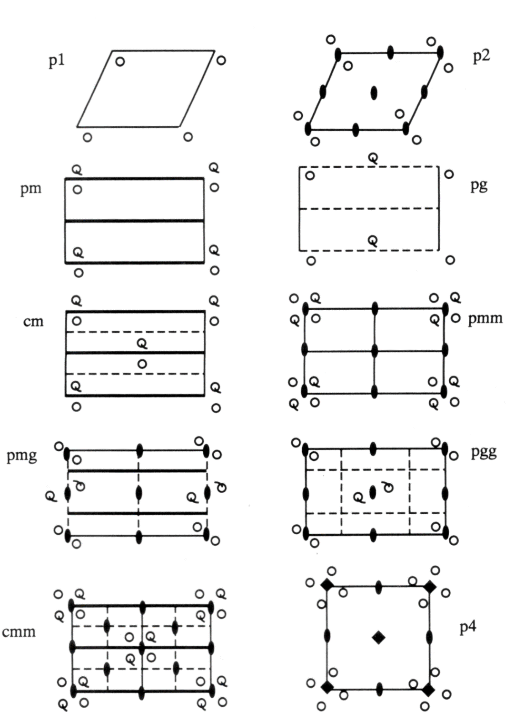
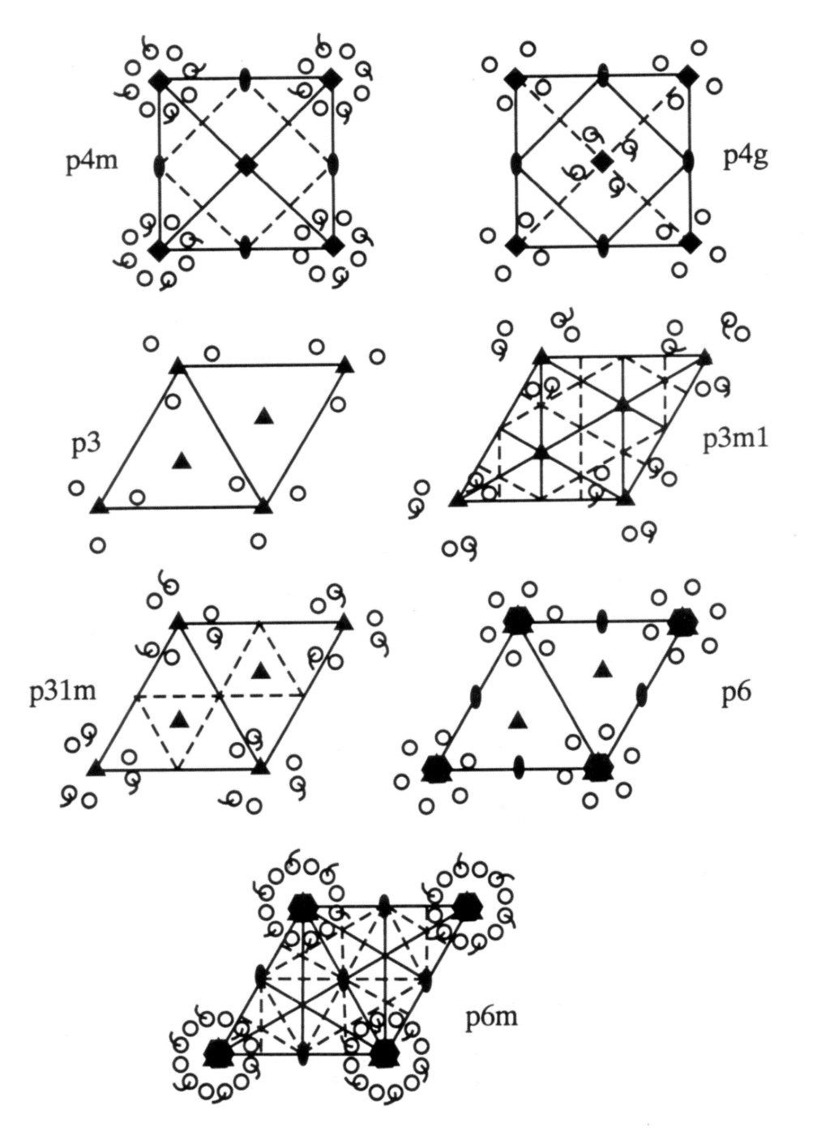

Slide 101


Slide 102
Origin Definition c2mm
Mirror Planes
1
2
3
4

Slide 103
Origin Definition c2mm
Origin Definition c2mm
1
2
3
4
(11) Βeam Defined

Slide 104
Origin Definition p2mm
Origin Definition c2mm
1
2
3
4
(11) & (10) Βeam Defined

Slide 105
General Formalism as dual
Initial ρ(r)
Project onto “Real Space Constraint” ρ²(r)
FFT
Project amplitudes onto Observed
FFT

Slide 106
In Reciprocal Space: Tangent Formula
If U(r) = U(r)² = U'( r)
Important part is the phase
U(u) = |U(u)|exp(iθ); we know |U(u)| but not θ
exp(iθ) = exp(iθ'); Tan(θ) = Tan(θ')
Replace old θ by new one

Slide 107
Last step - Refinement
Fit atom positions via:
  R_{n} = Σ |I_{calc}-I_{expt}|^{n}/ ΣI_{expt}^{n} (or F_{calc}, F_{expt})
  χ^{n} = Σ |I_{calc}-I_{expt}|^{n}/σ^{n}
  n=1 for Robust Estimation
Should use dynamical I_{calc} for electrons
R₁ < 0.01 for most x-ray structures, < 0.1 currently for TED.
R₁~0.5 for random variables

Slide 108
Gerchberg-Saxton Algorithm
Optik 35, 237 (1972) Citations > 1500
Paper was rediscovered by Crystallographers in 1990’s

Slide 109
Algorithm Overview (Gerschberg-Saxton)
Fourier Transform
Impose real space
constraints (S₁)
Atoms
Impose Fourier space
constraints (S₂)
Intensities
Inverse
Fourier Transform
Recovery
Criterion
Observed Intensities
(assigned phases)
(Global Search)
NO
YES
Feasible Solution

Slide 110
When does it work?
Kinematical Diffraction (surfaces)
1s-Channelling
Intensity ordering (PED)
L. D. Marks, W. Sinkler, Sufficient conditions for direct methods with swift electrons. Microsc. Microanal. 9, 399 (2003).

Slide 111

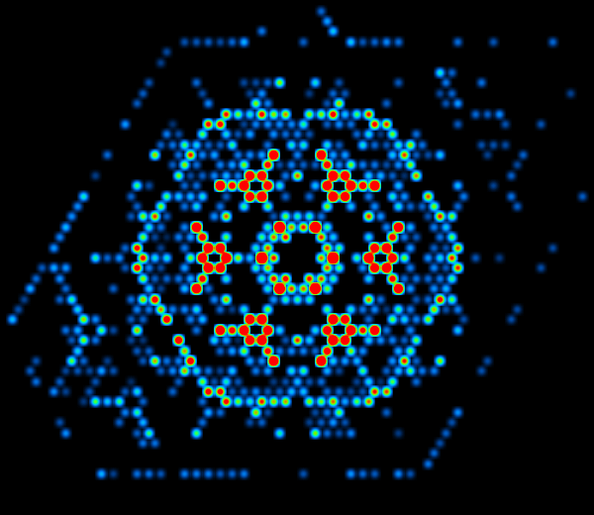
TED: Si (111) 7x7
Method: Merge data for 6-20 different exposures to obtain accuracies of ~1% with statistical significance
Cross-Correllation Method
P. Xu, et al. Ultramicroscopy 53, 15 (1994).
Errors independent of intensity (this data set)

Slide 112


1000 °C in flowing O₂
1
3
_
(110)
1x1
(001)
DP’s from Arun Subramanian
112
Notes:
Point out which spots are bulk

Slide 113

Direct Methods Solution
113

Slide 114



Atomic Positions Refined
114
Notes:
5 Ti 4+ = 20+
13 O 20 = 26-
Total 6-

Slide 115


SrTiO₃ (110) 3x1
TiO₂ overall surface stoichiometry
  Ti₅O₇ atop O₂ termination
  Ti₅O₁₃ atop SrTiO termination
Surface composed of corner sharing TiO₄ tetrahedra
  Arranged in rings of 6 or 8 tetrahedra
  4 corner share with bulk octahedra
  1 edge shares with bulk octahedron
Blue polyhedra are surface polyhedra, gold are bulk octahedra, orange spheres Sr, blue spheres Ti, red spheres O
Enterkin et. al., Nature Materials, 2010

Slide 116
When does it work?
Kinematical Diffraction (surfaces)
1s-Channelling
Intensity ordering (PED)
L. D. Marks, W. Sinkler, Sufficient conditions for direct methods with swift electrons. Microsc. Microanal. 9, 399 (2003).

Slide 117




Method
Initial
Phases
FFT
Nanoprobe
Diffraction Data
Conventional HREM Image
W. Sinkler et al. Acta Crystallogr. Sect. A 54, 591 (1998)

Slide 118
Channeling Approximation
e⁻
d
2-D Eigenvalue
Talks later by Van Dyck and Chukhovskii will explain more details
Σ₀ distribution is statistically kinematical
F. N. Chukhovskii, et al Acta Cryst A 57, 231 (2001)

Slide 119


Calculated Wave
|ψ(r)-1| at 113 A thickness
|ψ(r)-1| at 202 A thickness

Slide 120


O sites in (Ga,In)₂SnO₅ determined using
direct phasing of TED data.

Slide 121
When does it work?
Kinematical Diffraction (surfaces)
1s-Channelling
Intensity ordering (PED)
L. D. Marks, W. Sinkler, Sufficient conditions for direct methods with swift electrons. Microsc. Microanal. 9, 399 (2003).

Slide 122
Precession Electron Diffraction
Quasi-Kinematical Data
Averaging over angle/phase (and thickness) damps dynamical contributions
Intensities are close to monatomic with structure factors (statistically)

Slide 123


(Ga,In)₂SnO₄ precession data:
Direct methods solution
(Real Space)
 | ΔR (Å)
Sn1 | 0.00E+00
Sn2 | 0.00E+00
Sn3 | 6.55E-03
In/Ga1 | 5.17E-02
In/Ga2 | 2.37E-03
Ga1 | 6.85E-02
Ga2 | 1.22E-01
Displacement (R_{neutron} – R_{precession}):
ΔR_{mean} < 4*10⁻² Å
(Sinkler, et al. J. Solid State Chem, 1998).
(Own, Sinkler, & Marks, submitted.)

Slide 124
Conclusion
The “Phase Problem” with electrons is no longer really a problem….assuming ideal data of course
Many technique work most of the time
Few techniques work all the time
Some unresolved issues (proper dynamical refinement)
Rember that we are solving an inversion problem, and these are susceptible to ill-conditioning

Slide 125
Four basic elements are required to solve a recovery problem
1. A data formation model
  Imaging/Diffraction/Measurement
2. A priori information
The presence of atoms or similar
3. A recovery criterion:
  A numerical test of Goodness-of-Fit
4. A solution method.
  Mathematical details
Patrick Combettes, (1996). Adv. Imag. Elec. Phys. 95, 155

Slide 126
Questions ?

