Slide 1
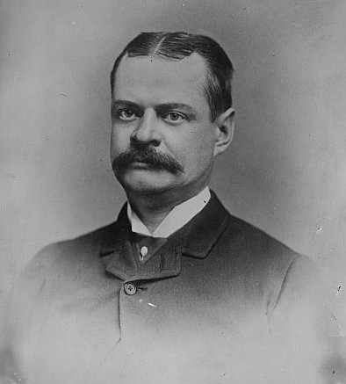
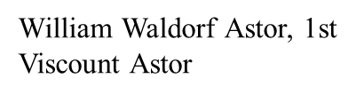
Nanoparticles: from thermodynamics and shape to plasmonics and catalysis
www.numis.northwestern.edu/Astor_Nanoparticles.pptx
Subtitle
Something old, something new, a lot borrowed, a lot purple
L. D. Marks
Astor Lecture

Slide 2

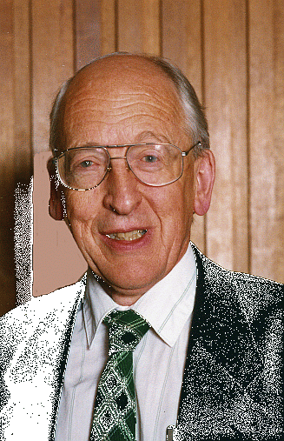

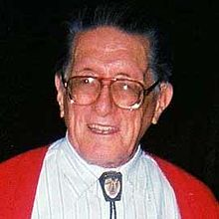


Acknowledgements 1
Phase 1: 1978-1994
  E. Yoffe, A. Howie, D. J. Smith, J. M. Cowley, J. Dundurs
  P. M. Ajayan, D. Iyer

Slide 3








Acknowledgements 2
Phase 2: 2008-
K. R. Poeppelmeier R. Van Duyne
J. Enterkin E. Ringe B. Peng D. Alpay S. Patala
Materials Research Science & Engineering Center
Northwestern University
Notes:
3

Slide 4

Small can be beautiful
Pro’s
  Nanoplasmonics
  Nanoparticles for catalysis
  Sensing
  Drug delivery
  …
Image Source:
John Stringer
Electric Power Research Institute
Notes:
4

Slide 5
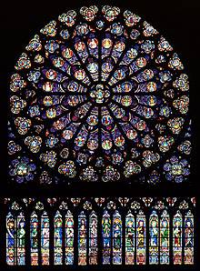
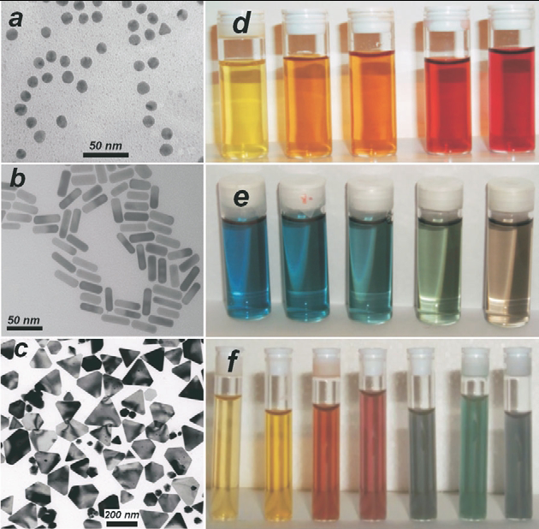
Nanosized Gold
L. Liz-Marzan, Mater. Today 7, 21 (2004)
www.notredamedeparis.fr
Notes:
5

Slide 6
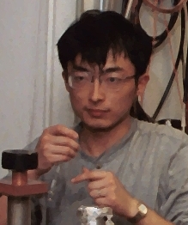
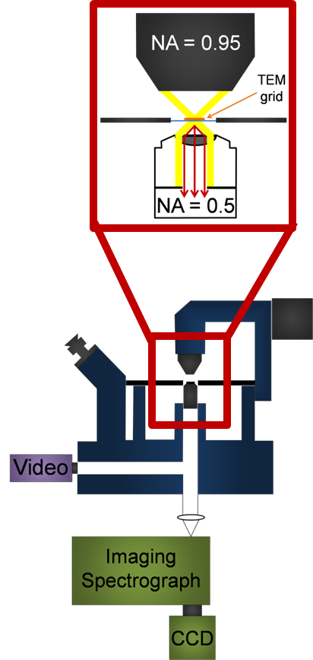
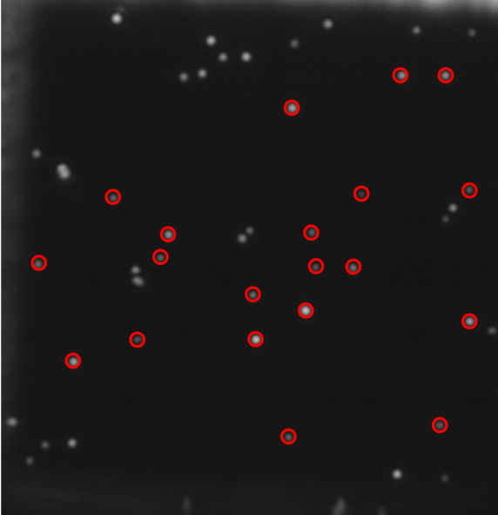
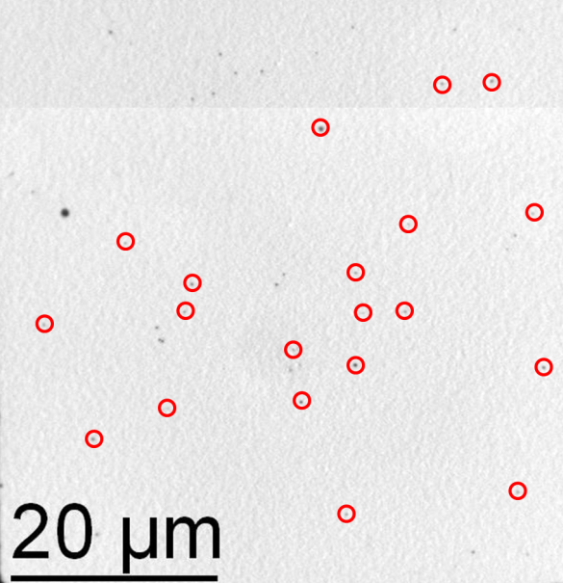
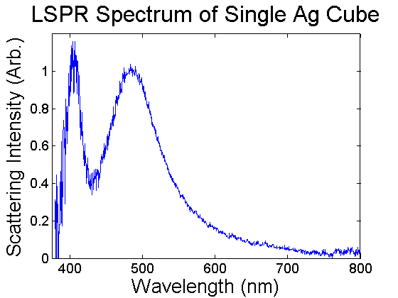
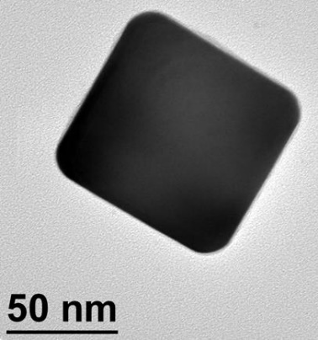
Single Silver Nanocube LSPR/TEM/FDTD
Y. Wang et al, Ultramicroscopy 2009, 109, 1110-1113.
Notes:
6

Slide 7
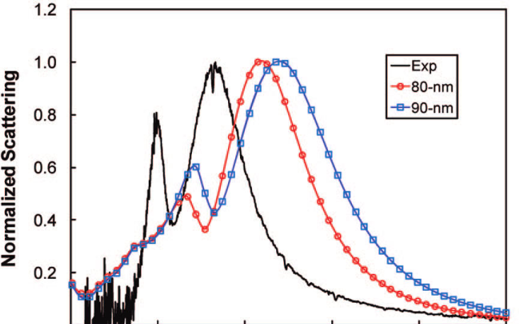
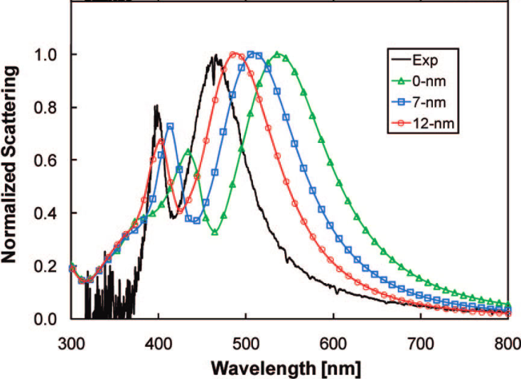
FDTD Results: Effect of Size and Corner Rounding in Ag Cubes
Effect of size
Effect of corner rounding
J. M. McMahon, et al, JPCC, 113, 2731 (2009)
Notes:
7

Slide 8
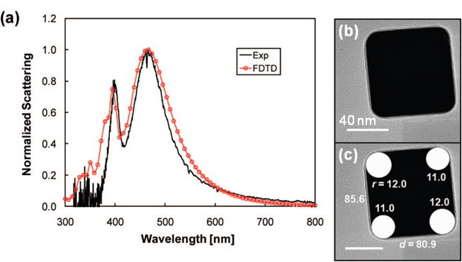
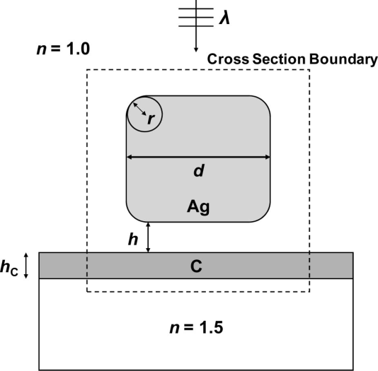
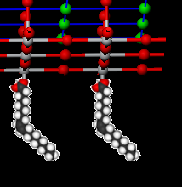
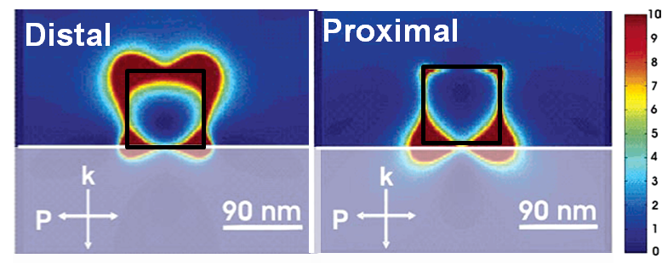
Reasonable agreement
FDTD
2
1
Oleic Acid Surfactant
40 nm
(1) Distal peak, quadrupolar:
Sharp, high energy, EF away from substrate
(2) Proximal peak, dipolar:
Broader, EF extends into the substrate
L. J. Sherry, et al, Nano Lett., 5, 2034 (2005); J. M. McMahon, et al, JPCC, 113, 2731 (2009)
8
Notes:
8

Slide 9
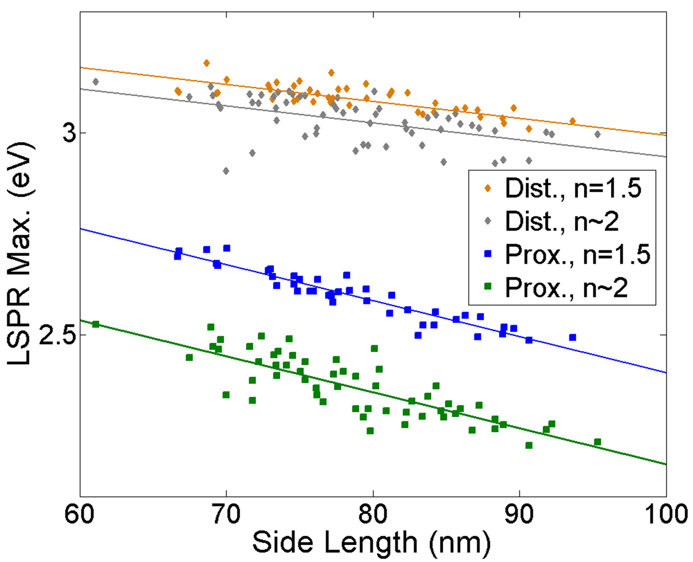
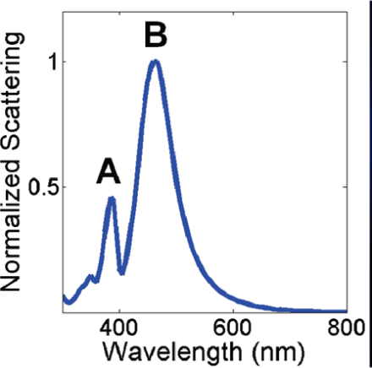
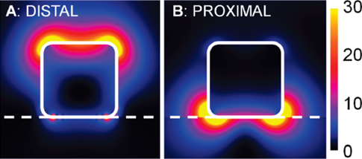
Effect of Size and Substrate, Ag Nanocubes
Distal
0.05 eV
Distal
Proximal
0.23 eV
Proximal
Distal peak → Slope = -4.2(0.55) meV/nm
Proximal peak → Slope = -8.9 (0.5) meV/nm
E. Ringe, et al, JPCC, 114, 12511 (2010)
Notes:
9

Slide 10
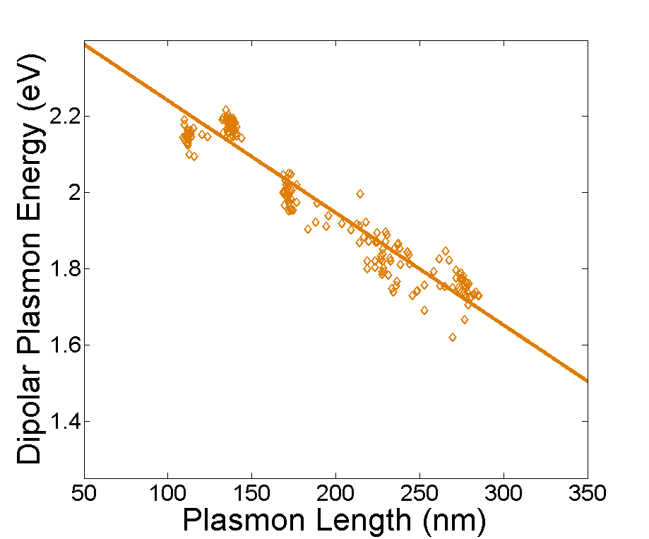
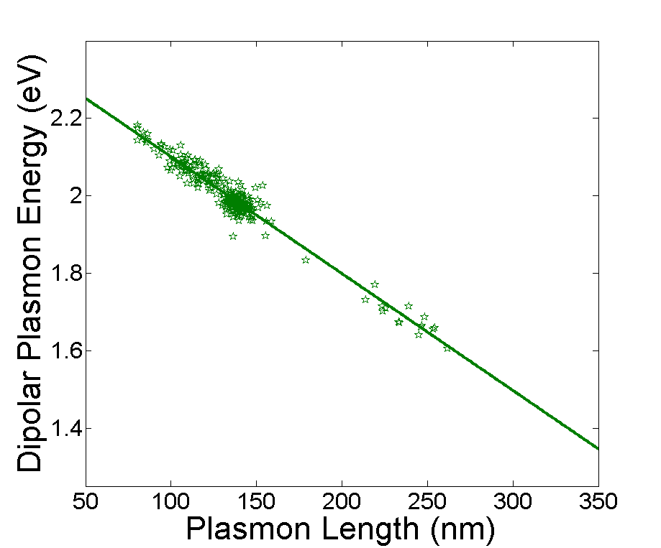
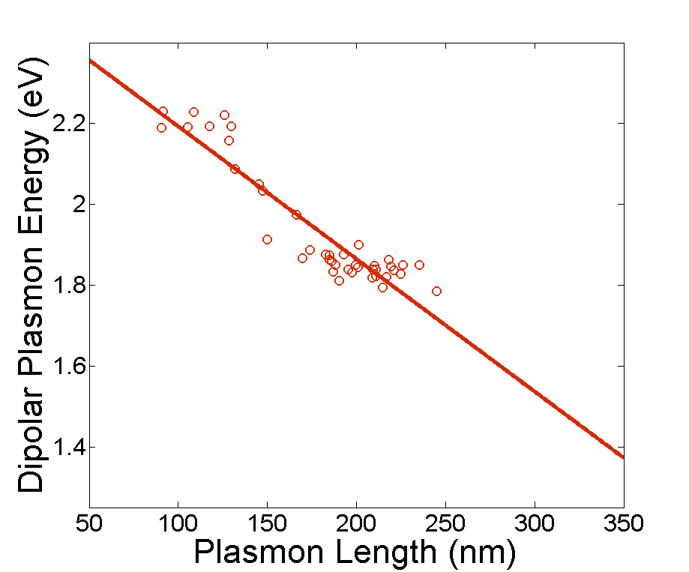
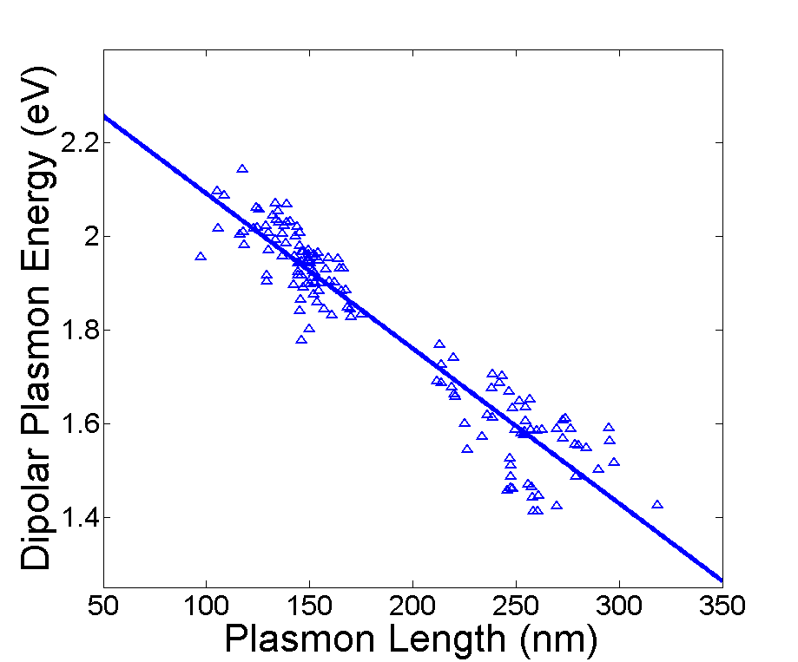
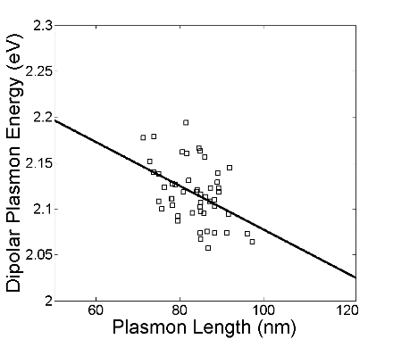
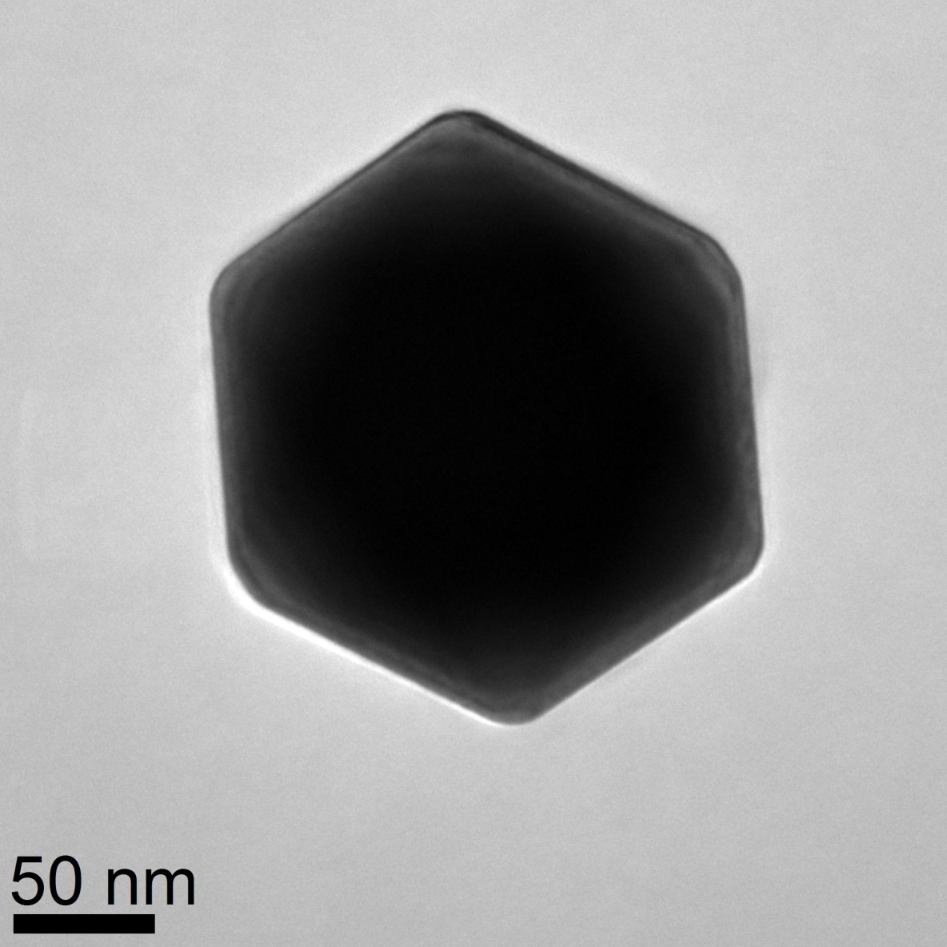
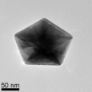
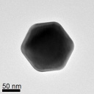

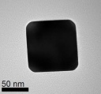
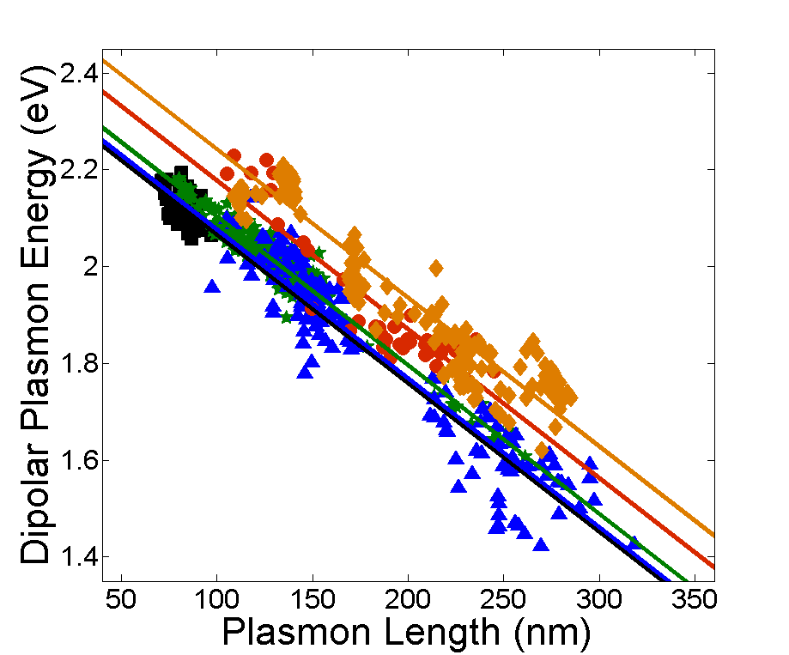
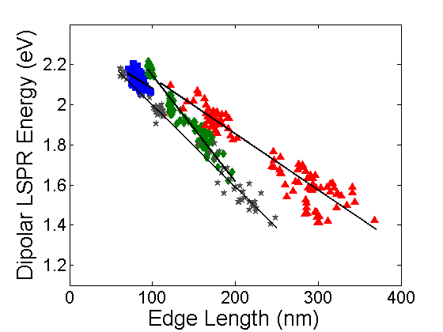
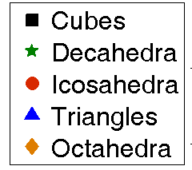
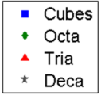
Shape Independent Result
Slope = -3.06(4)
Slope = -3.02(5)
Slope = -3.3(2)
Slope = -3.22(9)
Slope = -2.4(6) meV/nm
Plasmon Length
E. Ringe, M. R. Langille, J. Zhang, J. Huang, C. A. Mirkin, R. P. Van Duyne, L. D. Marks, J. Phys. Chem. Lett. (2012) 3, 1479

Slide 11
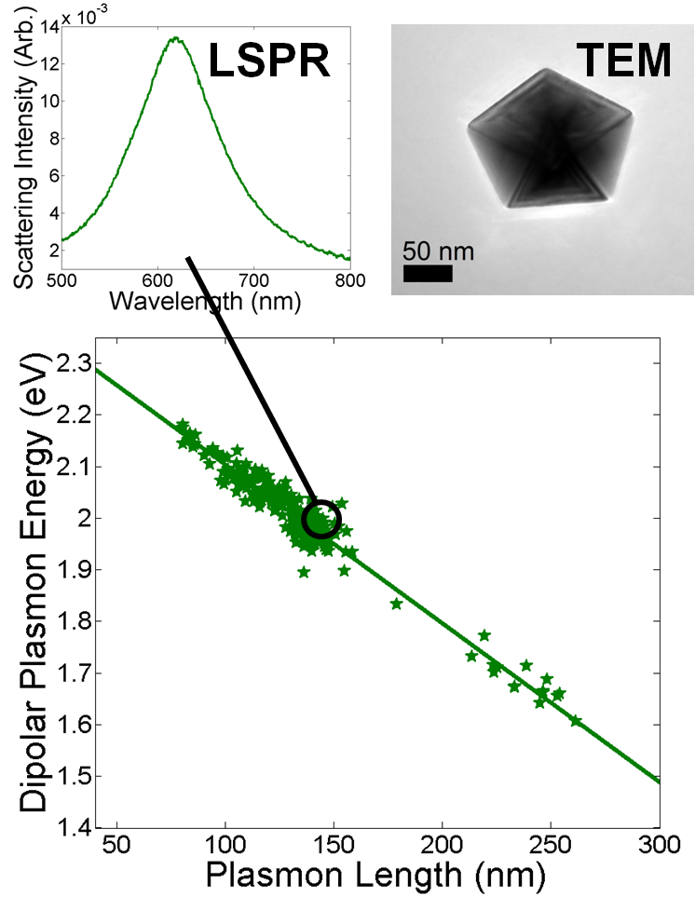
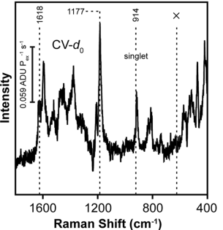
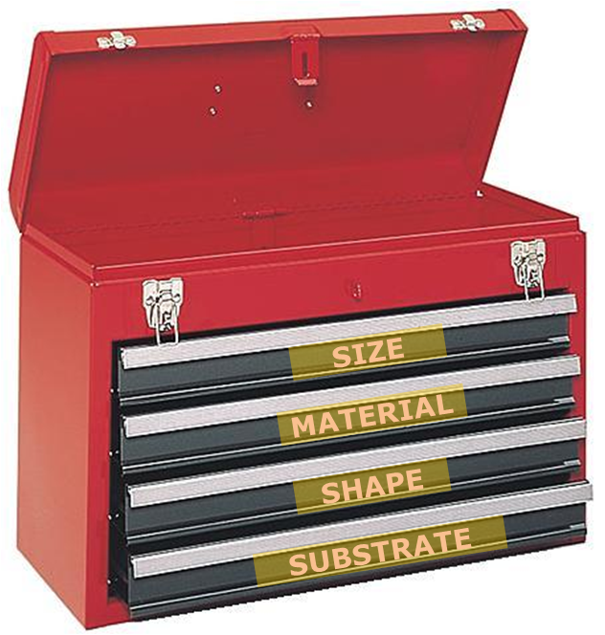
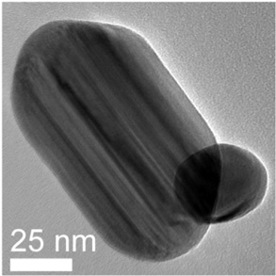
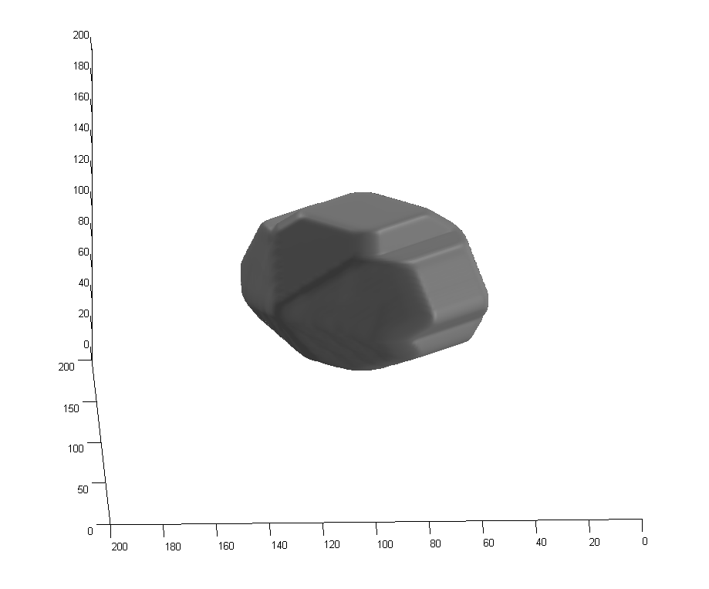
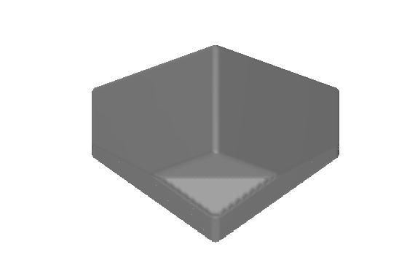
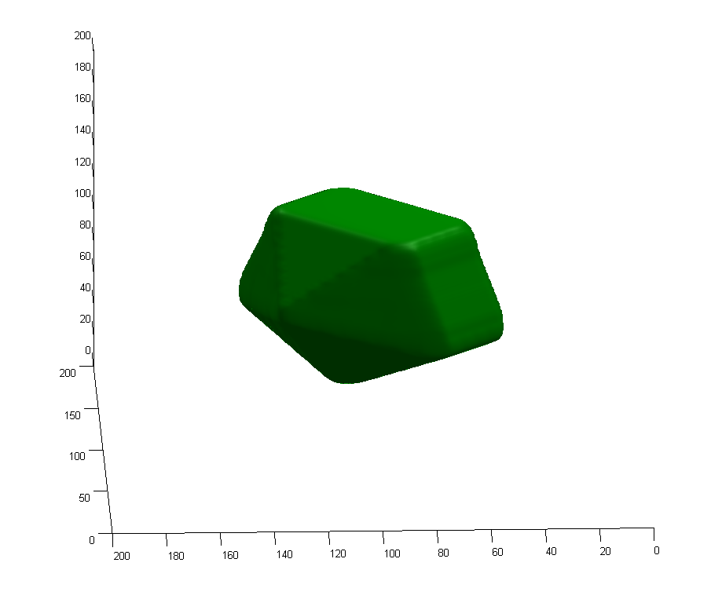
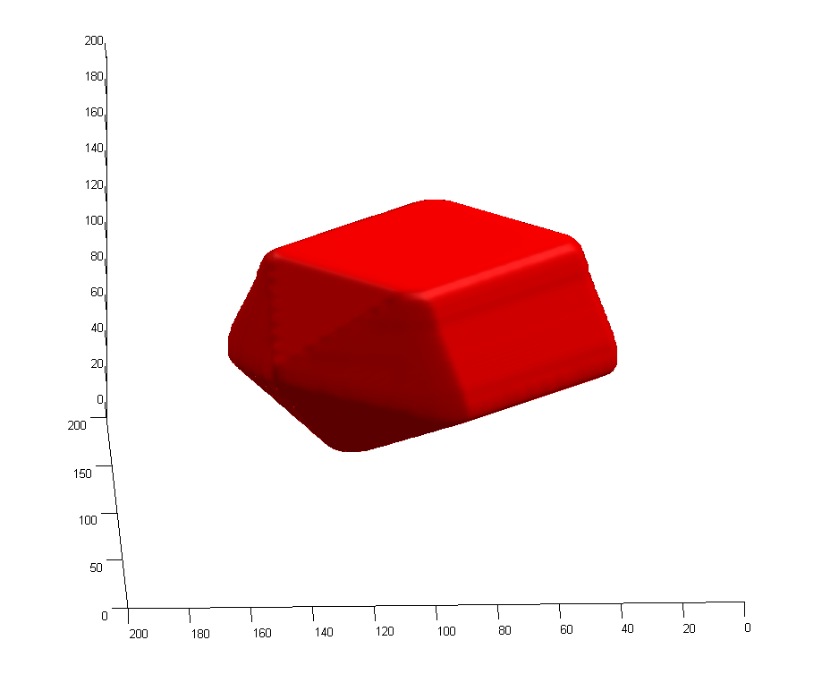
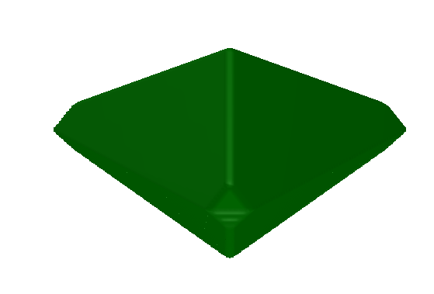

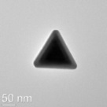
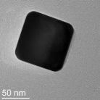
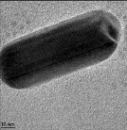
Need Controlled Nanoplasmonics Toolbox
Modeling
Thermodynamic
Kinetic

Slide 12

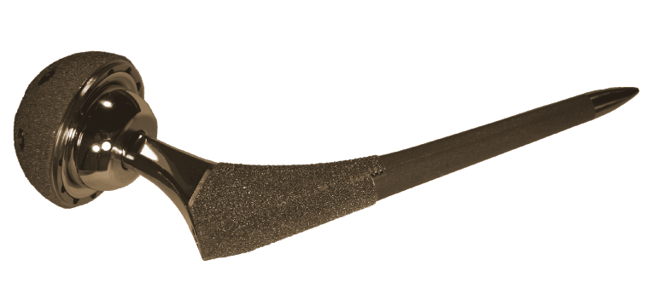
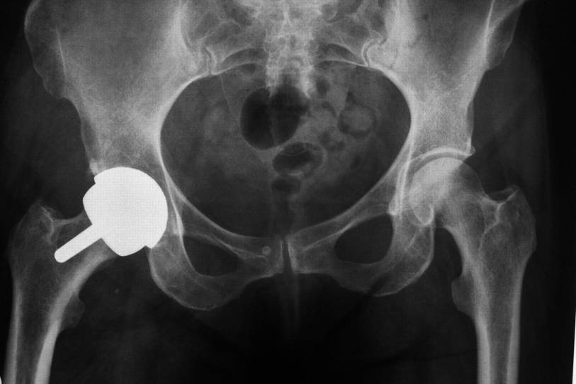
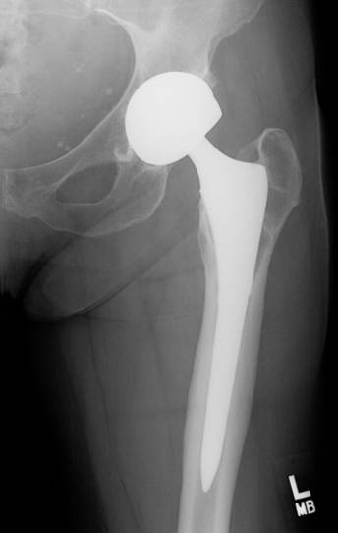
Small can be ugly
Con’s
  Toxic
  Wear Debris
Hip Implant
Liao et al., Science 334, 1687 (2011)
Notes:
12
12

Slide 13
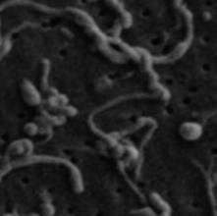


Wear-Mediated Osteolysis
osteolysis
disrupted balance between osteoclasts/PMNs and osteoblasts:
osteoclasts ↑, osteoblasts ↓
wear particles
osteoclast/ polymorphonuclear giant cell
opsonization
phagocytosis
osteoblast
http://academic.brooklyn.cuny.edu/biology/bio4fv/page/aviruses/cellular-immune.html
Archibeck, MJ; Jacobs, JJ; Roebuck, KA; Glant, TT. Journal of Bone & Joint Surg, 2000

Slide 14

Typical cartoons/visuals used in the literature
alkane + O_{lattice} olefin + water
(Reactants) (Products)
O=O
2e⁻
O²⁻
O
O
O
surface
Mg
V
V
Mg
O
O
O
bulk
O
Mg
Mg
O
Mg₃(VO₄)₂ Mg₃V₂O₆ + 2O_{bulk}

Slide 15

Nanoparticle publications/year

Slide 16
Overview
Some basics that everyone should know
  Wulff, Winterbottom and friends
Some basics that most do not know or get wrong
  The artifact of some particle size effects
  There are two Wulff constructions
Some new basics
  Segregation in nanoparticles and with strain
A little bit about applications for catalysis

Slide 17

Basics: Continuum, not so simple
The total energy of an ordered, crystalline nanoparticle can be written as
$$E=\sum_{i,j,k}{a_{ijk}n_{i}n_{j}n_{k}}+\sum_{i,j}{b_{ij}n_{i}n_{j}+}\sum_{i}{c_{i}n_{i}+d} +…$$
The n_{i} are positive integers represent the number of atoms along particular directions. Which term is “bulk”, which term is “surface” ?

Slide 18

Counting Effects
Number of Atoms
= n(n+1)/2
Not n² dependence
n

Slide 19


Wulff shape apparently size dependent
Particle-Size Effects on Wulff Constructions. Marks, L.D., Surface Science, 1985. 150(2), 358
Surface Facetting in Small Ceramic Particle. Bonevich, J.E., Proc 47th Ann EMSA, 1989, 258.

Slide 20
What is the size?
Crystallographic Size
Chemisorption Size
Thermodynamic Size
V = constant*N
C=O

Slide 21



Care needed
Simplest approach, define distances such that V(h) = Nv_{atom}
Introduces a non-linear relationship between h & N
Adds some minor corrections
$$h100 =(n100+1/2)d100 +f(n100))$$
$$h110 =(n110+1/2)d110 +f(n110)$$
Based on, but not the same as Hamilton, Phys. Rev. B, 2006. 73: 125447, see also Cleveland and Landman JCP, 1991. 94(11), 7376
Equimolar Gibbs surface using Wigner-Seitz cells

Slide 22


Lengths matter
Hamilton, Phys. Rev. B, 2006. 73: 125447, see also Cleveland and Landman JCP, 1991. 94(11), 7376

Slide 23

Simplification
$$E=\sum_{i,j,k}{A_{ijk}h_{i}h_{j}h_{k}}+\sum_{i,j}{B_{ij}h_{i}h_{j}+}\sum_{i}{C_{i}h_{i}+D}+…$$
Bulk Surface Edge Corner
Rewrite as
$$E=V\left(\frac{μ_{B}}{Ω_{a}}+W_{D}\right)+V^{2/3}γ_{111}ε_{W}+<g_{ij}e_{ij>}+O(V^{\frac{1}{3}})$$
W_{D} Strain Energy Density
$ε_{W}=\int{γdS}/γ_{111}V^{2/3}$ Dimensionless shape term
$\left\langle g_{ij}e_{ij}\right\rangle$ Surface Stress Contribution

Slide 24


Weighted Mean Curvature
With E_{s} total surface energy:
$wmc(hi)$ = $(dEs/dhi)/(dV/dhi)$
= $i/Ωa$
Equilibrium
$i/Ωa= wmc(hi)=$ ;
$d\{Es−V\}/dhi = 0$;
The same as Wulff construction (Lagrangian)
For an alloy, $wmcj(hi) = j$, each component j
e.g. Taylor, J.E., Acta Met., 1992. 40(7): p. 1475-1485.

Slide 25


Geometric interpretation
$wmc(hi) = \overline{γ}i$ {ar₁+b} /{cr_{i}²+dr_{i}+e}
≅ $C\overline{γ}i$ /r_{i}
Nominal equivalent of Gibbs-Thompson term, but for a faceted surface. Suggests that corners are rarely sharp, observed experimentally
r_{i}
h_{i}
Alpay, D., L. Peng, and L.D. Marks, The Journal of Physical Chemistry C, 2015. 119(36), 21018-21023.

Slide 26


Validation of WMC from DFT
Alpay, D., L. Peng, and L.D. Marks, The Journal of Physical Chemistry C, 2015. 119(36), 21018-21023.

Slide 27


Surface Energy & Stress
Surface (Free) Energy γ
  Define as energy to create new fully relaxed surface
Surface Stress
  Derivative with strain
  $g_{ij}=∂γ/∂e_{ij}$
Shuttleworth equation is not correct with definitions per atom

Slide 28


Anatase TiO₂ showing an expansion
Ahmad, M.I. and S.S. Bhattacharya, Applied Physics Letters, 2009. 95(19), 191906.
Surface Stress leads to lattice changes
(a)
(b)
Relative decrease in lattice parameter in Ag₃Sn
N., M. Knipper, J. Parisi, T. Plaggenborg, and J. Kolny-Olesiak, Journal of Physical Chemistry C, 2015. 119(25), 14450-14454.

Slide 29

Basics: Continuum, simple
The total energy of an ordered, crystalline nanoparticle can be written as
$$E=AV+BV^{2/3}+CV^{1/3}+D+E/{V^{1/3}+…}$$
Bulk Surface Edge Corner
Thermodynamic shape for reasonable sizes minimizes E at a fixed volume
Find the shape that optimizes the surface energy

Slide 30




Wulff Construction
Max Von Laue
Minimize surface energy for fixed volume
  $$S_{W}=\{x:x.\hat{n}≤λγ\left(\hat{n}\right) for all unit vectors \hat{n}\}$$
G. Z. Wulff, Kristallogr. Mineral 34, 4490 (1901); M. Z. Von Laue, Kristallogr. 105, 124 (1943); A. Z. Dinghas, A. Z. Kristallogr. 105, 304 (1944)

Slide 31

Example: SrTiO₃
10nm
Crosby, L., J. Enterkin, F. Rabuffetti, K. Poeppelmeier, and L. Marks, Surface Science, 2015. 632, L22-L25
Notes:
31

Slide 32

Chemisorption Dependent
Cu Bi-saturated Cu
Curtesy Paul Wynblatt

Slide 33
Winterbottom Construction
Include the effect of a nanoparticle sitting on a substrate
γ_{Int}

Slide 34


Wulff & Winterbottom
001
001
100
110
51° rotation around [011]
Projection down [010]
45° rotation around [100]
Projection down [110]
γ₁₁₁
γ₁₁₁
γ₁₀₀
γ₁₁₁
γ_{Int} – γ_{Sub} = γ_{Pt}
0 < γ_{Int} – γ_{Sub} < γ_{Pt}
γ_{Int} – γ_{Sub} = 0
-γ_{Pt} < γ_{Int} – γ_{Sub} < 0
γ_{Int} – γ_{Sub} ≤ -γ_{Pt}
Increasing γ_{int}
Increasing γ_{sub}
Increasing γ_{Pt}
34
J. A. Enterkin, K. R. Poeppelmeier, L. D. Marks, Nano Lett. 11, 993 (2011); G. Z. Wulff, Kristallogr. Mineral 34, 4490 (1901);
W. L. Winterbottom, Acta Metallurgica 15, 303 (1967)

Slide 35



Depends upon environment
As prepared (oxidized) Reduced (after WGS)
Lin, Y., Z. Wu, J. Wen, K. Ding, X. Yang, K.R. Poeppelmeier, and L.D. Marks, Nano Lett, 2015. 15(8), 5375-5381

Slide 36

Caveat: assumes flat substrate
Connects to SMSI
Ajayan, P.M. and L.D. Marks, Nature, 1989. 338(6211), 139

Slide 37




Continuing, beyond single crystals
Reduce surface energy, at the cost of strain energy
Decahedral MTP Icosahedral MTP

Slide 38
Distorted tetrahedral units
S. Ogawa & S. Ino, J. Vac. Sci., Tech. 6, 527 (1969).

Slide 39

But…Dh is not so simple
L. D. Marks,. Philos. Mag. A. 49, 81 (1984).

Slide 40
Modified Wulff Construction
Include the effect of a nanoparticle with a twin
γ_{twin}/2

Slide 41
LTPs

Slide 42
Modified Wulff Construction
$S^{i}=\{x:(x−o^{i}).\hat{n}≤λ^{i}γ^{i}\left(\hat{n}\right)\}$
L. D. Marks,. Philos. Mag. A. 49, 81 (1984).

Slide 43

Modified Wulff Construction
$S^{i}=\{x:(x−o^{i}).\hat{n}≤λ^{i}γ^{i}\left(\hat{n}\right)\}$
L. D. Marks,. Philos. Mag. A. 49, 81 (1984).

Slide 44
Dh & Ic segments

Slide 45



Modified Wulff Construction for Twinned Particles
Lamellar Twinned Particles
2 or more segments
1 boundaries/segment (caps)
2 boundaries/segment (middle)
Decahedral
Multiply Twinned Particle
5 segments
2 boundaries/segment
Icosahedral
Multiply Twinned Particle
20 segments
3 boundaries/segment
L. D. Marks, J. Cryst. Growth 1983, 61, 556-566
Notes:
45

Slide 46

Shapes for Dh reported in 19th century – “Fivelings”
From H. Hofmeister, Z Krist 224 (2009) 528

Slide 47





Different Cases
E. Ringe, R.P. Van Duyne, L. D. Marks, Journal of Physical Chemistry C, 2013. 117, 15859

Slide 48



Different Shapes for Ic as well
{111} only
{110} only
N.B., no {100} in an Ic, see L. D. Marks, Philos. Mag. A. 49, 81 (1984)
Images courtesy of M. Yacaman
{111} + {110}

Slide 49

Surfaces depend upon environment
“5x1” (001) reconstruction on Au Dh, Image courtesy of Gilberto Casillas-Garcia, UTSA

Slide 50
MTP Energetics
Three Terms
  Strain, fcc units do not fit together without it
  Difference in total surface free energy
  Difference in total surface stress terms
  N.B., twin boundary energy negligable

Slide 51


Strain: Volterra Disclination
S. Ogawa & S. Ino, J. Vac. Sci. Tech. 6, 527 (1969).
R. de Wit, Journal of Physics C, 1972, 5, 529
A. Howie and L. D. Marks, Phil Mag 1984. 49(1), 95-109.
Patala, S., L.D. Marks, and M.O. de la Cruz, Journal of Physical Chemistry C, 2013. 117(3), 1485
Von Mises stress distribution (a)

Slide 52
MTPs have less of the Wulff shape
Segment for Dh
Twin boundaries restrict which surfaces are exposed
L. D. Marks,. Philos. Mag. A. 49, 81 (1984).

Slide 53


Energy Balance
Three competing terms
  Gain in surface energy (MTPs more {111})
  Cost to strain the particle
  Energy change due to expansion at surface, surface stress term (heavily environment dependent)
$$E/V^{2/3}$$
Ic Dh Sc
$$V^{1/3}$$
A. Howie and L. D. Marks, Phil Mag 1984. 49(1), 95-109.

Slide 54




Energetics
Icosahedra
Quasi-spherical shape.
Close-packed surface but
large internal strain.
Favourable at small sizes
Decahedra
Intermediate behaviour.
Favourable at
Intermediate sizes
Polyhedra
Non-spherical shape
No internal strain.
Favourable at large sizes
Courtesy Riccardo Ferrando

Slide 55
Growth
Complex, can be templated (i.e. large from small) or there can be changes
K. Yagi et al, Journal of Crystal Growth 28 (1975) 117

Slide 56
Growth
Asymm Dh Dh Dh Ic
K. Yagi et al, Journal of Crystal Growth 28 (1975) 117
L. D. Marks, Journal of Crystal Growth 61(1983) 556

Slide 57

Structural Fluctuations (Iijima)
P. M. Ajayan, L. D. Marks,. 24-6, 229 (1990)

Slide 58


A simple physical concept
The potential surface, very schematically: solid in the deep, narrow well, liquid in the high rolling plain:
Courtesy of Stephen Berry

Slide 59











Quasimelting
$$⇌$$
$$⇌$$
$b=−0.25$
b$=0.0$
$b=0.25$
b
J. Dundurs, L. D. Marks, P. M. Ajayan,. Philos. Mag. A. 57, 605 (1988)

Slide 60
Phase Diagram (1990 vintage)
P. M. Ajayan, L. D. Marks. Phase Transit. 24-6, 229 (1990)

Slide 61




Morphological Transitions (Angus Kirkland)
5.5nm size
FCC
Decahedral
Room temp
300°C
400°C
7.2nm size
Icosahedral
Decahedral
In-situ Heating
RT
400°C
RT
10.4nm size
Decahedral
Decahedral
Ultramicroscopy, 110 (2010) 506
RT
400°C
RT
ACS Nano, 3 (2009) 1431
Solid – Solid Transition below T_{m}
As Synthesised Particles not in Thermodynamic Ground State

Slide 62
The Two Wulff Constructions
Just to make life more fun
  Is every Wulff shape thermodynamic
  No, and probably the original paper was not

Slide 63





Thermodynamic Wulff Construction
γ₁₀₀ << γ₁₁₁ γ₁₀₀ ~
001
001
100
110
γ = surface free energy
n = crystallographic face (hkl)
h_{(n)} = surface normal
Λ_{(c)} = Wulff constant (accounts for volume)
γ₁₁₁
γ₁₁₁
γ₁₀₀
  $$S_{W}=\{x:x.\hat{n}≤λγ\left(\hat{n}\right) for all unit vectors \hat{n}\}$$
G. Z. Wulff, Kristallogr. Mineral. 34, 449 (1901)
Notes:
63

Slide 64
Kinetic Wulff Construction
001
001
100
110
v= growth velocity
n = crystallographic face (hkl)
h_{(n)} = surface normal
Λ_{(c)} = Wulff constant (accounts for volume)
γ₁₁₁
γ₁₁₁
γ₁₀₀
  $$S_{W}=\{x:x.\hat{n}≤λv\left(\hat{n}\right) for all unit vectors \hat{n}\}$$
Frank, F. C. In Growth and Perfection of Crystals; Doremus, R. H., Roberts, B. W., Tumbull, D., Eds.; Wiley (1958)
Notes:
64

Slide 65


Schematic for growth
Nucleation barrier for terrace

Slide 66


Kinetic v Thermodynamic Wulff
$hi = i$
γ_{i} depends upon
Chemisorption
Surface Composition
Bulk Composition
Surface Segregation
$hi = vi$
v_{i} depends upon
Rate limiting step (diffusion/nucleation)
Transition state (e.g. desorption of surfactants)
$wmcj(hi)$, i.e. local chemical potential

Slide 67



Origin of twin enhancement term
Atoms added at a twin have a higher co-ordination number than on a flat surface
Additional energy makes nucleation easier

Slide 68



Kinetic Wulff: Growth Velocity
Twinned Wulff: Assemble Segments
=
5X
+ Growth enhancement
Kinetic Wulff Construction for Twinned Particles
Re-entrant surface growth enhancement
Disclination/twin boundary growth enhancement
$S^{i}=\{x:(x−o^{i}).\hat{n}≤λ^{i}v^{i}\left(\hat{n}\right)\}$
Frank, F. C. In Growth and Perfection of Crystals; Doremus, R. H., Roberts, B. W., Tumbull, D., Eds.; Wiley (1958)
L. D. Marks, J. Cryst. Growth 61, 556 (1983) ;E. Ringe, R.P. Van Duyne, L. D. Marks, Journal of Physical Chemistry C, 2013. 117, 15859

Slide 69



Modified Kinetic Wulff Construction:
Shape of Dh Structures
Re-entrant growth
100
111
Re-entrant + Stable 111
γ₁₁₁/ γ_{100 = √3/2}
Disclination + re-entrant
B. Petrobon, M. McEachran, V. Kitaev, ACS Nano 2009, 3, 21-26
100 nm
Notes:
69

Slide 70
Diamond for different conditions
1.3 1.4 1.7 1.9 2.5
J. Bühler, Y. Prior, J Cryst Growth 209 (2000) 779

Slide 71










Modified Kinetic Wulff Construction:
Shape of {111} – Dominated Monotwin Structures
Twin growth enhancement
Re-entrant surface growth enhancement
Twin + re-entrant growth enhancement
Notes:
71

Slide 72
Alloy Wulff Construction
Alloy Wulff has an extra degree of freedom: surface composition
Use available/measurable parameters (surface/bulk energies) to produce a predictive model
Result of energy minimization: size-dependant balance between
  Surface energy
  Starvation energy
001
001
100
110
γ₁₁₁
γ₁₁₁
γ₁₀₀
E. Ringe, R.P. Van Duyne, L. D. Marks, Nano Lett. 11, 3399 (2011)
Notes:
72

Slide 73
Alloy Wulff Construction:
Minimization of Energy via Lagrangian Multipliers
Conventional Wulff
Alloy Wulff
h₍₁₀₀₎
Size Independent
Size Dependent: Starvation
h₍₁₁₀₎
γ = surface free energy
n = crystallographic face
C^{S}_{i} = surface concentration of element i
C^{V}_{i} = bulk concentration
G = bulk free energy
Λ = Wulff constant (accounts for volume)
h_{n} = surface normal
γ = surface free energy
n = crystallographic face
h_{n} = surface normal
Λ_{c} = Wulff constant (accounts for volume)

Slide 74



Comparison of Methods
Conventional Wulff
X Segregation
X Starvation
Infinite Reservoir
Segregation
X Starvation
Alloy Wulff
Segregation
Starvation
Surface
Bulk

Slide 75





3 Regimes in CuAu Alloy Wulff Construction
1 2 3
1 2 3
γ_{Au} < γ_{Cu}
1: De-alloying 2: Bulk/surface equilibrium 3: Monolayer formation
Notes:
75

Slide 76

Strain: Disclination
Von Mises stress distribution (a) Top-view along the disclination axis and (b) with a plane-cut (perpendicular to the disclination axis) through the geometric center of particle
Patala, S., L.D. Marks, and M.O. de la Cruz, Journal of Physical Chemistry C, 2013. 117(3), 1485

Slide 77




Strain-driven segregation?
Problem Maps to Cottrell Cloud Problem
Distribution of point defects around a dislocation line,
$$c\left(r,θ\right)=\frac{1}{1+exp\left[\frac{W\left(r,θ\right)−G_{0}}{kT}\right]}$$
Distribution Au atoms
Peng, L.X., R.P. Van Duyne, and L.D. Marks, Journal of Physical Chemistry Letters, 2015. 6(10), 1930-1934

Slide 78

Segregation at different Temperatures
No significant segregation when temperature is high
Peng, L.X., R.P. Van Duyne, and L.D. Marks, Journal of Physical Chemistry Letters, 2015. 6(10), 1930-1934

Slide 79





Experimental Data Needed
Shape
Surface/bulk Composition
H. E, P. D. Nellist, S. Lozano-Perez, D. Ozkaya, J. Phys. Conf. Series 241, 012067 (2010)
F. Krumeich, S. Marx, A. Baiker, R. Nesper, Z. Anorg. Allg. Chem. 637, 875 (2011)
Notes:
79

Slide 80


Can we exploit these ideas
Winterbottom construction, different exposed facets
NO on Pt Masel, 1983
Substrate
80
J. A. Enterkin, K. R. Poeppelmeier, L. D. Marks, Nano Lett. 11, 993 (2011);

Slide 81
Propane Oxidation
Pt/SrTiO₃ epitaxy stabilizes metallic Pt
  For particle of radius R ΔG=ΔG_{Ox}+3Δγ_{Int}/2R
  More reactive Pt/PtO_{x} core/shell structure in oxidizing conditions
  Flux of reactants also different for different surfaces
J. A. Enterkin, W. Setthapun, J. W. Elam, S. T. Christensen, F. A. Rabufetti, L. D. Marks, P. C. Stair, K. R. Poeppelmeier, C. L. Marshall,
ACS Catalysis 1, 629 (2011)

Slide 82








Catalysts by design
1nm
Oleic Acid
(111)
(100)
(111)
SrO
(111)
SrO surface
Acetic Acid
1nm
(100)
(100)
TiO₂
TiO₂ DL

Slide 83
Summary
While we know at lot from old work (even back to Gibbs)
Care is needed
  Being precise with size matters
Nanoalloys has some new possibilities
Still manye things that are not fully understood

Slide 84

Questions ?
www.numis.northwestern.edu/Astor_Nanoparticles.pptx
Research is to see what everybody else has seen, and to think what nobody else has thought
Albert Szent-Györgi

