Slide 1
Fixed-Point Optimization of Atoms & Density in DFT
L. D. Marks
Department of Mat. Sci. & Eng.
Northwestern University

Slide 2


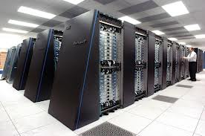
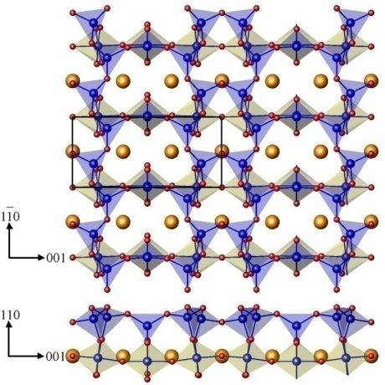
Fundamentals
A substantial fraction of the world computing is doing DFT calculations.
IBM Blue Gene
Increasingly large calculations are being done by experimentalists. Need robust, reliable, accurate and fast algorithms.
Enterkin et. al., Nature Materials, 2010

Slide 3
Converging many DFT codes
The DFT literature (published, unpublished, listserver) is full of “fudges” and confusion about getting calculations to converge.
  “Mixing factors”
  Run calculations at 2000K (metals)

Slide 4
Self-consistent field (SCF) cycle
Start with ρ(r)
Mix F(ρ(r)) & ρ(r)
Calculate V_{eff} (r) =f[ρ(r)]
SCF cycle

Slide 5
DFT
Atomic Positions
Minimize Energy
Density
Inner loop to obtain fixed-point for given atom positions
Outer loop to optimize atomic positions
Potential
Solve eigenvectors
values
New Density
Mix Density
No
Converged?
Forces Small
Yes
No

Slide 6
Current algorithms (pure DFT)
Calculate SCF mapping, time T₀
Broyden expansion for fixed-point problem, self-consistent density, N_{SCF} iterations
BFGS is most common for optimizing the atomic positions (Energy), N_{BFGS}
Time scales as N_{SCF}*N_{BFGS}*T₀

Slide 7
Double-Loop
Energy Contours
Fixed-Point for Density
BFGS step
Born-Oppenheimer Surface

Slide 8
Convergence
Classic QN convergence results*:
  N_{SCF} scales as number of clusters of eigenvalues of the dielectric response, << number of variables
  N_{BFGS} scales as the number of clusters of the force matrix (similar to phonons)
*For instance:
C.T. Kelly, Iterative Methods for Linear and Nonlinear Equations, SIAM, Philadelphia, 1995.
J. Nocedal, S. Wright, Numerical Optimization, New York, 2006.

Slide 9
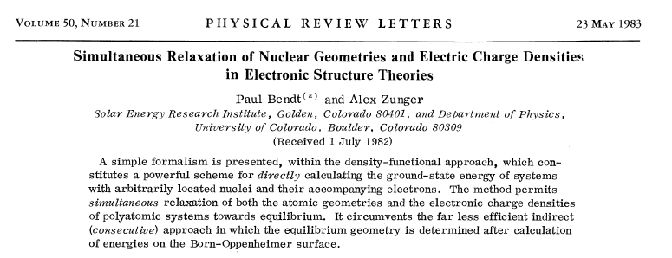
Why separate?
Fused problem, number of clusters will be less than the product N_{SCF}*N_{BFGS}
First proposed by Bendt & Zunger (1983), but they could not implement it.

Slide 10
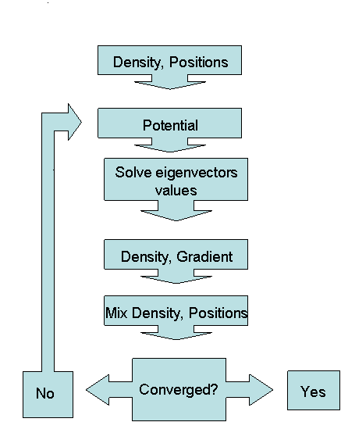
Fused Loop
Treat the density and atomic positions (as well as hybrid potentials etc as needed) all at the same time.
No restrictions to “special” cases, general algorithm has to work for insulators, metals, semiconductors, surfaces, defects, hybrids….
Few to no user adjustable parameters

Slide 11
Fused Loop
Residual Contours
Energy Contours
Born-Oppenheimer Surface
Zero-Force Surface

Slide 12
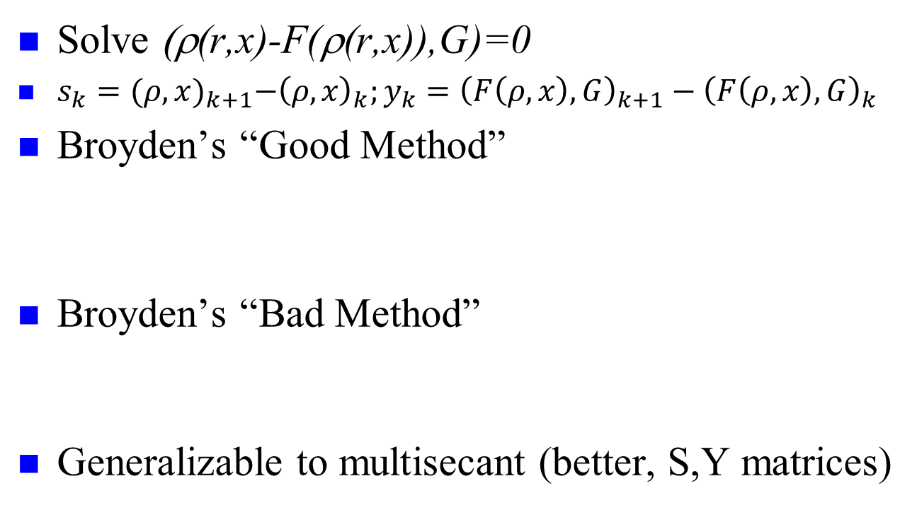
Broyden Fixed-Point Methods
Solve (ρ(r,x)-F(ρ(r,x)),G)=0
$s_{k}={(ρ,x)}_{k+1}−{\left(ρ,x\right)}_{k};y_{k}={\left(F\left(ρ,x\right),G\right)}_{k+1}−{\left(F\left(ρ,x\right),G\right)}_{k}$
Broyden’s “Good Method”
Broyden’s “Bad Method”
Generalizable to multisecant (better, S,Y matrices)
C.G. Broyden, A Class of Methods for Solving Nonlinear Simultaneous Equations, Mathematics of Computation, 19 (1965) 577-593.

Slide 13
Multisecant Approach
Consider a number of values:
S = (s₀,s₁,….s_{n}) ; Y=(y₀,y₁,….y_{n})
Expand to a simultaneous solution:
BS = Y ; or HY=S
Minimum-Norm Solution
Take H_{k}=I

Slide 14
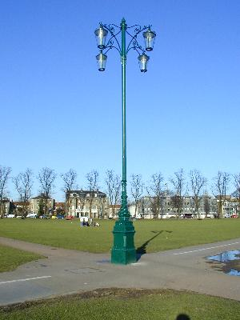
Reality Checkpoint
In a linear model both “Good” and “Bad” methods have been shown to be superlinearly convergent, and by induction so will a linear combination*.
Hence they should behave comparably.
They don’t, Good is unstable in DFT
Hence the linear model is misleading
*For instance:
C.T. Kelly, Iterative Methods for Linear and Nonlinear Equations, SIAM, Philadelphia, 1995.
J. Nocedal, S. Wright, Numerical Optimization, New York, 2006.

Slide 15
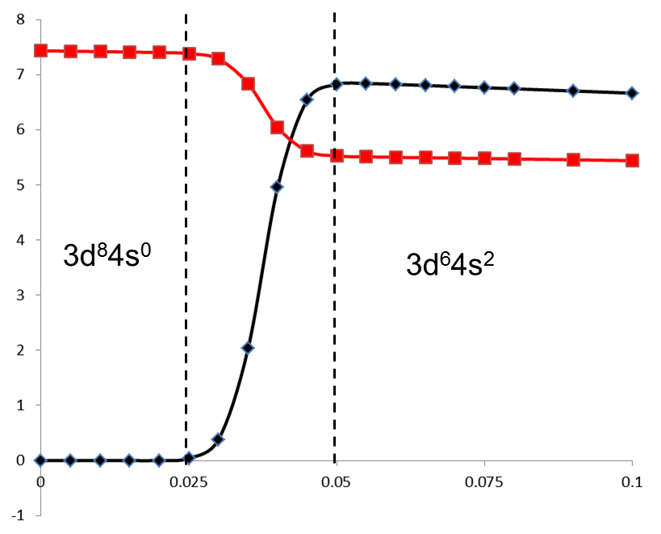
Phase Transitions: Jacobian can change discontinuously
Electronic configuration of F(ρ) in the second step as a function of the size of the first Pratt step for an Fe atom, with the 4s occupancy within the muffin-tins in black (x10) and the 3d in red
Other examples

Slide 16

Algorithm Greed
“A greedy algorithm always makes the choice that looks best at the moment. That is, it makes a locally optimal choice in the hope that this choice will lead to a globally optimal solution.”¹
Good Broyden is the optimal greedy algorithm. Hence if the linear model is valid it is best.
Bad Broyden is the least greedy algorithm, optimal if the linear model is not valid.
¹T.H. Cormen, C.E. Leiserson, R.L. Rivest, C. Stein, Introduction to Algorithms, MIT Press, Boston, US, 2009.

Slide 17
What is a greedy algorithm?
A greedy algorithm takes decisions on the basis of information at hand without worrying about the consequences. In many cases “greed is good”, but not always.
Example: make 41c with 25c, 10c, 4c coins
Optimum solution: 25+4x4
Greedy solution: start with 41c, use largest reduction
  25c Remainder 16
  10c Remainder 6
  4c Remainder 2

Slide 18
Ansatz for Fixed-Point Family
Neither Good nor Bad Broyden work for fused problem
Define the “Fixed-point Broyden Family”
At the solution, H_{k} is positive definite (stability condition). Therefore chose α to be as small as possible and still yield a positive definite Jacobian. (Optimal greed?)

Slide 19

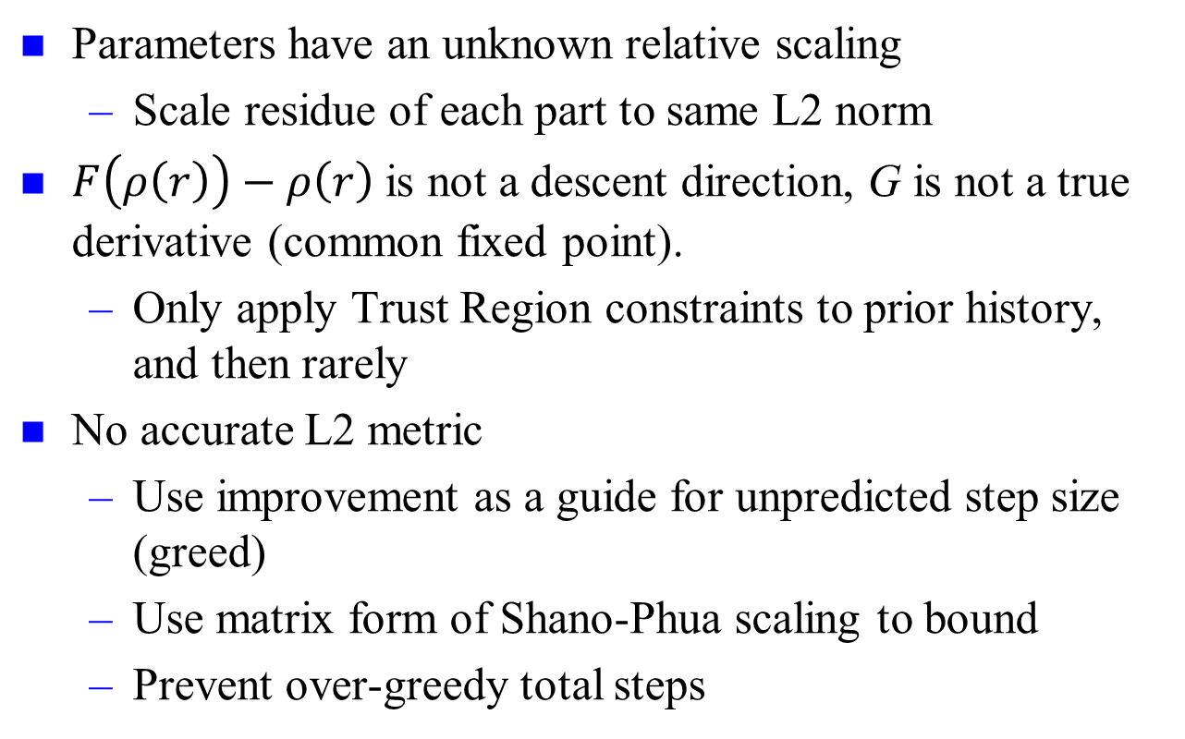
Additional Issues
Parameters have an unknown relative scaling
  Scale residue of each part to same L2 norm
$F\left(ρ\left(r\right)\right)−ρ\left(r\right)$ is not a descent direction, G is not a true derivative (common fixed point).
  Only apply Trust Region constraints to prior history, and then rarely
No accurate L2 metric
  Use improvement as a guide for unpredicted step size (greed)
  Use matrix form of Shano-Phua scaling to bound
  Prevent over-greedy total steps

Slide 20
Comparison
Double-Loop calculations
  “Standard” BFGS (PORT library)¹
  Spring model initialization²
  MSR1 algorithm, but without atom movement for inner loop
Initialization: normally atomic densities.
No adjusted parameters – i.e. the same results as a novice will obtain.
Room temperature
¹Dennis, J. E.; Mei, H. H. W., Journal of Optimization Theory and Applications 1979, 28 (4), 453-482.
²Rondinelli, J.; Bin, D.; Marks, L. D., Computational Materials Science 2007, 40, 345-353.

Slide 21
Convergence of QN methods
Depends upon clustering of eigenvectors
Rondinelli, J.; Bin, D.; Marks, L. D., Enhancing structure relaxations for first-principles codes: an approximate Hessian approach. Computational Materials Science 2007, 40, 345-353.

Slide 22
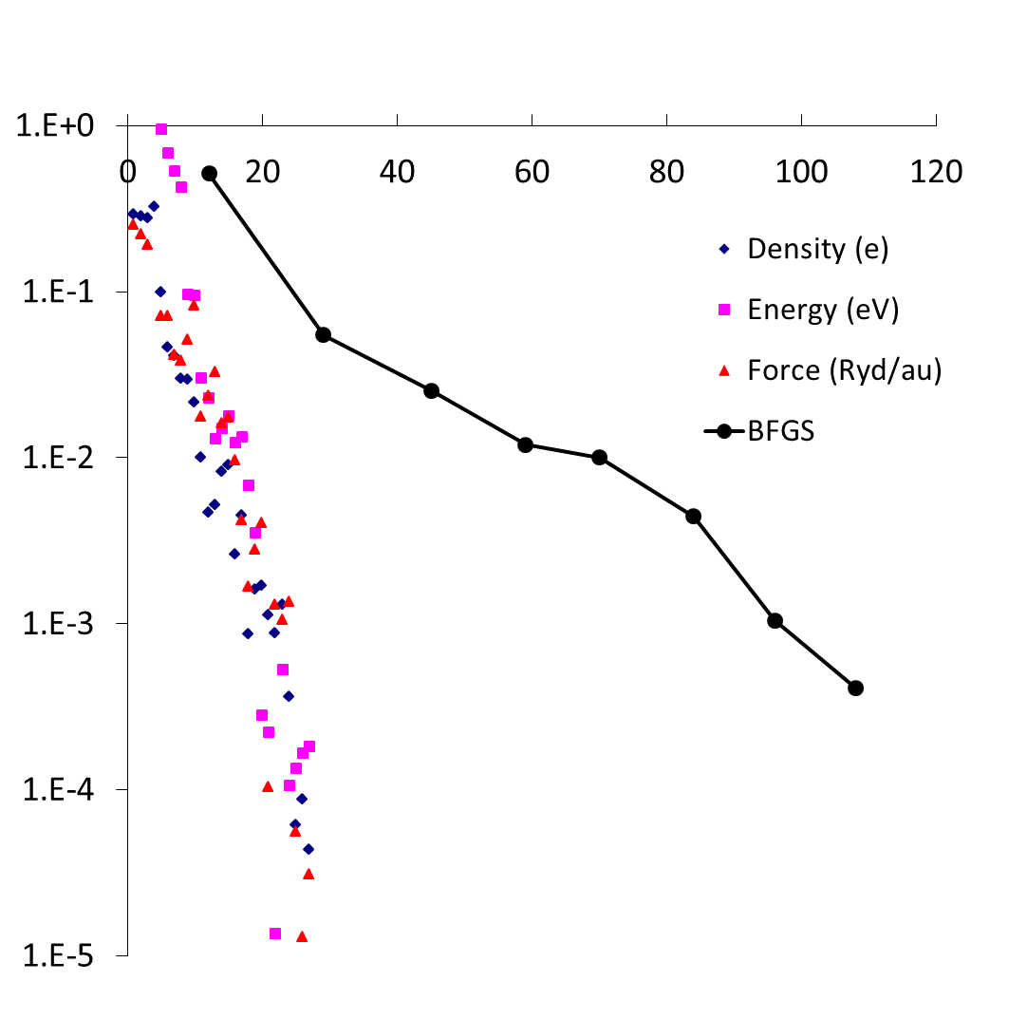
Bulk NiO, on-site hybrid

Slide 23
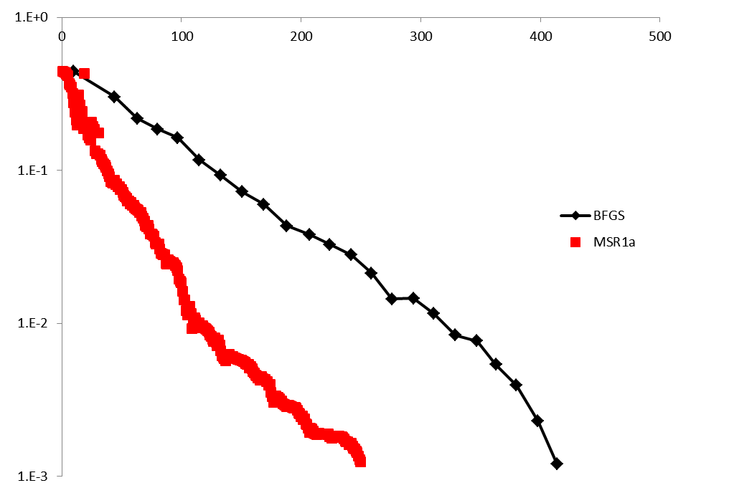
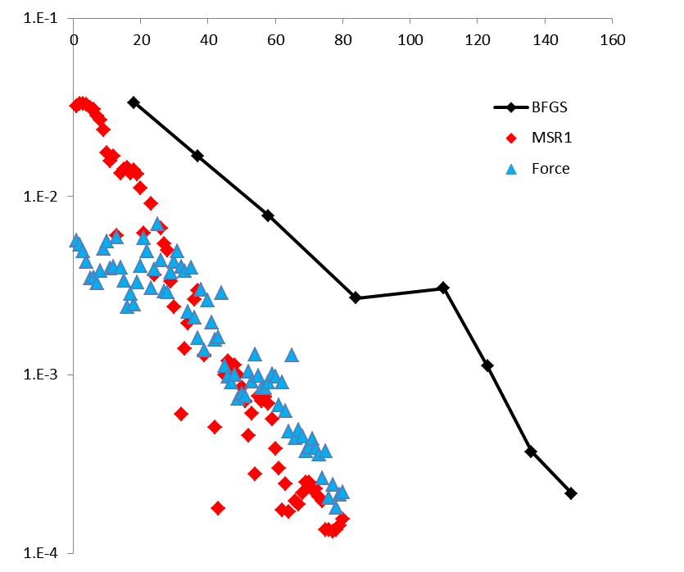
Larger Problems, 52 atoms, MgO (111)+H2O (left) & 108 AlFe (right)
J. Ciston, A. Subramanian, L.D. Marks, PhRvB, 79 (2009) 085421.
Lyudmila V. Dobysheva (2011)

Slide 24
Numbers (unreadable)
Figure | Name | Atoms | Ineq Atoms N_{a} | Atomic Variables N_{av} | Matrix Size | Density Size N_{e} | States | Max Change (au) | SCF MSR1 | SCF/Iter BFGS
3 | Ni(OH)₂ | 5 | 3 | 2 | 601 | 5644 | 15 | 0.20 | 27 | 108/8
4 | MgO (111)+H₂O | 52 | 21 | 42 | 6344 | 28842 | 176 | 2.12 | 241 | 414/23
6 | Al₁₀₆Fe₂ | 108 | 42 | 92 | 5945 | 82643 | 491 | 0.48 | 76 | 148/8
7 | TiO₂ (001) 2x2 | 40 | 16 | 35 | 6518 | 25361 | 163 | 0.53 | 156 | 349/13
8 | SrTiO₃ (001) 2x1 | 108 | 44 | 96 | 16106 | 65752 | 400 | 2.87 | 480 | 645/40
9 | MgO (111) octapole | 44 | 12 | 20 | 10029 | 17046 | 176 | 1.09 | 92 | 170/13
 |  | 68 | 18 | 32 | 10185 | 21732 | 272 | 1.19 | 109 | 158/10
 |  | 92 | 24 | 44 | 10341 | 26418 | 358 | 1.27 | 138 | 152/10
 |  | 116 | 30 | 56 | 10497 | 31104 | 464 | 1.35 | 151 | 189/14
10 | C₂N₂H₈ | 24 | 6 | 18 | 5764 | 16085 | 26 | 3.20 | 575 | 575/45

Slide 25
Open questions
Is the ansatz “right”, or is there a better one?
Can the Hessian (Force Matrix) be extracted (to date failed)?
Can the guesstimated dielectric response be better exploited?
Can the fixed-point Broyden family method be used for other problems?
How well will the algorithm work with pseudopotential codes (probably better)?
GNU version (man/woman power /$$ needed)
How to safeguard numerical accuracy degredation?

Slide 26
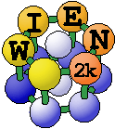
Summary
Production level code (not demonstration)
Fused algorithm is ~ twice as fast (sometimes more, in rare cases the same speed)
Works for metals, insulators, atoms, hybrid potentials…
Should work for pseudopotential & other methods
Idiot proof (within reason)
No user input parameters needed in most cases
Many possibilities to improve…..

Slide 27
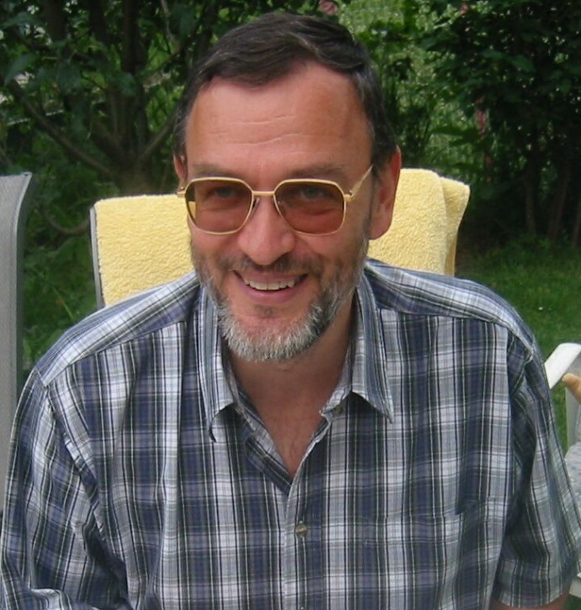
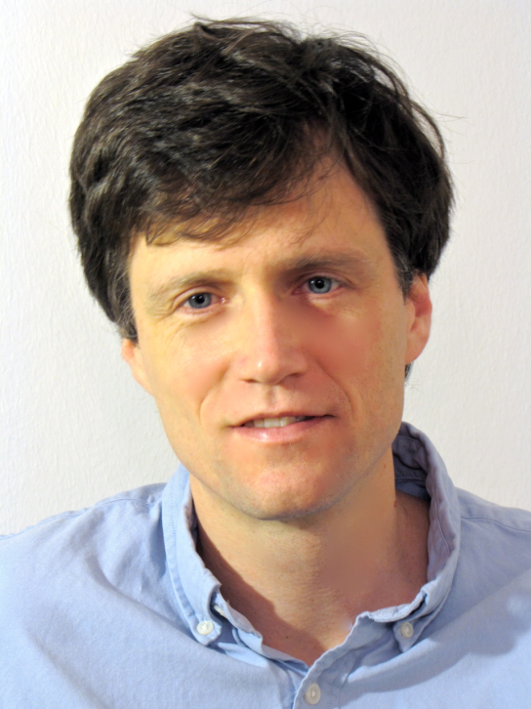

Acknowledgements
Peter Blaha Russel Luke TU Wien U. Göttingen

Slide 28
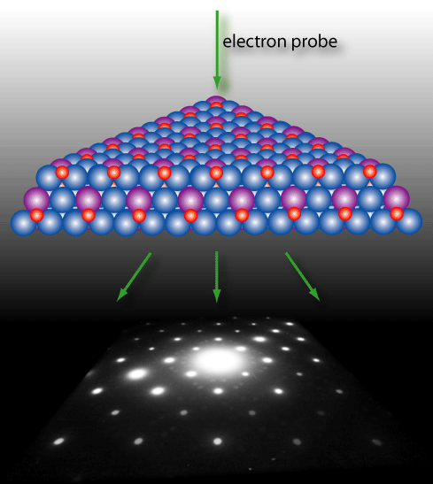
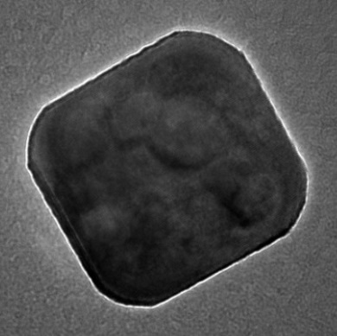
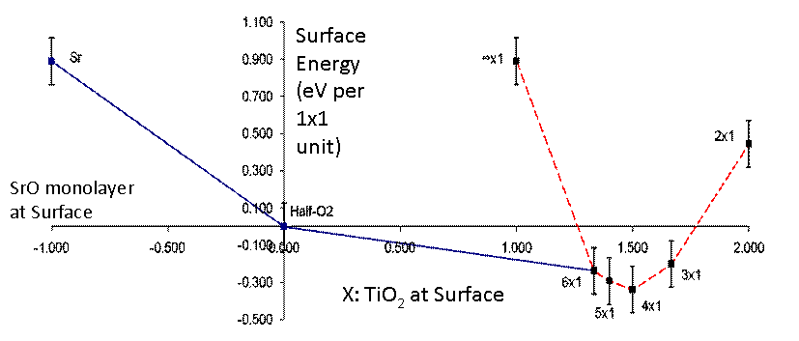
Questions ?
It is through science that we prove, but through intuition that we discover.
Jules H. Poincaré
Diffraction
DFT
10 nm
NanoCatalysts
Structure

