Slide 1
MTPs:
Some ruminations
http://www.numis.northwestern.edu/Presentations

Slide 2

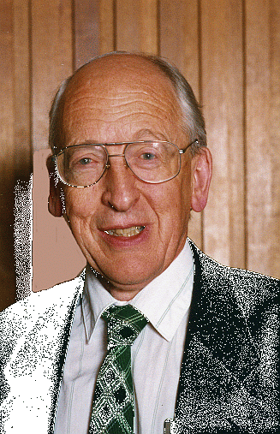

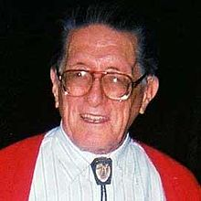


Acknowledgements 1
Phase 1: 1978-1994
  E. Yoffe, A. Howie, D. J. Smith, J. M. Cowley, J. Dundurs
  P. M. Ajayan, D. Iyer

Slide 3

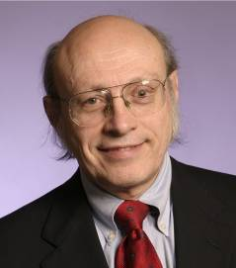






Acknowledgements 2
Phase 2: 2008-
K. R. Poeppelmeier R. Van Duyne
J. Enterkin E. Ringe B. Peng D. Alpay S. Patala
Materials Research Science & Engineering Center
Northwestern University
Notes:
3

Slide 4

Small can be beautiful
Pro’s
  Nanoplasmonics
  Nanoparticles for catalysis
  Sensing
  Drug delivery
  …
Image Source:
John Stringer
Electric Power Research Institute
Notes:
4

Slide 5
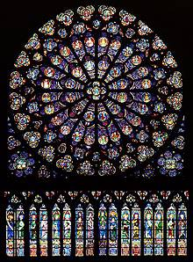
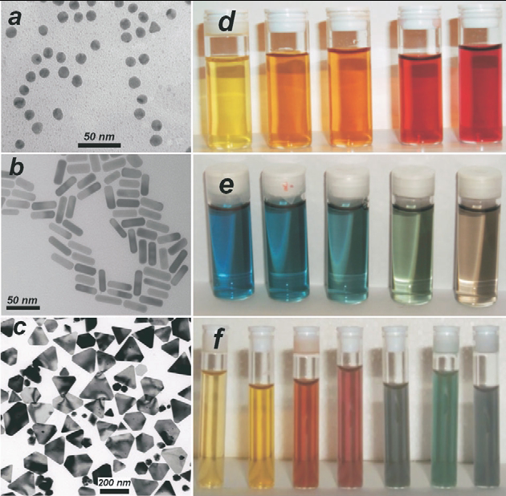
Nanosized Gold
L. Liz-Marzan, Mater. Today 7, 21 (2004)
www.notredamedeparis.fr
Notes:
5

Slide 6

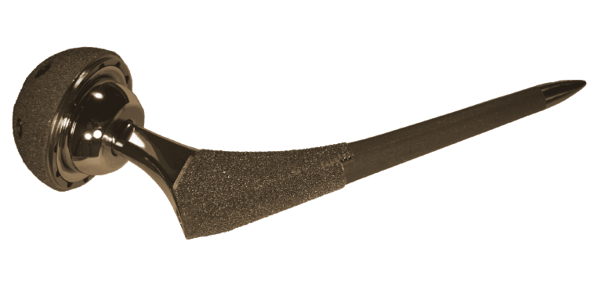
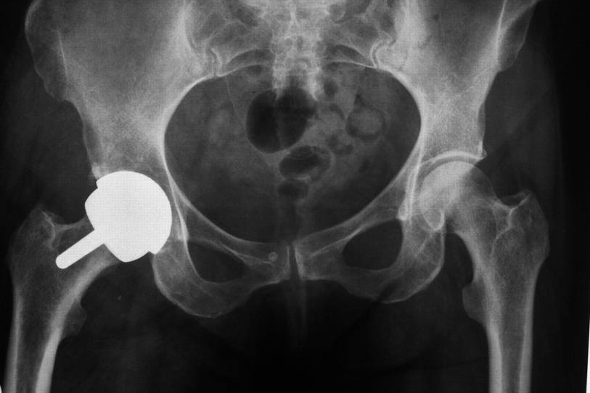
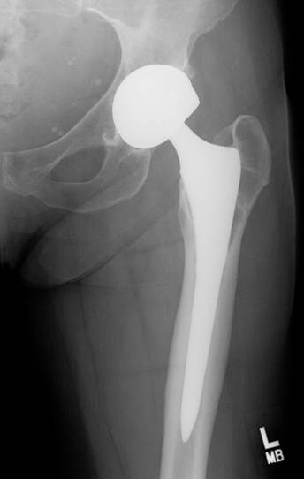
Small can be ugly
Con’s
  Toxic
  Wear Debris
Hip Implant
Liao et al., Science 334, 1687 (2011)
Notes:
6
6

Slide 7
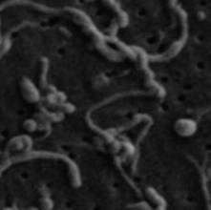
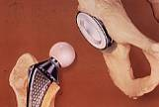
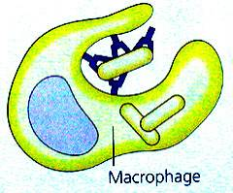
Wear-Mediated Osteolysis
osteolysis
disrupted balance between osteoclasts/PMNs and osteoblasts:
osteoclasts ↑, osteoblasts ↓
wear particles
osteoclast/ polymorphonuclear giant cell
opsonization
phagocytosis
osteoblast
http://academic.brooklyn.cuny.edu/biology/bio4fv/page/aviruses/cellular-immune.html
Archibeck, MJ; Jacobs, JJ; Roebuck, KA; Glant, TT. Journal of Bone & Joint Surg, 2000

Slide 8
Nanoparticle Crystallography from 100 nm down
Some basics that everyone should know
  Wulff,
  Winterbottom
  Modified Wulff
Some basics that most do not know or get wrong
  The artifact of some particle size effects
  There are two Wulff constructions

Slide 9
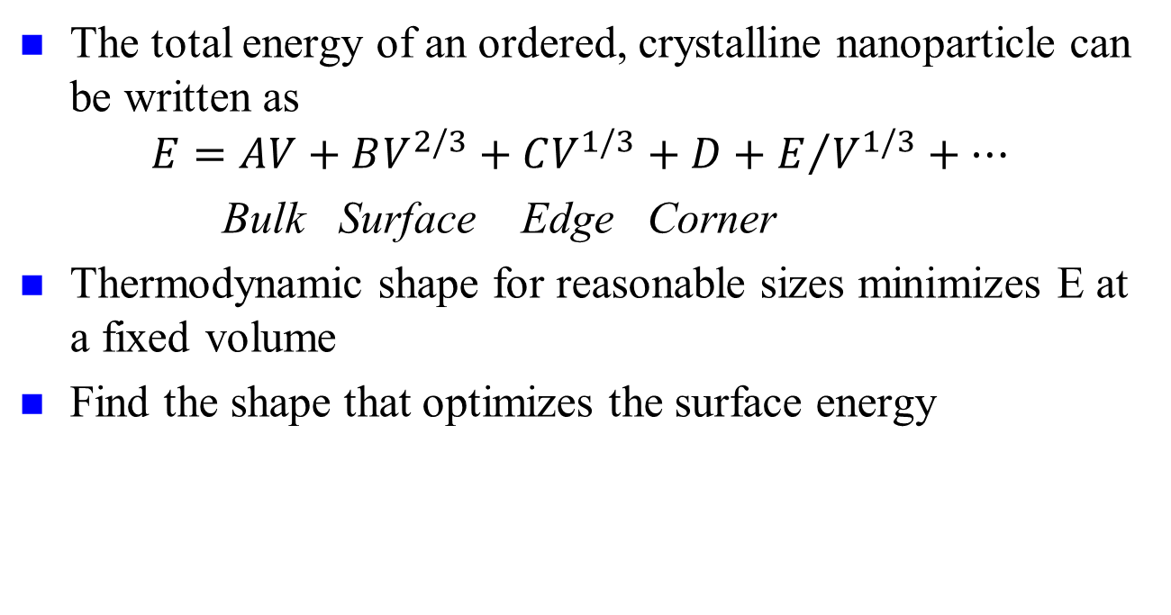
Basics: Continuum, simple
The total energy of an ordered, crystalline nanoparticle can be written as
$$E=AV+BV^{2/3}+CV^{1/3}+D+E/{V^{1/3}+…}$$
Bulk Surface Edge Corner
Thermodynamic shape for reasonable sizes minimizes E at a fixed volume
Find the shape that optimizes the surface energy

Slide 10
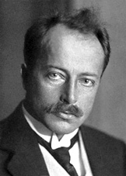
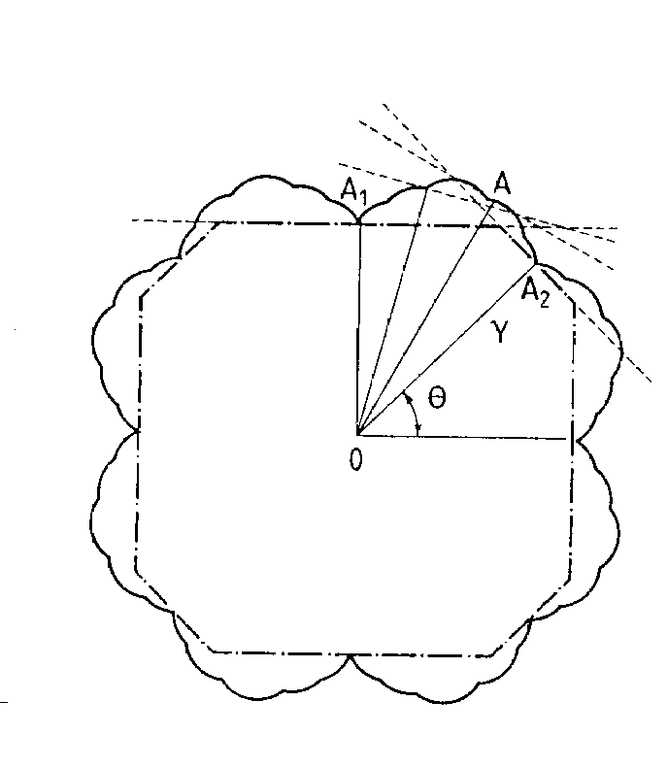
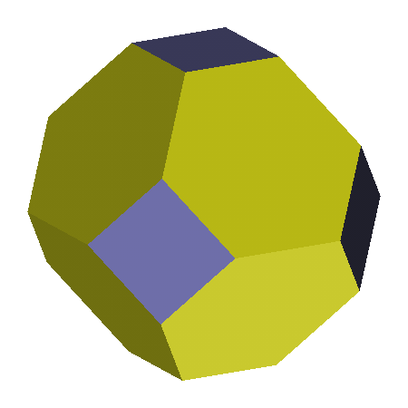

Wulff Construction
Max Von Laue
Minimize surface energy for fixed volume
  $$S_{W}=\{x:x.\hat{n}≤λγ\left(\hat{n}\right) for all unit vectors \hat{n}\}$$
G. Z. Wulff, Kristallogr. Mineral 34, 4490 (1901); M. Z. Von Laue, Kristallogr. 105, 124 (1943); A. Z. Dinghas, A. Z. Kristallogr. 105, 304 (1944)

Slide 11
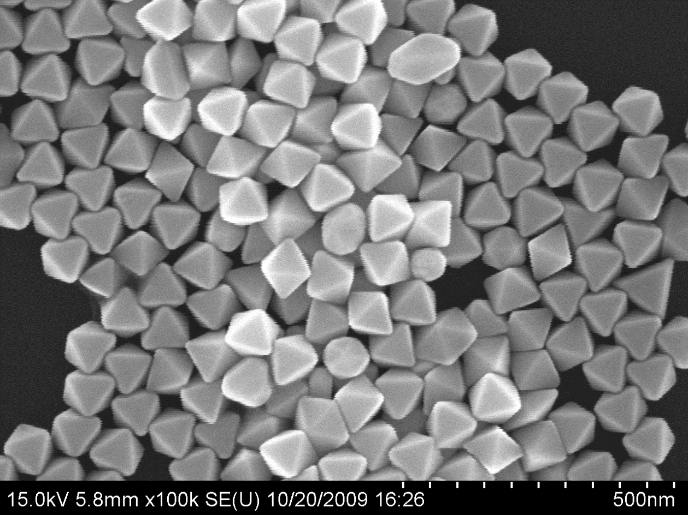
Example: Gold Octahedra
C. Li, K. L. Shuford, M. Chen, E. J. Lee, S. O. Cho, ACS Nano. 2, 1760 (2008)
Notes:
11

Slide 12

Chemisorption Dependent
Cu Bi-saturated Cu
Curtesy Paul Wynblatt

Slide 13
Winterbottom Construction
Include the effect of a nanoparticle sitting on a substrate
γ_{Int}
N.B., Kaischew may be a better source, unclear

Slide 14
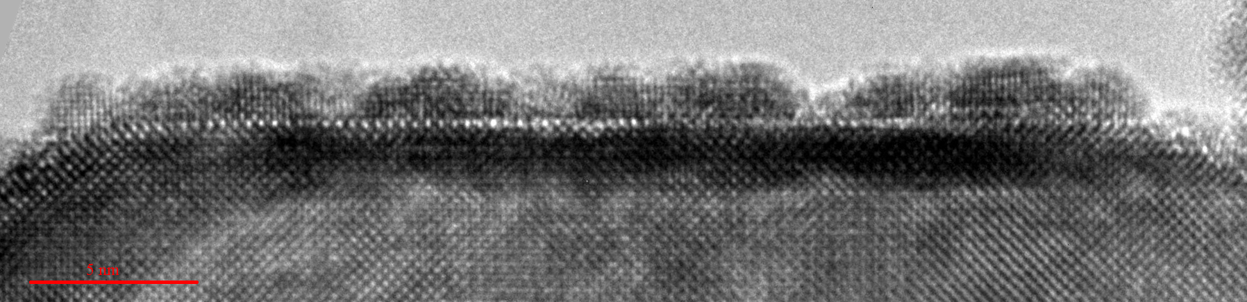
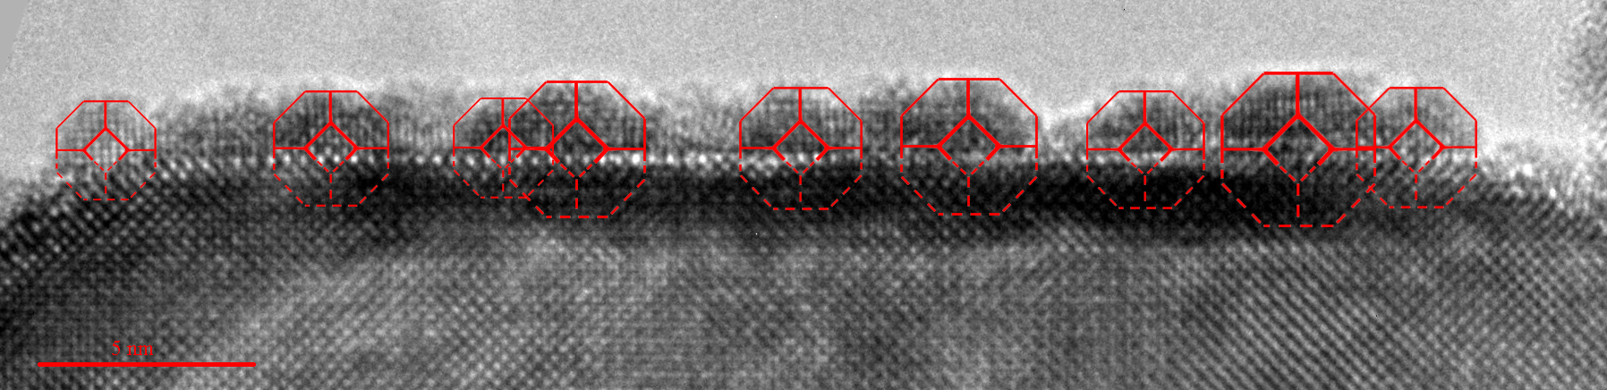
Wulff & Winterbottom
001
001
100
110
51° rotation around [011]
Projection down [010]
45° rotation around [100]
Projection down [110]
γ₁₁₁
γ₁₁₁
γ₁₀₀
γ₁₁₁
γ_{Int} – γ_{Sub} = γ_{Pt}
0 < γ_{Int} – γ_{Sub} < γ_{Pt}
γ_{Int} – γ_{Sub} = 0
-γ_{Pt} < γ_{Int} – γ_{Sub} < 0
γ_{Int} – γ_{Sub} ≤ -γ_{Pt}
Increasing γ_{int}
Increasing γ_{sub}
Increasing γ_{Pt}
J. A. Enterkin, K. R. Poeppelmeier, L. D. Marks, Nano Lett. 11, 993 (2011); G. Z. Wulff, Kristallogr. Mineral 34, 4490 (1901); W. L. Winterbottom, Acta Metallurgica 15, 303 (1967)
14

Slide 15
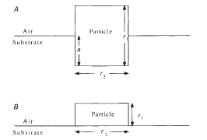
Caveat: assumes flat substrate
Connects to strong metal support interactions (SMSI)
Ajayan, P.M. and L.D. Marks, Nature, 1989. 338(6211), 139

Slide 16
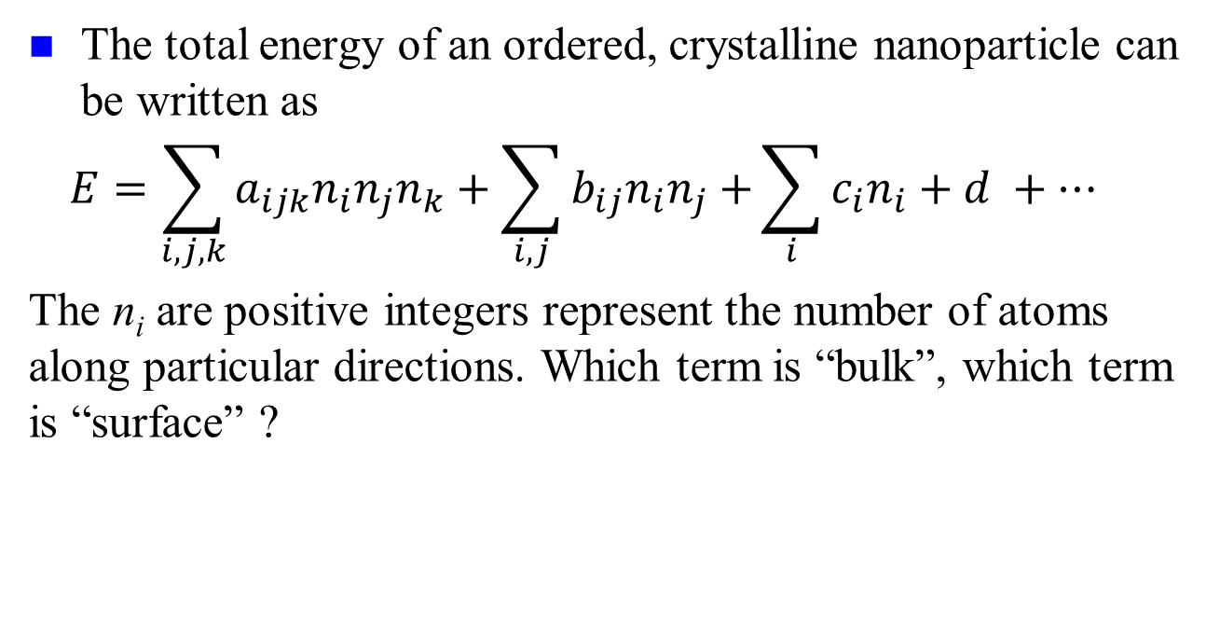
Basics: Continuum, not so simple
The total energy of an ordered, crystalline nanoparticle can be written as
$$E=\sum_{i,j,k}{a_{ijk}n_{i}n_{j}n_{k}}+\sum_{i,j}{b_{ij}n_{i}n_{j}+}\sum_{i}{c_{i}n_{i}+d} +…$$
The n_{i} are positive integers represent the number of atoms along particular directions. Which term is “bulk”, which term is “surface” ?

Slide 17
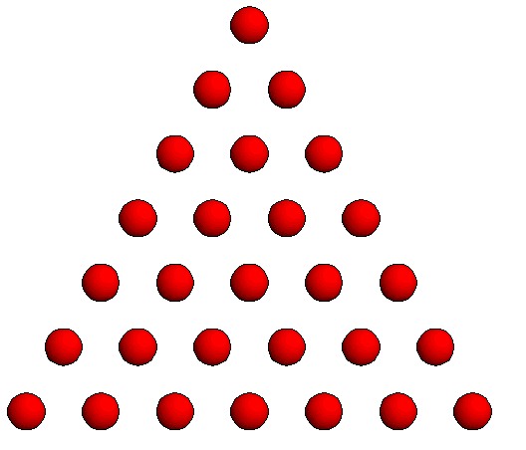
Counting Effects
Number of Atoms
= n(n+1)/2
Not n² dependence
n

Slide 18
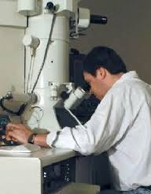
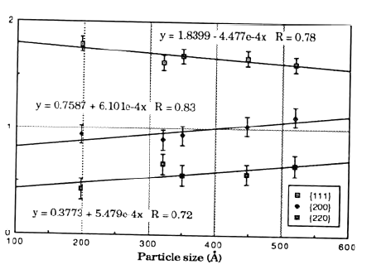
Wulff shape apparently size dependent
Marks, L.D., Surface Science, 1985. 150(2), 358; Bonevich, J.E., Proc 47th Ann EMSA, 1989, 258.

Slide 19
What is the size?
Crystallographic Size
Chemisorption Size
Thermodynamic Size
V = constant*N
C=O

Slide 20

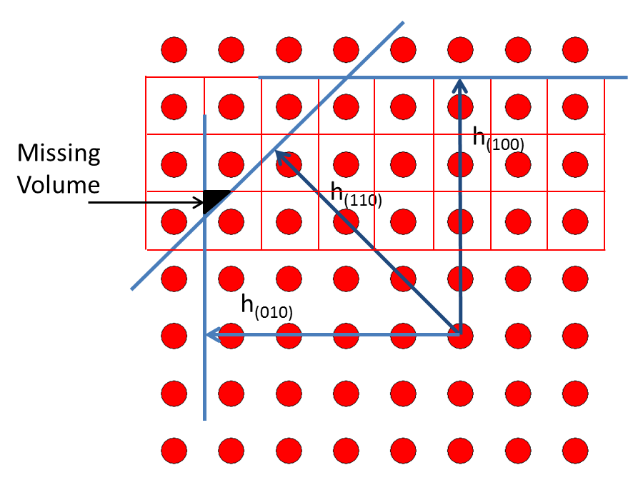
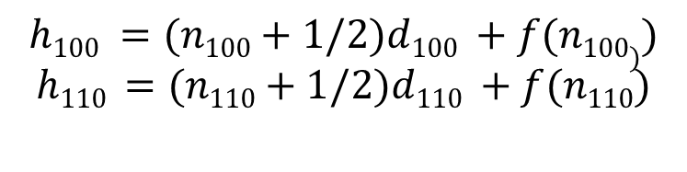
Care needed
Simplest approach, define distances such that V(h) = Nv_{atom}
Introduces a non-linear relationship between h & N
Adds some minor corrections
$$h100 =(n100+1/2)d100 +f(n100))$$
$$h110 =(n110+1/2)d110 +f(n110)$$
Based on, but not the same as Hamilton, Phys. Rev. B, 2006. 73: 125447, see also Cleveland and Landman JCP, 1991. 94(11), 7376
Equimolar Gibbs surface using Wigner-Seitz cells

Slide 21
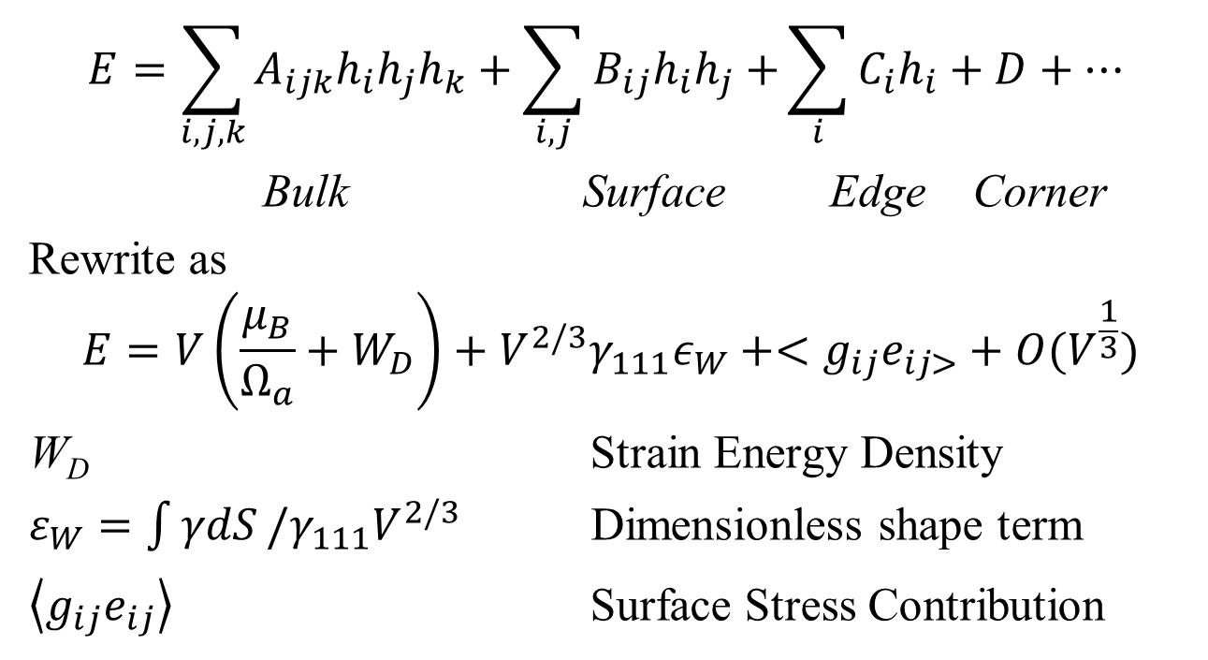
Simplification
$$E=\sum_{i,j,k}{A_{ijk}h_{i}h_{j}h_{k}}+\sum_{i,j}{B_{ij}h_{i}h_{j}+}\sum_{i}{C_{i}h_{i}+D}+…$$
Bulk Surface Edge Corner
Rewrite as
$$E=V\left(\frac{μ_{B}}{Ω_{a}}+W_{D}\right)+V^{2/3}γ_{111}ε_{W}+<g_{ij}e_{ij>}+O(V^{\frac{1}{3}})$$
W_{D} Strain Energy Density
$ε_{W}=\int{γdS}/γ_{111}V^{2/3}$ Dimensionless shape term
$\left\langle g_{ij}e_{ij}\right\rangle$ Surface Stress Contribution

Slide 22
Surface Energy & Stress I
Important: never use the term “surface tension” for a solid. Never. Really never.
Surface (Free) Energy γ
  Define as energy to create new fully relaxed surface
  Different from cleavage energy
  Caveat: definition “per area” or “per atom” are not the same – thermodynamic & DFT definitions can differ

Slide 23
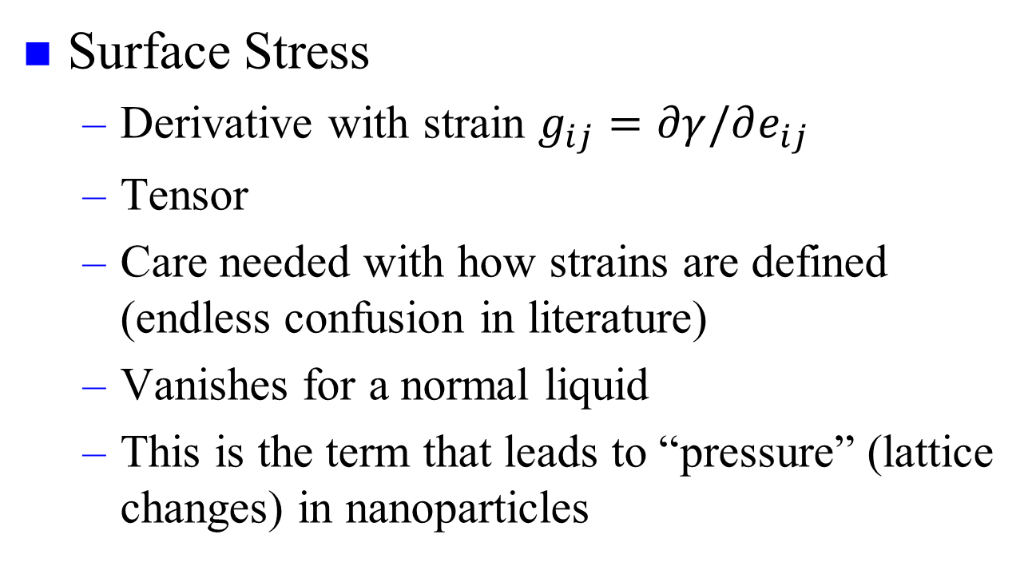
Surface Energy & Stress II
Surface Stress
  Derivative with strain $g_{ij}=∂γ/∂e_{ij}$
  Tensor
  Care needed with how strains are defined (endless confusion in literature)
  Vanishes for a normal liquid
  This is the term that leads to “pressure” (lattice changes) in nanoparticles

Slide 24
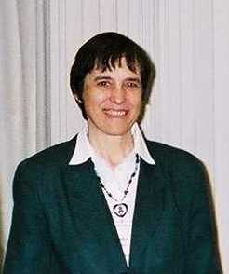
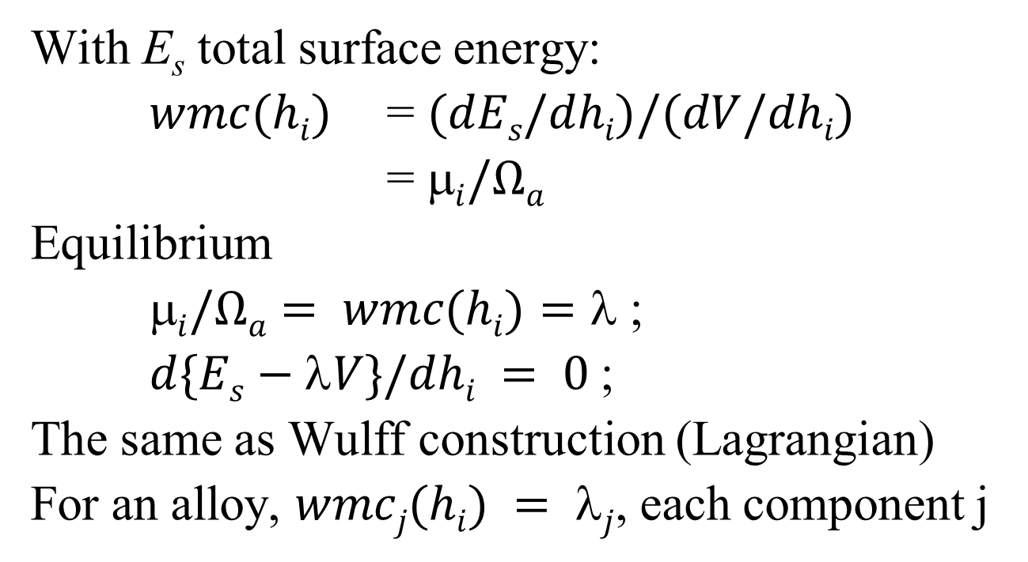
Weighted Mean Curvature
With E_{s} total surface energy:
$wmc(hi)$ = $(dEs/dhi)/(dV/dhi)$
= $i/Ωa$
Equilibrium
$i/Ωa= wmc(hi)=$ ;
$d\{Es−V\}/dhi = 0$;
The same as Wulff construction (Lagrangian)
For an alloy, $wmcj(hi) = j$, each component j
e.g. Taylor, J.E., Acta Met., 1992. 40(7): p. 1475-1485.

Slide 25
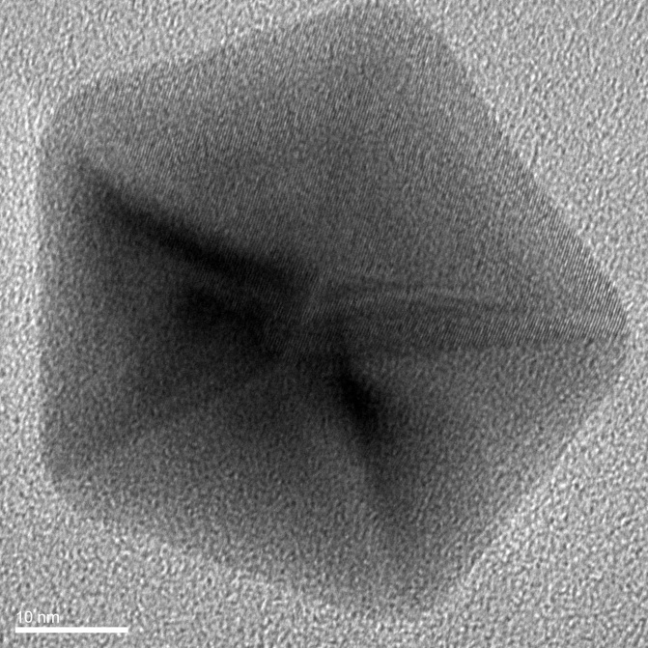
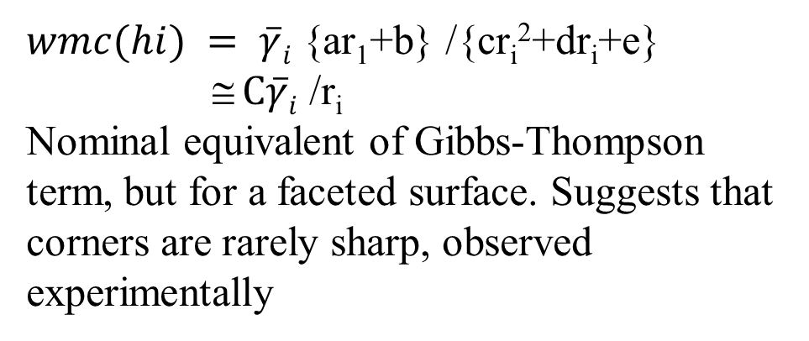
Geometric interpretation
$wmc(hi) = \overline{γ}i$ {ar₁+b} /{cr_{i}²+dr_{i}+e}
≅ $C\overline{γ}i$ /r_{i}
Nominal equivalent of Gibbs-Thompson term, but for a faceted surface. Suggests that corners are rarely sharp, observed experimentally
r_{i}
h_{i}

Slide 26
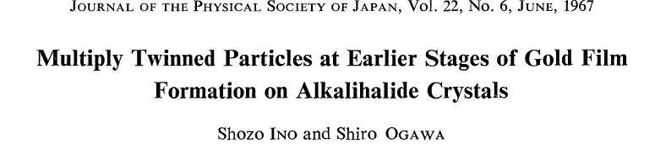
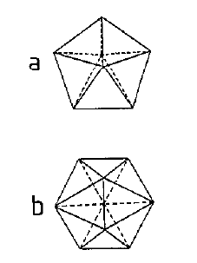
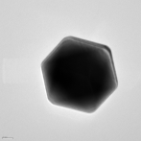
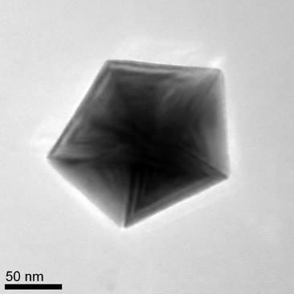
Continuing, beyond single crystals
Reduce surface energy, at the cost of strain energy
Decahedral MTP Icosahedral MTP

Slide 27
Distorted tetrahedral units
S. Ogawa & S. Ino, J. Vac. Sci., Tech. 6, 527 (1969).

Slide 28
Common orientations

Slide 29
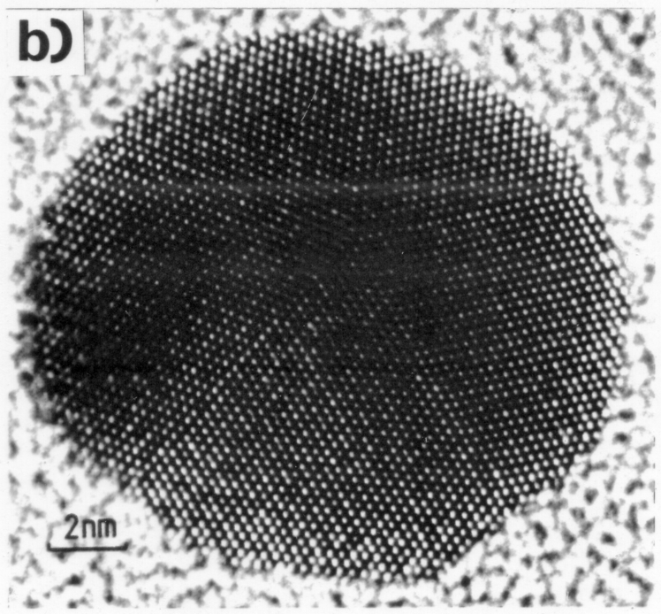
But…Dh is not so simple
L. D. Marks,. Philos. Mag. A. 49, 81 (1984).

Slide 30
Modified Wulff Construction
Include the effect of a nanoparticle with a twin
γ_{twin}/2

Slide 31
LTPs

Slide 32
Modified Wulff Construction
$S^{i}=\{x:(x−o^{i}).\hat{n}≤λ^{i}γ^{i}\left(\hat{n}\right)\}$
L. D. Marks,. Philos. Mag. A. 49, 81 (1984).

Slide 33
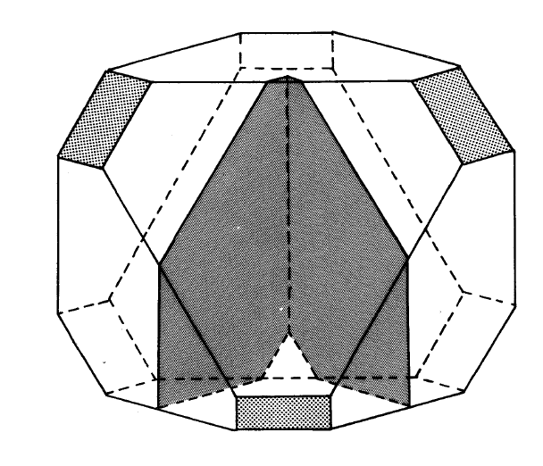
Modified Wulff Construction
$S^{i}=\{x:(x−o^{i}).\hat{n}≤λ^{i}γ^{i}\left(\hat{n}\right)\}$
L. D. Marks,. Philos. Mag. A. 49, 81 (1984).

Slide 34
Dh & Ic segments

Slide 35
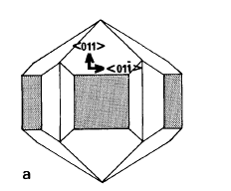
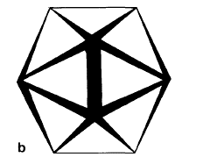
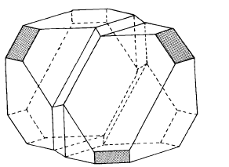
Modified Wulff Construction for Twinned Particles
Lamellar Twinned Particles
2 or more segments
1 boundaries/segment (caps)
2 boundaries/segment (middle)
Decahedral
Multiply Twinned Particle
5 segments
2 boundaries/segment
Icosahedral
Multiply Twinned Particle
20 segments
3 boundaries/segment
L. D. Marks, J. Cryst. Growth 1983, 61, 556-566
Notes:
35

Slide 36
Can be a second solution
L. D. Marks, J. Cryst. Growth 1983, 61, 556-566

Slide 37
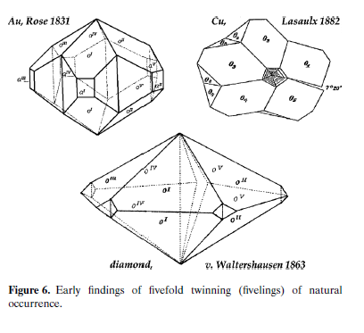
Shapes for Dh reported in 19th century
From H. Hofmeister, Z Krist 224 (2009) 528

Slide 38

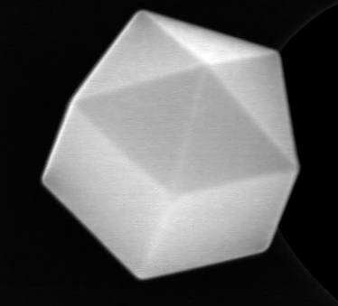
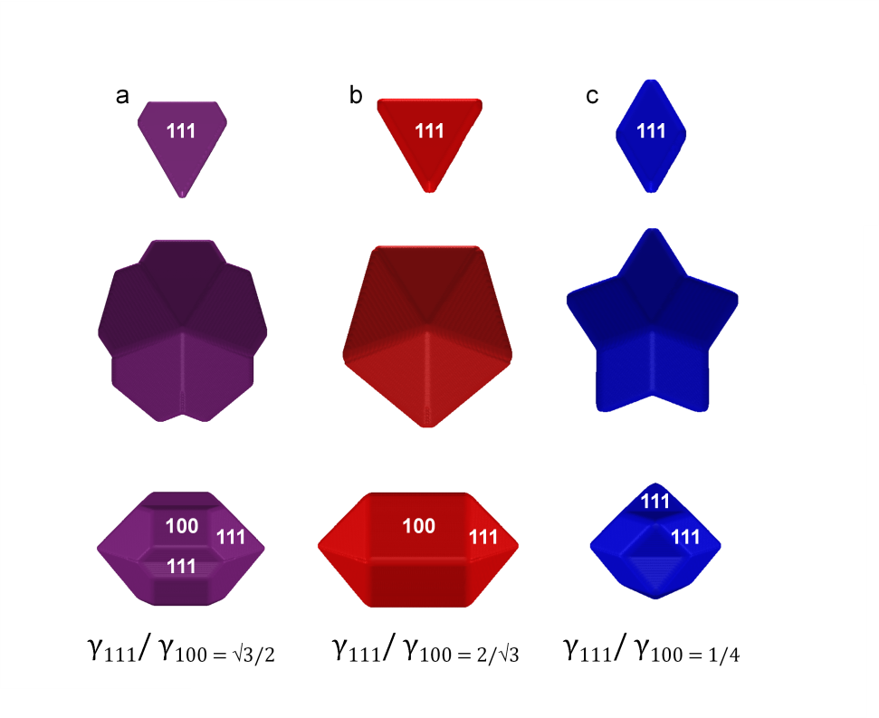
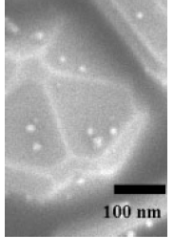
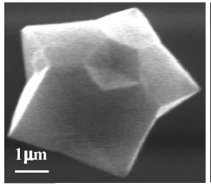
Different Cases
E. Ringe, R.P. Van Duyne, L. D. Marks, Journal of Physical Chemistry C, 2013. 117, 15859

Slide 39

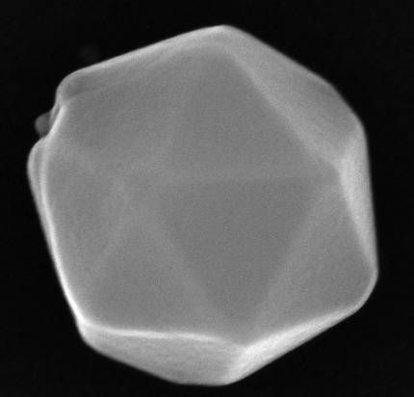
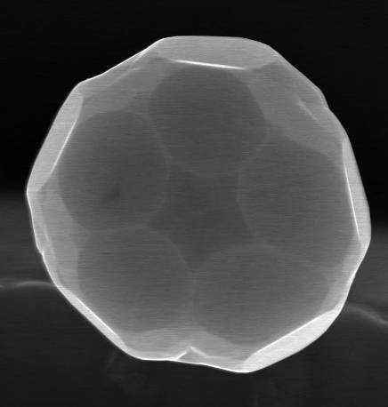
Different Shapes for Ic as well
{111} only
{110} only
N.B., no {100} in an Ic, see L. D. Marks, Philos. Mag. A. 49, 81 (1984)
Images courtesy of M. Yacaman
{111} + {110}

Slide 40

Surfaces depend upon environment
“5x1” (001) reconstruction on Au Dh, Image courtesy of Gilberto Casillas-Garcia, UTSA

Slide 41
MTP Energetics
Three Terms
  Strain, fcc units do not fit together without it
  Difference in total surface free energy
  Difference in total surface stress terms
  N.B., twin boundary energy negligable

Slide 42
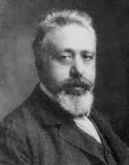
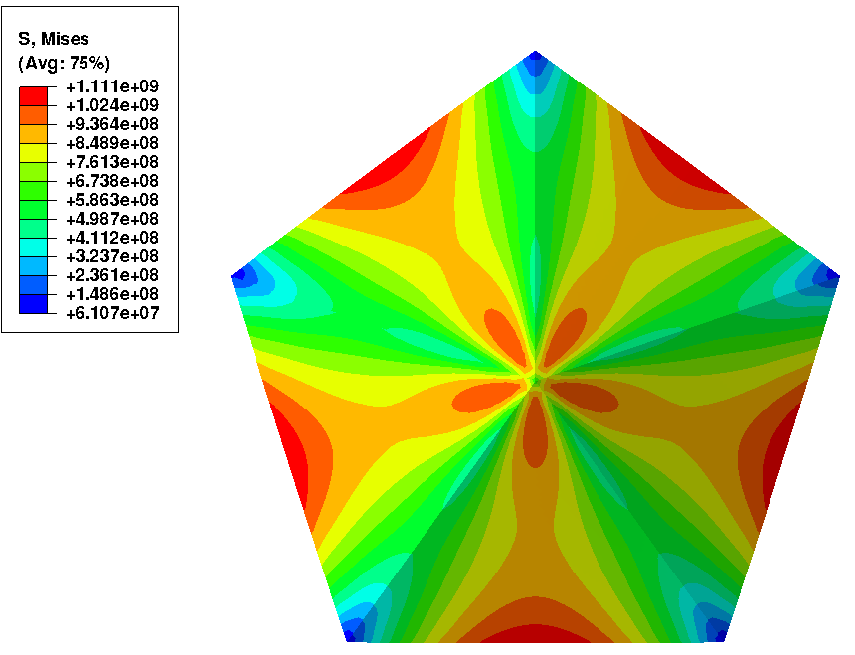
Strain: Volterra Disclination
S. Ogawa & S. Ino, J. Vac. Sci. Tech. 6, 527 (1969).
R. de Wit, Journal of Physics C, 1972, 5, 529
A. Howie and L. D. Marks, Phil Mag 1984. 49(1), 95-109.
Patala, S., L.D. Marks, and M.O. de la Cruz, Journal of Physical Chemistry C, 2013. 117(3), 1485
Von Mises stress distribution (a)

Slide 43
MTPs have less of the Wulff shape
Segment for Dh
Twin boundaries restrict which surfaces are exposed
L. D. Marks,. Philos. Mag. A. 49, 81 (1984).

Slide 44


Energy Balance
Three competing terms
  Gain in surface energy (MTPs more {111})
  Cost to strain the particle
  Energy change due to expansion at surface, surface stress term (heavily environment dependent)
$$E/V^{2/3}$$
Ic Dh Sc
$$V^{1/3}$$
A. Howie and L. D. Marks, Phil Mag 1984. 49(1), 95-109.

Slide 45




Energetics
Icosahedra
Quasi-spherical shape.
Close-packed surface but
large internal strain.
Favourable at small sizes
Decahedra
Intermediate behaviour.
Favourable at
Intermediate sizes
Polyhedra
Non-spherical shape
No internal strain.
Favourable at large sizes
Courtesy Riccardo Ferrando

Slide 46
Growth
Complex, can be templated (i.e. large from small) or there can be changes
K. Yagi et al, Journal of Crystal Growth 28 (1975) 117

Slide 47
Growth
Asymm Dh? Dh Dh Ic
K. Yagi et al, Journal of Crystal Growth 28 (1975) 117
L. D. Marks, Journal of Crystal Growth 61(1983) 556

Slide 48

Structural Fluctuations (Iijima)
P. M. Ajayan, L. D. Marks,. 24-6, 229 (1990)

Slide 49
Transformation?
Plausible transformations between MTPs
The Structure of Small Silver Particles
L. D. Marks, 1980
www.numis.northwestern.edu/thesis/LDM_Thesis.pdf

Slide 50


A simple physical concept
The potential surface, very schematically: solid in the deep, narrow well, liquid in the high rolling plain:
Courtesy of Stephen Berry

Slide 51
Quasimelting
J. Dundurs, L. D. Marks, P. M. Ajayan,. Philos. Mag. A. 57, 605 (1988)

Slide 52




Morphological Transitions (Angus Kirkland)
5.5nm size
FCC
Decahedral
Room temp
300°C
400°C
7.2nm size
Icosahedral
Decahedral
In-situ Heating
RT
400°C
RT
10.4nm size
Decahedral
Decahedral
Ultramicroscopy, 110 (2010) 506
RT
400°C
RT
ACS Nano, 3 (2009) 1431
Solid – Solid Transition below T_{m}
As Synthesised Particles not in Thermodynamic Ground State

Slide 53
Phase Diagram (1990 vintage)
P. M. Ajayan, L. D. Marks. Phase Transit. 24-6, 229 (1990)

Slide 54
The Two Wulff Constructions
Just to make life more fun
  Is every Wulff shape thermodynamic?
  No, and probably the original paper was not a thermodynamic case!

Slide 55






Thermodynamic Wulff Construction
001
001
100
110
γ = surface free energy
n = crystallographic face (hkl)
h_{(n)} = surface normal
Λ_{(c)} = Wulff constant (accounts for volume)
γ₁₁₁
γ₁₁₁
γ₁₀₀
  $$S_{W}=\{x:x.\hat{n}≤λγ\left(\hat{n}\right) for all unit vectors \hat{n}\}$$
G. Z. Wulff, Kristallogr. Mineral. 34, 449 (1901)
Notes:
55

Slide 56
Kinetic Wulff Construction
001
001
100
110
v= growth velocity
n = crystallographic face (hkl)
h_{(n)} = surface normal
Λ_{(c)} = Wulff constant (accounts for volume)
γ₁₁₁
γ₁₁₁
γ₁₀₀
  $$S_{W}=\{x:x.\hat{n}≤λv\left(\hat{n}\right) for all unit vectors \hat{n}\}$$
Frank, F. C. In Growth and Perfection of Crystals; Wiley (1958)
Notes:
56

Slide 57


Kinetic v Thermodynamic Wulff
$hi = i$
γ_{i} depends upon
Chemisorption
Surface Composition
Bulk Composition
Surface Segregation
$hi = vi$
v_{i} depends upon
Rate limiting step (diffusion/nucleation)
Transition state (e.g. desorption of surfactants)
$wmcj(hi)$, i.e. local chemical potential

Slide 58



Origin of twin enhancement term
Atoms added at a twin have a higher co-ordination number than on a flat surface
Additional energy makes nucleation easier
Atom bonds to those on both sides
Gamalski et al, Nano Lett 2014, 14, 1288

Slide 59



Kinetic Wulff: Growth Velocity
Twinned Wulff: Assemble Segments
=
5X
+ Growth enhancement
Kinetic Wulff Construction for Twinned Particles
Re-entrant surface growth enhancement
Disclination/twin boundary growth enhancement
$S^{i}=\{x:(x−o^{i}).\hat{n}≤λ^{i}v^{i}\left(\hat{n}\right)\}$
Frank, F. C. In Growth and Perfection of Crystals; Doremus, Wiley (1958)
L. D. Marks, J. Cryst. Growth 61, 556 (1983) ;E. Ringe, R.P. Van Duyne, L. D. Marks, JPC C, 2013. 117, 15859

Slide 60







Modified Kinetic Wulff Construction:
Shape of Dh Structures
Re-entrant growth
100
111
Re-entrant + Stable 111
γ₁₁₁/ γ_{100 = √3/2}
Disclination + re-entrant
B. Petrobon, M. McEachran, V. Kitaev, ACS Nano 2009, 3, 21-26
100 nm
Notes:
60

Slide 61










Modified Kinetic Wulff Construction:
Shape of {111} – Dominated Monotwin Structures
Twin growth enhancement
Re-entrant surface growth enhancement
Twin + re-entrant growth enhancement
Notes:
61

Slide 62
Diamond for different conditions
1.3 1.4 1.7 1.9 2.5
J. Bühler, Y. Prior, J Cryst Growth 209 (2000) 779

Slide 63
Summary
While we know at lot from old work (even back to Gibbs)
Care is needed (many errors in literature)
  Being precise with size matters
Still some things that are not fully understood

Slide 64

Follow the science, not the electron (or x-ray)
Laue, Friedrich and Knipping discovered x-ray diffraction by not following the research direction of their boss
Research is to see what everybody else has seen, and to think what nobody else has thought
Albert Szent-Györgi

