Slide 1
Nanoparticles: from Wulff to Winterbottom and Beyond
Subtitle
Something old, something new, a lot borrowed, a lot purple
http://www.numis.northwestern.edu/Presentations

Slide 2

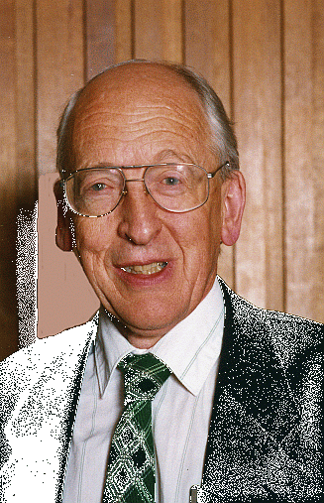

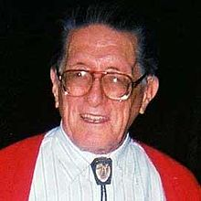


Acknowledgements 1
Phase 1: 1978-1994
  E. Yoffe, A. Howie, D. J. Smith, J. M. Cowley, J. Dundurs
  P. M. Ajayan, D. Iyer

Slide 3

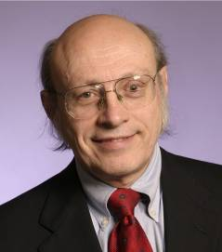
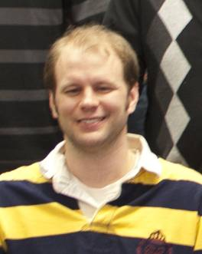





Acknowledgements 2
Phase 2: 2008-
K. R. Poeppelmeier R. Van Duyne
J. Enterkin E. Ringe B. Peng D. Alpay S. Patala
Materials Research Science & Engineering Center
Northwestern University
Notes:
3

Slide 4

Small can be beautiful
Pro’s
  Nanoplasmonics
  Nanoparticles for catalysis
  Sensing
  Drug delivery
  …
Image Source:
John Stringer
Electric Power Research Institute
Notes:
4

Slide 5
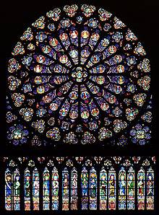
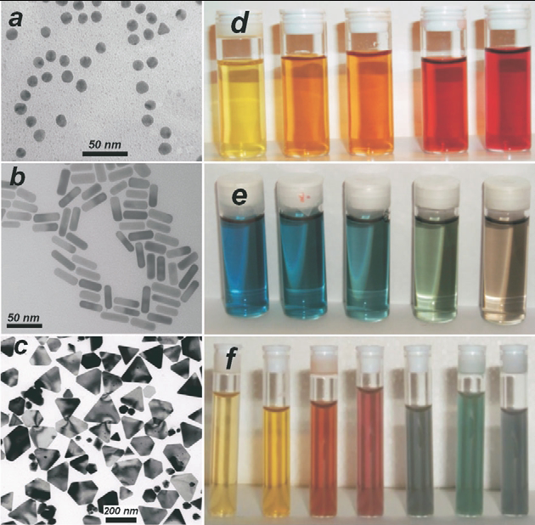
Nanosized Gold
L. Liz-Marzan, Mater. Today 7, 21 (2004)
www.notredamedeparis.fr
Notes:
5

Slide 6
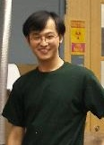
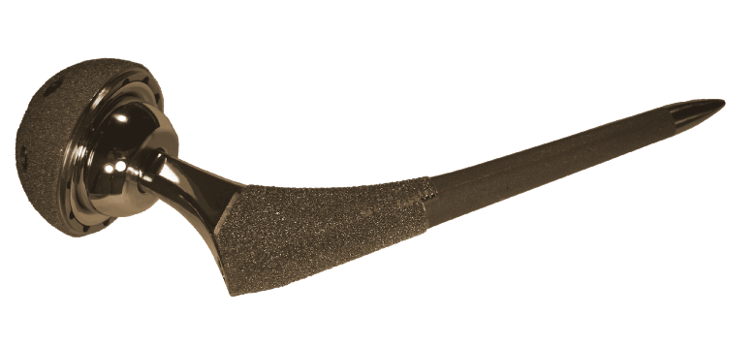
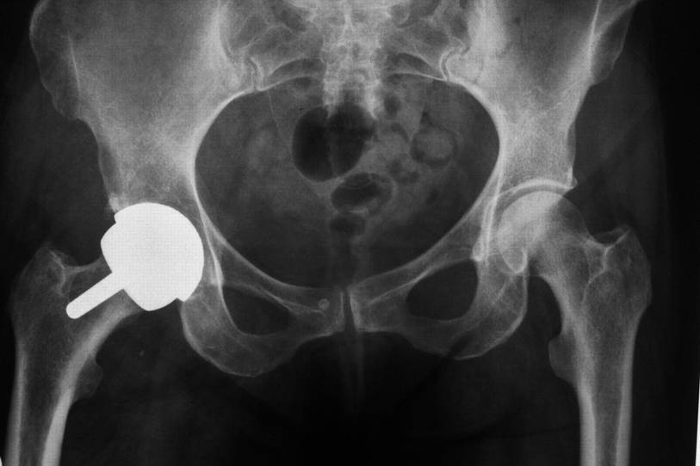
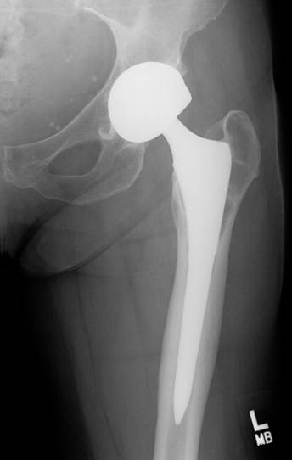
Small can be ugly
Con’s
  Toxic
  Wear Debris
Hip Implant
Liao et al., Science 334, 1687 (2011)
Notes:
6
6

Slide 7
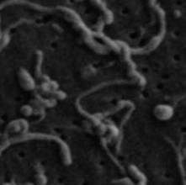
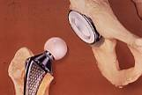
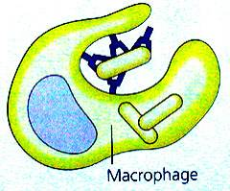
Wear-Mediated Osteolysis
osteolysis
disrupted balance between osteoclasts/PMNs and osteoblasts:
osteoclasts ↑, osteoblasts ↓
wear particles
osteoclast/ polymorphonuclear giant cell
opsonization
phagocytosis
osteoblast
http://academic.brooklyn.cuny.edu/biology/bio4fv/page/aviruses/cellular-immune.html
Archibeck, MJ; Jacobs, JJ; Roebuck, KA; Glant, TT. Journal of Bone & Joint Surg, 2000

Slide 8
Nanoparticle Crystallography from 100 nm down
Some basics that everyone should know
  Wulff, Winterbottom and friends
Some basics that most do not know or get wrong
  The artifact of some particle size effects
  There are two Wulff constructions
Some new basics
  Segregation in nanoparticles and with strain
One application – catalysts by design

Slide 9
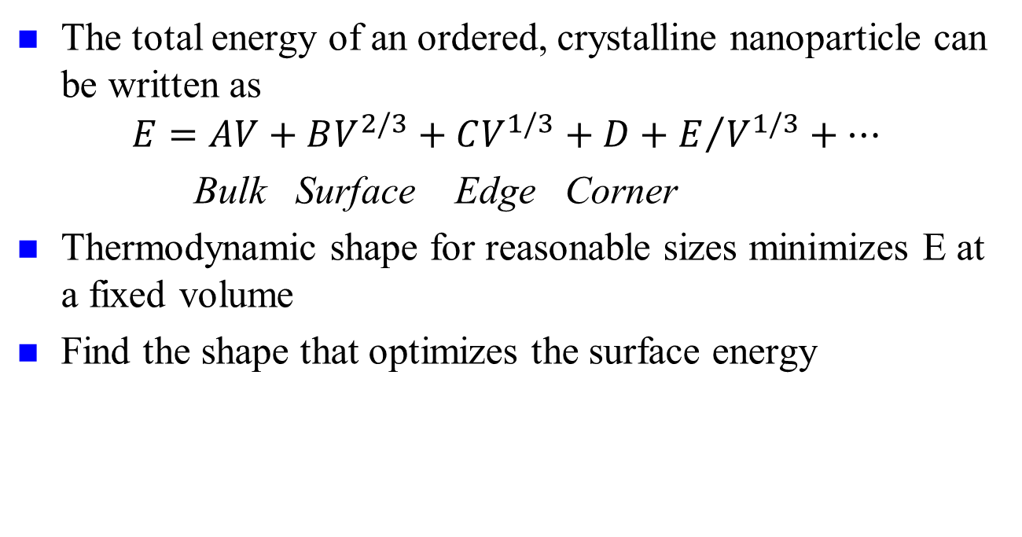
Basics: Continuum, simple
The total energy of an ordered, crystalline nanoparticle can be written as
$$E=AV+BV^{2/3}+CV^{1/3}+D+E/{V^{1/3}+…}$$
Bulk Surface Edge Corner
Thermodynamic shape for reasonable sizes minimizes E at a fixed volume
Find the shape that optimizes the surface energy

Slide 10
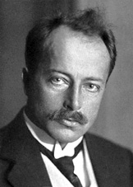
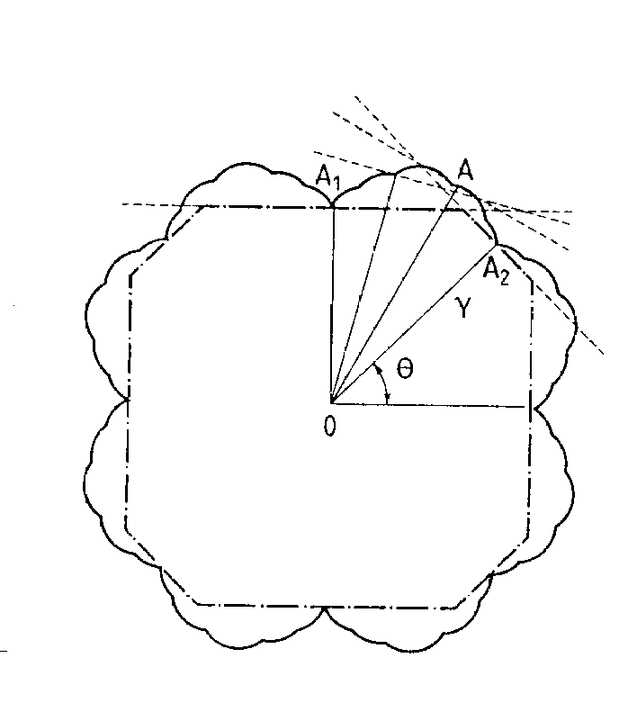


Wulff Construction
Max Von Laue
Minimize surface energy for fixed volume
  $$S_{W}=\{x:x.\hat{n}≤λγ\left(\hat{n}\right) for all unit vectors \hat{n}\}$$
G. Z. Wulff, Kristallogr. Mineral 34, 4490 (1901); M. Z. Von Laue, Kristallogr. 105, 124 (1943); A. Z. Dinghas, A. Z. Kristallogr. 105, 304 (1944)

Slide 11
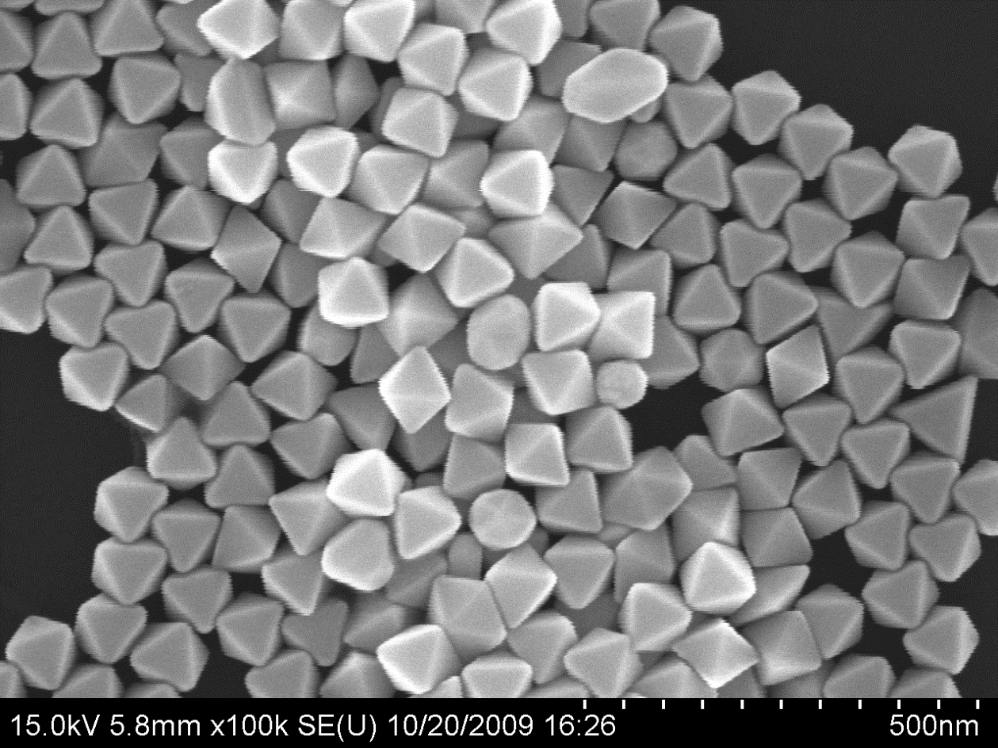
Example: Gold Octahedra
C. Li, K. L. Shuford, M. Chen, E. J. Lee, S. O. Cho, ACS Nano. 2, 1760 (2008)
Notes:
11

Slide 12

Chemisorption Dependent
Cu Bi-saturated Cu
Curtesy Paul Wynblatt

Slide 13
Winterbottom Construction
Include the effect of a nanoparticle sitting on a substrate
γ_{Int}
N.B., Kaischew may be a better source, unclear

Slide 14
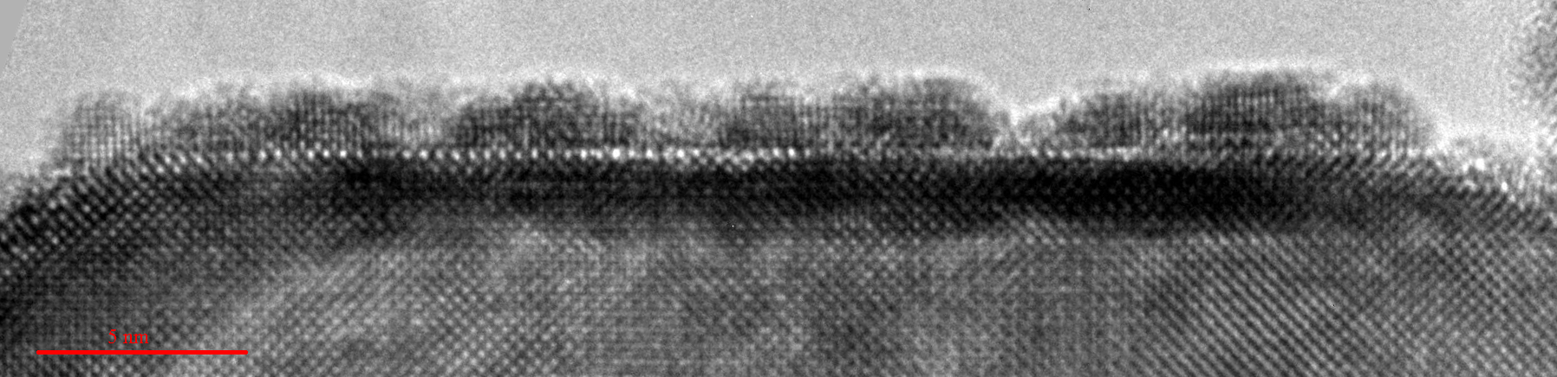
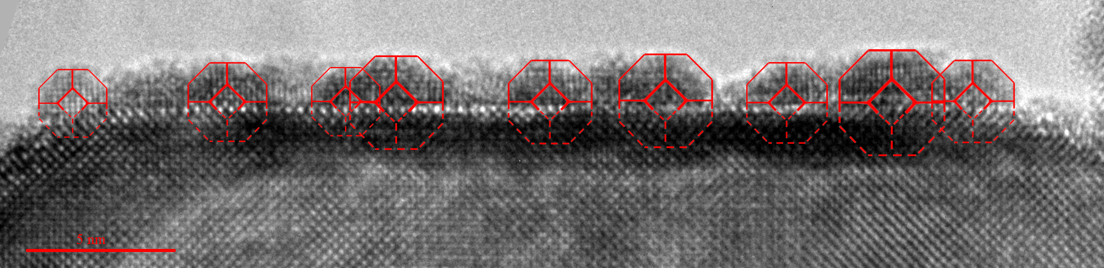
Wulff & Winterbottom
001
001
100
110
51° rotation around [011]
Projection down [010]
45° rotation around [100]
Projection down [110]
γ₁₁₁
γ₁₁₁
γ₁₀₀
γ₁₁₁
γ_{Int} – γ_{Sub} = γ_{Pt}
0 < γ_{Int} – γ_{Sub} < γ_{Pt}
γ_{Int} – γ_{Sub} = 0
-γ_{Pt} < γ_{Int} – γ_{Sub} < 0
γ_{Int} – γ_{Sub} ≤ -γ_{Pt}
Increasing γ_{int}
Increasing γ_{sub}
Increasing γ_{Pt}
J. A. Enterkin, K. R. Poeppelmeier, L. D. Marks, Nano Lett. 11, 993 (2011); G. Z. Wulff, Kristallogr. Mineral 34, 4490 (1901); W. L. Winterbottom, Acta Metallurgica 15, 303 (1967)
14

Slide 15
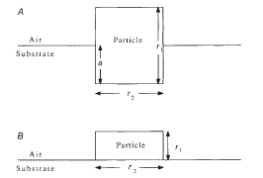
Caveat: assumes flat substrate
Connects to strong metal support interactions (SMSI)
Ajayan, P.M. and L.D. Marks, Nature, 1989. 338(6211), 139

Slide 16
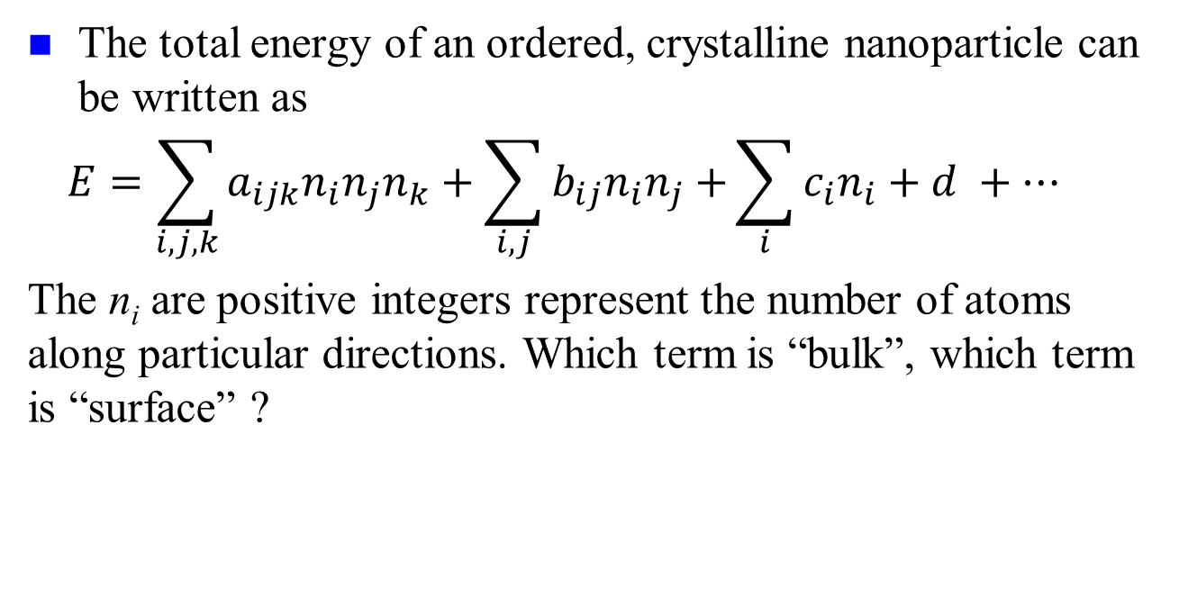
Basics: Continuum, not so simple
The total energy of an ordered, crystalline nanoparticle can be written as
$$E=\sum_{i,j,k}{a_{ijk}n_{i}n_{j}n_{k}}+\sum_{i,j}{b_{ij}n_{i}n_{j}+}\sum_{i}{c_{i}n_{i}+d} +…$$
The n_{i} are positive integers represent the number of atoms along particular directions. Which term is “bulk”, which term is “surface” ?

Slide 17
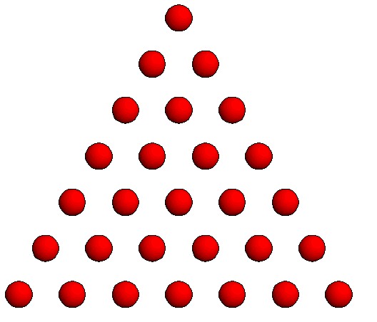
Counting Effects
Number of Atoms
= n(n+1)/2
Not n² dependence
n

Slide 18
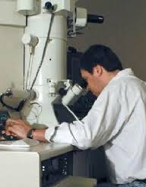
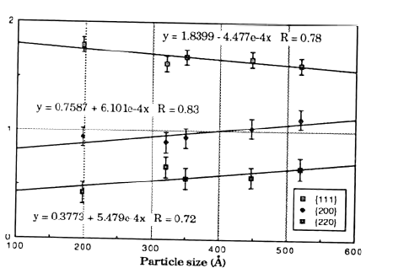
Wulff shape apparently size dependent
Marks, L.D., Surface Science, 1985. 150(2), 358; Bonevich, J.E., Proc 47th Ann EMSA, 1989, 258.

Slide 19
What is the size?
Crystallographic Size
Chemisorption Size
Thermodynamic Size
V = constant*N
C=O

Slide 20

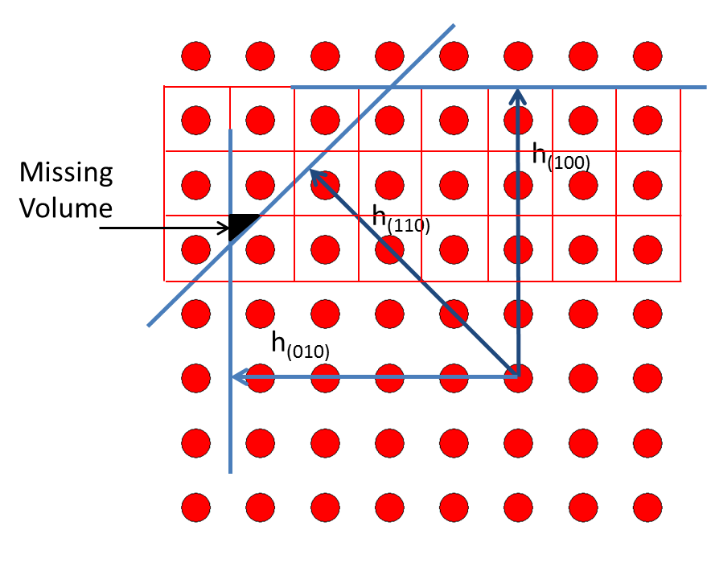
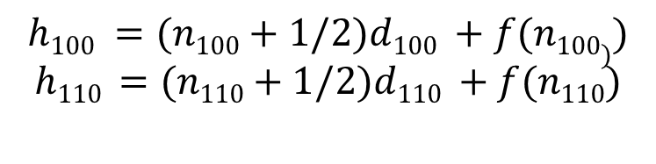
Care needed
Simplest approach, define distances such that V(h) = Nv_{atom}
Introduces a non-linear relationship between h & N
Adds some minor corrections
$$h100 =(n100+1/2)d100 +f(n100))$$
$$h110 =(n110+1/2)d110 +f(n110)$$
Based on, but not the same as Hamilton, Phys. Rev. B, 2006. 73: 125447, see also Cleveland and Landman JCP, 1991. 94(11), 7376
Equimolar Gibbs surface using Wigner-Seitz cells

Slide 21
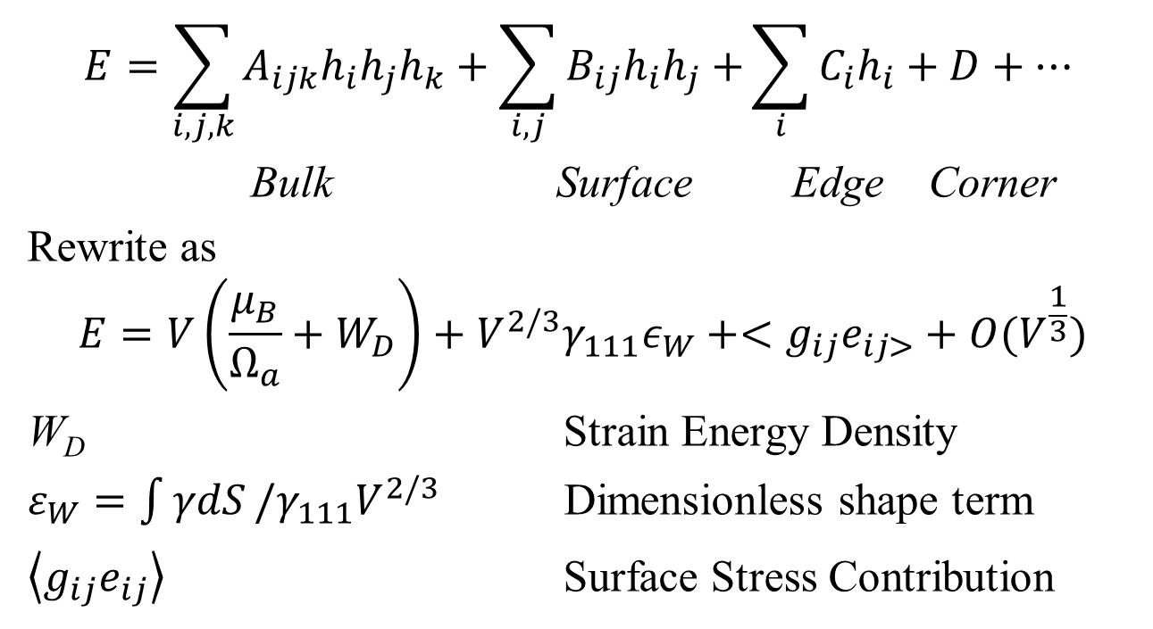
Simplification
$$E=\sum_{i,j,k}{A_{ijk}h_{i}h_{j}h_{k}}+\sum_{i,j}{B_{ij}h_{i}h_{j}+}\sum_{i}{C_{i}h_{i}+D}+…$$
Bulk Surface Edge Corner
Rewrite as
$$E=V\left(\frac{μ_{B}}{Ω_{a}}+W_{D}\right)+V^{2/3}γ_{111}ε_{W}+<g_{ij}e_{ij>}+O(V^{\frac{1}{3}})$$
W_{D} Strain Energy Density
$ε_{W}=\int{γdS}/γ_{111}V^{2/3}$ Dimensionless shape term
$\left\langle g_{ij}e_{ij}\right\rangle$ Surface Stress Contribution

Slide 22
Surface Energy & Stress I
Important: never use the term “surface tension” for a solid. Never. Really never.
Surface (Free) Energy γ
  Define as energy to create new fully relaxed surface
  Different from cleavage energy
  Caveat: definition “per area” or “per atom” are not the same – thermodynamic & DFT definitions can differ

Slide 23
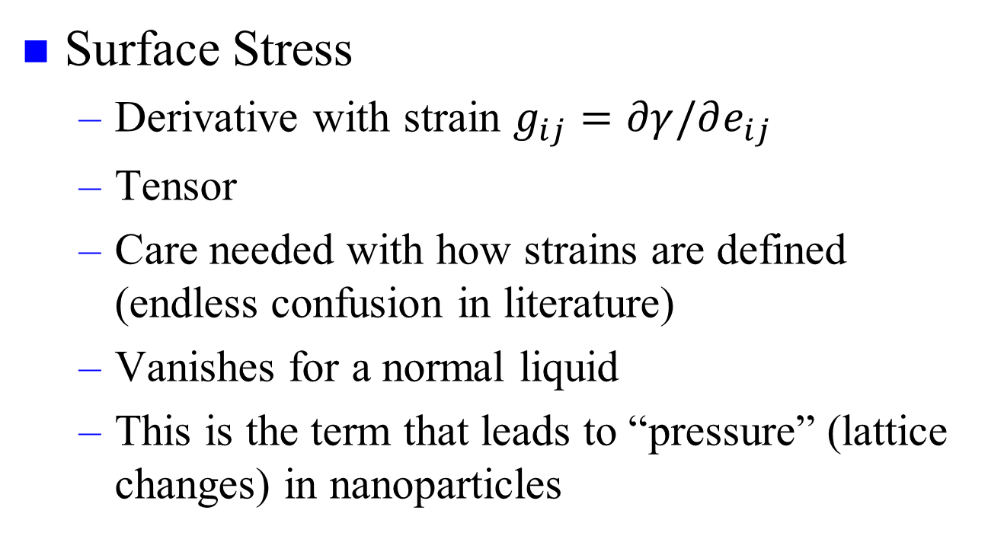
Surface Energy & Stress II
Surface Stress
  Derivative with strain $g_{ij}=∂γ/∂e_{ij}$
  Tensor
  Care needed with how strains are defined (endless confusion in literature)
  Vanishes for a normal liquid
  This is the term that leads to “pressure” (lattice changes) in nanoparticles

Slide 24
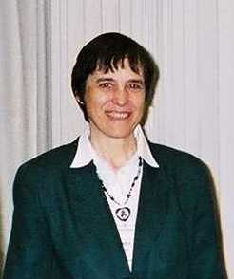
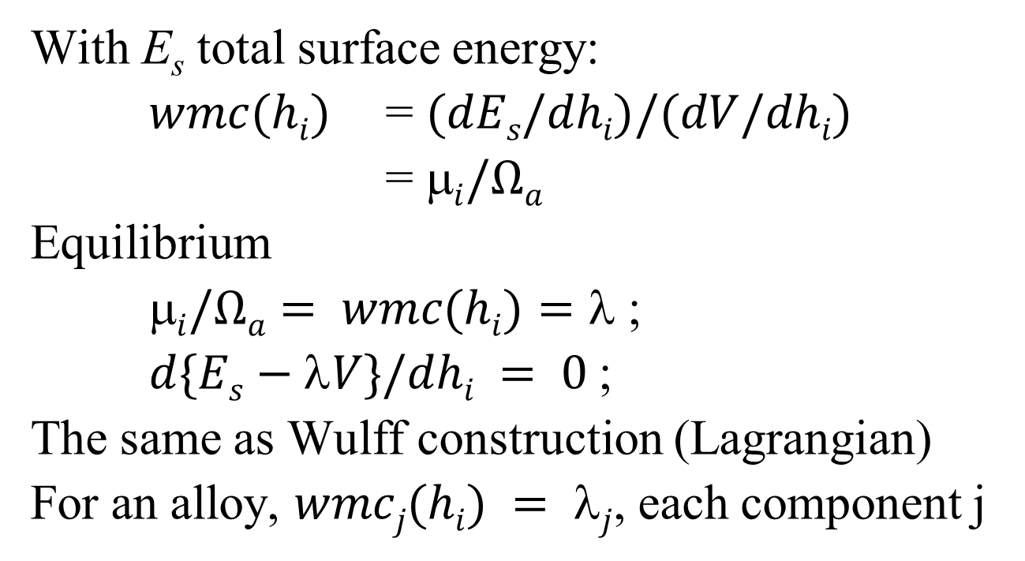
Weighted Mean Curvature
With E_{s} total surface energy:
$wmc(hi)$ = $(dEs/dhi)/(dV/dhi)$
= $i/Ωa$
Equilibrium
$i/Ωa= wmc(hi)=$ ;
$d\{Es−V\}/dhi = 0$;
The same as Wulff construction (Lagrangian)
For an alloy, $wmcj(hi) = j$, each component j
e.g. Taylor, J.E., Acta Met., 1992. 40(7): p. 1475-1485.

Slide 25
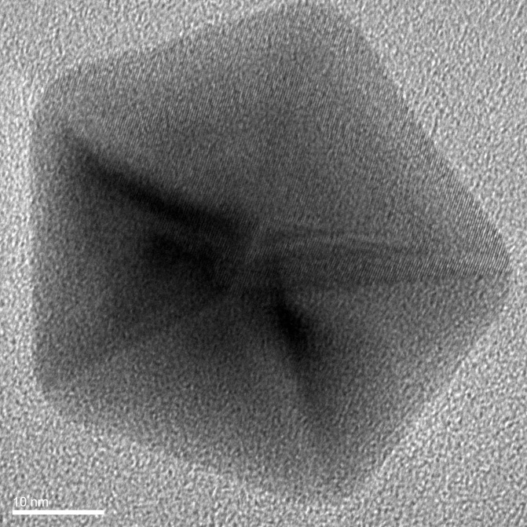
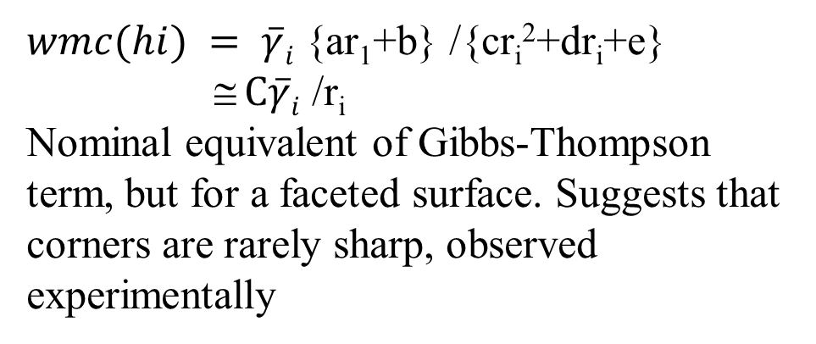
Geometric interpretation
$wmc(hi) = \overline{γ}i$ {ar₁+b} /{cr_{i}²+dr_{i}+e}
≅ $C\overline{γ}i$ /r_{i}
Nominal equivalent of Gibbs-Thompson term, but for a faceted surface. Suggests that corners are rarely sharp, observed experimentally
r_{i}
h_{i}

Slide 26
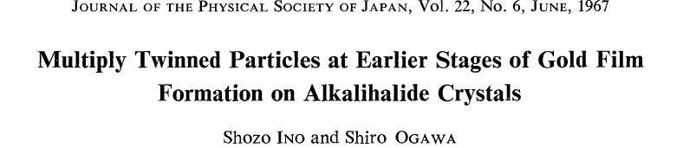
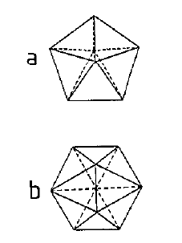
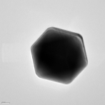
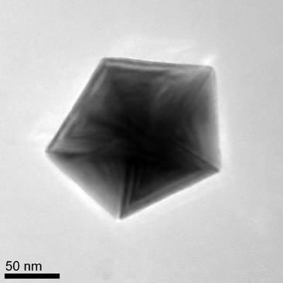
Continuing, beyond single crystals
Reduce surface energy, at the cost of strain energy
Decahedral MTP Icosahedral MTP

Slide 27
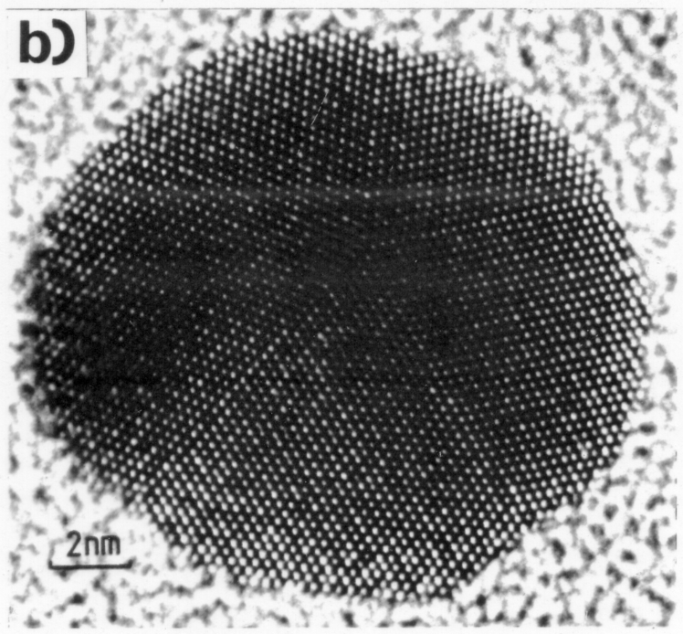
But…Dh is not so simple
L. D. Marks,. Philos. Mag. A. 49, 81 (1984).

Slide 28
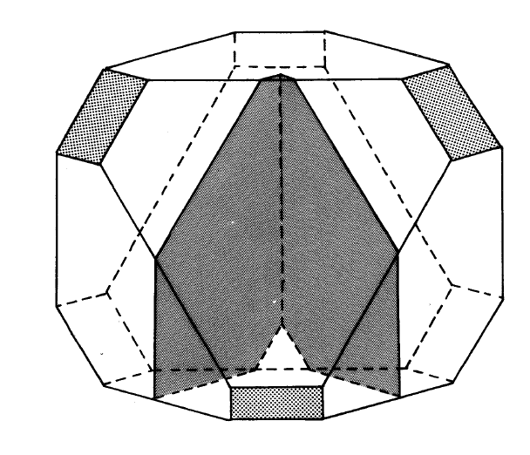
Modified Wulff Construction
$S^{i}=\{x:(x−o^{i}).\hat{n}≤λ^{i}γ^{i}\left(\hat{n}\right)\}$
L. D. Marks,. Philos. Mag. A. 49, 81 (1984).

Slide 29
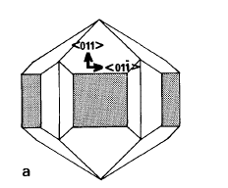
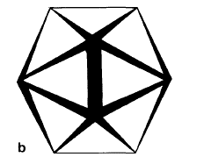
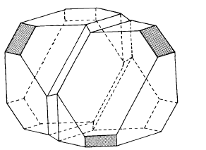
Modified Wulff Construction for Twinned Particles
Lamellar Twinned Particles
2 or more segments
1 boundaries/segment (caps)
2 boundaries/segment (middle)
Decahedral
Multiply Twinned Particle
5 segments
2 boundaries/segment
Icosahedral
Multiply Twinned Particle
20 segments
3 boundaries/segment
L. D. Marks, J. Cryst. Growth 1983, 61, 556-566
Notes:
29

Slide 30
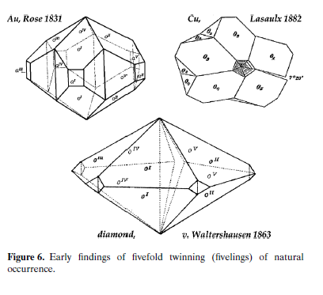
Shapes for Dh reported in 19th century
From H. Hofmeister, Z Krist 224 (2009) 528

Slide 31

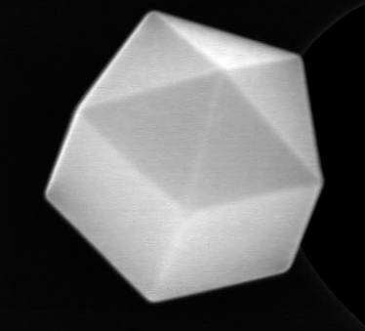
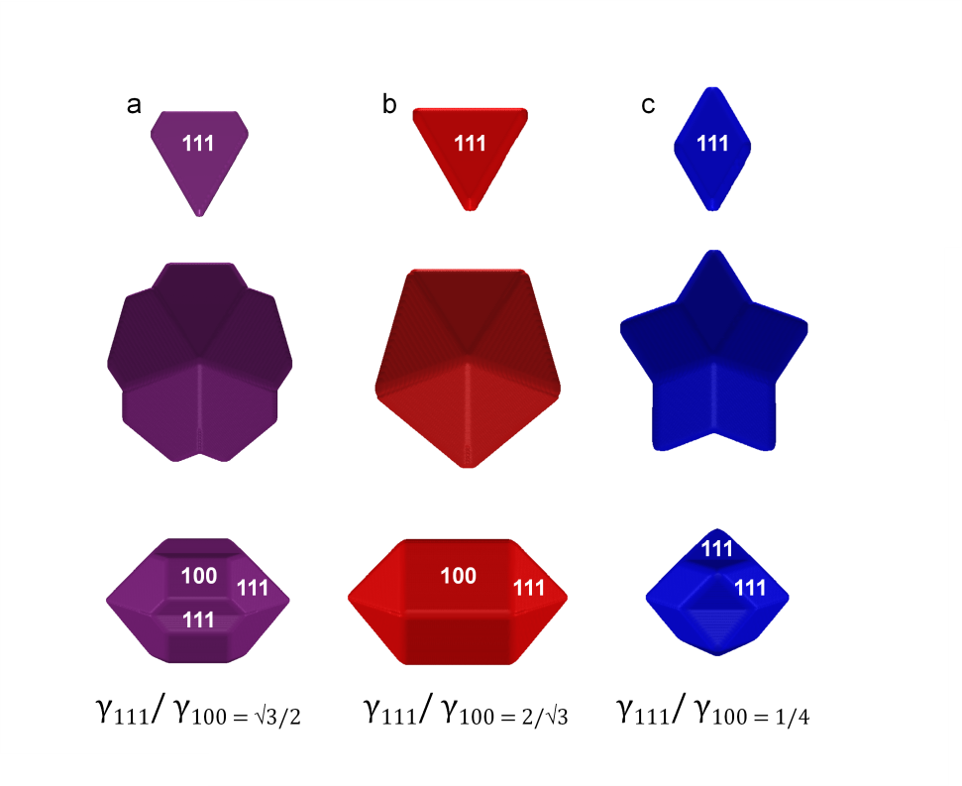
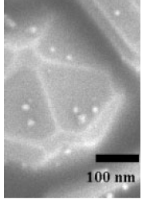
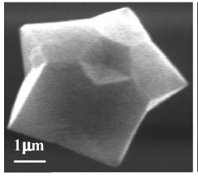
Different Cases
E. Ringe, R.P. Van Duyne, L. D. Marks, Journal of Physical Chemistry C, 2013. 117, 15859

Slide 32

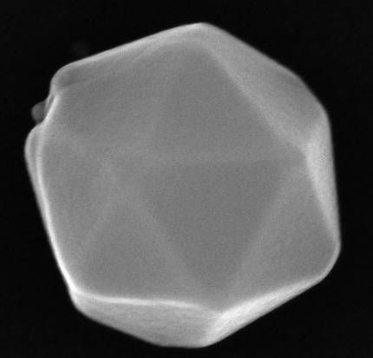
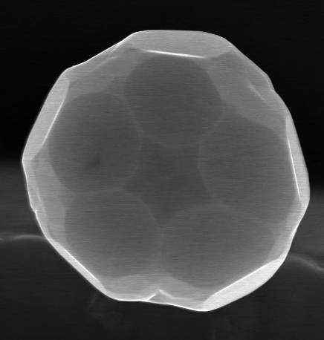
Different Shapes for Ic as well
{111} only
{110} only
N.B., no {100} in an Ic, see L. D. Marks, Philos. Mag. A. 49, 81 (1984)
Images courtesy of M. Yacaman
{111} + {110}

Slide 33

Surfaces depend upon environment
“5x1” (001) reconstruction on Au Dh, Image courtesy of Gilberto Casillas-Garcia, UTSA

Slide 34
MTP Energetics
Three Terms
  Strain, fcc units do not fit together without it
  Difference in total surface free energy
  Difference in total surface stress terms
  N.B., twin boundary energy negligable

Slide 35
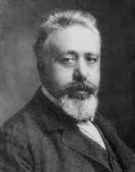

Strain: Volterra Disclination
S. Ogawa & S. Ino, J. Vac. Sci. Tech. 6, 527 (1969).
R. de Wit, Journal of Physics C, 1972, 5, 529
A. Howie and L. D. Marks, Phil Mag 1984. 49(1), 95-109.
Patala, S., L.D. Marks, and M.O. de la Cruz, Journal of Physical Chemistry C, 2013. 117(3), 1485
Von Mises stress distribution (a)

Slide 36
MTPs have less of the Wulff shape
Segment for Dh
Twin boundaries restrict which surfaces are exposed
L. D. Marks,. Philos. Mag. A. 49, 81 (1984).

Slide 37


Energy Balance
Three competing terms
  Gain in surface energy (MTPs more {111})
  Cost to strain the particle
  Energy change due to expansion at surface, surface stress term (heavily environment dependent)
$$E/V^{2/3}$$
Ic Dh Sc
$$V^{1/3}$$
A. Howie and L. D. Marks, Phil Mag 1984. 49(1), 95-109.

Slide 38




Energetics
Icosahedra
Quasi-spherical shape.
Close-packed surface but
large internal strain.
Favourable at small sizes
Decahedra
Intermediate behaviour.
Favourable at
Intermediate sizes
Polyhedra
Non-spherical shape
No internal strain.
Favourable at large sizes
Courtesy Riccardo Ferrando

Slide 39

Structural Fluctuations (Iijima)
P. M. Ajayan, L. D. Marks,. 24-6, 229 (1990)

Slide 40


A simple physical concept
The potential surface, very schematically: solid in the deep, narrow well, liquid in the high rolling plain:
Courtesy of Stephen Berry

Slide 41
Quasimelting
J. Dundurs, L. D. Marks, P. M. Ajayan,. Philos. Mag. A. 57, 605 (1988)

Slide 42




Morphological Transitions (Angus Kirkland)
5.5nm size
FCC
Decahedral
Room temp
300°C
400°C
7.2nm size
Icosahedral
Decahedral
In-situ Heating
RT
400°C
RT
10.4nm size
Decahedral
Decahedral
Ultramicroscopy, 110 (2010) 506
RT
400°C
RT
ACS Nano, 3 (2009) 1431
Solid – Solid Transition below T_{m}
As Synthesised Particles not in Thermodynamic Ground State

Slide 43
Phase Diagram (1990 vintage)
P. M. Ajayan, L. D. Marks. Phase Transit. 24-6, 229 (1990)

Slide 44
The Two Wulff Constructions
Just to make life more fun
  Is every Wulff shape thermodynamic?
  No, and probably the original paper was not a thermodynamic case!

Slide 45






Thermodynamic Wulff Construction
001
001
100
110
γ = surface free energy
n = crystallographic face (hkl)
h_{(n)} = surface normal
Λ_{(c)} = Wulff constant (accounts for volume)
γ₁₁₁
γ₁₁₁
γ₁₀₀
  $$S_{W}=\{x:x.\hat{n}≤λγ\left(\hat{n}\right) for all unit vectors \hat{n}\}$$
G. Z. Wulff, Kristallogr. Mineral. 34, 449 (1901)
Notes:
45

Slide 46
Kinetic Wulff Construction
001
001
100
110
v= growth velocity
n = crystallographic face (hkl)
h_{(n)} = surface normal
Λ_{(c)} = Wulff constant (accounts for volume)
γ₁₁₁
γ₁₁₁
γ₁₀₀
  $$S_{W}=\{x:x.\hat{n}≤λv\left(\hat{n}\right) for all unit vectors \hat{n}\}$$
Frank, F. C. In Growth and Perfection of Crystals; Wiley (1958)
Notes:
46

Slide 47


Kinetic v Thermodynamic Wulff
$hi = i$
γ_{i} depends upon
Chemisorption
Surface Composition
Bulk Composition
Surface Segregation
$hi = vi$
v_{i} depends upon
Rate limiting step (diffusion/nucleation)
Transition state (e.g. desorption of surfactants)
$wmcj(hi)$, i.e. local chemical potential

Slide 48



Origin of twin enhancement term
Atoms added at a twin have a higher co-ordination number than on a flat surface
Additional energy makes nucleation easier
Atom bonds to those on both sides
Gamalski et al, Nano Lett 2014, 14, 1288

Slide 49



Kinetic Wulff: Growth Velocity
Twinned Wulff: Assemble Segments
=
5X
+ Growth enhancement
Kinetic Wulff Construction for Twinned Particles
Re-entrant surface growth enhancement
Disclination/twin boundary growth enhancement
$S^{i}=\{x:(x−o^{i}).\hat{n}≤λ^{i}v^{i}\left(\hat{n}\right)\}$
Frank, F. C. In Growth and Perfection of Crystals; Doremus, Wiley (1958)
L. D. Marks, J. Cryst. Growth 61, 556 (1983) ;E. Ringe, R.P. Van Duyne, L. D. Marks, JPC C, 2013. 117, 15859

Slide 50







Modified Kinetic Wulff Construction:
Shape of Dh Structures
Re-entrant growth
100
111
Re-entrant + Stable 111
γ₁₁₁/ γ_{100 = √3/2}
Disclination + re-entrant
B. Petrobon, M. McEachran, V. Kitaev, ACS Nano 2009, 3, 21-26
100 nm
Notes:
50

Slide 51










Modified Kinetic Wulff Construction:
Shape of {111} – Dominated Monotwin Structures
Twin growth enhancement
Re-entrant surface growth enhancement
Twin + re-entrant growth enhancement
Notes:
51

Slide 52
Alloy Wulff Construction
Alloy Wulff has an extra degree of freedom: surface composition
Use available/measurable parameters (surface/bulk energies) to produce a predictive model
Result of energy minimization: size-dependant balance between
  Surface energy
  Starvation energy
001
001
100
110
γ₁₁₁
γ₁₁₁
γ₁₀₀
E. Ringe, R.P. Van Duyne, L. D. Marks, Nano Lett. 11, 3399 (2011)
Notes:
52

Slide 53
Alloy Wulff Construction:
Minimization of Energy via Lagrangian Multipliers
Conventional Wulff
Alloy Wulff
h₍₁₀₀₎
Size Independent
Size Dependent: Starvation
h₍₁₁₀₎
γ = surface free energy
n = crystallographic face
C^{S}_{i} = surface concentration of element i
C^{V}_{i} = bulk concentration
G = bulk free energy
Λ = Wulff constant (accounts for volume)
h_{n} = surface normal
γ = surface free energy
n = crystallographic face
h_{n} = surface normal
Λ_{c} = Wulff constant (accounts for volume)

Slide 54



Comparison of Methods
Conventional Wulff
X Segregation
X Starvation
Infinite Reservoir
Segregation
X Starvation
Alloy Wulff
Segregation
Starvation
Surface
Bulk

Slide 55







Alloy Wulff Construction for Weak Alloy AgAu
Monolayer formation De-alloying
Surface
Bulk
γ_{Au} > γ_{Ag}
Surface
Bulk
Notes:
55

Slide 56




3 Regimes in CuAu Alloy Wulff Construction
1 2 3
1 2 3
γ_{Au} < γ_{Cu}
1: De-alloying 2: Bulk/surface equilibrium 3: Monolayer formation
Notes:
56

Slide 57


Can we exploit these ideas
Winterbottom construction, different exposed facets
NO on Pt Masel, 1983
Substrate
57
J. A. Enterkin, K. R. Poeppelmeier, L. D. Marks, Nano Lett. 11, 993 (2011);

Slide 58
Propane Oxidation
Pt/SrTiO₃ epitaxy stabilizes metallic Pt
  For particle of radius R ΔG=ΔG_{Ox}+3Δγ_{Int}/2R
  More reactive Pt/PtO_{x} core/shell structure in oxidizing conditions
  Flux of reactants also different for different surfaces
J. A. Enterkin et al,, ACS Catalysis 1, 629 (2011)

Slide 59





Nanoparticle surfaces?
PRL 111, 156101 (2013)
Oleic Acid Acetic Acid
^{1nm}
^{1nm}
SrO surface
TiO₂ DL

Slide 60
Summary
While we know at lot from old work (even back to Gibbs)
Care is needed (many errors in literature)
  Being precise with size matters
Nanoalloys has some new possibilities
Still some things that are not fully understood

Slide 61
But
All details how surface structure & segregation couples to nanoparticle structure not clear yet
Everthing becomes richer (but manageable) when chemisorption is included
Often there are no precise measurements of structure to match to models
And how this couples to rates/selectivity…

Slide 62

Questions ?
Research is to see what everybody else has seen, and to think what nobody else has thought
Albert Szent-Györgi

