Slide 1
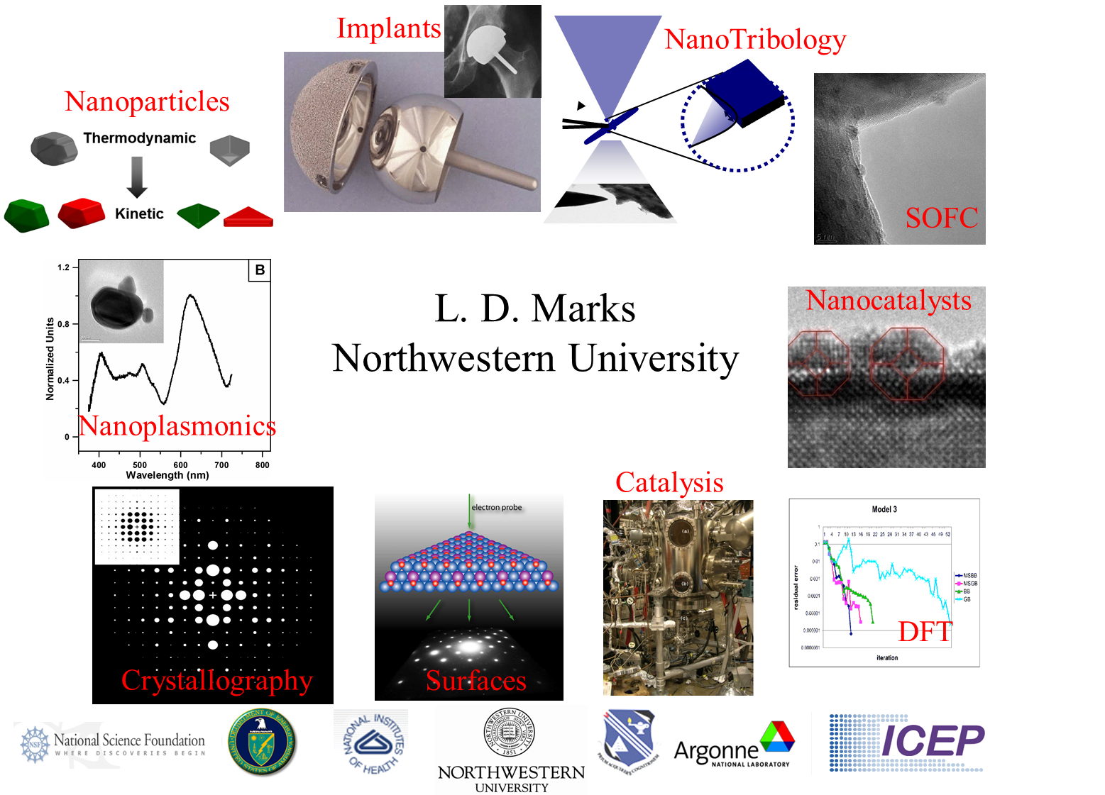

Slide 2
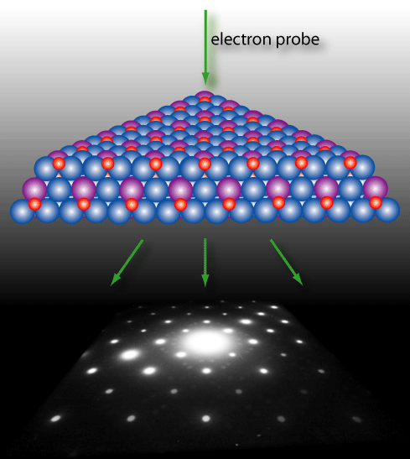
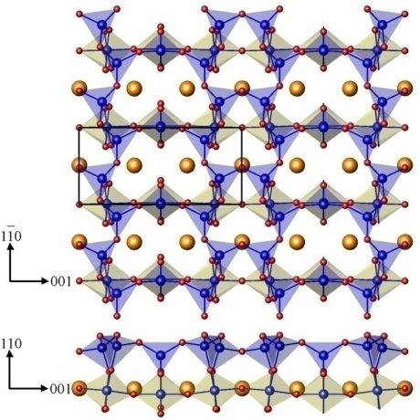
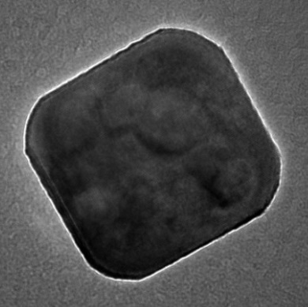
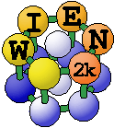
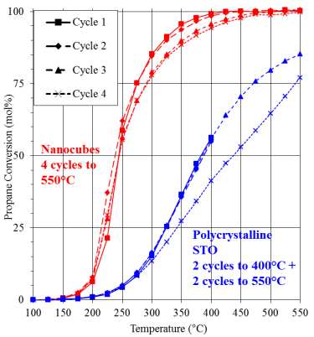
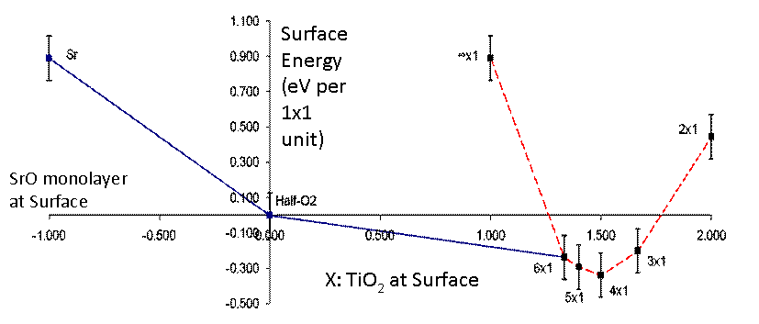
Oxide Surfaces
Opening the Pandora’s Box for SrTiO₃
L. D. Marks
DFT
Surfaces
Structure
10 nm
NanoCatalysts
Catalysis

Slide 3





Acknowledgements
TEM: N. Erdman (JEOL), A. Subramanian (Intel), A. Chiaramonti (NIST), A. Becerra (Dow), J. Enterkin (Philips 66), D. Keinzle (Premier International), Y. Lin
DFT: A. Becerra, J. Enterkin, D. Keinzle, Y. Lin & LDM
STM Simulations: A. Becerra
Synthesis: L. Hu, Y. Lin, C. Wang
Catalysis: L. Hu, Y. Lin, C. Wang
Collaborators:
K. Poeppelmeier (NU), P.C. Stair (NU), P. Blaha (Vienna), M. Castell (Oxford), O. Warschkow (U. Sydney), U Diebold (Vienna)

Slide 4
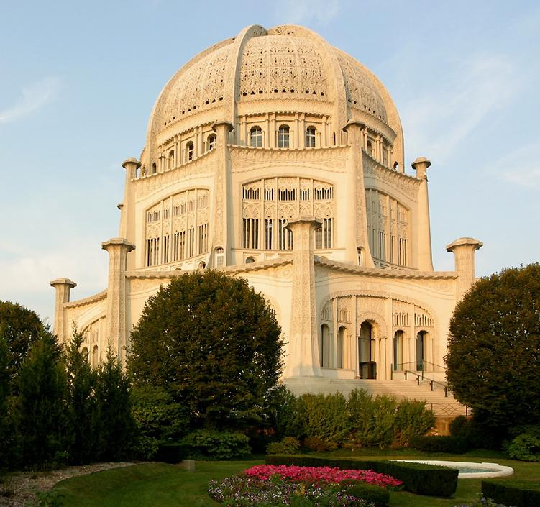
Motivation
Oxide surfaces are everywhere:
  Everything in this room
  Active catalysts
  Catalytic supports
  Photocatalysts
  Multiferroic Oxides
  Solid Oxide Fuel Cells
  Corrosion products
  Buildings (cement)
Baha’i Temple, Wilmette

Slide 5

Looking to the future
Need to better understand catalysts and oxide surfaces:
Convert light petroleum and coal to useful products
Convert biomass to gasoline
Convert carbon dioxide into liquid fuels
Low-power oxide electronics
Image Source:
John Stringer
Electric Power Research Institute

Slide 6
Catalytic Schematics
Overall Objective: To characterize and identify the active site(s) for oxidative dehydrogenation; reductive addition and oxidative elimination.
Mg₃V₂O₈
alkane + O_{lattice} olefin + water
(Reactants) (Products)
O=O
2e-
H₂ / propane
O2-
O
O
[100]
O
surface
Mg
V
V
Mg
Mg₃V₂O₆
O
O
O
bulk
O
Mg
Mg
O
Mg₃(VO₄)₂ Mg₃V₂O₆ + 2O_{bulk}
[011]
The activity and selectivity are
closely related to the structures
of the catalyst used.
This cartoon is almost certainly far from reality about the surface structure

Slide 7
Broad Vision
Discovery-based
Time
Oxide Nanocatalysts By Design
Time
Adapted From: Paget Donnelly, Nanomaterials By Design, Chemical Industry R&D Roadmap, www.chemicalvision2020.org/downloads/nanochemroadmap_presentation_1-5-04.ppt

Slide 8
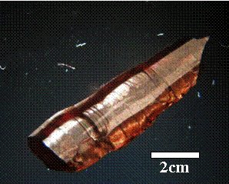

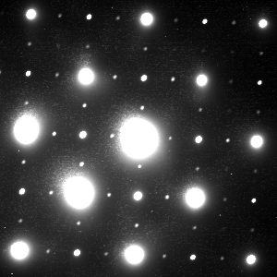

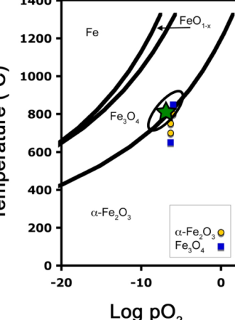
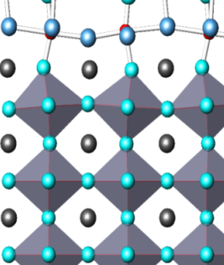
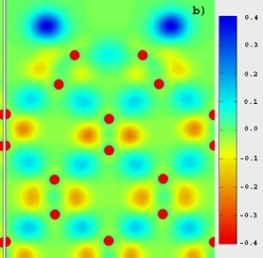
Nanoparticle
Synthesis
Single Crystal
Growth
10 nm
Catalytic
Activity
(110)
TEM & Electron Diffraction
Bridge the Materials Gap
Catalytic Oxides
Ti
Ti
O
Sr
Surface
Structure
Thermodynamics
Direct Methods & DFT

Slide 9
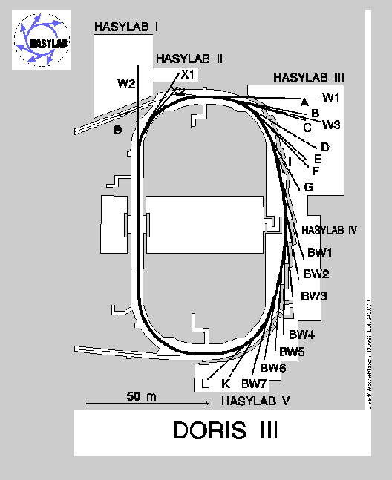
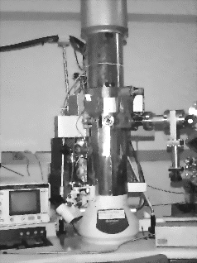
Basics
100-300 keV
Both give kinematical data for surfaces

Slide 10
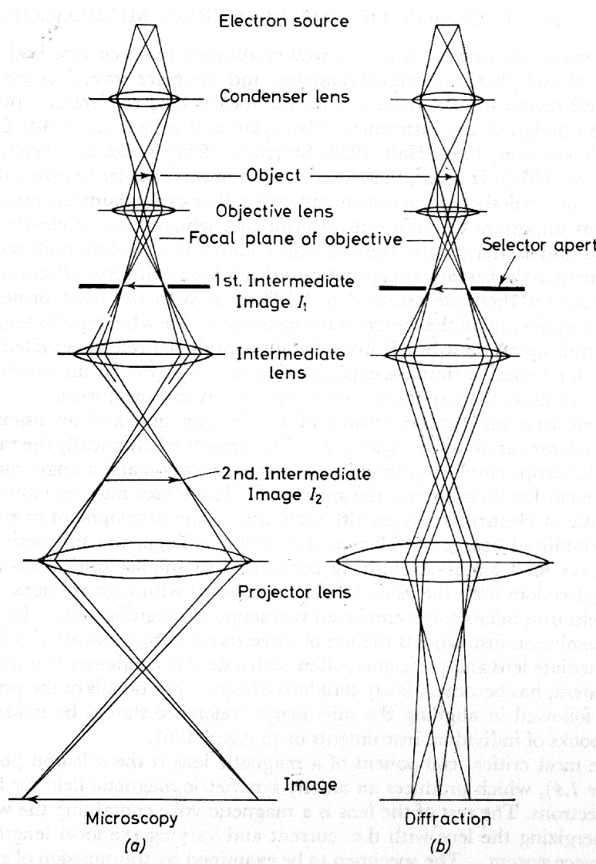
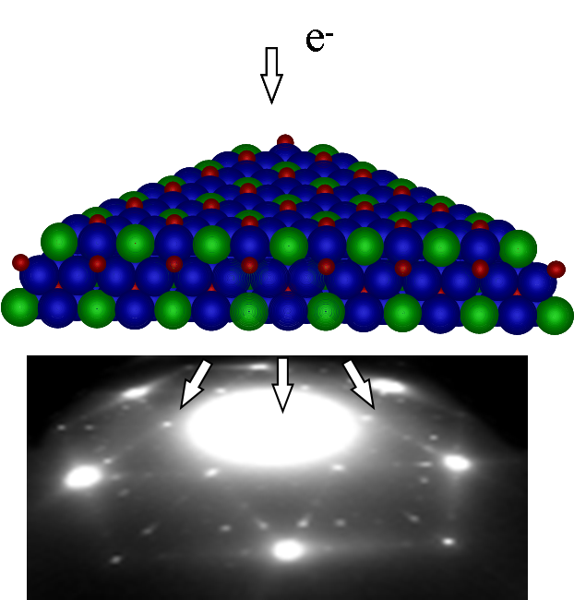
Core experimental technique
Incident 100-300 kV electrons
Collect images or diffraction information
+SXRD, STM if available

Slide 11
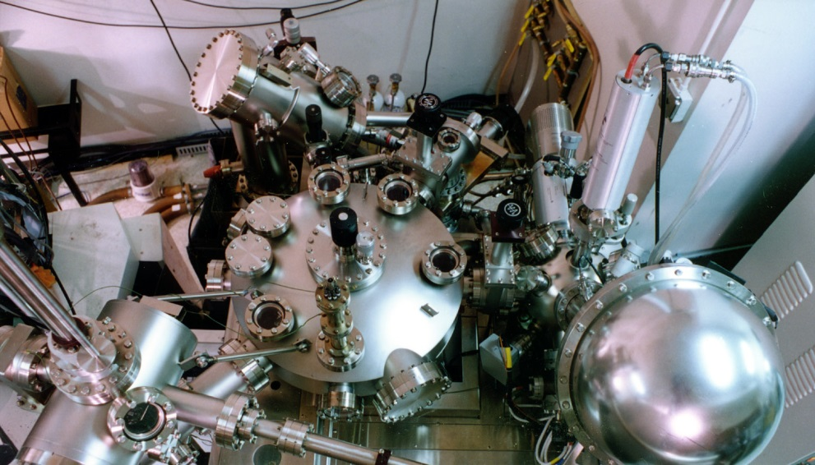
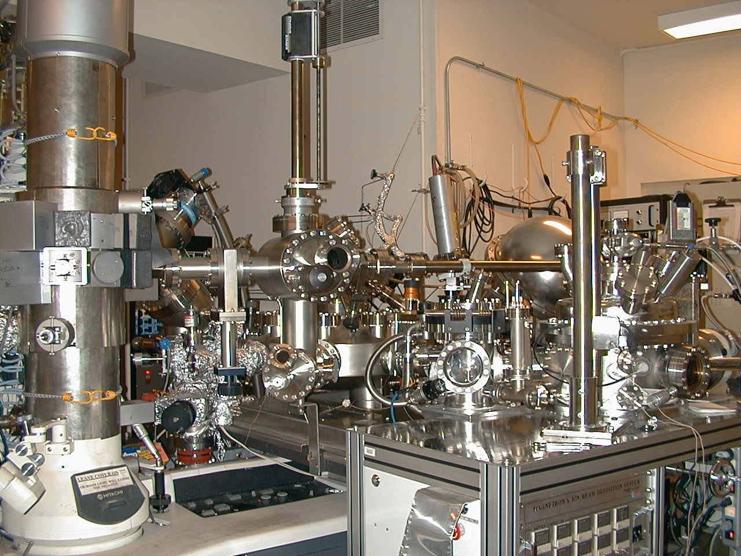
UHV-TEM &
Vacuum Chamber

Slide 12

Configuration & Operation
BN 5x10-11τ
HREM
Load Sample
Clean
Deposit BN
Check Sample
Gas Cell
600C, 1 atmosphere
X
Load-lock
X
Metal Evaporator
Transfer
Chamber 1x10-11 τ
Analytical
Chamber
5x10-11τ
X
X
X
UHV-H9000
5-10x10-11τ @ 300kV
MIBE 1x10-9τ
CN growth

Slide 13
Sample preparation (an art)
Dimple Wheel
Cut 3mm disc or mount sample
Dimple thin to 10 μm
Thin to < 0.1 μm
  Ion beam (damage)
  Chemical (?)
Anneal damage (carefully!)
Last step similar to making new oxides
  Try a time/temperature: if it works, celebrate
  If it does not, try again…..
  All you need are enough slaves grads/undergrads
Sample

Slide 14

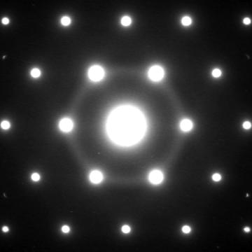
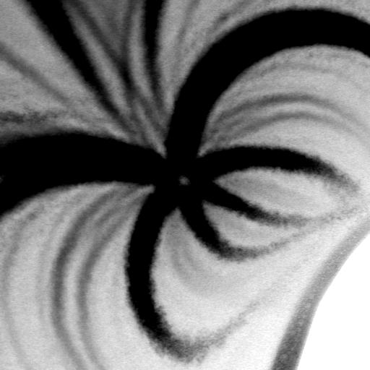
SrTiO₃ (111): Pre-annealing
Sample is under stress, disordered, and non-stoichiometric
(110)
[111]
100 nm
diffuse ring
~100 Å
A. N. Chiaramonti et al., Surf. Sci. 602, 3018 (2008).

Slide 15
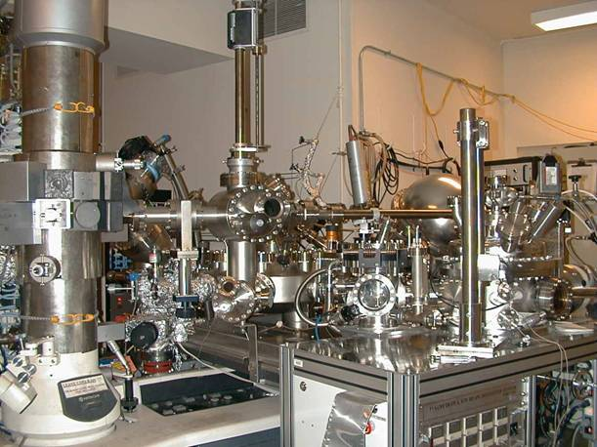
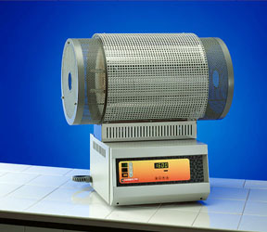
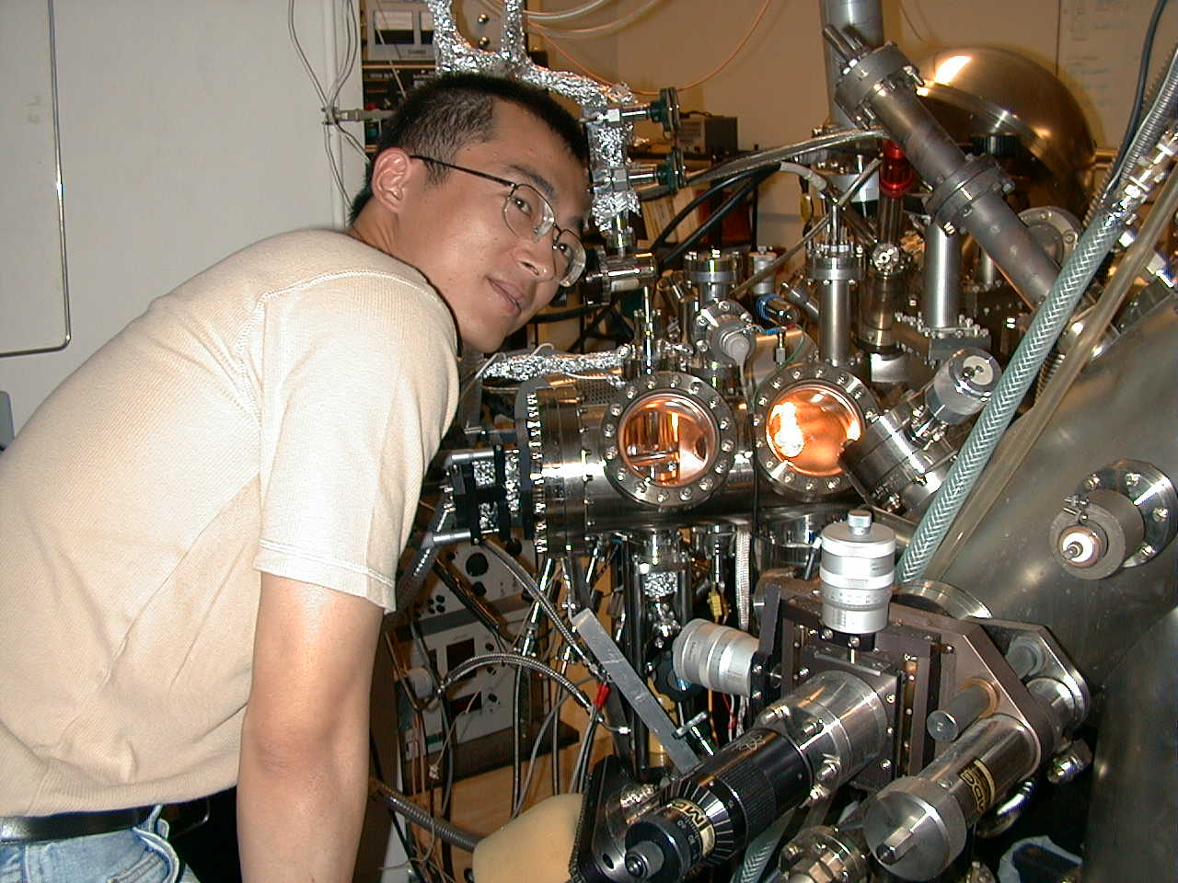
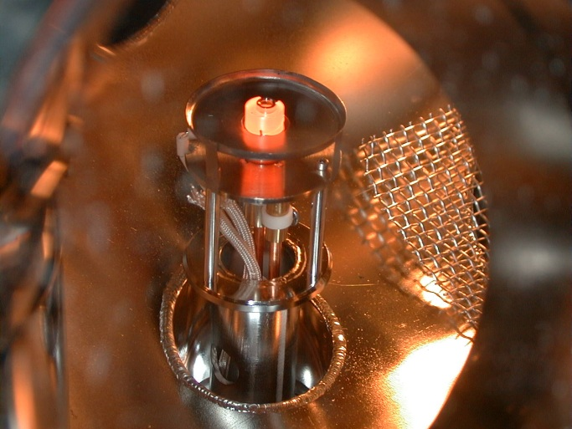
Annealing
Ex-situ
In-situ

Slide 16
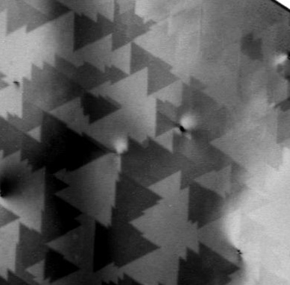
SrTiO₃ (111): Annealed
Surfaces are:
  ordered, flat
  covered in large often triangular terraces and step bunches
Reconstructed
Air stable (months)
Reproducible
100 nm
A. N. Chiaramonti et al., Surf. Sci. 602, 3018 (2008).

Slide 17

Measured Intensities
EELS, thickness
Errors (repeat measurements)
Weak dynamical effects

Slide 18
How to solve a structure?
Guess, then refine
  Will always give something, but if the guess is wrong GIGO
Use Patterson function
  Difficult for complicated structures
Get an image
  STM is hard to interpret
  HREM is difficult for surfaces (and not always possible)
Use DFT
  If the original guess is wrong, GIGO
  Functionals can be (very) inaccurate for oxides
Try something else?

Slide 19
Diffraction Phase Problem
Surface ρ(r)
FFT
F(h) = |F(h)|exp[2πiΦ(h)]
Measured diffraction intensities
|F(h)| = [I(h)]1/2
Unmeasured
An equal opportunity problem – true for x-ray and electron diffraction

Slide 20


Phase: Apples & Oranges
FT A_{a} exp(-i φ_{a})
FT A_{o} exp(-i φ_{o})
+
{
Oranle ?
Appge ?
A_{o} exp(-i φ_{a}) IFT
Phase of Apple + Amplitude of Orange = ?

Slide 21

Phase of Apple = Apple
FT-1 {A_{o} exp(-i φ_{a}) }
Apple
Phase is more important than amplitude

Slide 22
Direct Methods vs.
Indirect Methods
Indirect Methods:
“Trial and Error”
Direct Methods:
Using available information
to find solutions

Slide 23
Second Core: Direct Methods
Fourier Transform
Impose real space
constraints (S₁)
Atoms
Impose Fourier space
constraints (S₂)
Intensities
Inverse
Fourier Transform
Recovery
Criterion
Observed Intensities
(assigned phases)
(Global Search)
NO
YES
L. D. Marks, W. Sinkler, and E. Landree, Acta Cryst A55, 601 (1999) L. D. Marks, Phys. Rev. B 60, 2771 (1999)
L. D. Marks et al., Surf. Rev. Lett. 5, 1087 (1998).
Feasible Solution

Slide 24
Ag on Ge (111) 4x4
[110]
[112]
X-ray data
Collazo-Davila et al, Surface Science 418, 395 (1998)

Slide 25
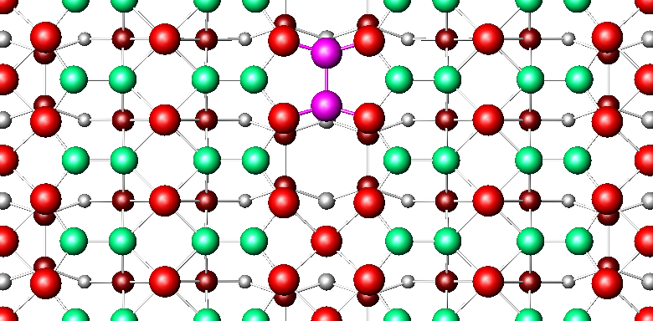

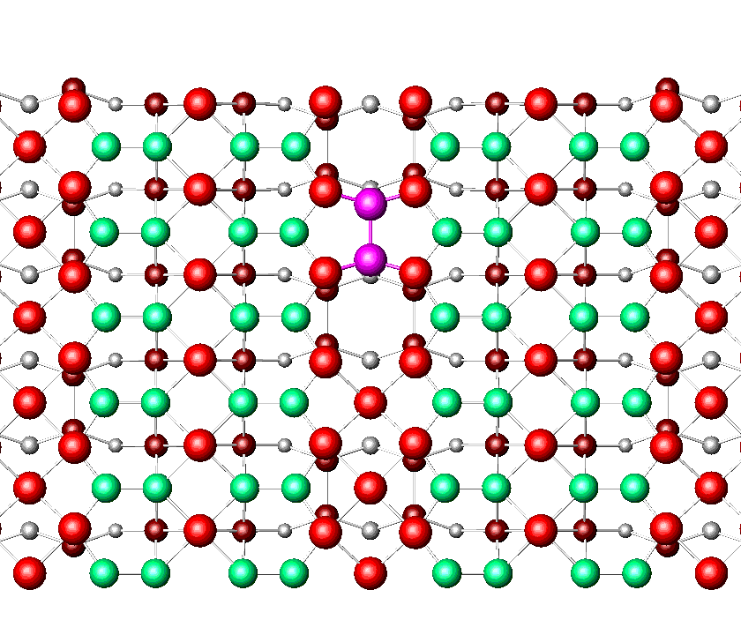
InSb c8x2
C. Kumpf, et al, Physical Review Letters 86, 3586 (2001)

Slide 26
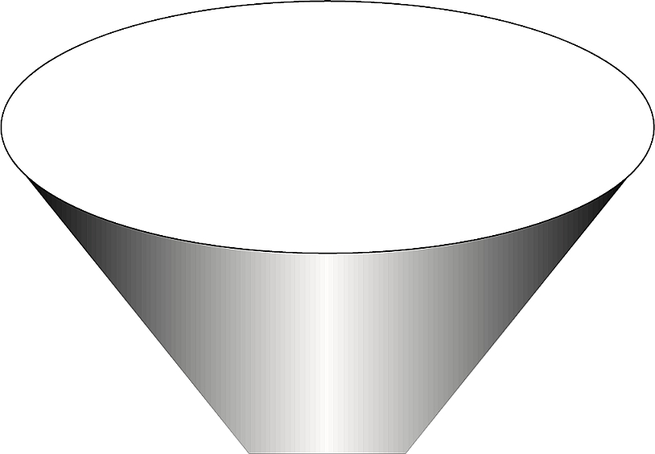
Aim
Infinite Number of Possible
Arrangements of
Atoms
Direct Methods
Finite
R, χ2, structure, DFT and chemistry

Slide 27
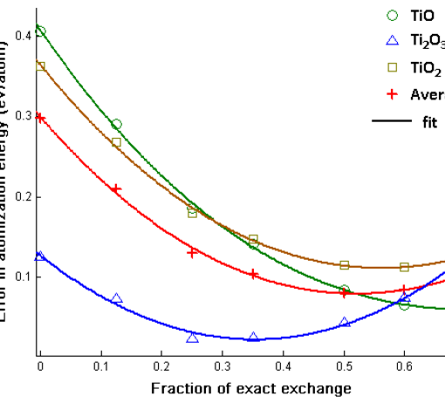
Third Key Tool: DFT
Has become (alas?) almost a black-box method
GIGO – DFT only refines, it is not a search method (which Direct Methods are)
DFT energies have serious errors for oxides
  Need to calibrate errors, and understand them (~0.1eV/1x1 cell)
  Need to use higher-order functionals (not just PW91/PBE or even PBEsol) such as meta-GGA and/or hybrids (exchange corrections)

Slide 28
Four examples
Connect TED, DFT, STM (and chemistry); the SrTiO₃ (110) surface
What lies beyond order: glass-like tilings on SrTiO₃, the √13x√13 (001) reconstruction
Surface Structure of Nanocuboid SrTiO₃
Some additional complications: SrTiO₃ (111), water and beyond

Slide 29
Four examples
Connect TED, DFT, STM (and chemistry); the SrTiO₃ (110) surface
What lies beyond order: glass-like tilings on SrTiO₃, the √13x√13 (001) reconstruction
Surface Structure of Nanocuboid SrTiO₃
Some additional complications: SrTiO₃ (111), water and beyond

Slide 30

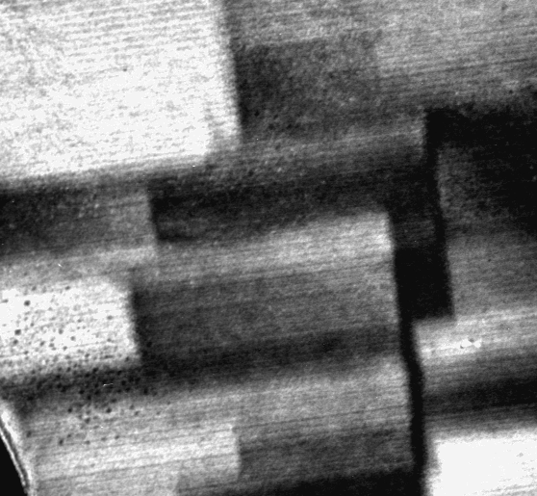
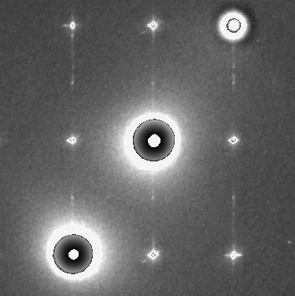
SrTiO₃ (110): 900C in O₂
Dark Field
1x1
001
40 nm
30
N. Erdman, PhD Thesis, 2002

Slide 31

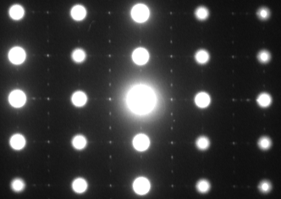
1000 °C in flowing O₂
1
3
_
(110)
1x1
(001)
DP’s from Arun Subramanian

Slide 32
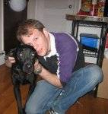
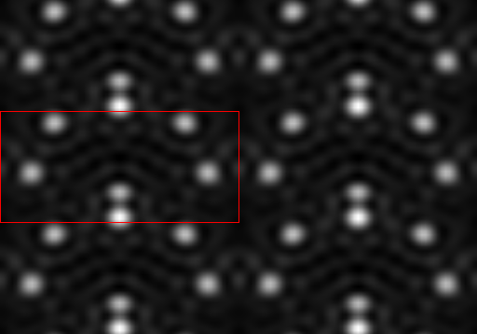
Direct Methods Solution

Slide 33
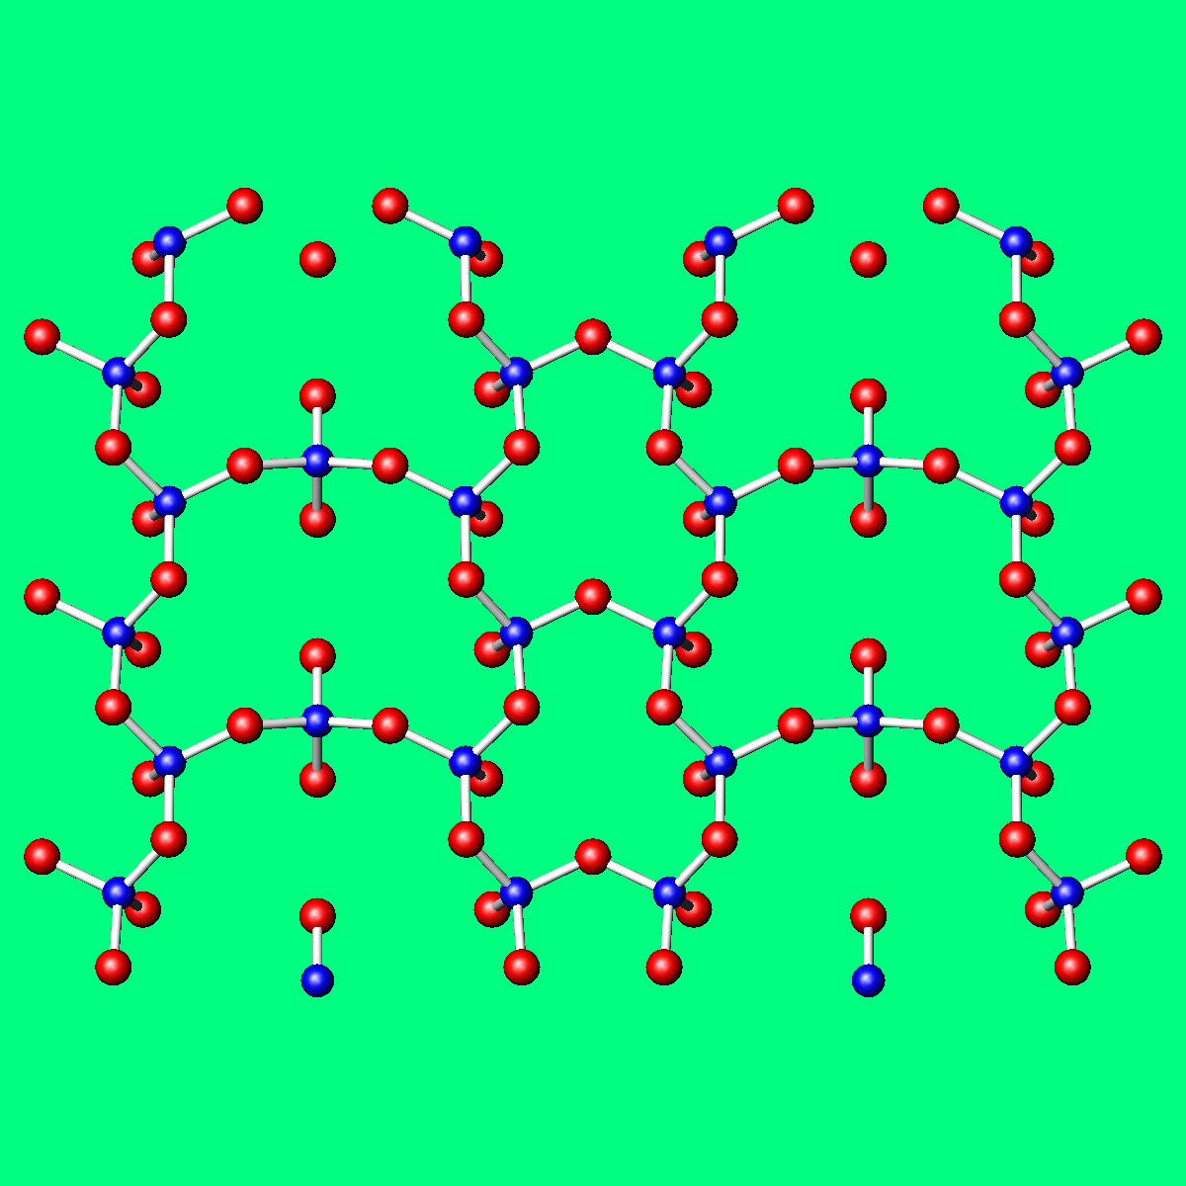
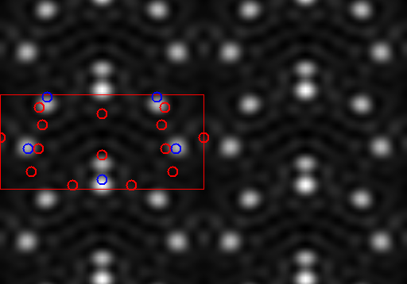
Atomic Positions Refined
33

Slide 34
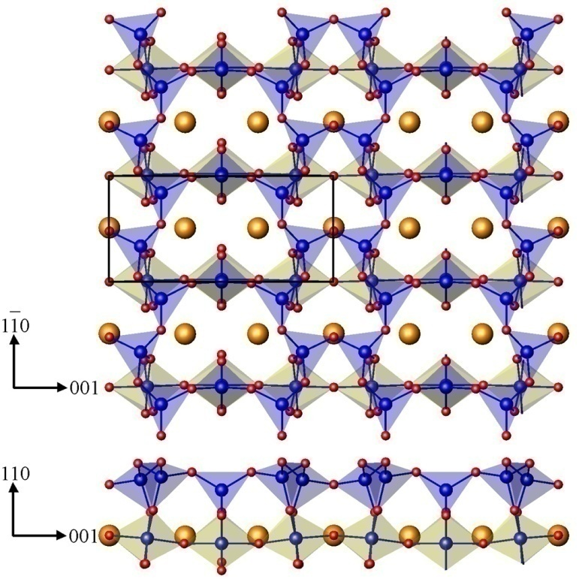
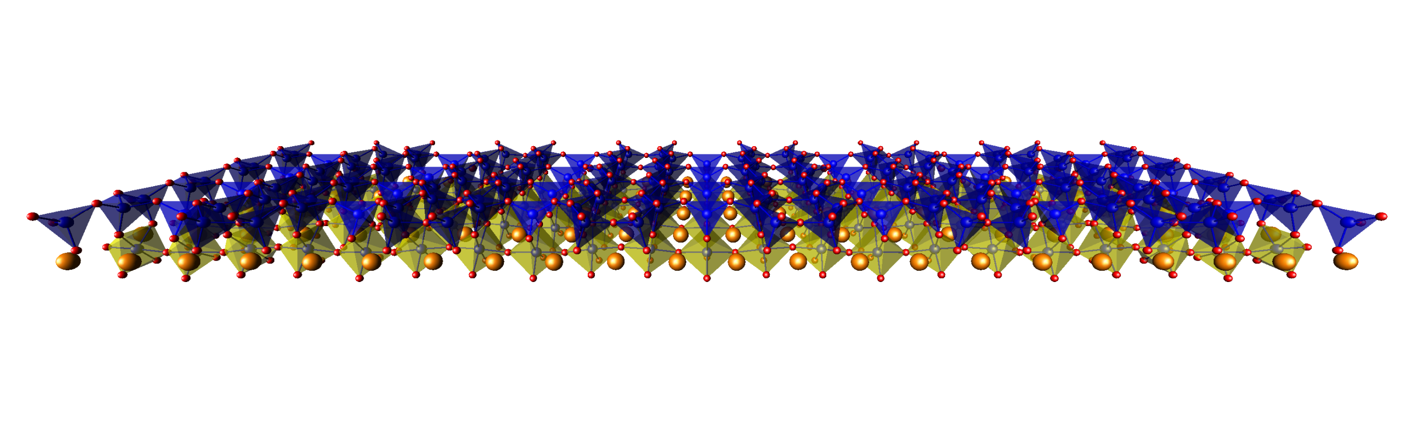
SrTiO₃ (110) 3x1
TiO₂ overall surface stoichiometry
  Ti₅O₇ atop O₂ termination
  Ti₅O₁₃ atop SrTiO termination
Surface composed of corner sharing TiO₄ tetrahedra
  Arranged in rings of 6 or 8 tetrahedra
  4 corner share with bulk octahedra
  1 edge shares with bulk octahedron
Blue polyhedra are surface polyhedra, gold are bulk octahedra, orange spheres Sr, blue spheres Ti, red spheres O
Enterkin et. al., Nature Materials, 2010

Slide 35
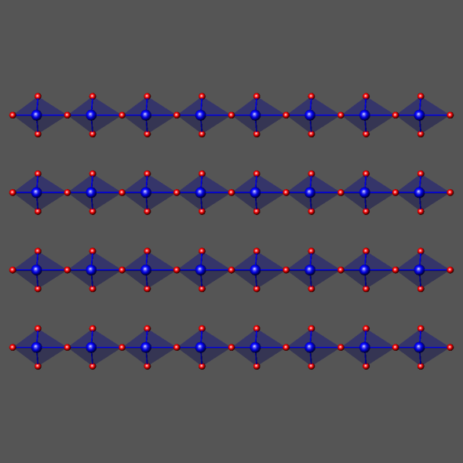
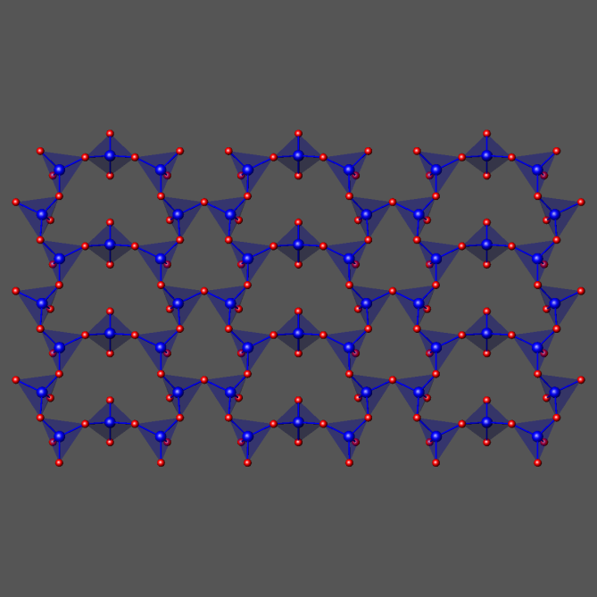
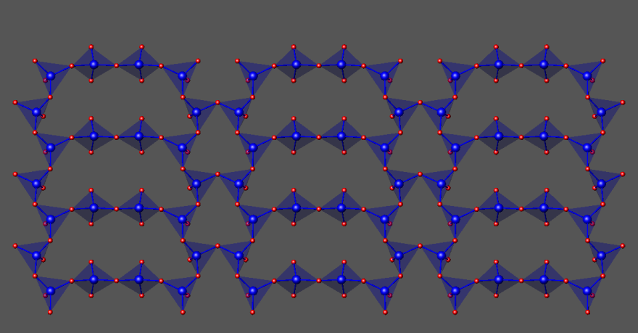
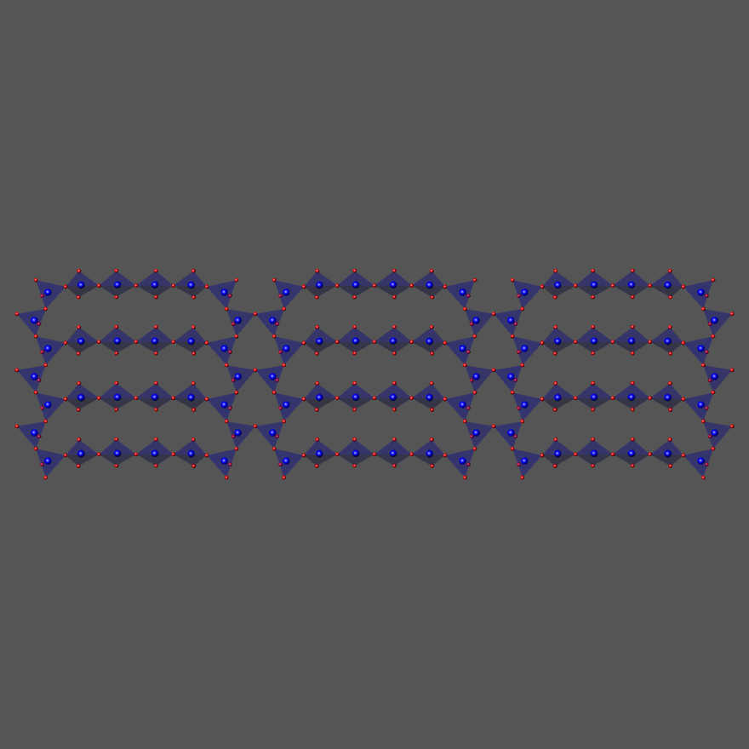
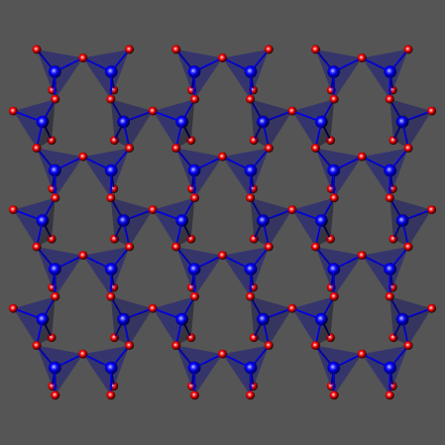
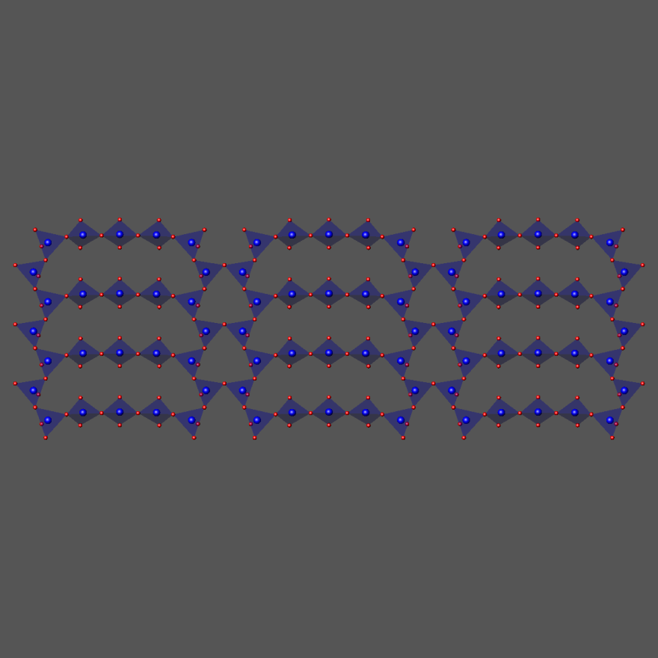
SrTiO₃ (110) nx1
3x1
Expansion to other nx1 by changing the number of TiO₄ surface tetrahedra per ring
2x1
4x1
∞x1
6x1
3x1
5x1
4x1
Notes:
Talk about composition of each
First observation of homologous series on a surface

Slide 36

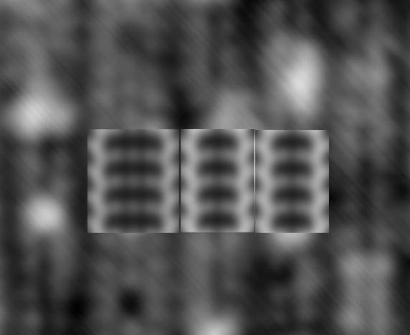
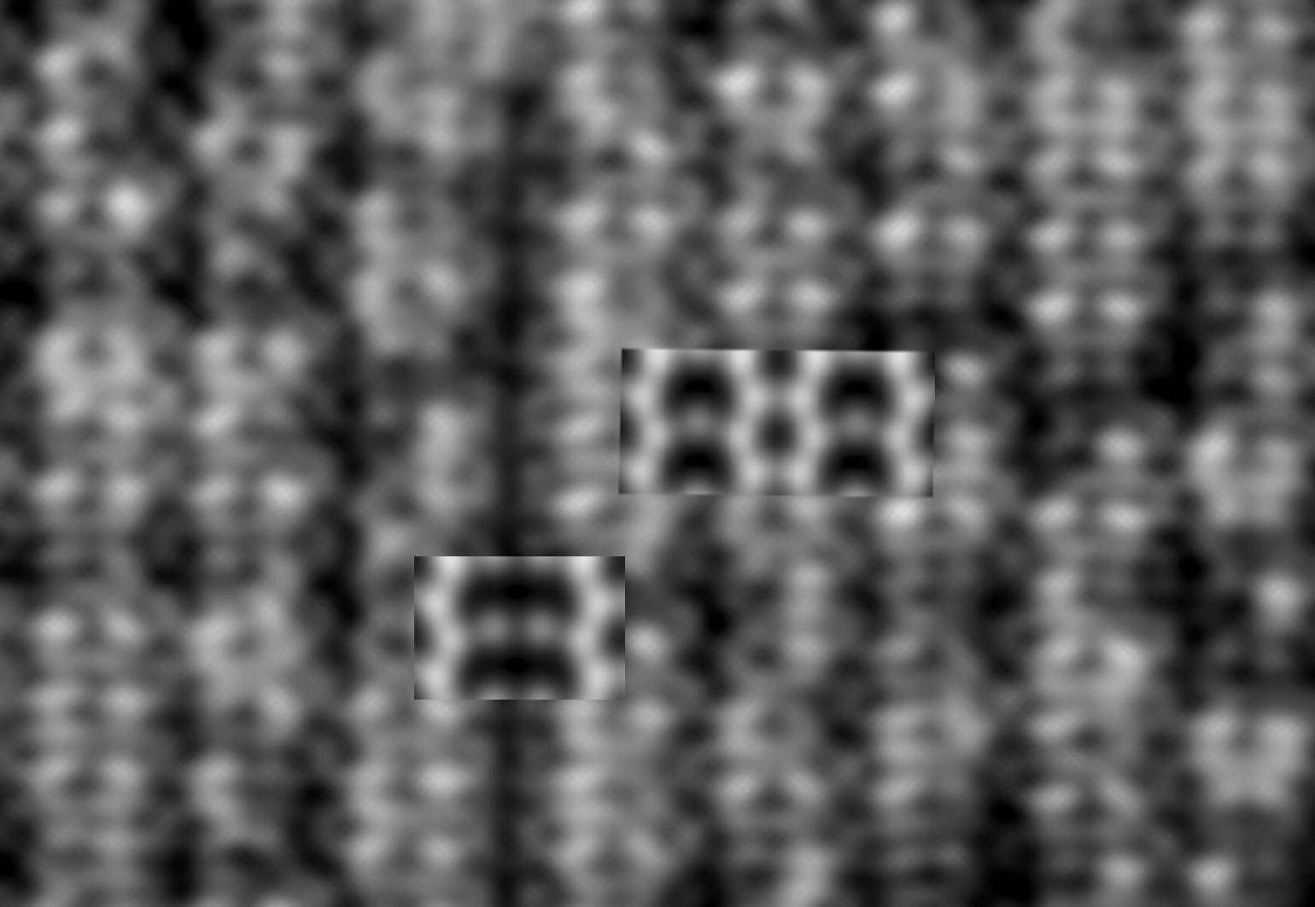
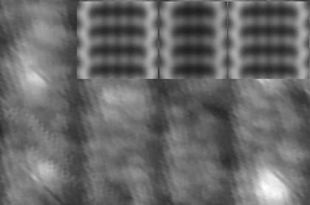
Intergrowths
STM with simulations (DFT)
5x1
4x1
4x1
3x1
3x1
4x1
6x1
5x1
6x1
Enterkin et. al., Nature Materials, 2010

Slide 37

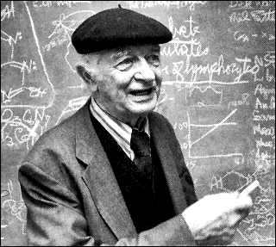
SrTiO₃ (110) 3x1
Ti1
O1
Bond valence sums
  Ti1 = 4.04
  Ti2 = 4.08
  Ti3 = 4.04
  O1 = 2.03-
  O2 = 2.02-
  O3 = 2.04-
  O4 = 2.19-
Ti2
O2
Ti3
O4
O3
Explanation: Pauling’s Rules (BVS)
Blue polyhedra are surface polyhedra, gold are bulk octahedra, orange spheres Sr, blue spheres Ti, red spheres O
Enterkin et. al., Nature Materials, 2010
The principles determining the structure of complex ionic crystals. J. Am. Chem. Soc. 51 (4): 1010 1929.

Slide 38
STO (110) Bond Valence Sums
Bond Valence |  | Sr | Half-O₂ | ∞x1 | 6x1 | 5x1 | 4x1 | 3x1 | 2x1
Surf | Ti(Sr) | 1.88 | 3.83 | 3.41 | 3.87 | 3.93 | 3.99 | 4.06 | 4.02
Surf | O | 1.49- | 1.94- | 1.21- | 1.88- | 1.95- | 1.99- | 2.05- | 2.07-
Sub-surf | O | 2.61- | 1.88- | 2.07- | 2.02- | 2.04- | 2.05- | 2.05- | 1.94-
Surface Energy
(eV per 1x1 unit)
TPSSh
SrO monolayer
at Surface
X: TiO₂ at Surface

Slide 39
Four examples
Connect TED, DFT, STM (and chemistry); the SrTiO₃ (110) surface
What lies beyond order: glass-like tilings on SrTiO₃, the √13x√13 (001) reconstruction
Surface Structure of Nanocuboid SrTiO₃
Some additional complications: SrTiO₃ (111), water and beyond

Slide 40
STiO₃ (001) Energies
eV/1x1 cell, revTPSSh
(001)
2x1 2x2 √2x√2 c4x2 c6x2 √5x√5 √13x√13
c4x2
2x2
√2
TiO₂
SrO
TiO₂ per 1x1
For errors, see L. D. Marks et al., Surf. Sci. 603, 2179 (2009) For revTSPP J.P. Perdew, PRL 103, 026403 (2009)

Slide 41
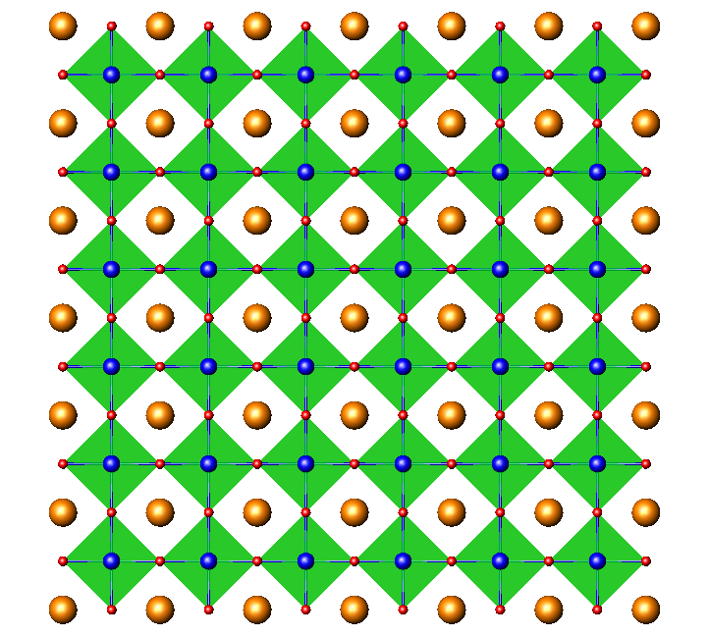


Common features: 1x1 Base
Top View Side View
Building Blocks:
Sr (not critical)
5-fold Ti 6-fold Ti

Slide 42



2x2 Structure
Top View Side View
O. Warschkow et al., Surf. Sci. 573, 446 (2004).

Slide 43

√2x√2 R45
Top View Side View
O. Warschkow et al., Surf. Sci. 573, 446 (2004).

Slide 44

c(4x2)
Top View Side View
N. Erdman et al., J. Am. Chem. Soc. 125, 10050 (2003).

Slide 45
STiO₃ (001) Energies
eV/1x1 cell, revTPSSh
(001)
2x1 2x2 √2x√2 c4x2 c6x2 √5x√5 √13x√13
c4x2
2x2
√2
TiO₂
SrO
Intermediate compositions?
TiO₂ per 1x1
For errors, see L. D. Marks et al., Surf. Sci. 603, 2179 (2009) For revTSPP J.P. Perdew, PRL 103, 026403 (2009)

Slide 46



√13x√13 R33.7 SrTiO₃ (100)
Make a “normal” sample
Buffer-etched then annealed
Changes surface TiO₂ excess
D. M. Kienzle, A. E. Becerra-Toledo, and L. D. Marks,
Phys. Rev. Lett. 106, 176102 (2011)

Slide 47


(001) √13x√13 Initial Map

Slide 48

(001) √13x√13 Refined

Slide 49



Other tilings
3x3
√5x√5
√13x√13
D. M. Kienzle, A. E. Becerra-Toledo, and L. D. Marks, PRL. 106, 176102 (2011)

Slide 50


c4x2 (left) and √5x√5 (right)
STM: Castell Surface Science 505 (2002) 1–13

Slide 51
STiO₃ (001) Energies
eV/1x1 cell, revTPSSh
c4x2
2x2
√2
TiO₂
SrO
TiO₂ per 1x1

Slide 52
Stable according to DFT
eV/1x1 cell, revTPSSh
Glasses
c4x2
2x2
√5
√2
TiO₂
SrO
3x3
√13
TiO₂ per 1x1
D. M. Kienzle, A. E. Becerra-Toledo, and L. D. Marks, PRL. 106, 176102 (2011)

Slide 53
Four examples
Connect TED, DFT, STM (and chemistry); the SrTiO₃ (110) surface
What lies beyond order: glass-like tilings on SrTiO₃, the √13x√13 (001) reconstruction
Surface Structure of Nanocuboid SrTiO₃
Some additional complications: SrTiO₃ (111), water and beyond

Slide 54



Nanoparticle surfaces?
PRL 111, 156101 (2013)
Oleic Acid Acetic Acid

Slide 55


Profile Imaging
Area 2
Area 1
ACAT at ANL

Slide 56



Numbers, numbers, numbers
Images are for artists
Signals are for scientists
Gaussian Fit

Slide 57


Surfaces, surfaces, surfaces
MacTempas
Vibration
40 picometers
(Image Spread?)

Slide 58

Nanoparticle surfaces?
PRL 111, 156101 (2013)
Oleic Acid Acetic Acid
1nm
1nm
SrO surface
TiO₂ DL

Slide 59
Nanoparticle surfaces?
PRL 111, 156101 (2013)
To Bulk
1nm
SrO surface
Not for the faint hearted....

Slide 60
Nanoparticle surfaces?
PRL 111, 156101 (2013)
To Bulk
1nm
SrO surface
Not for the faint hearted....

Slide 61
Nanoparticle surfaces?
PRL 111, 156101 (2013)
To Bulk
1nm
SrO surface
Precision good enough – functional matters!

Slide 62
Nanoparticle surfaces?
PRL 111, 156101 (2013)
To Bulk
1nm
SrO surface
Precision good enough – functional matters!

Slide 63
Stable according to DFT
eV/1x1 cell, revTPSSh
c4x2
2x2
Acetic Acid
Oleic Acid
√5
√2
TiO₂
SrO
3x3
√13
TiO₂ per 1x1
D. M. Kienzle, A. E. Becerra-Toledo, and L. D. Marks, PRL. 106, 176102 (2011)

Slide 64
Four examples
Connect TED, DFT, STM (and chemistry); the SrTiO₃ (110) surface
What lies beyond order: glass-like tilings on SrTiO₃, the √13x√13 (001) reconstruction
Surface Structure of Nanocuboid SrTiO₃
Some additional complications: SrTiO₃ (111), water and beyond

Slide 65

Reality Checkpoint I
Are all your surfaces clean?
Are you really sure?
Really?

Slide 66






Conundrum
2×1
Determined via transmission electron diffraction*
Supported by SXRD†
High surface energy‡
Top
View
RT2
Lowest energy‡
But never observed!
(√2×√2)R45° (“RT2”)
2×1
Why??
Side
View
* Erdman et al. Nature 419, 55 (2002)
† Herger et al. PRL 98, 076102 (2007)
‡ Warschkow et al., Surf.Sci. 573, 446 (2004)

Slide 67
OH on SrTiO₃ (100) (2x1)
67

Slide 68




2×1: ½ML H₂O Coverage
Top
View
2x1Mol
2x1Diss
Side
View

Slide 69












(Top View)
Dry
½ ML
1 ML
RT2
2×2
c(4×2)
“2Ti”

Slide 70

Energy
RT2 not lowest energy structure when surfaces are “wet”
Suggests: H₂O opens kinetically favorable pathways to other structures
Becerra-Toledo, A.E., M.R. Castell, and L.D. Marks, Surface Science, 2012. 606(7-8), 762;
Becerra-Toledo, A.E., J.A. Enterkin, D.M. Kienzle, and L.D. Marks, Surface Science, 2012. 606(9-10), 791

Slide 71
Reality Checkpoint II
The results shown are just the tip of the iceburg
There are many more kinetic/thermodynamic reconstructions

Slide 72

More Ti-enriched surface
(n×1)
(m×4)
(6×1)
(5×1)
(4×1)
(2×4)
(6×4)
(1×4)
(1×5)
(1×1)
Sr dosage (ML)
Ti dosage (ML)
Z. Wang et al., Phys. Rev. B (2011)

Slide 73
What do we know
SrTiO₃ surfaces make semiconductors (and metals) look simple
  Simple 1x1 assumptions for SrTiO₃ are inappropriate and bad science
  Why should other perovskites be simpler?
  Disordered (glass) structures possible
  Chemisorbed water can be present
  Extensive data already exists that growth depends upon initial reconstructions

Slide 74

God made the bulk; the surface was invented by the devil
Wolfgang Pauli
Questions?

