Slide 1
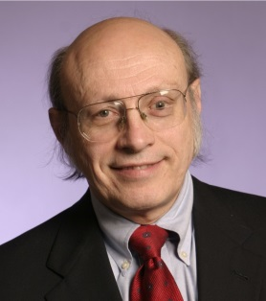
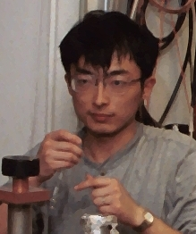

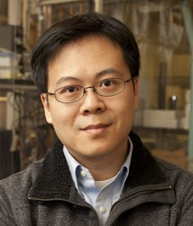


Nanoplasmonics:
Correlated LSPR and TEM
Emilie Ringe, Yingmin Wang,
R. Van Duyne & L. D. Marks
Collaborators:
Theory: G.C. Schatz
Synthesis: J. Huang, C. Mirkin , +++
Materials Research Science & Engineering Center
Northwestern University

Slide 2
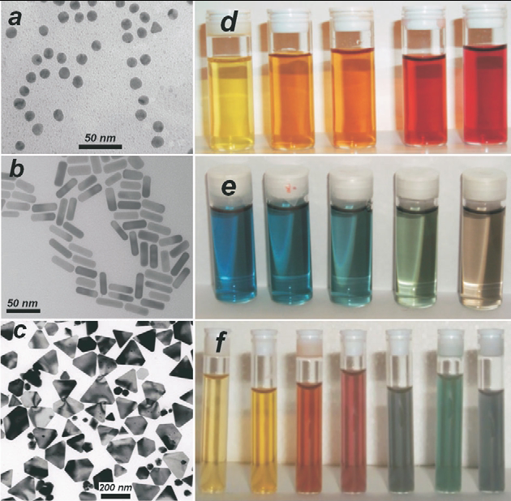
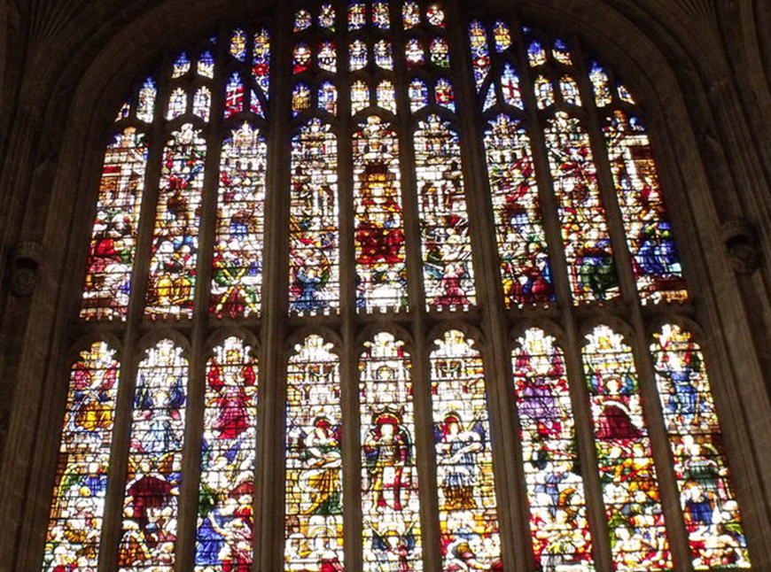
Localized Surface
Plasmon Resonance (LSPR)
Small particles of noble metal: used in stained glass since the middle ages
Wide range of colors depending on shape and size
Kings’ College, Cambridge
L. Liz-Marzan, Mater. Today 7, 21 (2004)
Notes:
2

Slide 3
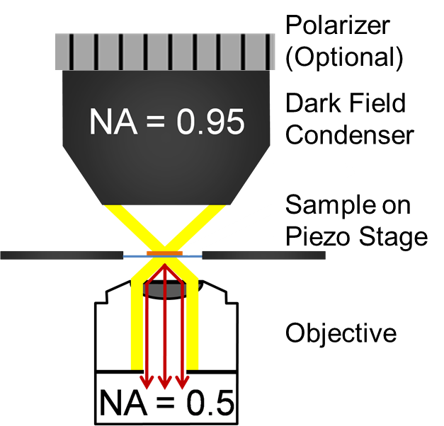
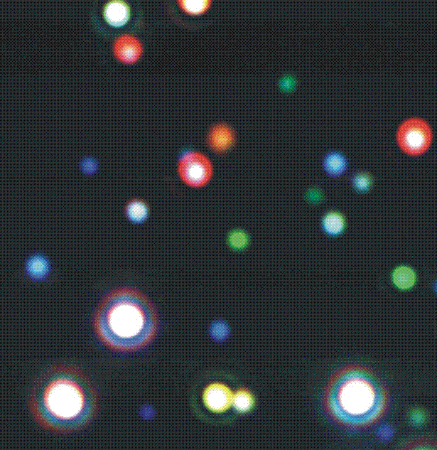
Synthesis yields Particles with Heterogeneous Optical Properties
10 μm
10 μm
Hollow-Cone DF = ADF

Slide 4
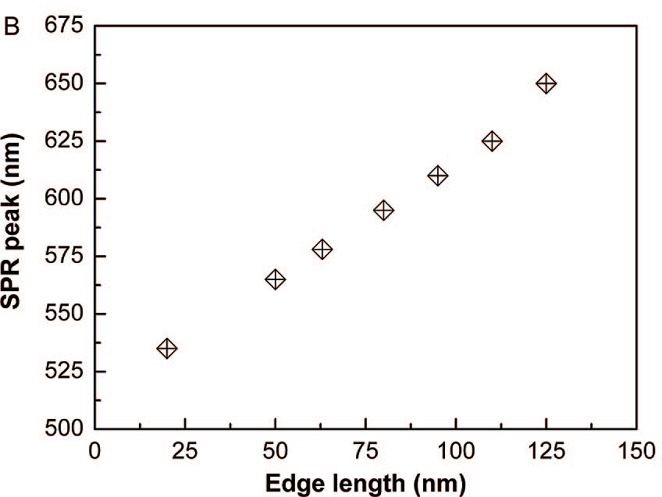
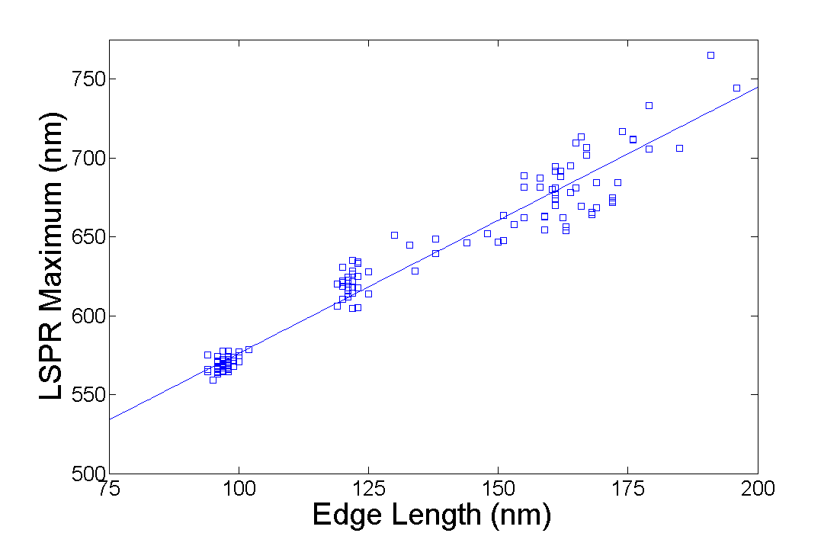
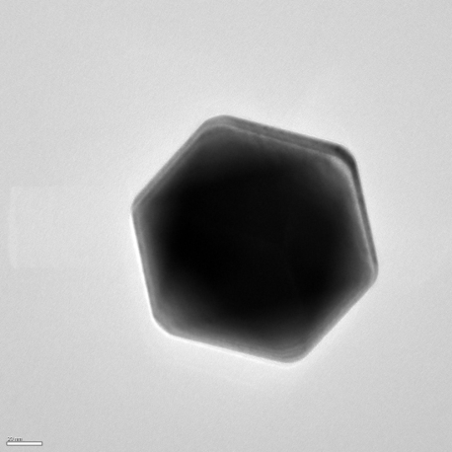
Gold Octahedra:
Ensemble versus Single Particle
ENSEMBLE
Slope ~1.1
SINGLE PART.
Slope=1.69(0.03)
C. Li, et al., ACS Nano. 2, 1760 (2008)

Slide 5
Follow the science, not the electron
For real commercial applications, we need five-sigma reliability
The £64,000 questions:
  How, in detail, do the plasmonic properties depend upon the size/shape/environment?
  How, in detail, do we control the shape/size with 100% reliability (chemical potential, growth/thermodynamics…)?

Slide 6
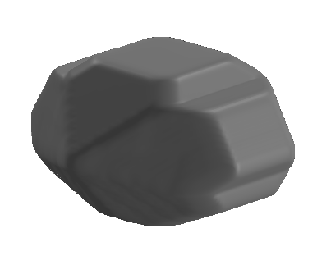
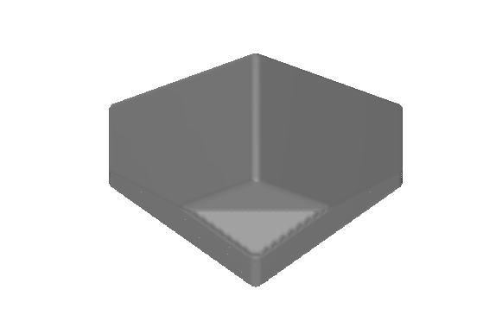
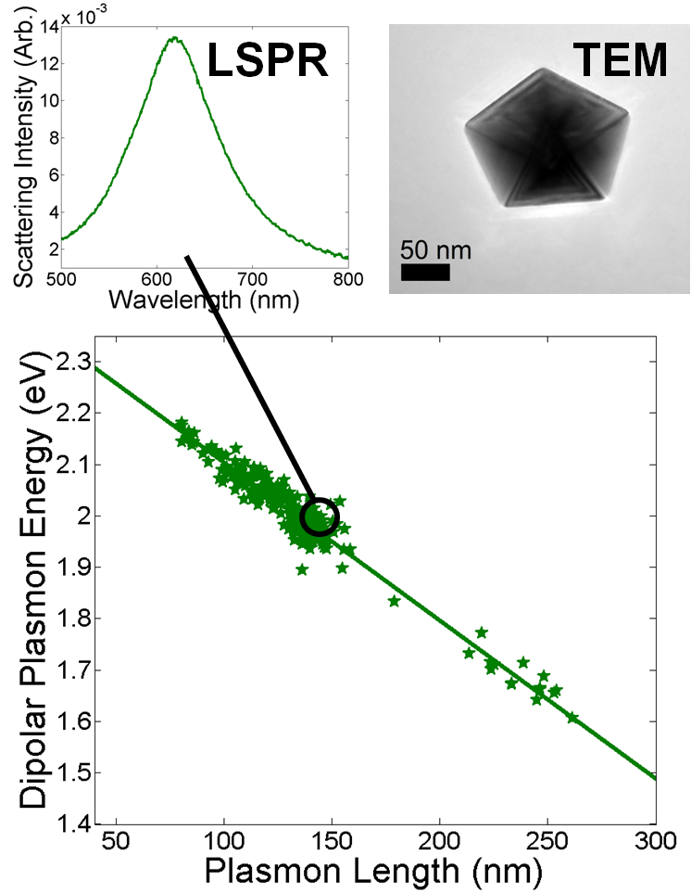
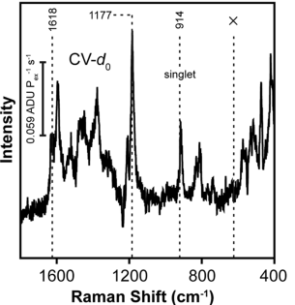
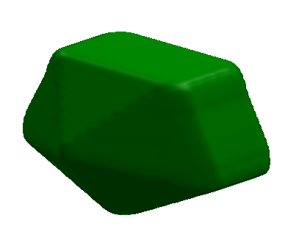
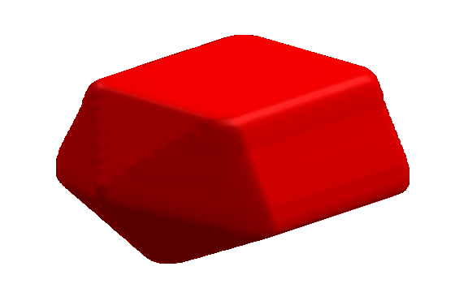
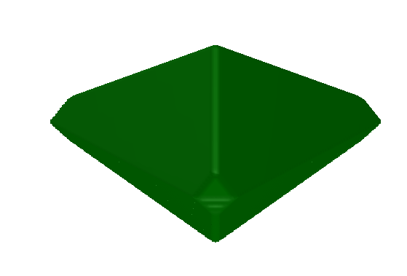

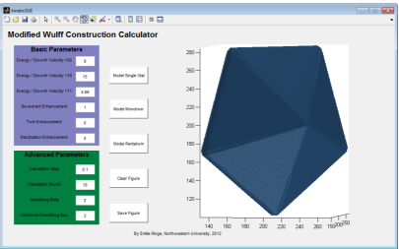
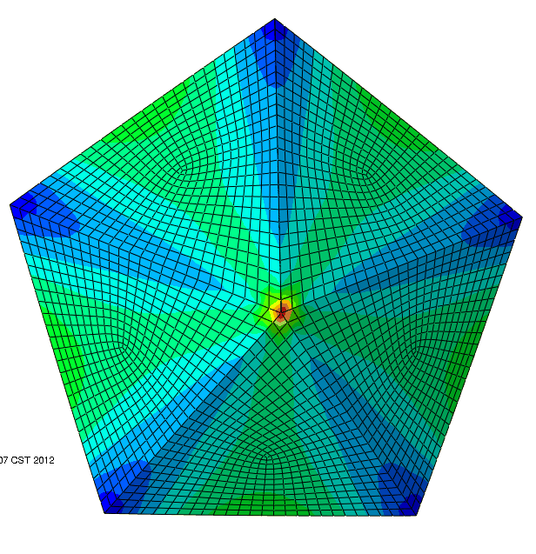
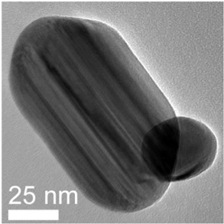
Strategy
Correlated measurements tools
Growth
Thermodynamic
Kinetic
Modified Kinetic Wulff shapes for Twinned Nanoparticles. Ringe, E., R.P. Van Duyne, and L.D. Marks, JPC C, 2013. 117: p. 15859.
Thermodynamic Analysis of Multiply Twinned Particles: Surface Stress Effects. Patala, S., L.D. Marks, and M. Olvera de la Cruz, JPCL, 2013. 4: p. 3089.
Elastic Strain Energy Effects in Faceted Decahedral Nanoparticles. Patala, S., L.D. Marks, and M.O. de la Cruz, JPC C, 2013. 117(3): p. 1485.

Slide 7

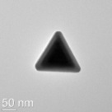
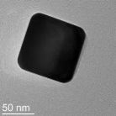
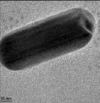
Goal: Build the
Nanoplasmonics Toolbox
10 μm

Slide 8
Three parts to talk today
How to combine TEM & LSPR
Follow the science, not the electron
Thousands of nanoparticles
A picture is worth a thousand words, but numbers are worth thousands of pictures
A few grey-haired thoughts

Slide 9
How to find the needle in a haystack….fast
Target
  Measure the optical response of nanoparticles, both single and (serendipity) small clusters of nanoparticles
  Determine the structure of exactly the same particles by TEM
  Close the loop with theoretical calculations
Y. Wang et al, Ultramicroscopy 2009, 109, 1110-1113.

Slide 10
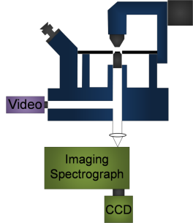
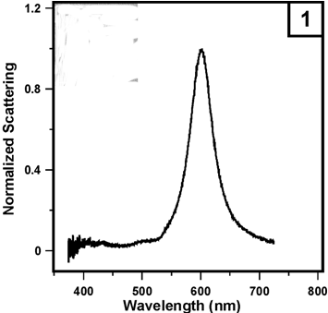
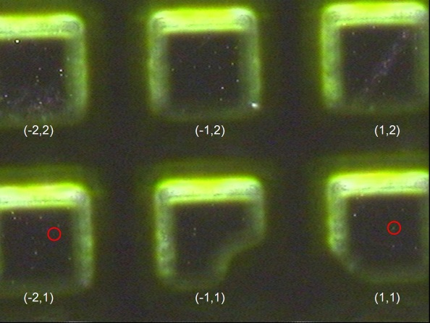
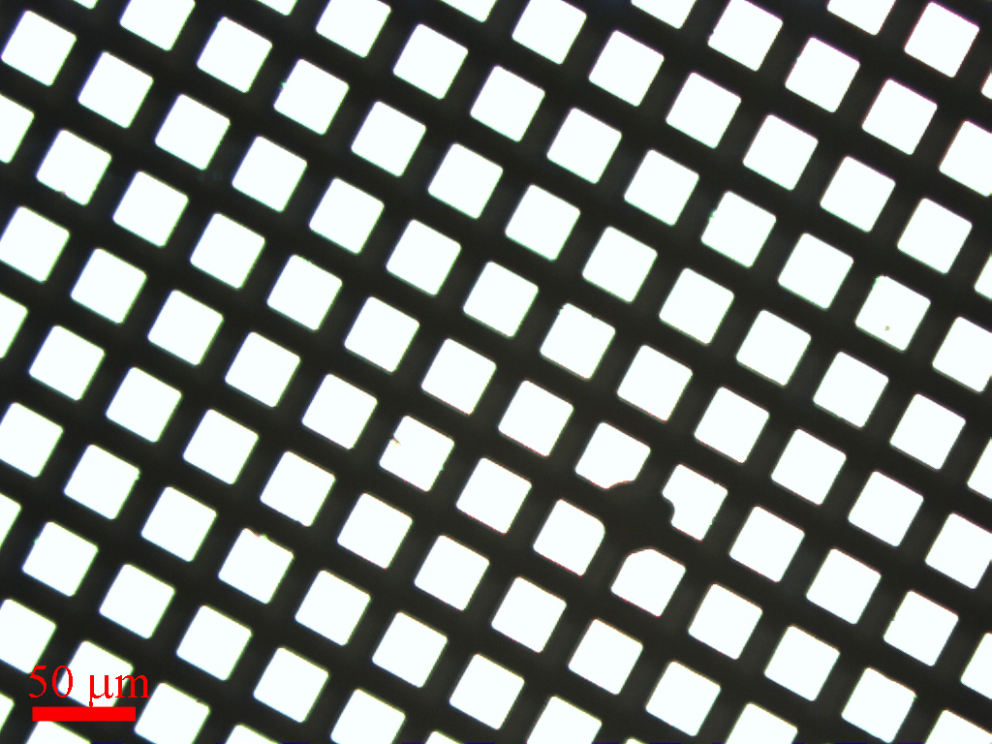

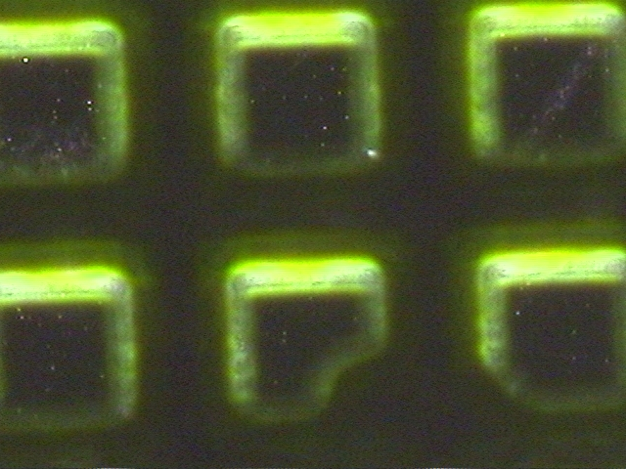
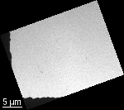
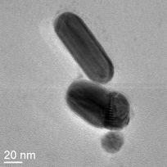
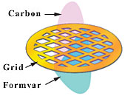
Method
Solvent + Nanoparticles
(-2,2)
(-1,2)
(1,2)
Y
X
(-2,1)
(-1,1)
(1,1)

Slide 11
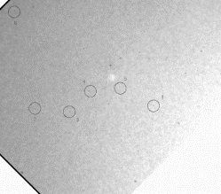
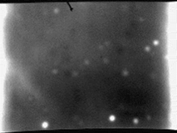
Correlated LSPR & TEM Imaging
Low resolution TEM image
LSPR image with 100x objective

Slide 12
Caveat: Damage I
Structural changes (quasimelting, enhanced surface diffusion etc)
  Patience is a virtue, turn the beam down!
Does the electron beam change the LSPR?
  Yes for TEM, no for SEM (with care)
  Local dielectric environment probably changes
  We always do the LSPR first

Slide 13
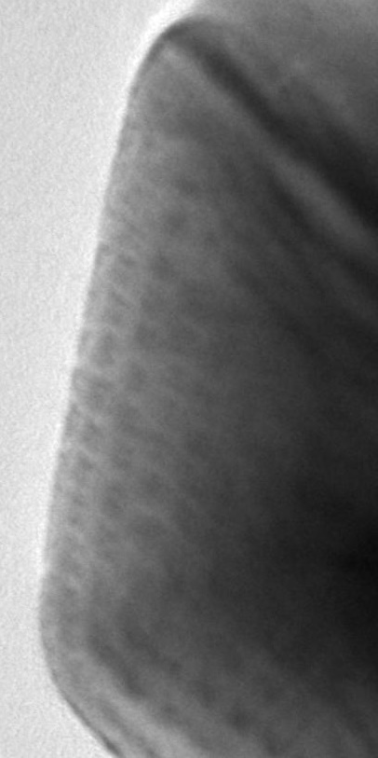
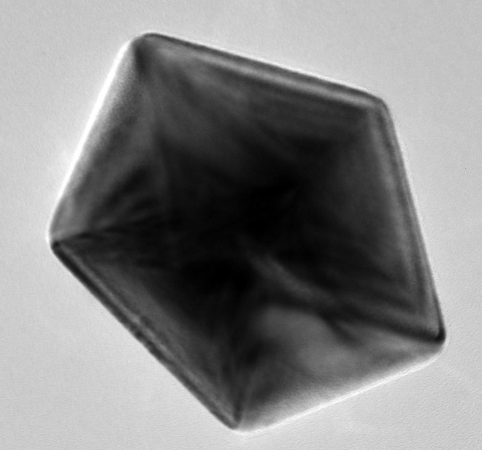
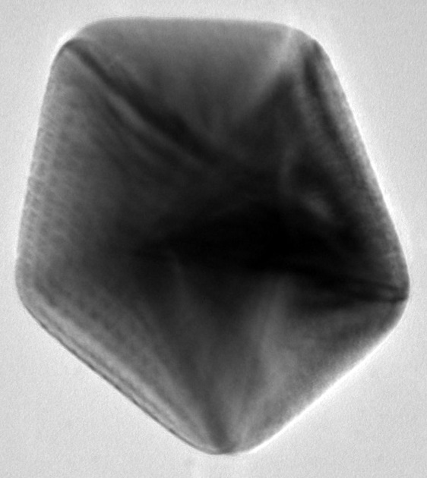
Caveat: Damage II
Optical damage?
  Possible, with high fluxes, e.g. photoemission expts, but rare
Rounded
Before After nx1 (111) (not the same nanoparticle) reconstruction
A. Grubisic et al, Nano Letters 2012, 12, 4823.

Slide 14
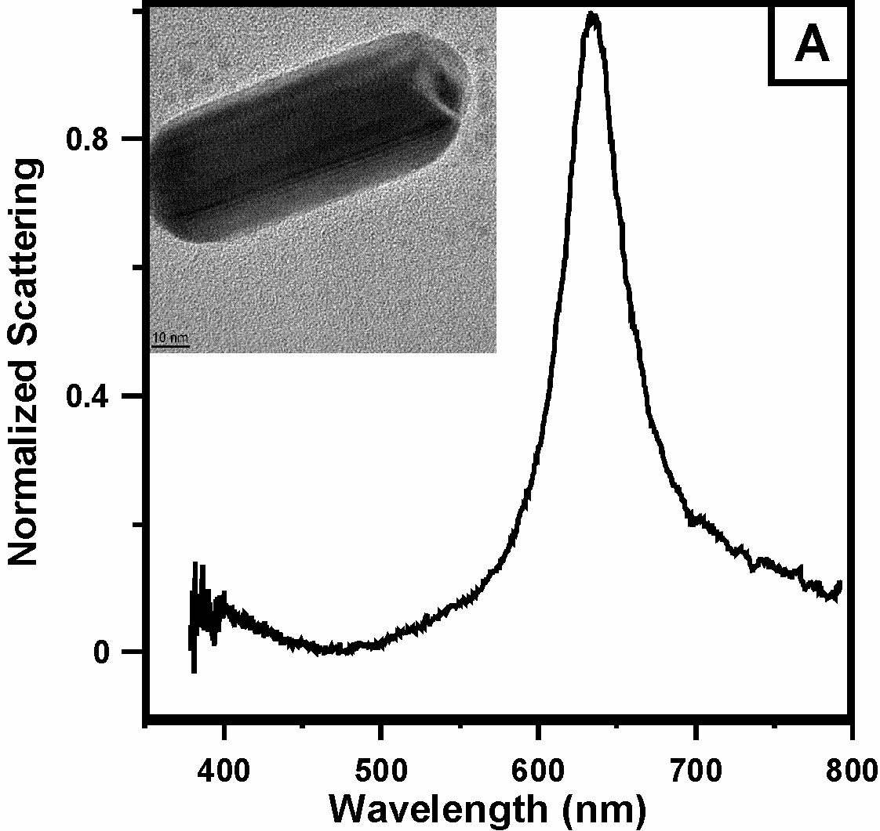
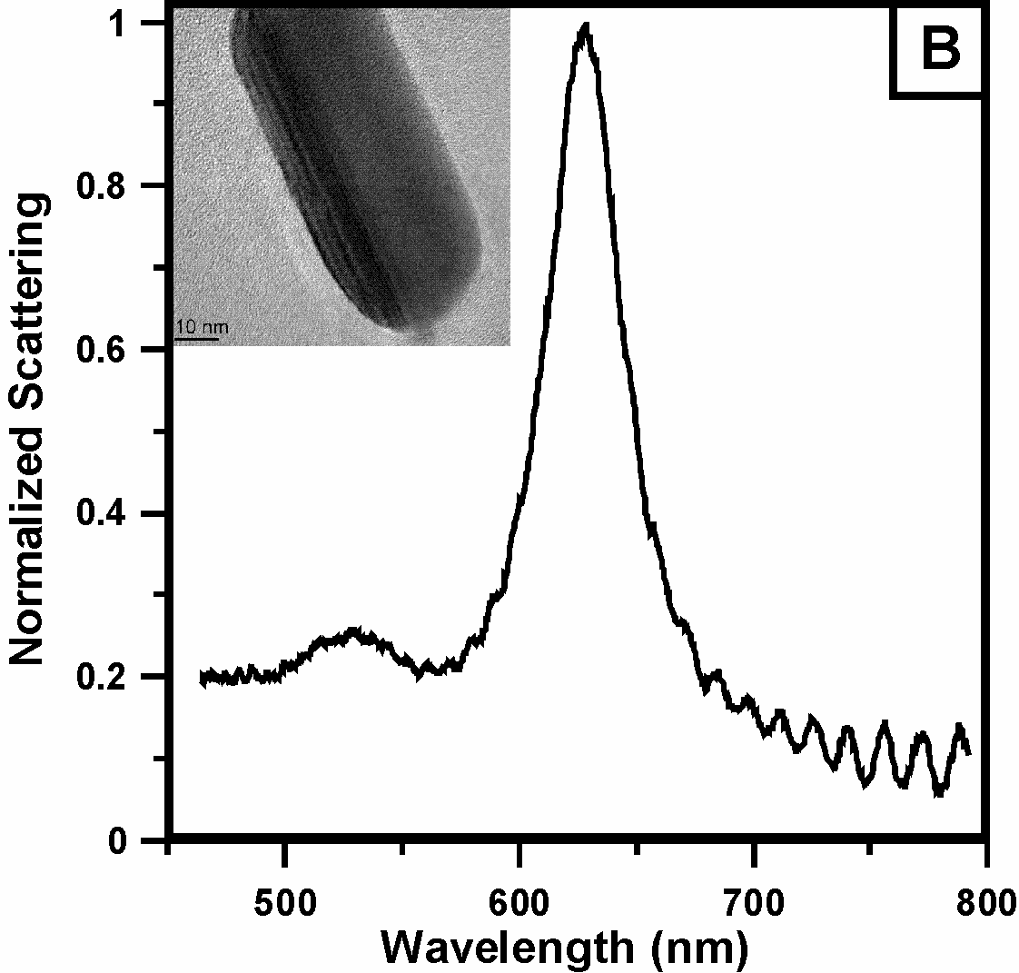
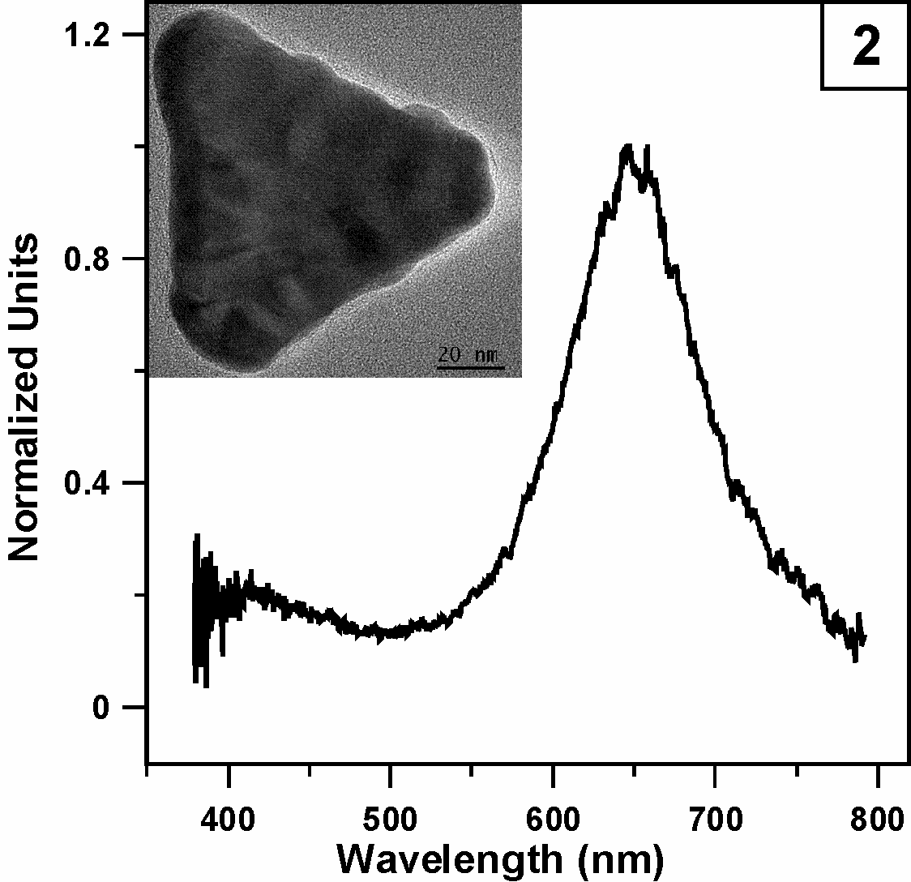
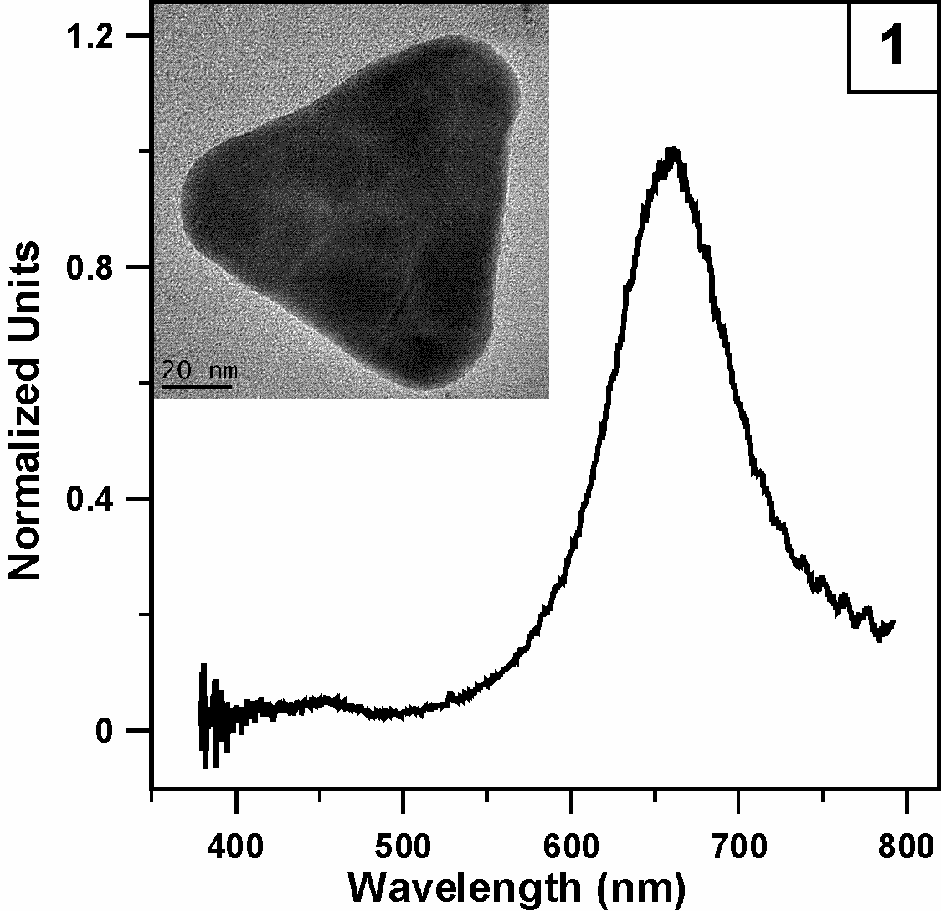
Narrow:
LTP Rods
Narrow Linewidth
Decagonal Rods
628.5 nm
633.6 nm
Γ
Γ
Γ = 0.156 eV
Γ = 0.120 eV
Wide Linewidth
Defective Particles (Odd ones, rough surfaces?)
FWHM
0.275 eV
FWHM
0.2505 eV

Slide 15
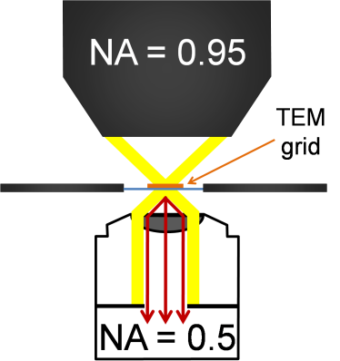
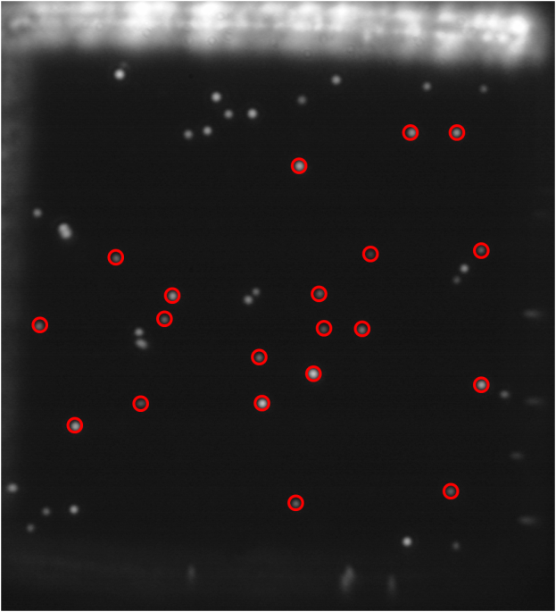
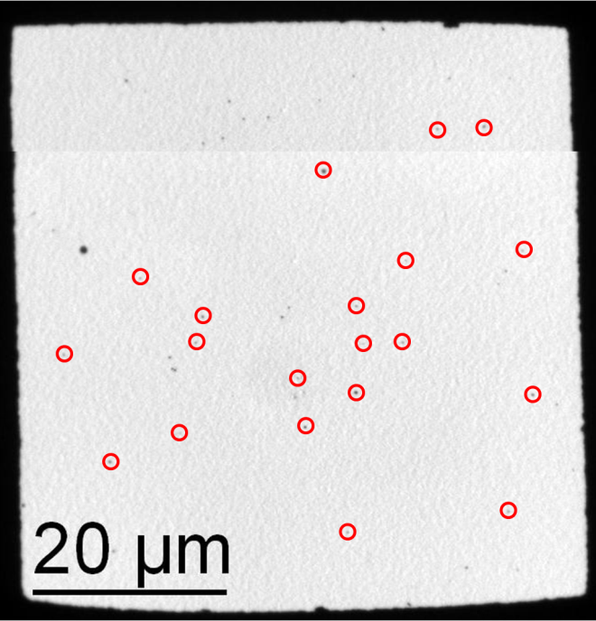

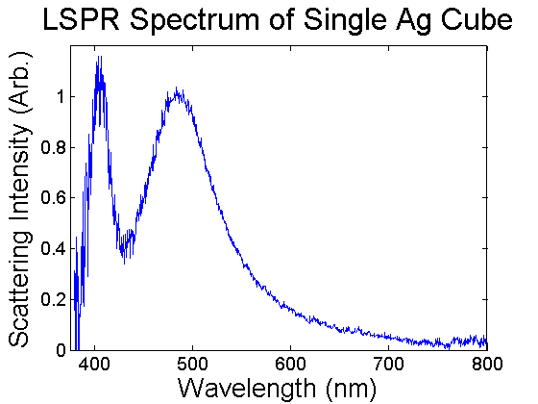
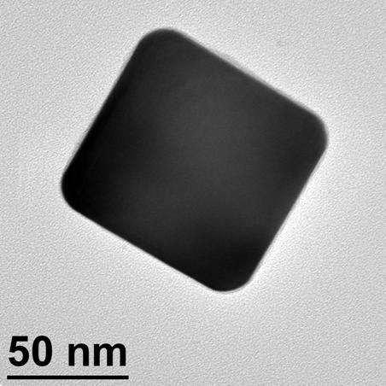
First Application: Single Silver Nanocube LSPR/TEM/FDTD
Step 1: LSPR
Step 2: TEM
Y. Wang et al, Ultramicroscopy 2009, 109, 1110-1113.
Notes:
15

Slide 16
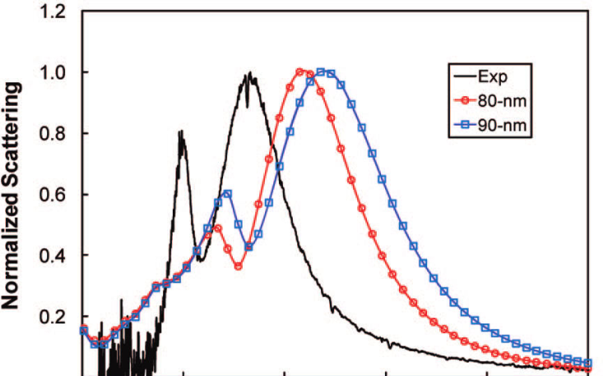
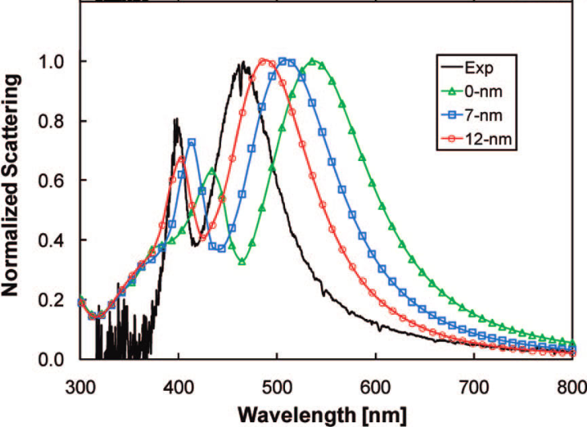
FDTD Results: Effect of Size and Corner Rounding in Ag Cubes
Effect of size
Effect of corner rounding
J. M. McMahon, et al, JPCC, 113, 2731 (2009)
Notes:
16

Slide 17
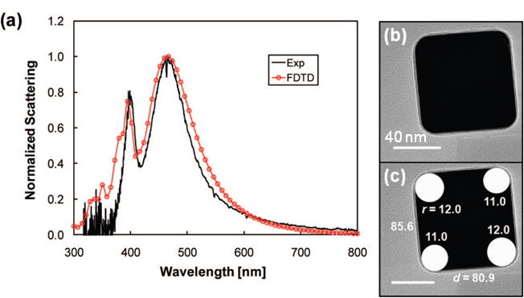
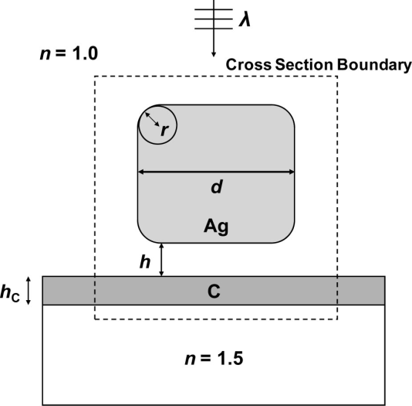
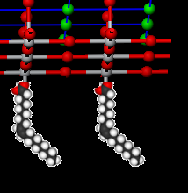

Reasonable agreement
FDTD
2
1
Oleic Acid Surfactant
40 nm
(1) Distal peak, quadrupolar:
Sharp, high energy, EF away from substrate
(2) Proximal peak, dipolar:
Broader, EF extends into the substrate
L. J. Sherry, et al, Nano Lett., 5, 2034 (2005); J. M. McMahon, et al, JPCC, 113, 2731 (2009)
17
Notes:
17

Slide 18

Hundreds (thousands) of needles
Measure many nanoparticles
Analyze the results statistically – new details appear
10 μm
A picture is worth a thousand words, but numbers are worth a thousand pictures
And thousands of numbers…
10 μm

Slide 19




Statistics
LSPR TEM
183 cubes → 5 Trends:
LSPR Redshift with
Size Increase
Ag → Au
Substrate
Ag more sensitive to
Substrate
Size
Ag
Au
η_{Si3N4} ~ 2.05
η_{Formvar} = 1.5
E. Ringe, et al, JPCC, 114, 12511 (2010)

Slide 20



Effect of Size and Substrate, Ag Nanocubes
Distal
0.05 eV
Distal
Proximal
0.23 eV
Proximal
Distal peak → Slope = -4.2(0.55) meV/nm
Proximal peak → Slope = -8.9 (0.5) meV/nm
E. Ringe, et al, JPCC, 114, 12511 (2010)
Notes:
20

Slide 21




Silver Right Bipyramids
Plasmon-mediated synthesis
  Start with “monotwins” seeds
  Control final size w/light λ
Size: edge length of triangular base
Rounding: height of triangle removed from corners
See effect of rounding and size on LSPR
500 nm

Slide 22

LSPR Dependence on Size and Rounding in Bipyramids
R²=75%
R²=49%
Both Factors play a role→neither accounts for all the variation

Slide 23


Bipyramids:
Fit to Two Parameters and Their Interplay
R²=88%
Ringe et al, Nanotechnology 2012, 23, 444005.

Slide 24












Correlating the Size, Shape, and Plasmon Energy (Retardation)
Ag and Au cubes
on different substrates
Ag cubes 50-200 nm
Au Icosahedra Au decahedra Au truncated bitetrahedra
Notes:
24

Slide 25


Experimental Data for Au Particles (Retardation)
If I can't calculate it, I don't understand it
Richard Feynman ( & AH?)

Slide 26



Edge length
J. Nelaya et al. Nano Lett. 10, 902 (2010)
Edge length
Triangles
Electrons oscillate approx. from an edge to an apex in the plane of the triangular base
Plasmon length=0.866*edge length
Cubes and rods
Electrons oscillate from one face to another face which is parallel.
Plasmon length=1* edge length
Edge length
Edge length
I. Pastoriza-Santos et al., Adv. Funct. Mater.
17, 1443 (2007)
Octahedra
In-plane and out-of plane contribute
Distance travelled=1*edge length up to
1.414*edge length
Decahedra (pentagonal bipyramids)
Electrons oscillate approx. from an edge to an apex in the plane of the pentagonal base
Distance travelled=1.306*edge length
C. Li et al., ACS Nano. 2, 1760 (2008)

Slide 27











Shape Independent Result
Slope = -3.06(4)
Slope = -3.02(5)
Slope = -3.3(2)
Slope = -3.22(9)
Slope = -2.4(6) meV/nm
Plasmon Length
E. Ringe, M. R. Langille, J. Zhang, J. Huang, C. A. Mirkin, R. P. Van Duyne, L. D. Marks, J. Phys. Chem. Lett. (2012) 3, 1479

Slide 28









Plasmon Length & FWHM
Slope = 2.92(8)
Slope = 2.89(10)
Slope = 2.4(3)
Slope = 2.78(11)
Slope = 3.1(8) meV/nm
Side Length
Plasmon Length
E. Ringe, M. R. Langille, J. Zhang, J. Huang, C. A. Mirkin, R. P. Van Duyne, L. D. Marks, J. Phys. Chem. Lett. (2012) 3, 1479

Slide 29



Higher Order Modes, Ag
4
3
1
EPL=L/n

Slide 30
Summary
A lot can be learned from single particle LSPR, particularly when done on many particles and with ~1meV resolution (sorry folks, not just EELS on one or two)
  Trends with size, shape, fine details of structure
Not everything
  We cannot resolve where the hot-spots are

Slide 31
Grey Haired Comments I

Slide 32






Surfaces are not trivial
Y. Lin et al, Physical Review letters, 2013. 111, 156101.
Grown with oleic acid
Grown with acetic acid
1nm
1nm
SrO surface
TiO₂ DL (√13)
Profile imaging, ANL-ACAT

Slide 33


Grey Hair Comments II
The Howie Challenge
The Marks Challenge
E. Ringe et al., Wulff Construction for Alloy Nanoparticles. Nano Letters 2011, 11, 3399

Slide 34
Questions ?
Research is to see what everybody else has seen, and to think what nobody else has thought
Albert Szent-Györgi

