Slide 1

Where did that charge come from?
Karl Olson, Chris A. Mizzi, Alex Y. W. Lin and L. D. Marks
Northwestern University

Slide 2
Tribology + Flexoelectricity = Triboelectricity
Mizzi, C.A., A.Y.W. Lin, and L.D. Marks, Does Flexoelectricity Drive Triboelectricity? Phys Rev Lett, 2019. 123(11): p. 116103 https://doi.org/10.1103/PhysRevLett.123.116103.
Mizzi, C.A. and L.D. Marks, The role of surfaces in flexoelectricity. Journal of Applied Physics, 2021. 129(22): p. 224102 https://doi.org/10.1063/5.0048920.
Mizzi, C.A. and L.D. Marks, When Flexoelectricity Drives Triboelectricity. Nano Lett, 2022, 22(10), 3939, https://doi.org/10.1021/acs.nanolett.2c00240.
Olson, K.P., C.A. Mizzi, and L.D. Marks, Band Bending and Ratcheting Explain Triboelectricity in a Flexoelectric Contact Diode. Nano Lett, 2022, 22(10), 3914 https://doi.org/10.1021/acs.nanolett.2c00107.

Slide 3
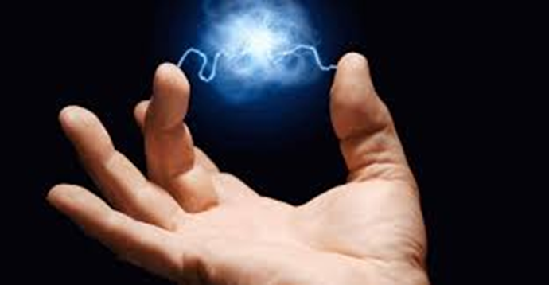
Overview
Setting the Stage
  A few basics of Triboelectricity
  A few basics of Flexoelectricity
Tribology + Flexoelectricity = Triboelectricity ?

Slide 4
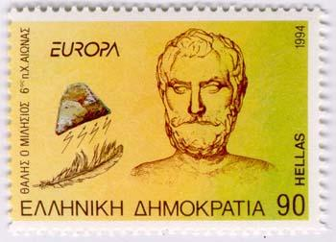
Triboelectricity
First observed by Thales of Miletus around 585 BC after rubbing amber with fur
The source of the word electricity, which is derived from ēlektron, the Greek word for amber.

Slide 5
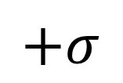
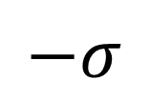
Charge Transfer on sliding
Solid 1
Solid 1
$$+σ$$
Solid 1
+
+
+
+
+
+
+
+
+
+
+
+
+
+
+
+
-
-
-
-
-
-
-
-
-
-
-
Solid 2
-
-
-
-
-
Solid 2
$$−σ$$
Solid 2
Charged species may be electrons, ions, molecular fragments (evidence for all in different cases)

Slide 6
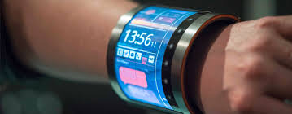
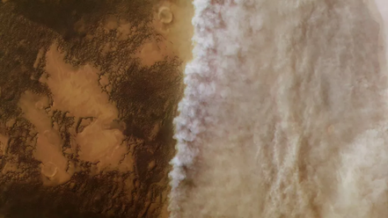
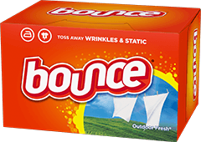

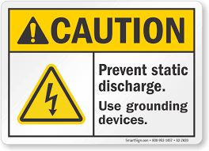
Many Areas
Power wearable electronics
Antistatic cloth
Dust Storms
Manufacturing
Weather
Safety

Slide 7
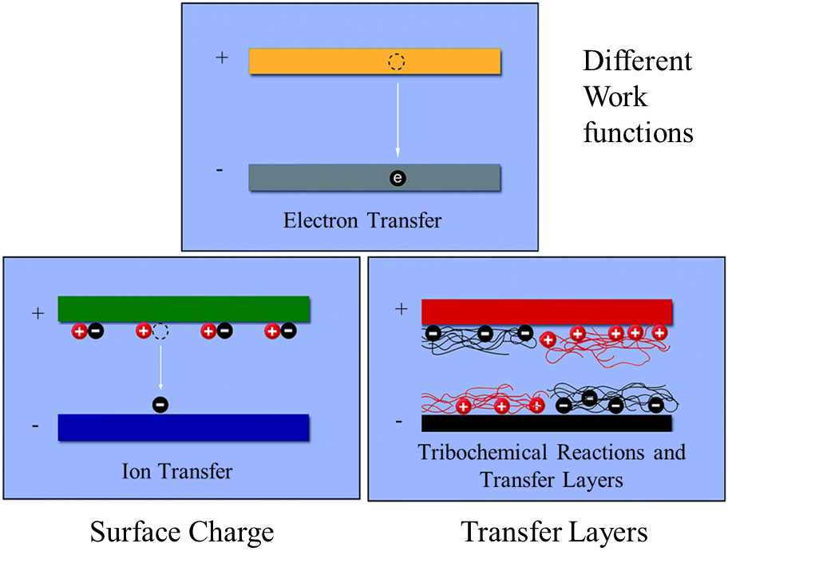
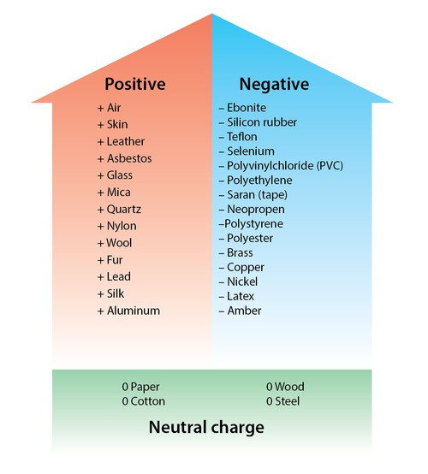
Current Models: Incomplete
Triboelectric Series
Adapted from F. Galembeck et. al., RSC Advances 4(109) (2014) 64280-64298.
kb.staticworx.com/glossary/triboelectric-series/

Slide 8
Some of the issues
Charge transfer inhomogeneous
Curvature matters (first shown by Jameson in 1910, a school teacher from Glasgow, DOI: 10.1038/083189a0)
Tribocurrent scales as F^{1/3}
Bipolar tribocharge (+/- during contact/pulloff)
Depends upon pre-strain of sample
Charge transfer can change sign with pressure
Occurs between different sized particles of the same material
Workfunction, dielectric constant, trap states matter

Slide 9

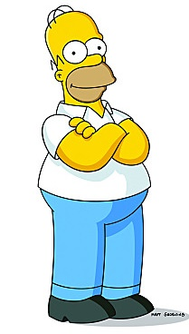
You can’t beat Gibbs
Why does charge transfer occur?
The free energy change for charge separation must be negative
Why is rubbing required (Tribology)?
“In this house we obey the laws of thermodynamics”
Mizzi, C.A., A.Y.W. Lin, and L.D. Marks, Does Flexoelectricity Drive Triboelectricity? Phys Rev Lett, 2019. 123(11): p. 116103 https://doi.org/10.1103/PhysRevLett.123.116103.

Slide 10
Friction is from plastic/elastic sliding of asperities
M. Falvo, Physics 267, http://www.physics.unc.edu/~falvo/phys267/index.html

Slide 11
Can asperities lead to potentials?
M. Falvo, Physics 267, http://www.physics.unc.edu/~falvo/phys267/index.html

Slide 12
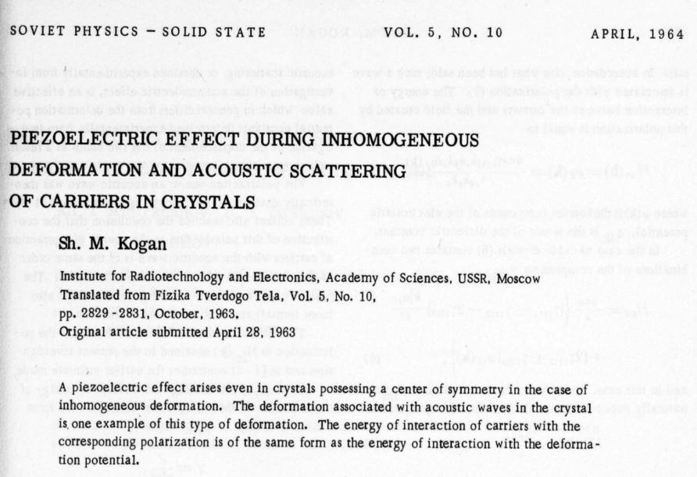
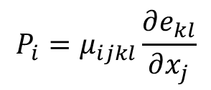
Yes -- Flexoelectric Effect
$$P_{i}=μ_{ijkl}\frac{∂e_{kl}}{∂x_{j}}$$
Coupling between strain gradient and polarization:
Discovered in the 1960s, but largely unnoticed for decades in crystalline solids (very important in biology, e.g. cell membranes)
S. M. Kogan, Sov. Phys. Solid State 1964, 5, 2069–2070
E. V. Bursian, O. I. Zaikovskii, Sov. Phys. Solid State 1968, 10, 1121–1124

Slide 13
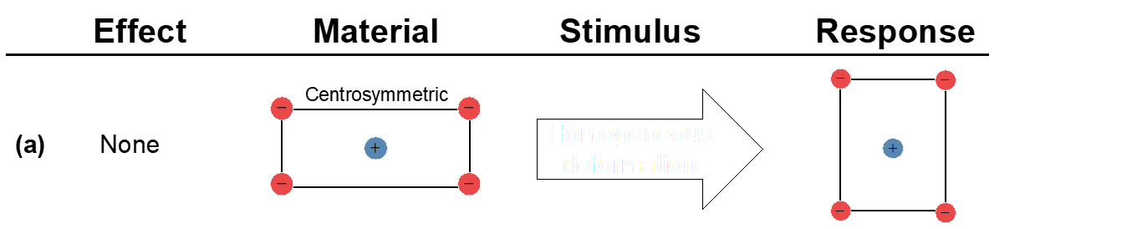
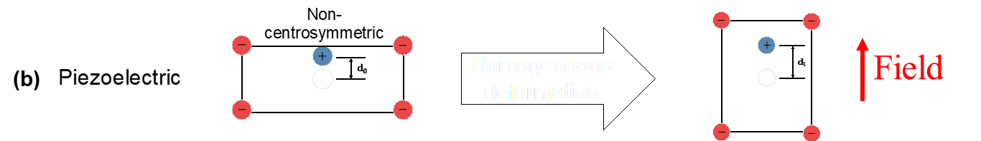
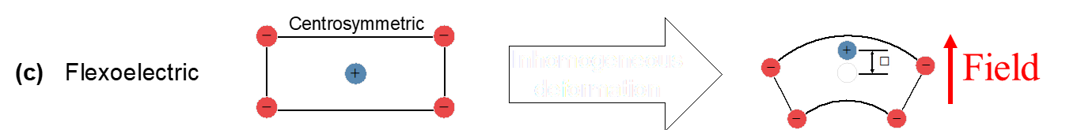
Why?
d

Slide 14
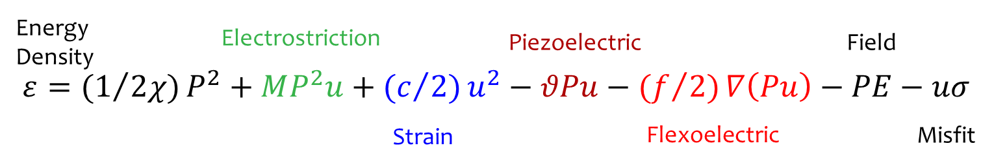
All Electromechanical Terms
Landau Expansion:
Gradient term adds an intrinsic 1/R dependence
Automatic “nano” dependence
Occurs in all insulators/semiconductors

Slide 15
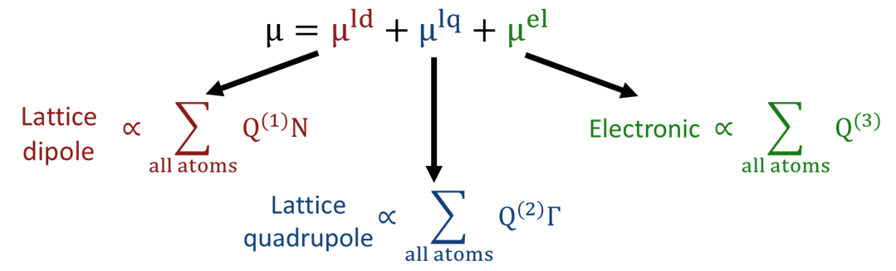
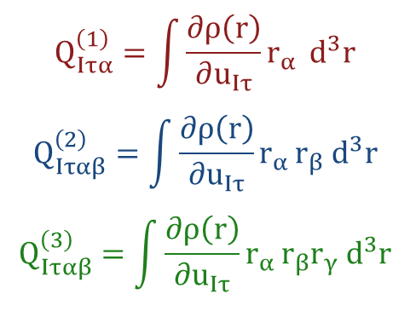
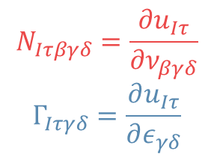
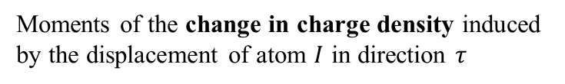
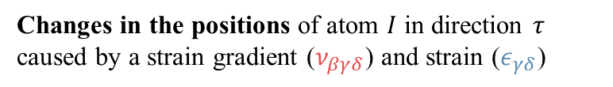
Established QM derivation
Moments of the change in charge density induced by the displacement of atom $I$ in direction $τ$
Changes in the positions of atom $I$ in direction $τ$ caused by a strain gradient ($ν_{βγδ}$) and strain ($ε_{γδ}$)
Hong, J.W. and D. Vanderbilt, Physical Review B 2011. 84(18) 180101 https://doi.org/10.1103/PhysRevB.84.180101.
Zubko, P., G. Catalan, and A.K. Tagantsev, Annual Review of Materials Research, Vol 43, D.R. Clarke, Editor. 2013,. 387-421. https://doi.org/10.1146/annurev-matsci-071312-121634
Stengel, M.,. Physical Review B, 2016. 93(24) 245107 https://doi.org/10.1103/PhysRevB.93.245107.

Slide 16

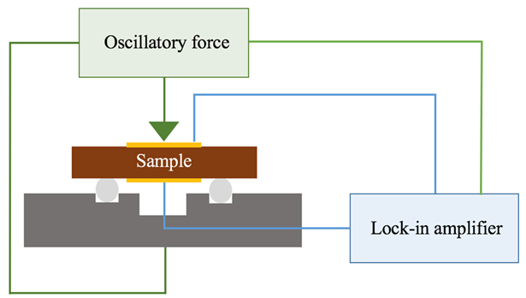
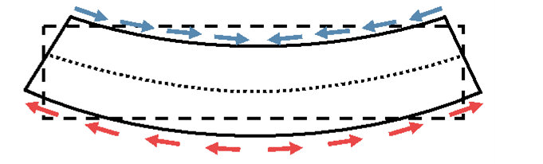
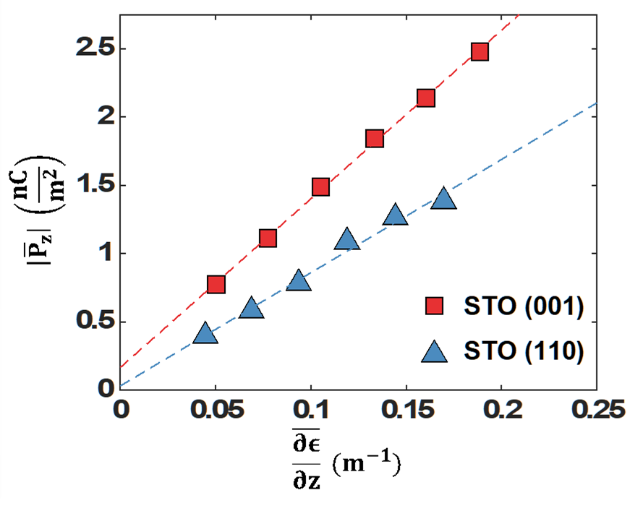
Flexocoupling voltage measurements
Classic 3-point bending experiment with conducting electrode and lock-in amplifier
e

Slide 17
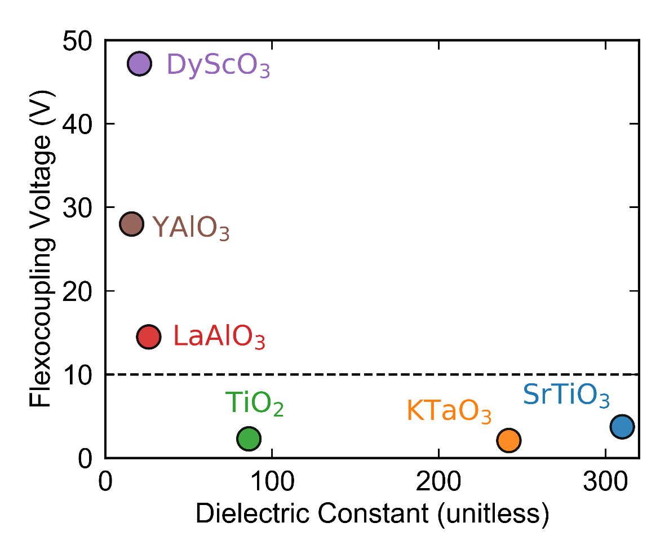
Flexocoupling voltages
Experimental data. Reasons for differences not yet clear
Mizzi, C. A.; Guo, B.; Marks, L. D. Physical Review Materials 2022, 6, (5), 055005.

Slide 18
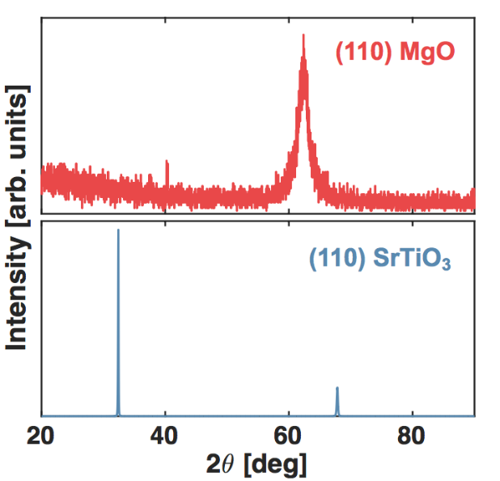
Measured flexocoupling voltage
Material | Space Group | Bending Direction | Flexocoupling Voltage (V)
MgO | $$\text{Fm}\overline{\text{3}}\text{m}$$ | [100] | 24±3
MgO | $$\text{Fm}\overline{\text{3}}\text{m}$$ | [111] | 62±7
SrTiO₃ | $$\text{Pm}\overline{\text{3}}\text{m}$$ | [100] | 4.7±0.2
SrTiO₃ | $$\text{Pm}\overline{\text{3}}\text{m}$$ | [110] | 3.1±0.5
KTaO₃ | $$\text{Pm}\overline{\text{3}}\text{m}$$ | [100] | 2.3±0.5
TiO₂ | P4₂/mnm | [100] | 3.1±1.0
DyScO₃ | Pbnm | [110] | 42±2
YAlO₃ | Pbnm | [101] | 26±1
LaAlO₃ | $$\text{R}\overline{\text{3}}\text{c}$$ | [100] | 15±1
Note: MgO anomalous
Mizzi, C. A.; Guo, B.; Marks, L. D. Physical Review Materials 2022, 6, (5), 055005.

Slide 19
Typical polymer coefficients
Reference | Material | |µ| (nC/m) | |f| (V)
1 | PVDF | 13 | 160
1 | Oriented PET | 9.9 | 289
1 | Polyethylene | 5.8 | 273
1 | Epoxy | 2.9 | 84
2 | P(VDF-TrFE) (70/30) | 3 | 31
2 | P(VDF-TrFE) (55/45) | 4.2 | 43
2 | PVDF | 3.5 | 10
3 | Jeffamine | ~ 0.1 | ~ 4.5
3 | Keltan | ~ 0.1 | ~ 4.5
3 | Natural Rubber | ~ 0.5 | ~ 20
Assume flexoelectric coefficient of 1 nC/m
1 B. Chu and D. R. Salem, Appl. Phys. Lett. 101, 103905 (2012).
2 J. Liu et al, Appl. Phys. Lett. 112, 232901 (2018).
3. M. Marvan and A. Havranek, Prog. Colloid Polym. Sci. 78, 33 (1988).

Slide 20
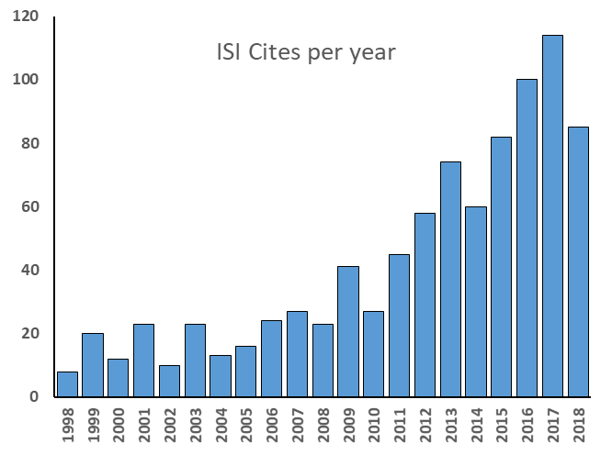
Growing Interest
Flexoelectric actuators using SrTiO₃ have comparable quality factors to best piezoelectric devices
U. K. Bhaskar, N. Banerjee, A. Abdollahi, Z. Wang, D. G. Schlom, G. Rijnders, G. Catalan, Nat. Nanotechnol. 2016, 11, 263–266.
Flexoelectric response in bone may stimulate healing
F. Vasquez-Sancho, A. Abdollahi, D. Damjanovic, G. Catalan, Adv. Mater. 2018, 30, 1705316

Slide 21


Back to Triboelectricity
Why does charge transfer occur?
The free energy change for charge separation must be negative
  Asperity contact/shear/bending leads to strain gradients
  Strain gradients lead to polarization (electric fields)
  Free energy of charge transfer negative
  Independent of whether this involves electrons, ions or charged molecular fragments.
Are the fields large enough to matter?

Slide 22
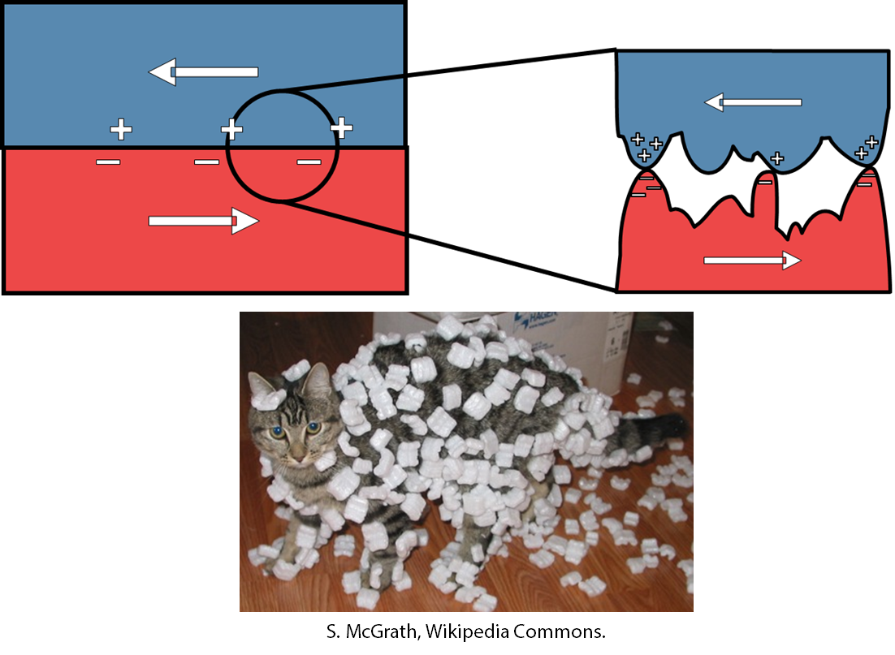
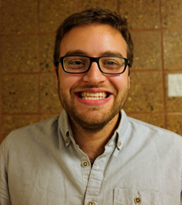
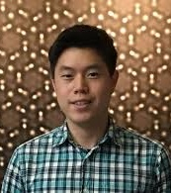
Tribology + Flexoelectricity?
C. A. Mizzi, A. Y. W. Lin & L. D. Marks Phys Rev Lett. 2019;123(11):116103.

Slide 23
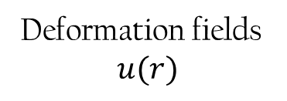
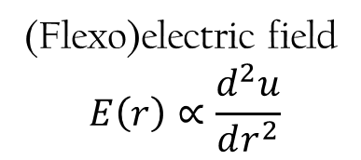
Spherical Bicycle Approximation
Indentation
Deformation fields
$$u(r)$$
Pre-contact
Pull-off
(Flexo)electric field
$$E\left(r\right)∝\frac{d^{2}u}{dr^{2}}$$

Slide 24
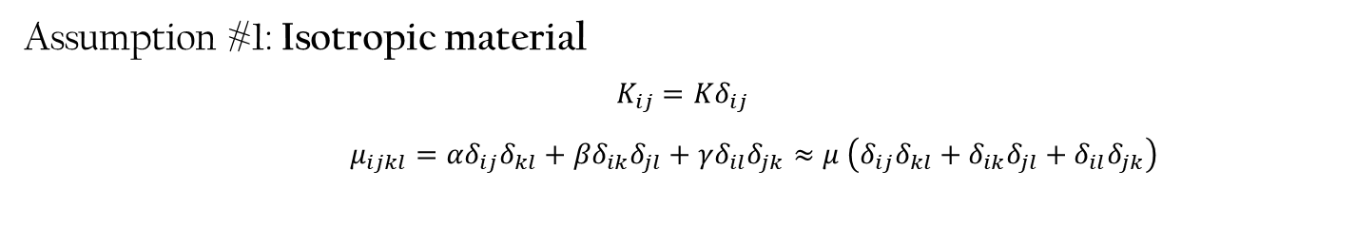
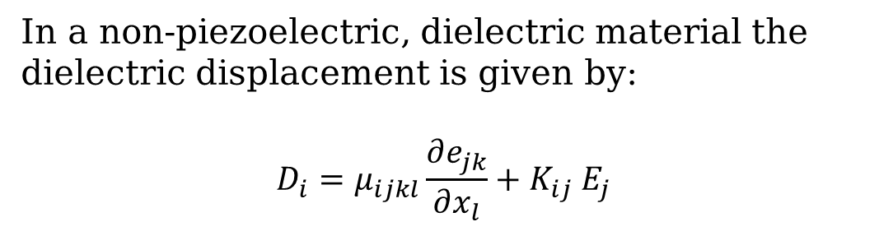
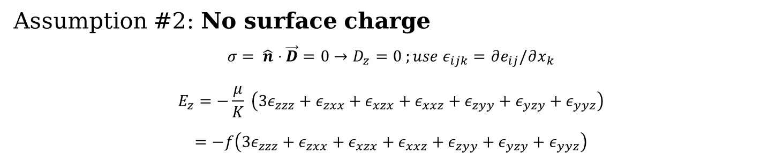
Flexoelectric half-space
In a non-piezoelectric, dielectric material the dielectric displacement is given by:
$$D_{i}=μ_{ijkl}\frac{∂e_{jk}}{∂x_{l}}+K_{ij} E_{j}$$
x
z
Assumption #1: Isotropic material
$$K_{ij}=Kδ_{ij}$$
$μ_{ijkl}=αδ_{ij}δ_{kl}+βδ_{ik}δ_{jl}+γδ_{il}δ_{jk}≈μ \left(δ_{ij}δ_{kl}+δ_{ik}δ_{jl}+δ_{il}δ_{jk}\right)$
Assumption #2: No surface charge
$$σ= \hat{n}⋅\vec{D}=0→D_{z}=0 ;use ε_{ijk}=∂e_{ij}/∂x_{k}$$
$$E_{z}=−\frac{μ}{K} \left(3ε_{zzz}+ε_{zxx}+ε_{xzx}+ε_{xxz}+ε_{zyy}+ε_{yzy}+ε_{yyz}\right)$$
$$=−f\left(3ε_{zzz}+ε_{zxx}+ε_{xzx}+ε_{xxz}+ε_{zyy}+ε_{yzy}+ε_{yyz}\right)$$

Slide 25
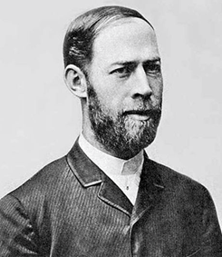
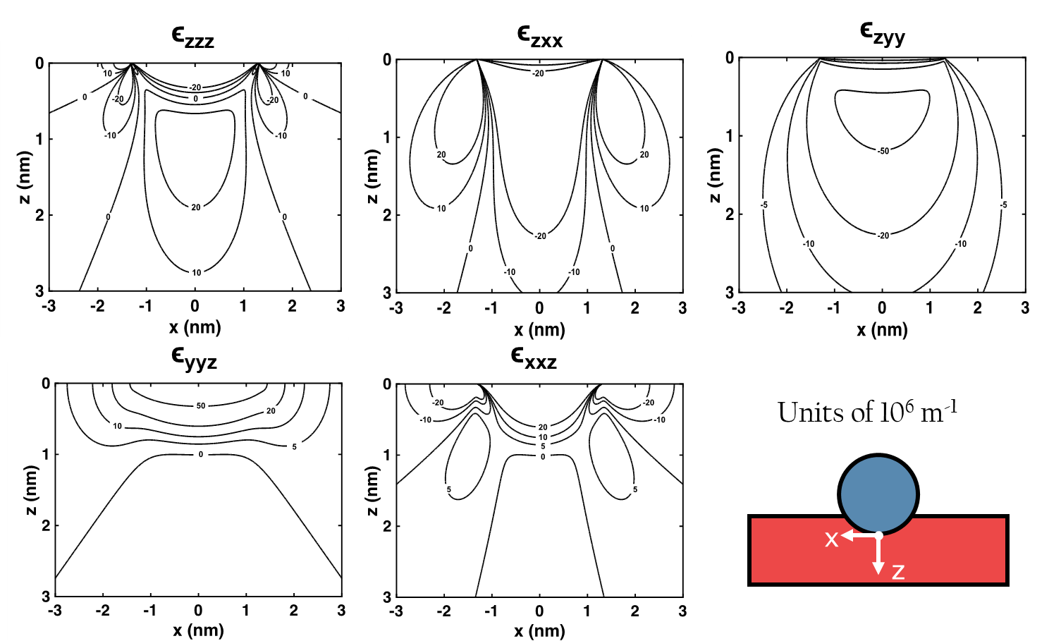
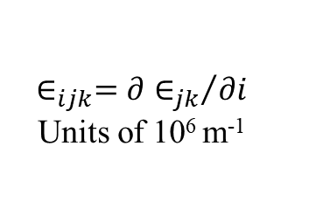
Strain gradient terms
$$∈_{ijk}={∂∈_{jk}}/{∂i}$$
Units of 106 m-1

Slide 26
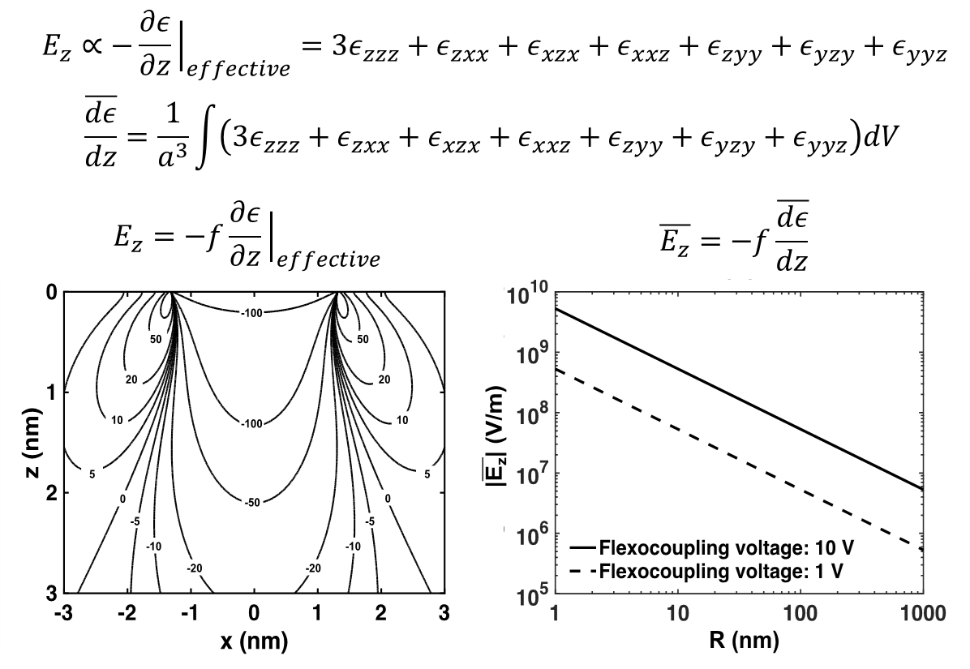
Indentation Electric Fields
0.1-1 V/nm
Tip Radius, (nm)

Slide 27
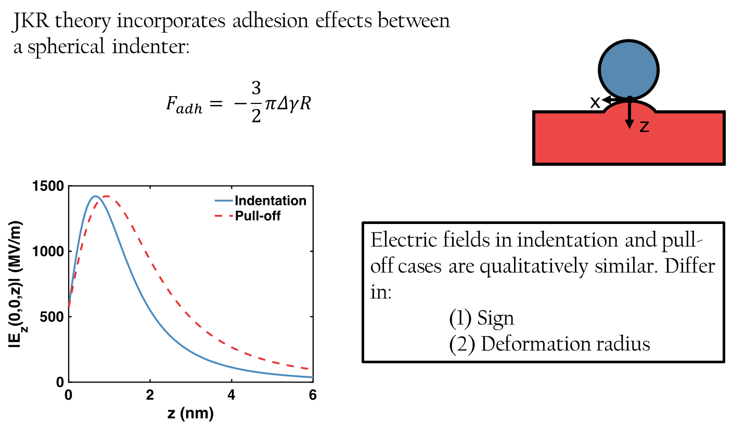
Pulloff case

Slide 28
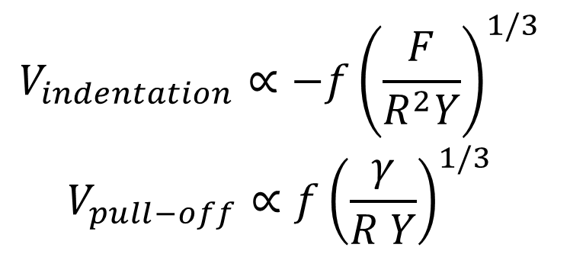
Spherical Bicycle Model
$$V_{indentation}∝−{f\left(\frac{F}{R^{2}Y}\right)}^{1/3}$$
$$V_{pull−off}∝{f\left(\frac{γ}{R Y}\right)}^{1/3}$$
1-10 Volts with very conservative numbers for f (100V is not unreasonable)
Does the bicycle work?

Slide 29
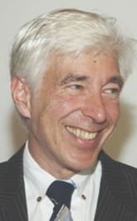
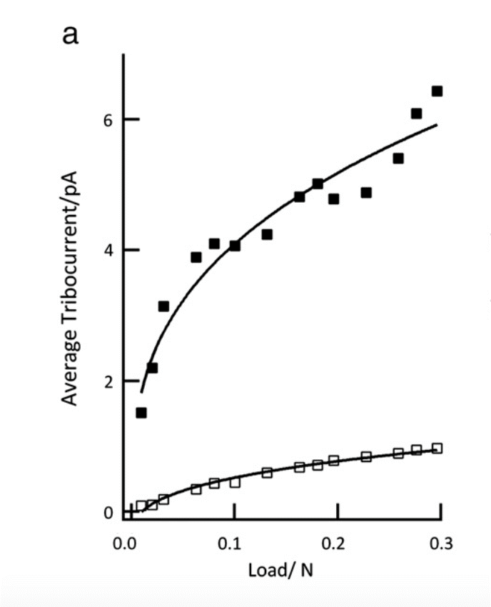
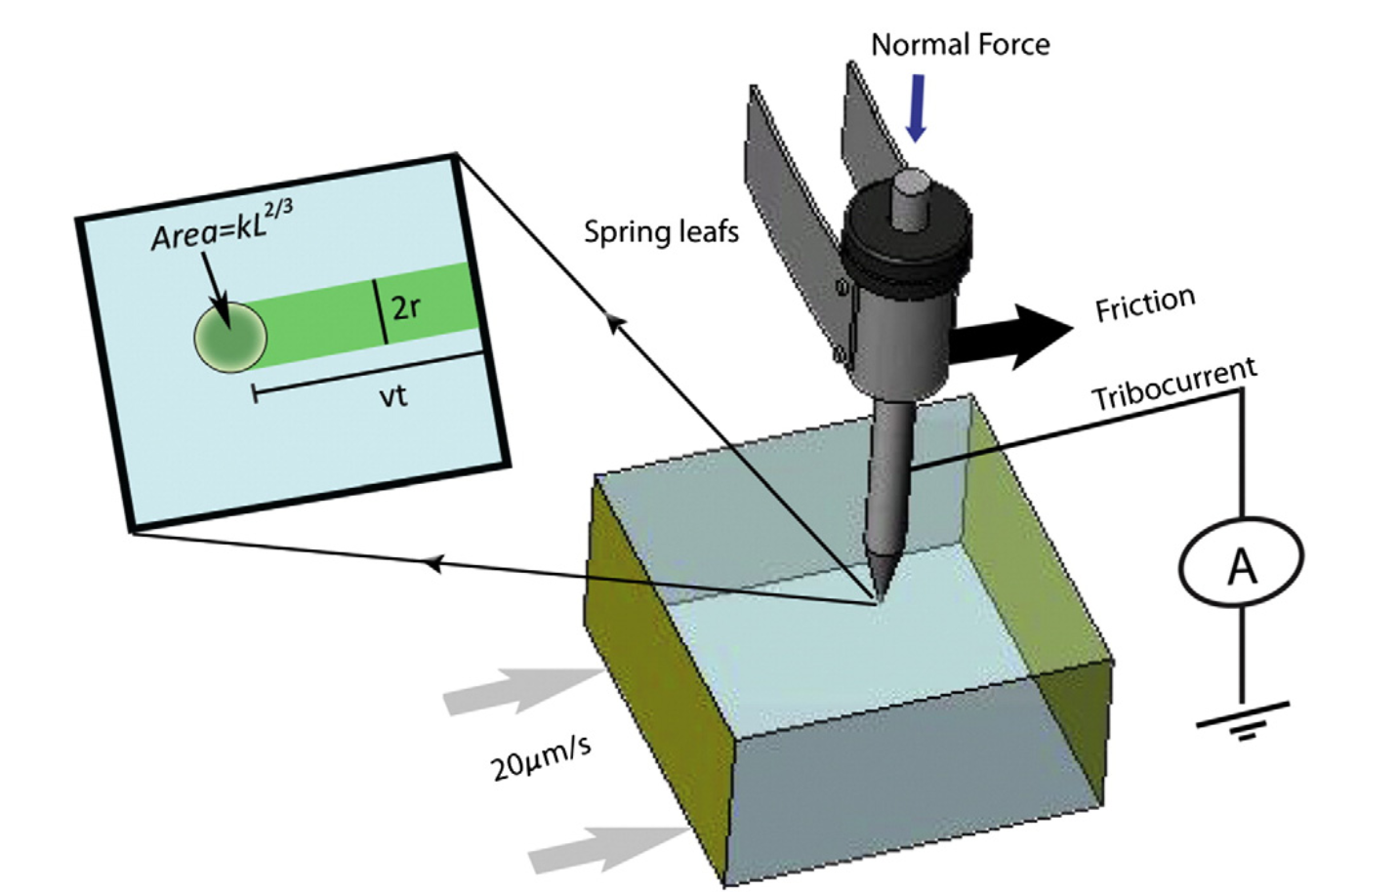
Tribocurrent scales as F^{1/3}
S. Putterman
J.V. Escobar, A. Chakravarty, S.J. Putterman. Diamond Relat. Mater. 36 (2013), 8-15.

Slide 30

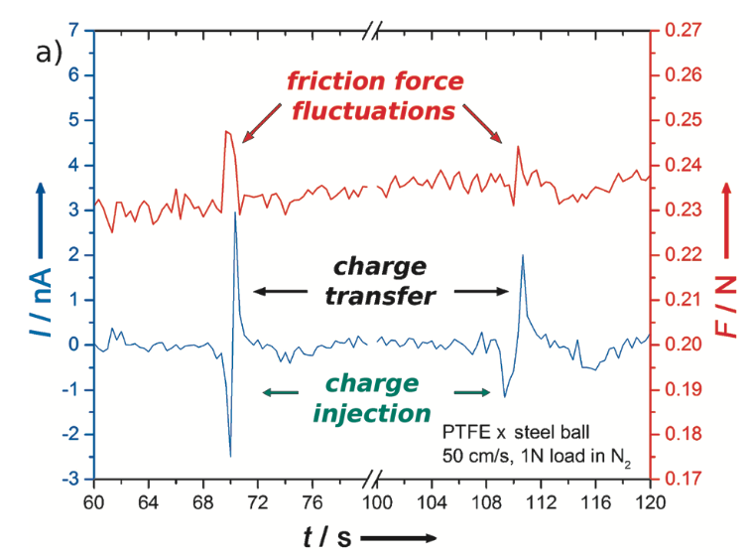
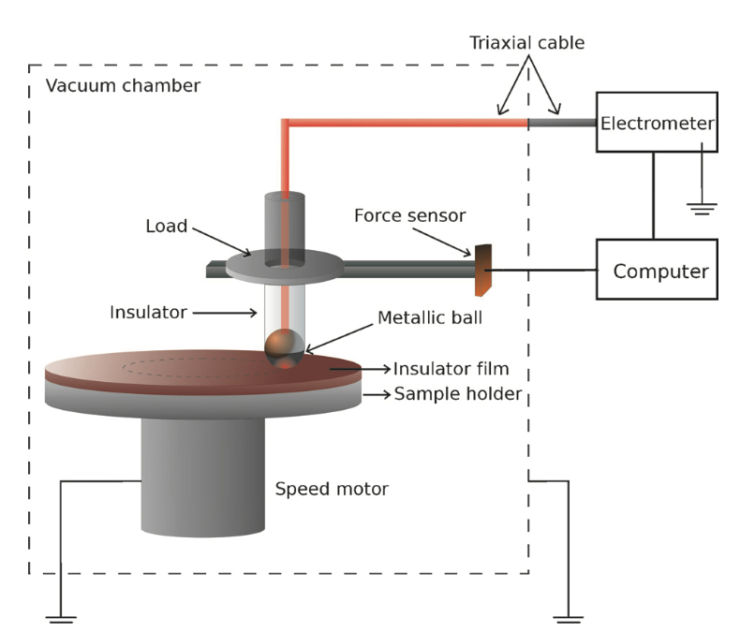
Bipolar tribocharge transfer
A. Erdimir
T.A.L. Burgo, A. Erdemir. Angew. Chem. Int. Ed. 53 (2014), 12101-12105.

Slide 31

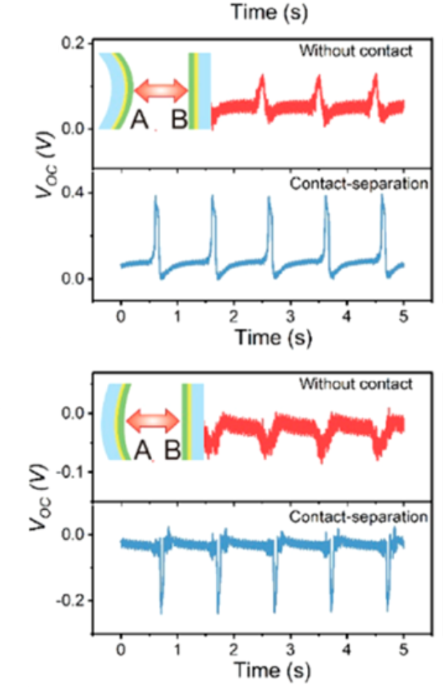
Curvature dependence
Z. L. Wang
Sign of charge/potential depends upon the curvature when using two pieces of the same material.
C. Xu et al., ACS Nano. 2019, 13, 2034-41.

Slide 32
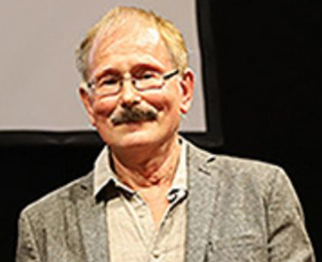
Charge inhomogeneity
B. Persson
Charging is inhomogeneous
Local curvature differences (indentor versus indentee)
H.T. Baytekin, et al. Science 333 (2011), 308-312.
Persson, B. N. J. . EPL (Europhysics Letters) 2020, 129, (1), 10006.

Slide 33

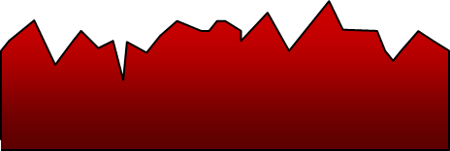
Strain Dependence
D. Lacks
Two unstrained samples
One strained sample
Linear strain with a rough surface leads to local strain gradients
A.E. Wang et al., Physical Review Materials 1(3) (2017) 035605.

Slide 34




X-ray Emission from sellotape
S. Putterman
$$V_{pull−off}∝{f\left(\frac{γ}{R Y}\right)}^{1/3}$$
X-ray pulses during pulloff
What is f for sellotape?
Bending contribution?
C.G. Camara, et al. Nature 455 (2008), 1089-1092.

Slide 35
Some of the issues
Charge transfer inhomogeneous
Curvature matters (first shown by Jameson in 1910, a school teacher from Glasgow, DOI: 10.1038/083189a0)
Tribocurrent scales as F^{1/3}
Bipolar tribocharge (+/- during contact/pulloff)
Depends upon pre-strain of sample
Charge transfer can change sign with pressure
Occurs between different sized particles of the same material
Workfunction, dielectric constant, trap states matter

Slide 36
Next Steps in Analysis
Charge transfer inhomogeneous
Curvature matters (first shown in 1908 by a school teacher from Glasgow)
Tribocurrent scales as F^{1/3}
Bipolar tribocharge (+/- during contact/pulloff)
Depends upon pre-strain of sample
Charge transfer can change sign with pressure
Occurs between different sized particles of the same material
Workfunction, dielectric constant, trap states matter

Slide 37

A lot now skipped…
Calculate the band bending
$$\begin{aligned}Δ{\overline{V}}^{FxE}=\frac{1}{2 ε_{0}\left(1+χ\right)}\int{\frac{{\vec{P}}_{FxE}\left(\vec{r}′\right)⋅\left(\vec{r}−{\vec{r}}^{′}\right)}{{\left|\vec{r}−\vec{r}′\right|}^{3}}}ρ dr\end{aligned}$$
Include
Flexoelectric Strain gradient terms
Mean-inner potential
FEM (beyond Hertz solutions)
Mizzi, C.A. and L.D. Marks, When Flexoelectricity Drives Triboelectricity. Nano Lett, 2022, 22(10), 3939, https://doi.org/10.1021/acs.nanolett.2c00240

Slide 38

Sphere on flat, same material
Band-Bending is asymmetric (Beyond Hertz)

Slide 39




Charging with the same material
H. Jaeger
Fused zirconium dioxide silicate particles of different sizes
S.R. Waitukaitis, et al. Phys. Rev. Lett. 112 (2014), 218001.

Slide 40

Sign change with Pressure
Zener Tunnelling
Sphere-on-flat contact band diagrams for a Si sphere (orange) on a SrTiO₃ flat (blue). (a)-(c) show the conduction and valence band edges as a function of depth (normalized by the indenter radius R) at different contact pressures for a fixed radial distance of 0.6a from the contact point

Slide 41

Reversal of charge transfer
Y. Li
Kelvin probe images obtained using different tips on SiOx substrates. a) CSG11 tip and b) NSG11 tip. The corresponding loaded forces are shown under each charge pattern. c) The loaded force dependence of surface potential when using NSG11 tips scanning over the SiOx surface.
Sun, H.; Chu, H.; Wang, J.; Ding, L.; Li, Y., Applied Physics Letters 2010, 96, (8), 083112.

Slide 42
Quantitative Confirmation?
Charge transfer inhomogeneous
Curvature matters (first shown by Jameson in 1910, a school teacher from Glasgow, DOI: 10.1038/083189a0)
Tribocurrent scales as F^{1/3}
Bipolar tribocharge (+/- during contact/pulloff)
Depends upon pre-strain of sample
Charge transfer can change sign with pressure
Occurs between different sized particles of the same material
Workfunction, dielectric constant, trap states matter

Slide 43



AFM experiments
Olson, K.P., C.A. Mizzi, and L.D. Marks, Band Bending and Ratcheting Explain Triboelectricity in a Flexoelectric Contact Diode. Nano Lett, 2022, 22(10), 3914 https://doi.org/10.1021/acs.nanolett.2c00107.

Slide 44

Flexoelectric Schottky Diode
Forward Current: Thermionic Emission
Reverse Current:
Thermally Assisted Tunnelling
Flexoelectric Band-Bending changes barrier

Slide 45




CAFM Data
Effective barrier
Forward
$$I_{For}\left(V_{a},F\right)∝\exp\left(−\frac{qφ^{eff}}{k_{B}T}\right)\exp\left(−\frac{qV_{a}}{nk_{B}T}\right)$$
Fit for $n$ and $φ^{eff}$
Reverse
Threshold bias $V_{t}$ where $I_{Rev}=30 pA$

Slide 46

Potential Terms
Mean Inner Potential
Flexoelectric Potential
Depletion Potential

Slide 47



Calculate current
Saddle Point
Thermionic
Radial section of band-bending for different forces

Slide 48


Comparison with experiment
Breakdown
Forward Reverse

Slide 49

Charge Ratchetting

Slide 50
Much still to be done
Beyond Hertzian & JKR – including shear terms
Bowden-Tabor ploughing contributions
Transfer layers, fracture contributions
Field induced chemical reactions (tribochemistry)
Plastic flexoelectric contributions (polar defects)
Gradient elasticity
Dynamics of charge transfer
Experiments & theory of above
…..
There is plenty of room at the bottom in triboelectricity

Slide 51


Summary I
Tribology
+
=
Triboelectricity

Slide 52
Summary II
Consistent with diverse old and new experimental observations, including
  Reversal of transfer with force
  Charging of identical materials
  Curvature and roughness dependence
  Temperature dependence
  Work function and dielectric constant dependence
  …
Contains no empirical, adjustable parameters
Consistent with other, known physics (band-bending etc)
All relevant terms can be measured/calculated (not so easy)

Slide 53




Questions?
Research is to see what everybody else has seen, and to think what nobody else has thought
Albert Szent-Györgi
Tribology + Flexoelectricity = Triboelectricity
Electric Collaborators Welcome: Laurence.Marks@gmail.com

