Slide 1






Tribology in Full View, From Atomic Transfer Layers to Hip Replacements
Laurie Marks
Department of Materials Science and Engineering, Northwestern University, USA

Slide 2

Energy
“…the greatest source of new energy is the energy we waste today.”
Samuel Bodman, U.S. Secretary of Energy, 2008
Image Source:
John Stringer
Electric Power Research Institute

Slide 3
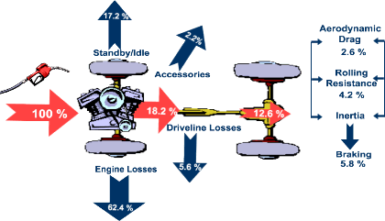
Friction
http://www.fueleconomy.gov
Friction ~5% of GDP
40-50% of power in a new auto engine

Slide 4
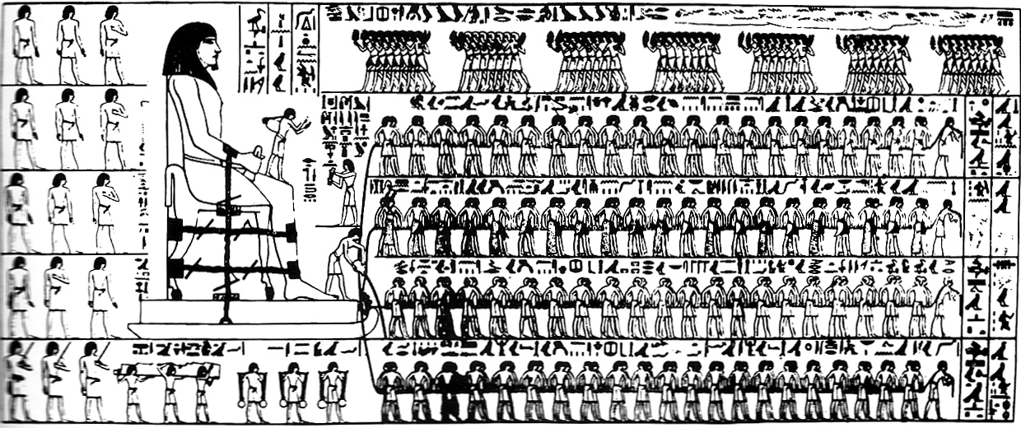
Tribology: The study of friction. From Greek “tribein” to rub
Empirically, we do better in reducing friction than the Egyptians, but we certainly do not understand everything.
D. Dowson. History of tribology. Professional Engineering Publishing, London, 2nd edition, 1998

Slide 5
Friction is from plastic/elastic sliding of asperities
M. Falvo, Physics 267, http://www.physics.unc.edu/~falvo/phys267/index.html

Slide 6
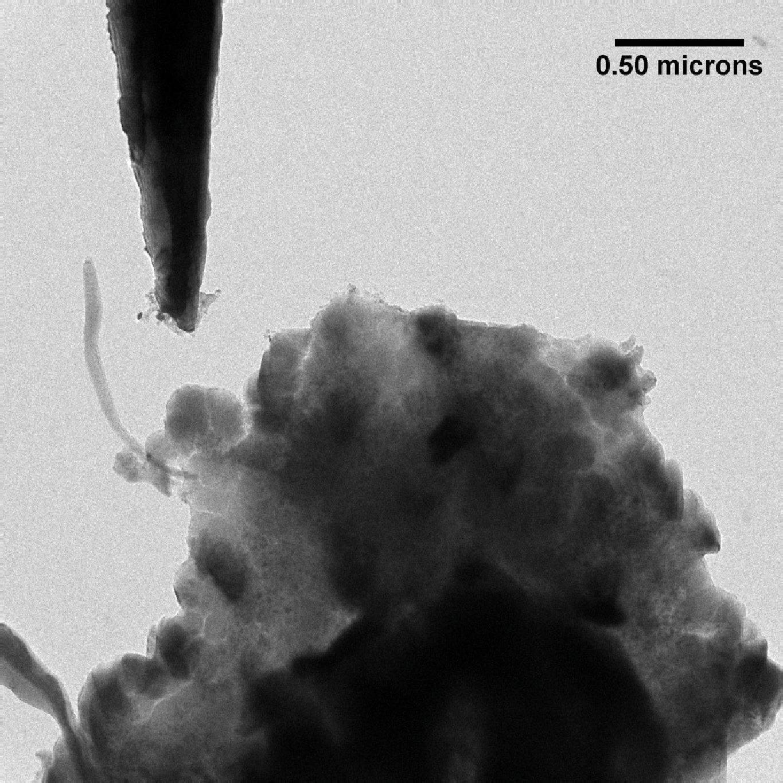
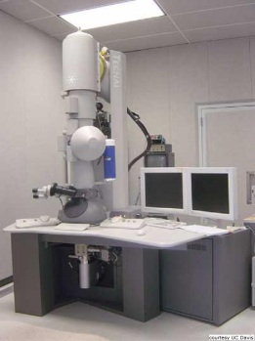
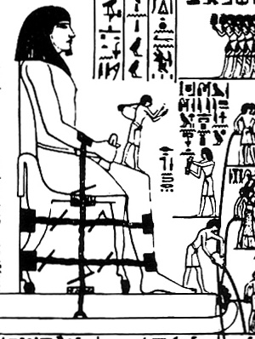
Experimental Approach

Slide 7

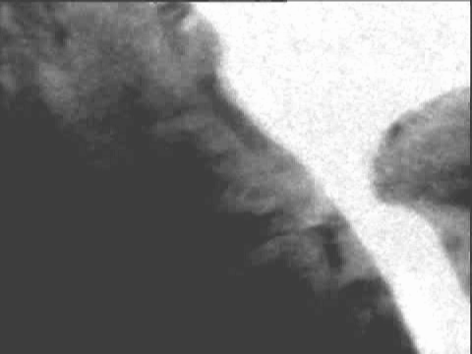
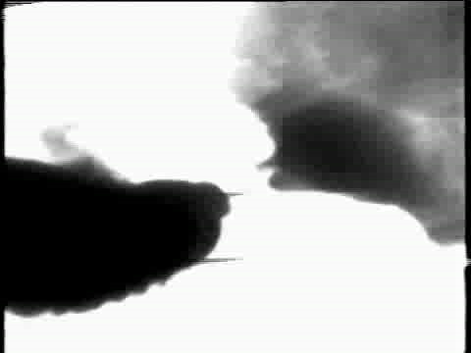
Simple Examples
50 nm
500 nm
Sliding of a W tip on Au: Ploughing
Liquid-like1 deformation of Au (surface diffusion dominated)
1D.W.Pashley, M.H. Jacobs, M.J. Stowell, T.J. Law, Phil Mag 10, 127 (1964); A. Merkle & L.D. Marks, Wear 265, 1864 (2008)

Slide 8

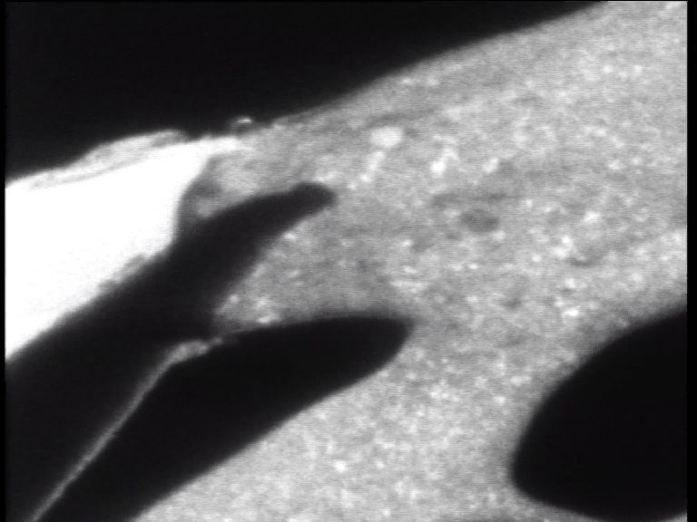
Tribological Recrystallization
Y. Liao et al, Phil Mag Letts 90 (2010) 219
Vacuum
150nm
Film
Tip

Slide 9


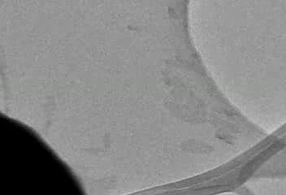
Sliding on NFC in wet N₂
A. M'ndange-Pfupfu et al, Tribology Letters, 49 (2013) 351.
Localized tribochemical etching by water C+H₂O → CO + H₂ (water-gas shift)

Slide 10
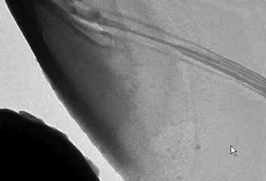
Sliding on NFC in H₂
A. M'ndange-Pfupfu et al, Tribology Letters, 49 (2013) 351.
Minimal wear, hydrogen passivation
Consistent with “classic” tribochemical opinion

Slide 11
Arthritis and Hip Replacement
8.5 M (19%)

Slide 12
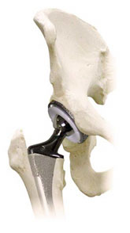
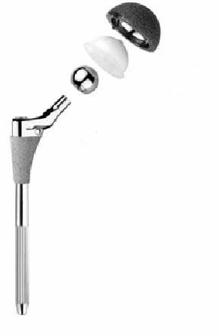
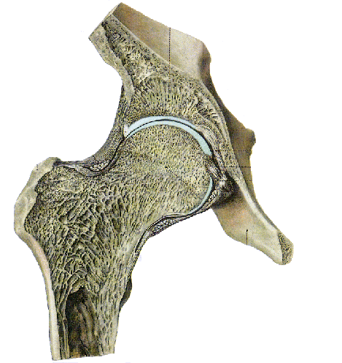
Hip Joint
acetabulum cup
pelvis
cartilage
acetabulum
femoral head
femur
femoral stem
Rauber/Kopsch: Anatomie des Menschen (1998)
www.zimmer.com

Slide 13
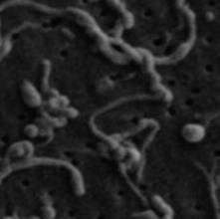
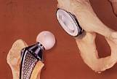
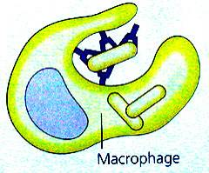
Wear-Mediated Osteolysis
osteolysis
disrupted balance between osteoclasts/PMNs and osteoblasts:
osteoclasts ↑, osteoblasts ↓
wear particles
osteoclast/ polymorphonuclear giant cell
opsonization
phagocytosis
osteoblast
http://academic.brooklyn.cuny.edu/biology/bio4fv/page/aviruses/cellular-immune.html
Archibeck, MJ; Jacobs, JJ; Roebuck, KA; Glant, TT. Journal of Bone & Joint Surg, 2000

Slide 14
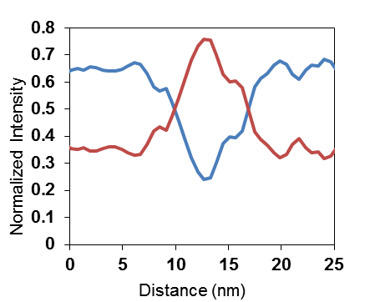
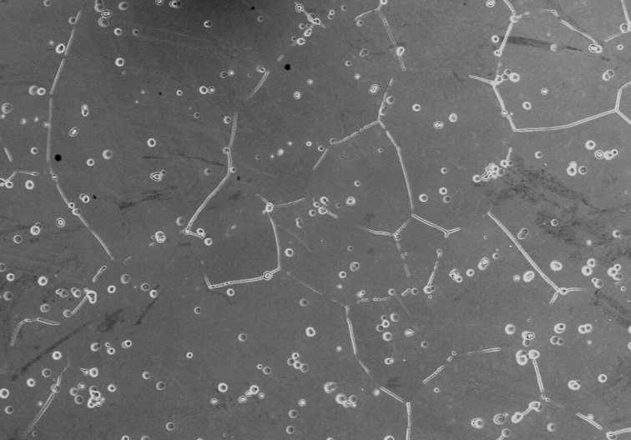
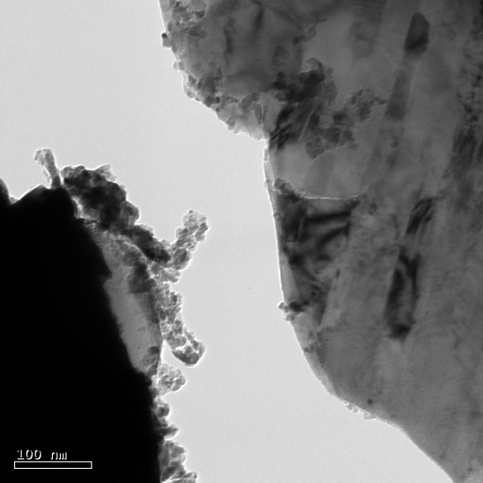
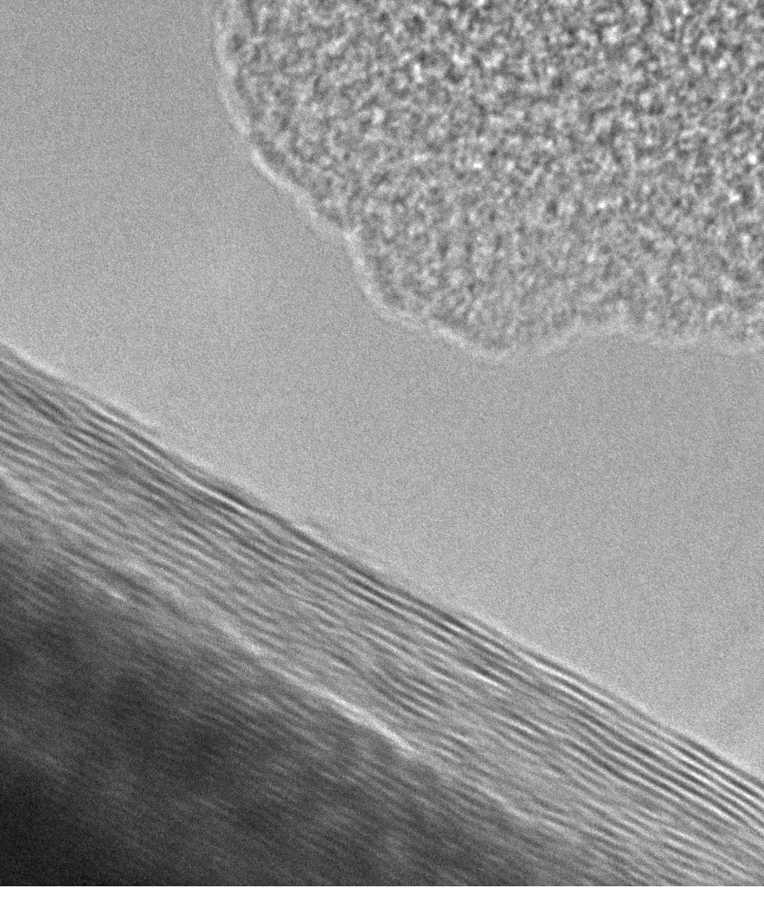
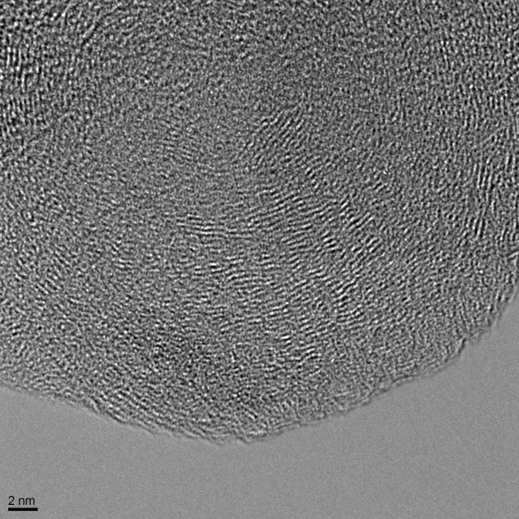
Some Issues
Grain Boundary Corrosion
P. Panigrahi et al; Hoffman et al
In-situ Wear
Liao & Marks, submitted
Graphitic Tribolayer
Liao et al., Science 334, 1687 (2011)
Transfer Layer Castillo et al, submitted

Slide 15

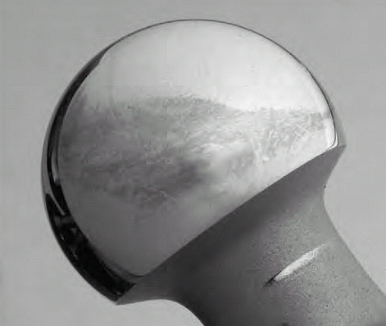
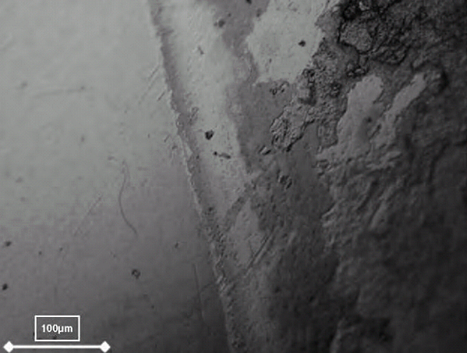
Tribological Layers on MoM
Carbonaceous layers formed by tribochemical reactions were observed on most of the MoM retrievals (80% of 42 retrievals, Wimmer et al., Wear, 255, 1007, 2003)

Slide 16
Key Observation
This tribolayer correlates with lower wear, corrosion etc
Implication: this is the triboactive region where sliding takes place
The layer has been assumed to be denatured protein (due to referee) – without proof

Slide 17
Experimental Method
Follow the Science, not the electron
Biological TEM
  Low-dose (~50 e/Å² or less) EELS
  Control samples (BCS/Albumin)
  Measure effect of sample preparation & electron dose on controls
Cross-check with Raman
Controls, controls, controls
Not just one measurement

Slide 18
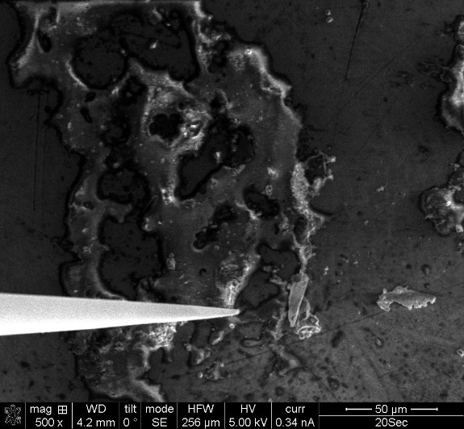
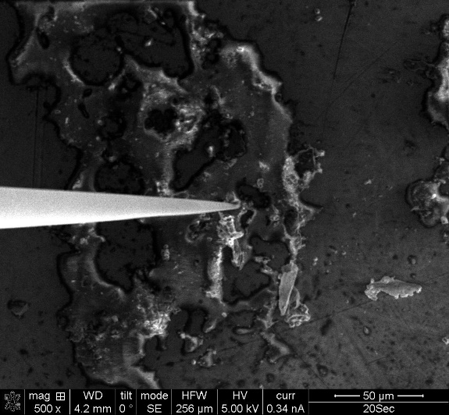
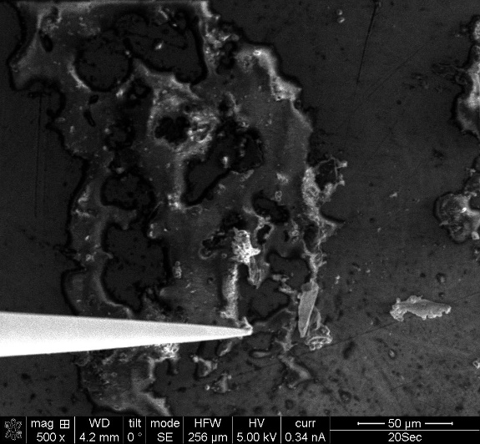
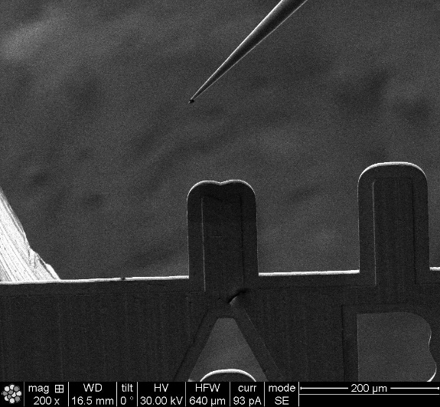
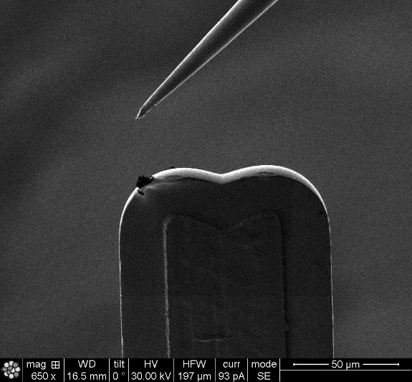
Tribofilm collection
Tribofilm on #17 retrieval was collected using a nanoprobe in FIB.
Care was taken to minimize the exposure to ion/electron beam.

Slide 19
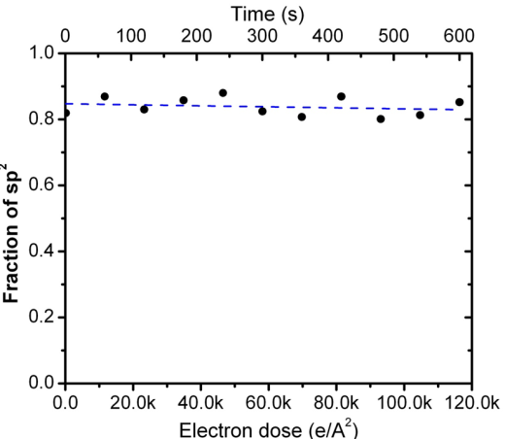
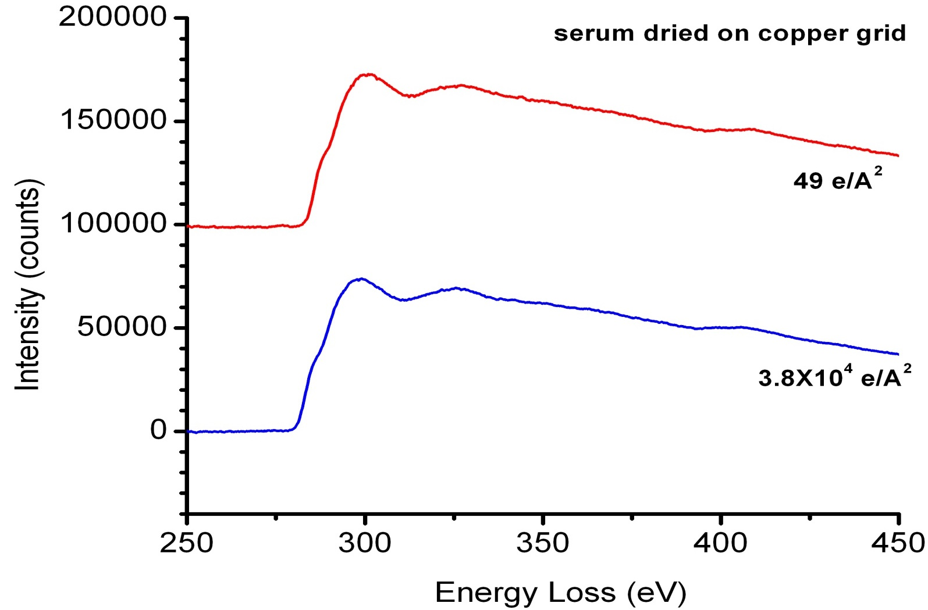
Minimize radiation damage
Dried Bovine Calf Serum
EELS spectrum of the serum dried on copper grid

Slide 20
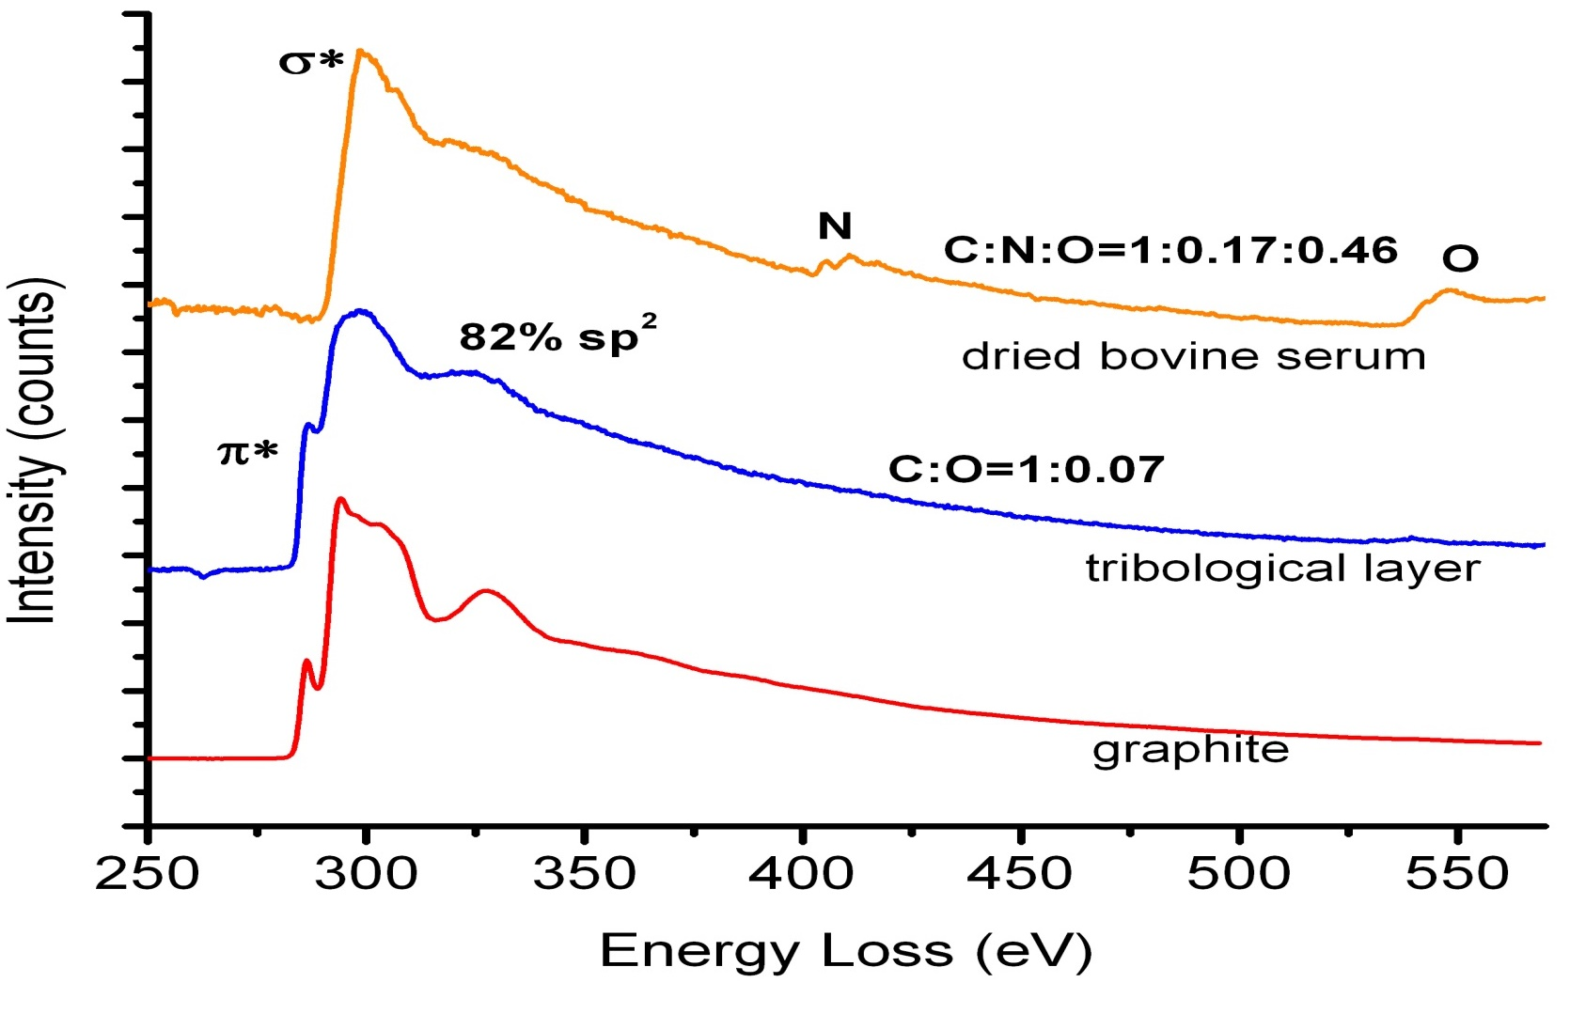
Graphitic carbon (~82% sp²)
58e/Å2
Sample from pole of retrieval, removed due to loosening of the acetabular component (not excessive wear)

Slide 21
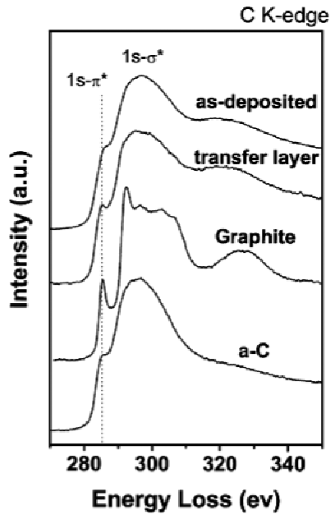
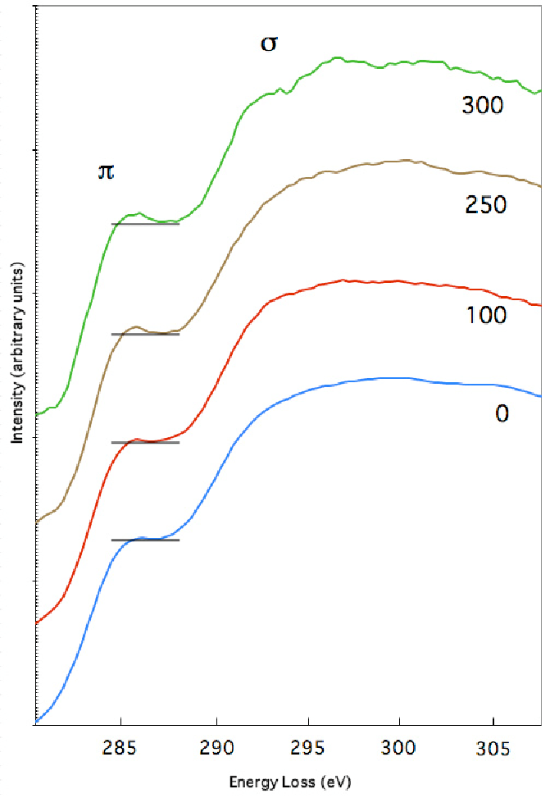
Graphitization of carbons due to sliding
In-situ
Merkle, et al. Carbon 48, 587 (2010)
M'Ndange-Pfupfu, et al Diam. Relat. Mat. 20, 1143 (2011)
J.C. Sanchez-Lopez et al., Surf. Coat. Tech. 163, 444 (2003)

Slide 22

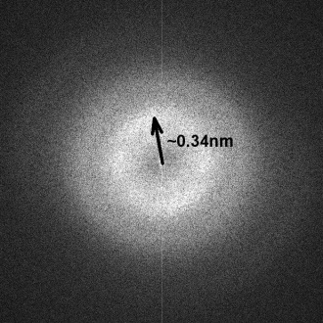
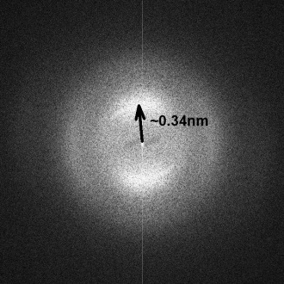
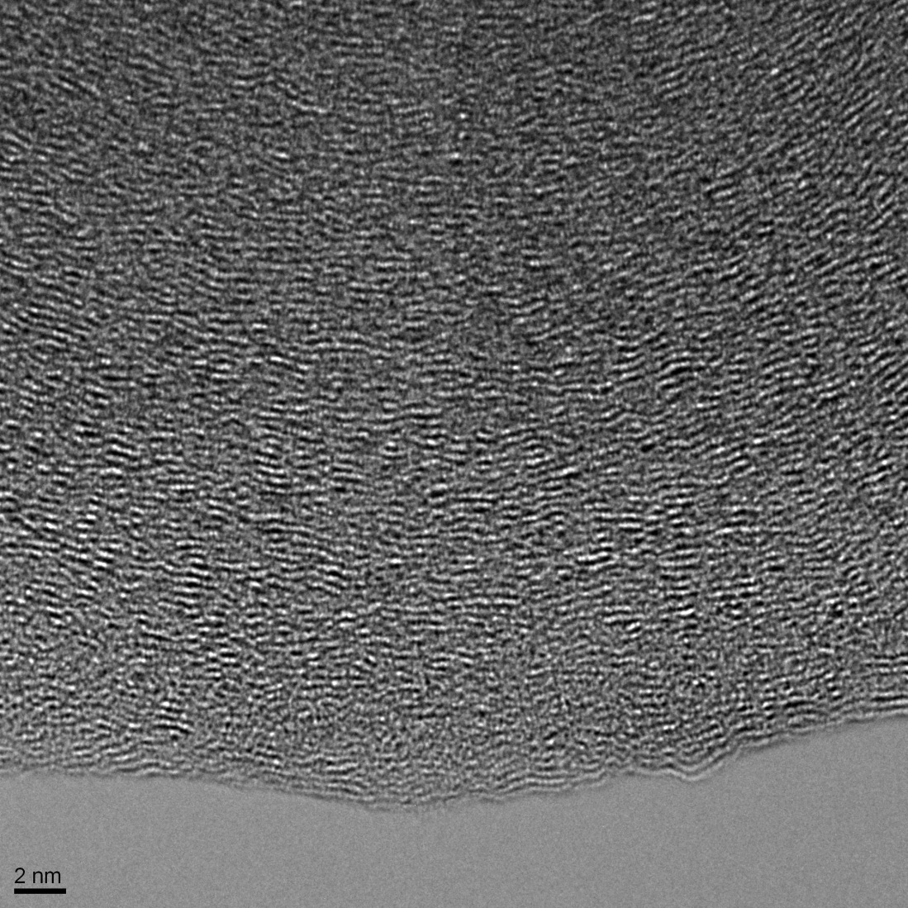
HREM: Graphitic carbon
“Classic” basal-plane fringes from graphitic material

Slide 23
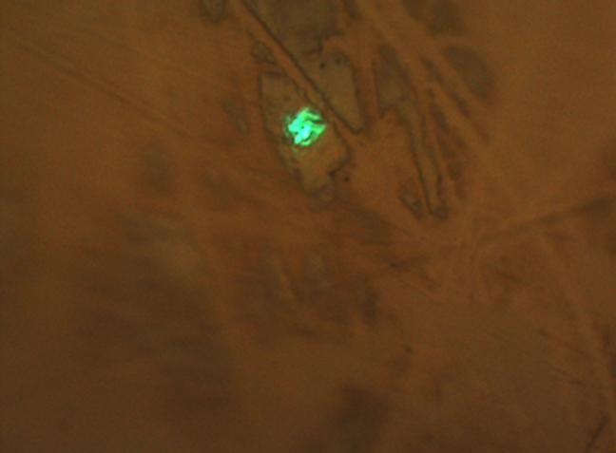
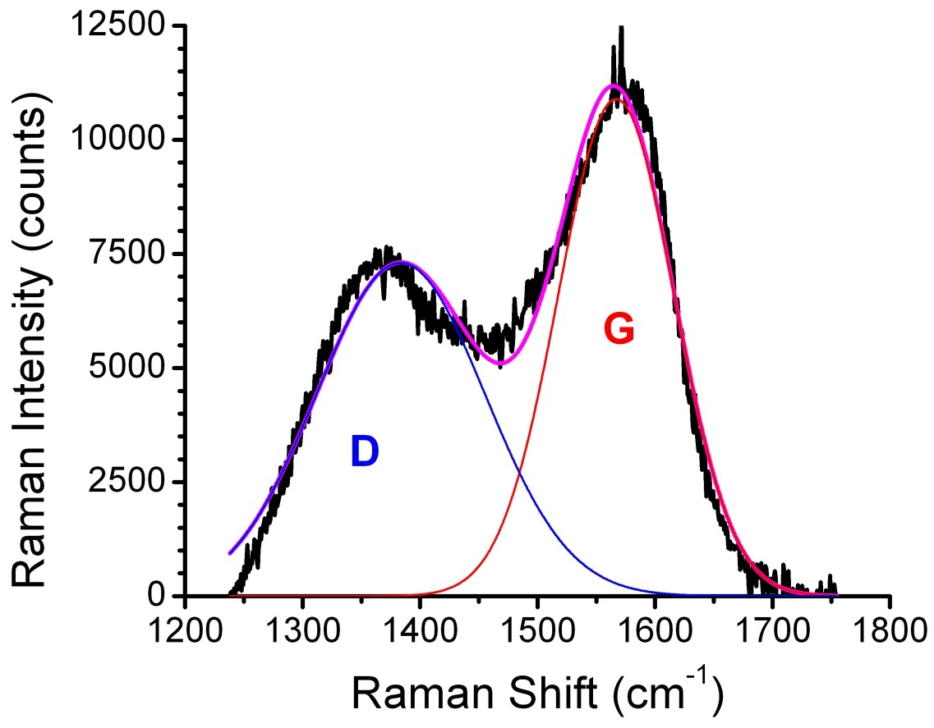
Raman Results
Similar results
Different Locations (pole/side of head/cup)
Different Retrievals
Simulator Tests
Blood is different
D band (disordered, sp3) at 1388 cm-1
G band (graphitic, sp2) at 1567 cm-1
(Stage 2 graphitic carbon)

Slide 24
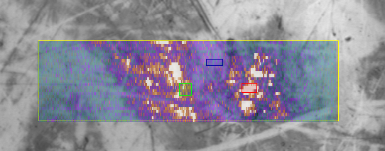
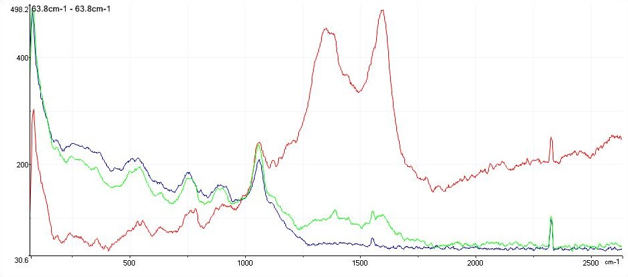
Raman Mapping
D
G
thick region
thin region
substrate
Amount of carbon varies in the tribofilm (presumably due to the thickness)

Slide 25
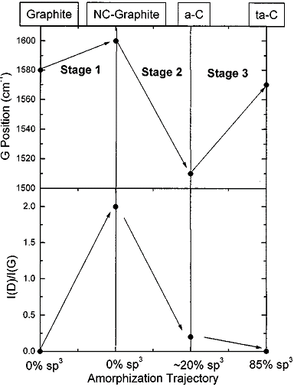
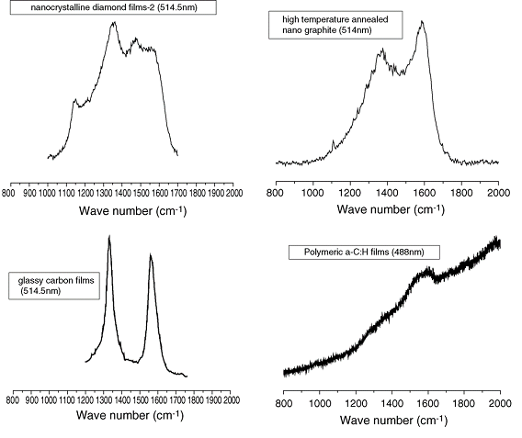
Raman spectra of carbon
Nano graphite
sp2 carbon > 80%
Typical Raman spectra of carbon films
Chu and Li, Mater. Chem. Phys, 2006
Amorphization trajectory showing variation of the G position and I(D)/I(G) ratio.
Ferrari and Robertson, Phys Rev B, 2000

Slide 26
Simulator Experiments
16 N
56 N
tribofilm
8 N
64 N
load
Raman results show that tribological film is generated when 16N < F < 56N,
consistent with optical/SEM observations.

Slide 27
What it is not
Graphite (short-range ordered sp²/sp³)
It is not temperature (too low)
It is not adventitious carbon (too thin)
It is not beam damage (control experiments)
It is not an artifact of sample preparation (control experiments)
It is not simply mechanical
Athermal effects (x-rays from sellotape), probably not

Slide 28
What do we know?
It is linked to Mo (not Cr or Co)
Film is yellow/brown, similar to degraded PTFE, hydraulic oil varnish…..
There is an electrochemical link
It requires both sliding and pressure to form
  Not too much, not too little (like vodka)
No evidence of CrO_{x} co-existing with layer (i.e. conditions at metal are reducing)
Albumin is C₃₀₇₆H₄₈₃₃N₈₂₁O₉₁₉S₄₂ , and eliminating water, ammonia (and hydrogen sulfide) gives C₃₀₇₆H₄₄₈ – close to NFC/DLC

Slide 29
Summary
Much to be done to understand tribology at the nanoscale (fun)
  Long-range elastic/plastic processes can occur
  Local tribochemical processes
  Local wear processes (ultra-low wear) at the monolayer even in hard materials
  Unexpected processes
  Formation of transfer layers which only need to be single layers

Slide 30
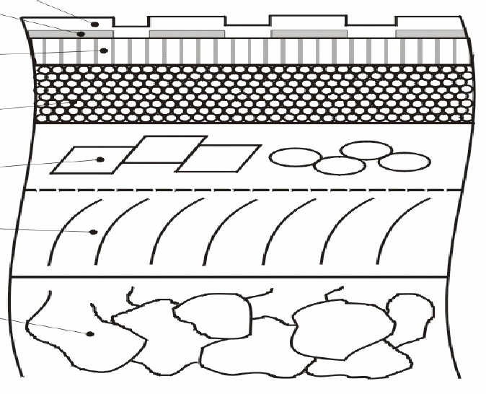
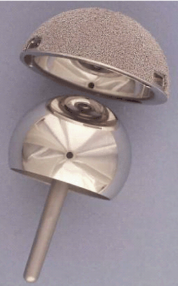
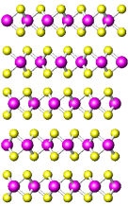
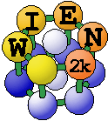
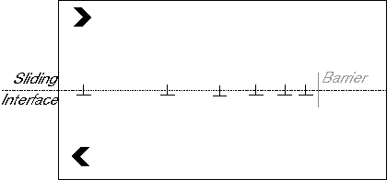
Questions?
Input
Basic materials parameters from experiment and/or theory, e.g. σ_{p}
Output
Scale independent models without free parameters
Implants
Extended Model of Schmaltz, 1936

